Slide 1
JTAG
Min-Yan.Hsieh

Slide 2
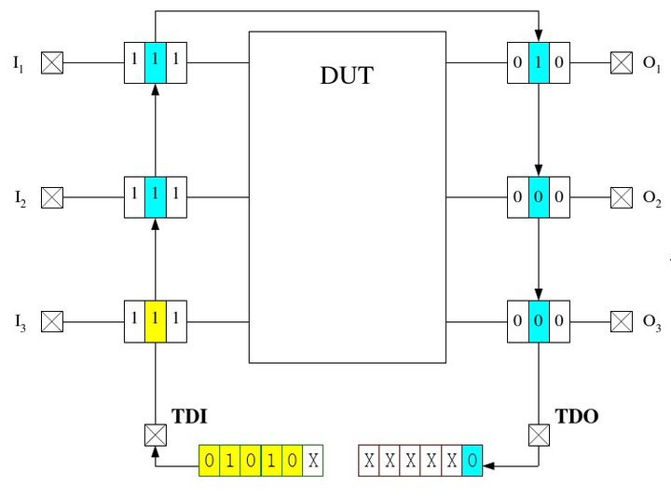
JTAG & DUT

Slide 3
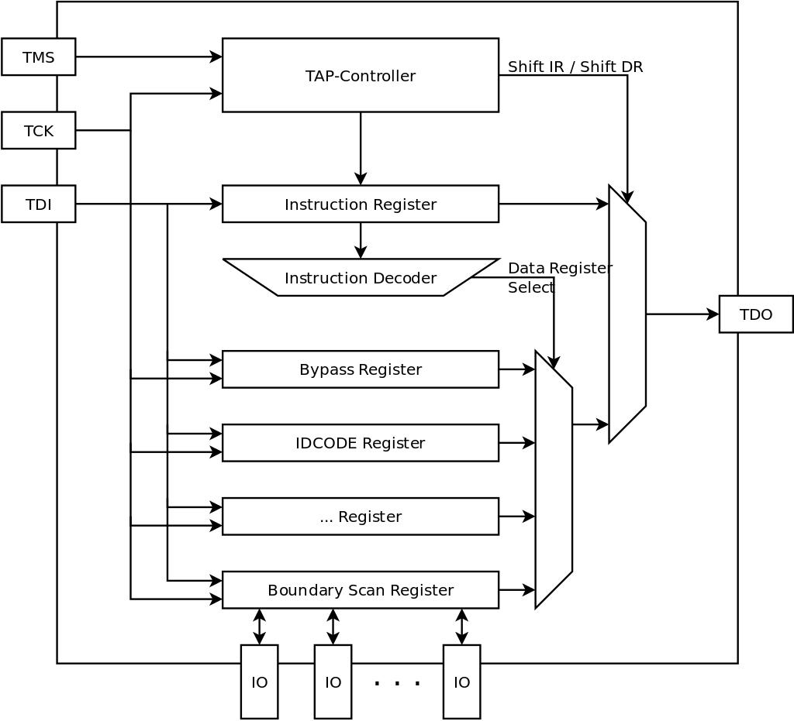
JTAG Overview
Input PIN: TMS、TCK、TDI
Output PIN: TDO
Block:
Boundary Scan Register
TAP Controller
Instruction Register
Instruction Decoder
Bypass Register

Slide 4
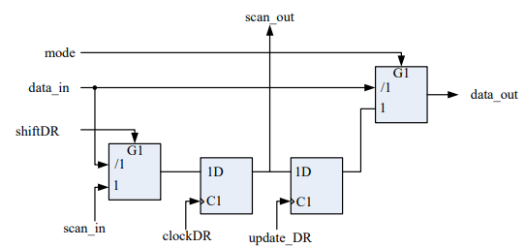
Boundary Scan Cell
Input PIN:
scan_in: from TDI PIN or last cell
data_in: from last block in SoC or SoC input PIN
mode: high when EXTEST or INTEST
ShiftDR, ClockDR, UpdateDR: Controll Signal generated by TAP Controller
Output PIN:
Scan_out: to next cell or TDO PIN
Data_out: to next block in SoC or SoC output PIN

Slide 5
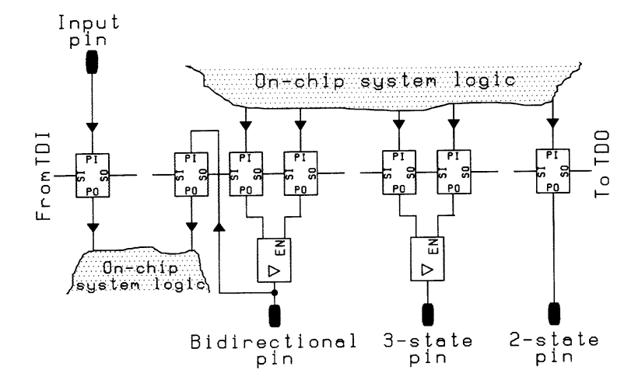
A Simplified View of Boundary-Scan Register
: PIN

Slide 6
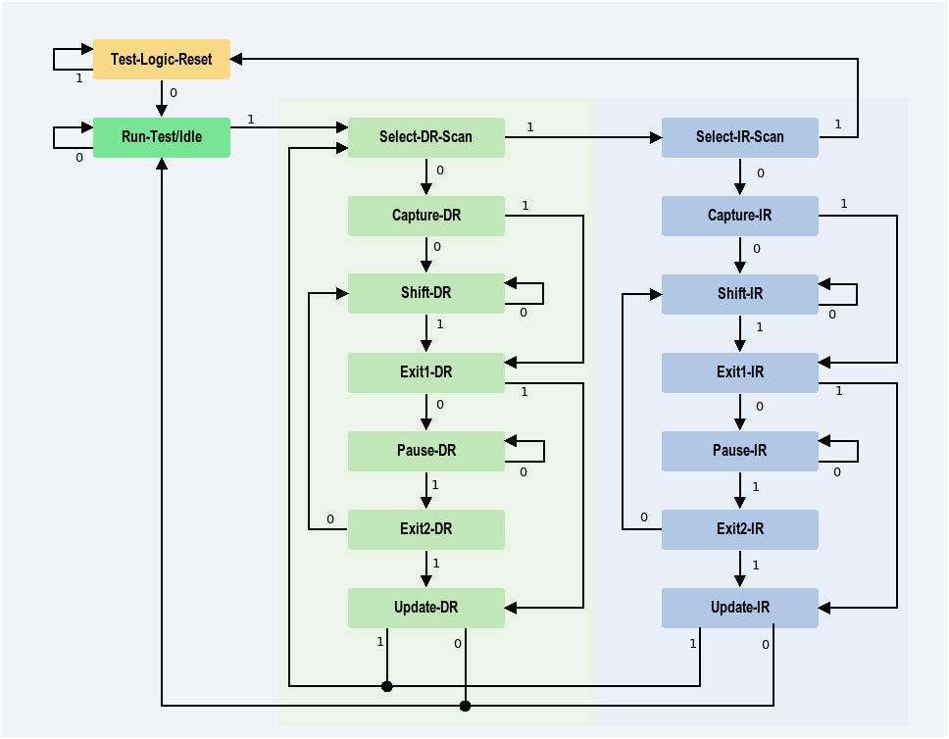
TAP Controller Finite-State Machine
TAP Controller is controlled by TMS
6

Slide 7
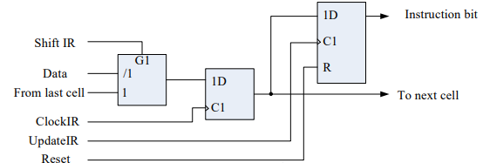
Instruction Register
Input PIN:
scan_in: from TDI or last cell
data_in: from last block in SoC or SoC input pin
ShiftIR, ClockIR, UpdateIR, Reset: Controll Signal generated by TAP Controller
Output PIN:
Scan_out: to next cell or TDO
Data_out: to next block in SoC or SoC output
8

Slide 8
JTAG Version
IEEE Std 1149.1-2001
IEEE Std 1149.7™-2009

Slide 9
Bypass
Instruction | Goal
BYPASS | Bypass Register shall be selected to be connected for serial access between TDI and TDO in Shift-DR TDI and TDO shall not be connected while not in Shift-DR state When the BYPASS instruction is selected, the operation of the test logic shall have no effect on the operation of the on-chip system logic The Bypass Code should be {111…1}

Slide 10
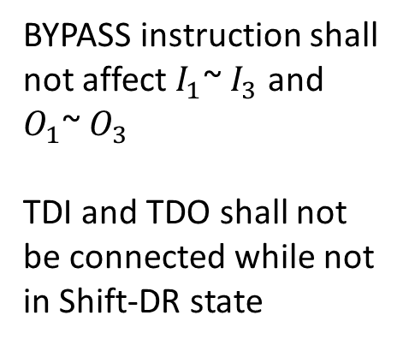






Bypass
$$I_{1}$$
$$O_{1}$$
BYPASS instruction shall not affect $I_{1}$~ $I_{3}$ and $O_{1}$~ $O_{3}$
TDI and TDO shall not be connected while not in Shift-DR state
DUT
$$I_{2}$$
$$O_{2}$$
$$I_{3}$$
$$O_{3}$$
Bypass Register
TDI
ShiftDR
TDO

Slide 11
Bypass Test
$$I_{1}$$
DUT
$$O_{1}$$
$$I_{2}$$
$$O_{2}$$
$$I_{3}$$
$$O_{3}$$
Bypass Register
TDI
ShiftDR
TDO
Test case
Outcome

Slide 12
Sample/Preload
Instruction | Goal
SAMPLE/PRELOAD | The SAMPLE/PRELOAD instruction shall select only the boundary-scan register to be connected for serial access between TDI and TDO in the Shift-DR When the SAMPLE/PRELOAD instruction is selected, the operation of the test logic shall have no effect on the operation of the on-chip system logic or on the flow of signals between the system pins and the on-chip system logic When the SAMPLE/PRELOAD instruction is selected, the states of all signals flowing through system pins (input or output) shall be loaded into the boundary-scan register on the rising edge of TCK in the Capture-DR controller state. When the SAMPLE/PRELOAD instruction is selected, parallel output registers/latches included in boundary-scan register cells shall load the data held in the associated shift-register stage on the falling edge of TCK in the Update-DR controller state

Slide 13
SAMPLE/PRELOAD
$$I_{1}$$
$$O_{1}$$
When the SAMPLE/PRELOAD instruction is selected, the states of all signals flowing through system pins (input or output) shall be loaded into the boundary-scan register on the rising edge of TCK in the Capture-DR controller state
DUT
$$I_{2}$$
$$O_{2}$$
$$I_{3}$$
$$O_{3}$$
CaptureDR
TDI
Bypass Register
TDO

Slide 14
SAMPLE/PRELOAD
$$I_{1}$$
$$O_{1}$$
The SAMPLE/PRELOAD instruction shall select only the boundary-scan register to be connected for serial access between TDI and TDO in the Shift-DR,
and shall have no effect on the operation of the on-chip system logic or on the flow of signals between the system pins and the on-chip system logic
DUT
$$I_{2}$$
$$O_{2}$$
$$I_{3}$$
$$O_{3}$$
ShiftDR
TDI
Bypass Register
TDO

Slide 15
SAMPLE/PRELOAD
$$I_{1}$$
$$O_{1}$$
When the SAMPLE/PRELOAD instruction is selected, parallel output registers/latches included in boundary-scan register cells shall load the data held in the associated shift-register stage on the falling edge of TCK in the Update-DR controller state(before EXTEST)
DUT
$$I_{2}$$
$$O_{2}$$
$$I_{3}$$
$$O_{3}$$
ShiftDR
TDI
Bypass Register
TDO

Slide 16
SAMPLE/PRELOAD TEST
1.Peak
3.Peak
2.Shift
$$I_{1}$$
DUT
$$O_{1}$$
$$I_{2}$$
$$O_{2}$$
$$I_{3}$$
$$O_{3}$$
ShiftDR
TDI
Bypass Register
TDO
Test case
Outcome

Slide 17
EXTEST
Instruction | Goal
EXTEST | The EXTEST instruction shall only select the boundary-scan register to be connected for serial access between TDI and TDO in the Shift-DR controller state While the EXTEST instruction is selected, the on-chip system logic shall be controlled such that it cannot be damaged as a result of signals received at the system input or system clock input pins. NOTE: This might be achieved by placing the on-chip system logic in a reset or hold state while the EXTEST instruction is selected When the EXTEST instruction is selected, the state of all signals driven from system output pins shall be completely driven by the data held in the boundary-scan register and changed only on the falling edge of TCK in the Update-DR controller state When the EXTEST instruction is selected, the state of all signals received at system input pins shall be loaded into the boundary-scan register on the rising edge of TCK in the Capture-DR controller state The EXTEST Code should be {000…0}

Slide 18
EXTEST
$$I_{1}$$
$$O_{1}$$
When the EXTEST instruction is selected, the state of all signals received at system input pins shall be loaded into the boundary-scan register on the rising edge of TCK in the Capture-DR controller state
DUT
$$I_{2}$$
$$O_{2}$$
$$I_{3}$$
$$O_{3}$$
TDI
CaptureDR
Bypass Register
TDO

Slide 19
EXTEST
$$I_{1}$$
$$O_{1}$$
The EXTEST instruction shall only select the boundary-scan register to be connected for serial access between TDI and TDO in the Shift-DR controller state
DUT
$$I_{2}$$
$$O_{2}$$
$$I_{3}$$
$$O_{3}$$
ShiftDR
TDI
Bypass Register
TDO

Slide 20
EXTEST
$$I_{1}$$
$$O_{1}$$
When the EXTEST instruction is selected, the state of all signals driven from system output pins shall be completely driven by the data held in the boundary-scan register and changed only on the falling edge of TCK in the Update-DR controller state
DUT
$$I_{2}$$
$$O_{2}$$
$$I_{3}$$
$$O_{3}$$
UpdateDR
TDI
Bypass Register
TDO

Slide 21
EXTEST TEST
2.Peak
$$I_{1}$$
DUT
$$O_{1}$$
$$I_{2}$$
$$O_{2}$$
$$I_{3}$$
$$O_{3}$$
ShiftDR
TDI
Bypass Register
TDO
1.Test case
3.Outcome
(Same as SAMPLE/PRELOAD Pattern)

Slide 22
INTEST
Instruction | Goal
INTEST | When the INTEST instruction is selected, all outputs from the component shall be defined as follows: All signals driven out of the component shall be defined by data held in the boundary-scan register, and shall change only on the falling edge of TCK in the Update-DR controller state or on selection of the INTEST instruction; or All outputs from the component (including those that are 2-state non-test signals) shall be placed in an inactive drive state (e.g., high-impedance) on selection of the INTEST instruction. When the INTEST instruction is selected, the state of all non-clock signals driven into the system logic from the boundary-scan register shall be completely defined by the data held in the register. Additionally, when the INTEST instruction is selected, the state of all system logic outputs to the boundary-scan register shall be loaded into the register on the rising edge of TCK in the Capture-DR controller state.

Slide 23
INTEST
$$I_{1}$$
$$O_{1}$$
All signals driven out of the component shall be defined by data held in the boundary-scan register, and shall change only on the falling edge of TCK in the Update-DR controller state or on selection of the INTEST instruction; or
All outputs from the component (including those that are 2-state non-test signals) shall be placed in an inactive drive state (e.g., high-impedance) on selection of the INTEST instruction.
DUT
$$I_{2}$$
$$O_{2}$$
$$I_{3}$$
$$O_{3}$$
UpdateDR
TDI
Bypass Register
TDO

Slide 24
INTEST
$$I_{1}$$
DUT
$$O_{1}$$
$$I_{2}$$
$$O_{2}$$
$$I_{3}$$
$$O_{3}$$
Run-Test/Idle
TDI
Bypass Register
TDO

Slide 25
INTEST
$$I_{1}$$
DUT
$$O_{1}$$
$$I_{2}$$
$$O_{2}$$
$$I_{3}$$
$$O_{3}$$
CaptureDR
TDI
Bypass Register
TDO

Slide 26
INTEST
$$I_{1}$$
DUT
$$O_{1}$$
$$I_{2}$$
$$O_{2}$$
$$I_{3}$$
$$O_{3}$$
ShiftDR
TDI
Bypass Register
TDO

Slide 27
INTEST TEST
2.Peak
3.Peak
4.Peak
$$I_{1}$$
DUT
$$O_{1}$$
$$I_{2}$$
$$O_{2}$$
$$I_{3}$$
$$O_{3}$$
TAP Controller
TDI
Bypass Register
TDO
4.Outcome
1.Test case
27

Slide 28
RUNBIST
Instruction | Goal
RUNBIST | When the RUNBIST instruction is selected, the test data register into which the results of the self-test(s) will be loaded shall be connected for serial access between TDI and TDO in the Shift-DR controller state. Self-test mode(s) of operation accessed through the RUNBIST instruction shall execute only in the Run-Test/Idle controller state. Where a test data register (other than the boundary-scan register) shall be initialized prior to the execution of the self-test, this shall occur at the start of the self-test without any requirement to shift data into the component (i.e., there shall be no requirement to enter seed values into any test data register other than the boundary-scan register). A duration shall be specified for the test executed in response to the RUNBIST instruction (e.g., a number of rising edges of TCK or the system clock). The result of the self-test(s) executed in response to the RUNBIST instruction shall be loaded into the test data register connected between TDI and TDO no later than the rising edge of TCK in the Capture-DR controller state.

Slide 29
RUNBIST
Instruction | Goal
RUNBIST | Following the specified minimum duration, the test result observed by loading and shifting of the test data register selected by the RUNBIST instruction shall be constant regardless of when the Capture-DR controller state is entered. Use of the RUNBIST instruction shall give the same result in all versions of a component. Data shifted out of a component following completion of execution of a self-test accessed using the RUNBIST instruction shall be independent of the operation of off-chip circuitry or board-level interconnections. All stages of the test data register selected by the RUNBIST instruction shall be set to determine logic states (0 or 1) in the Capture-DR controller state. The design of the component shall ensure that results of self-tests executed in response to the RUNBIST instruction are not affected by signals received at non-JTAG system input pins.

Slide 30
RUNBIST
Instruction | Goal
RUNBIST | When the RUNBIST instruction is selected, all system outputs from the component shall be deactivated as follows: All signals driven out of the component shall be deactivated by data held in the boundary-scan register and shall change only on the falling edge of TCK in the Update-DR controller state or on selection of the RUNBIST instruction; or All outputs from the component (including those that are 2-state non-test signals) shall be placed in an inactive drive state (e.g., high-impedance) upon selection of the RUNBIST instruction. The states of the parallel output registers or latches in boundary-scan registers cells located at system output pins (2-state, 3-state, or bidirectional) shall not change while the RUNBIST instruction is selected, unless the associated pins have been placed in an inactive drive state (e.g., high-impedance)

Slide 31
RUNBIST
$$I_{1}$$
DUT
$$O_{1}$$
$$I_{2}$$
$$O_{2}$$
$$I_{3}$$
$$O_{3}$$
Test Data Register
Run-Test/Idle
TDI
Bypass Register
TDO

Slide 32
RUNBIST
$$I_{1}$$
DUT
$$O_{1}$$
$$I_{2}$$
$$O_{2}$$
$$I_{3}$$
$$O_{3}$$
CaptureDR
TDI
Bypass Register
TDO

Slide 33
RUNBIST
$$I_{1}$$
DUT
$$O_{1}$$
$$I_{2}$$
$$O_{2}$$
$$I_{3}$$
$$O_{3}$$
ShiftDR
TDI
Bypass Register
TDO

Slide 34
CLAMP
Instruction | Goal
CLAMP | The CLAMP instruction shall select the Bypass Register to be connected for serial access between TDI and TDO in the Shift-DR controller state. NOTE: The Bypass Register will behave fully as described in Chapter 9 while the CLAMP instruction is selected. Therefore, it will load a logic 0 during the Capture-DR controller state and shift data during the Shift-DR controller state. When the CLAMP instruction is selected, the state of all signals driven from system output pins shall be completely derived by the data held in the boundary-scan register. For example, this data may be shifted into the boundary-scan register by previous use of the SAMPLE/PRELOAD instruction. The states of the parallel output registers or latches in boundary-scan registers shall not change while the CLAMP instruction is selected. When the CLAMP instruction is selected, the on-chip system logic shall be controlled such that it cannot be damaged as a result of signals received at the system input or system clock input pins. NOTE: This might be achieved by placing the on-chip system logic in a reset or "hold" state while the CLAMP instruction is selected.

Slide 35
CLAMP
$$I_{1}$$
DUT
$$O_{1}$$
$$I_{2}$$
$$O_{2}$$
$$I_{3}$$
$$O_{3}$$
Bypass Register
TDI
ShiftDR
TDO

Slide 36
IDCODE
Instruction | Goal
IDCODE | The IDCODE instruction shall select only the device identification register to be connected for serial access between TDI and TDO in the Shift-DR controller state (i.e., no other test data registers may be connected in series with the device identification register). When the IDCODE instruction is selected, the vendor identification code shall be loaded into the device identification register on the rising edge of TCK following entry into the Capture-DR controller state. When the IDCODE instruction is selected, all test data registers that can operate in either system or test modes shall perform their system function. When the IDCODE instruction is selected, the operation of the test logic shall have no effect on the operation of the on-chip system logic.

Slide 37
IDCODE
$$I_{1}$$
DUT
$$O_{1}$$
$$I_{2}$$
$$O_{2}$$
Loaded at CaptureDR,
Shifted at ShiftDR
$$I_{3}$$
$$O_{3}$$
ID Register
TDI
ShiftDR
TDO

Slide 38
USERCODE
Instruction | Goal
USERCODE | The USERCODE instruction shall select the device identification register to be connected for serial access between TDI and TDO in the Shift-DR controller state (i.e., no other test data registers may be connected in series with the device identification register). When the USERCODE instruction is selected, the user-programmable identification code shall be loaded into the device identification register on the rising edge of TCK following entry into the Capture-DR controller state. When the USERCODE instruction is selected, all test data registers that can operate in either system or test modes shall perform their system function. When the USERCODE instruction is selected, the operation of the test logic shall have no effect on the operation of the on-chip system logic.

Slide 39
USERCODE
$$I_{1}$$
DUT
$$O_{1}$$
$$I_{2}$$
$$O_{2}$$
Loaded at CaptureDR,
Shifted at ShiftDR
$$I_{3}$$
$$O_{3}$$
ID Register
TDI
ShiftDR
TDO

Slide 40
HIGHZ
Instruction | Goal
HIGHZ | The HIGHZ instruction shall select the bypass register for serial access between TDI and TDO in the Shift-DR controller state. Note: The bypass register will be fully loaded with logic 0 during the Capture-DR controller state and data shifted during the Shift-DR controller state. When the HIGHZ instruction is selected, all system logic outputs (including 2-state and 3-state outputs and bidirectional pins) of the component shall immediately be placed in a high-impedance state. Note: According to the rules in 10.5, there shall be no significant change in the states of the parallel output registers or latches in boundary-scan cells. For example, when leaving the HIGHZ instruction and selecting the EXTEST instruction, the data held in the boundary-scan register prior to the selection of the HIGHZ instruction should be applied to the system output pins. When the HIGHZ instruction is selected, the on-chip system logic shall be controlled such that it cannot be damaged as a result of signals received at the system input or system clock input pins. Note: This might be achieved by placing the on-chip system logic in a reset or "hold" state while the HIGHZ instruction is selected.

Slide 41
HIGHZ
$$I_{1}$$
Z
DUT
Z
$$O_{1}$$
$$I_{2}$$
Z
Z
$$O_{2}$$
Loaded 0 at CaptureDR,
Shifted at ShiftDR
$$I_{3}$$
Z
Z
$$O_{3}$$
Bypass Register
TDI
ShiftDR
TDO

Slide 42
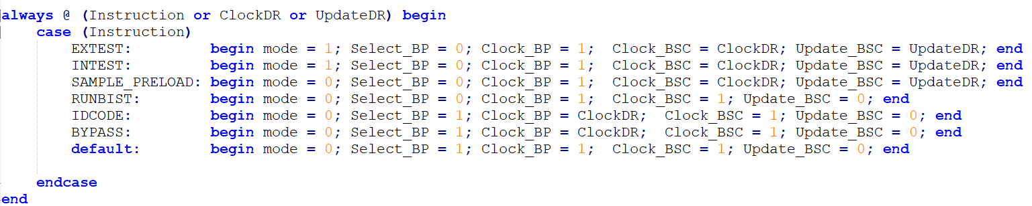
Instruction Decoder

Slide 43
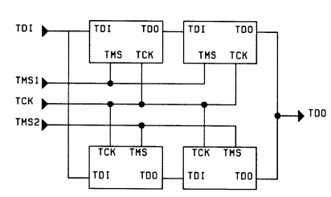
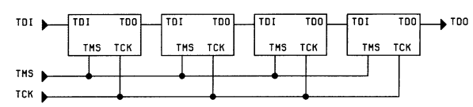
Mode 1
Mode 2
Serial Connection Using One TMS
Connection In two Paralled Selected Chains

