Slide 1
The Supercomputer in Front of You
Use your Flop/s!
Status of FOSS, Many-Core & C++11

Slide 2
Hm?
„Hihi, he said supercomputer“
What the FOSS?
„Let me do this“
Last but not least: language bashing!

Slide 3
Disclaimer(s)
Opinions, bad jokes, typos, denglisch, syntax
errors in code snippets, etc. are our own and do
not necessarily reflect the views of our current,
previous or future employers, funding agencies...
Authors did and do receive travel funding for scientific presentations from the GPU Center of Excellence Dresden financed by Nvidia Corp. - btw. not this weekend.

Slide 4
Who are those guys?

Slide 5
Hi!
René bitcoint miner gone serious
Erik … sag was ;)
Axel physicist: denies knowing Fortran

Slide 6
Many-Core Hardware
and why free & open-source
software projects might care

Slide 8
Programming Models

Slide 10
C++
yep, here comes the
language bashing...

Slide 12
What the FOSS, again?
Let's compare!

Slide 13
What is open about …?
FOSS
open but „closed-contribution“
non-free
 | OpenCL 1.X | SYCL | OpenMP 4.X | OpenACC 1/2 | CUDA
native languages | C (C++ in 2.2) | C++ | C/C++, Fortran | C/C++, Fortran | C/C++ Fortran
compiler / SDK | xl,ioc,gcc, clang,... | ComputeCPP, triSYCL? | gcc, xl? | clang, pgi | clang, nvcc
interm. rep. | SPIR, PTX | SPIR-V | -/- ; PTX | -/- ; PTX | PTX
RT | vendor, gallium,pocl? | soon? | pthreads; vendor | pthreads; vendor | cudaRT; GPU Ocelot
driver | all major, nouveau? | soon? | -/- ; vendor | -/- ; nvidia | nvidia ; -/-

Slide 14
SIMD Programming
examples

Slide 15
Average two Greyscale Images
+
=
2

Slide 16
Memory Layout
width
height
0
1
2
3
4
5
6
7
...
8
9
10
11
0
1
2
3
14
15
12
13
14
15
idx = y * width + x

Slide 17
Serial C-Program
/* a,b = input images
* c = result image */
int x,y;
for( y = 0; y < height; ++y )
for( x = 0; x < width; ++x )
{
const int idx = y * width + x;
c[ idx ] = ( a[ idx ] + b[ idx ] ) / 2;
}
$ gcc main.c

Slide 18
Threads (e.g. pthreads)
master
slave 0
slave 1
a[ ]
b[ ]
c[ ]
0
0
0
0
0
0
lock
mutex
1
1
1
1
1
1
...
2
2
2
lock
mutex
2
2
2
15
15
15
15
15
15
lock
mutex

Slide 19
OpenMP
/* a,b = input images
* c = result image */
int x,y;
#pragma omp parallel for collapse(2)
for( y = 0; y < height; ++y )
for( x = 0; x < width; ++x )
{
const int idx = y * width + x;
c[ idx ] = ( a[ idx ] + b[ idx ] ) / 2;
}
$ gcc -fopenmp main.c

Slide 20
OpenMP
/* a,b = input images
* c = result image */
#pragma omp parallel for
for( int y = 0; y < height; ++y )
for( int x = 0; x < width; ++x )
{
const int idx = y * width + x;
c[ idx ] = ( a[ idx ] + b[ idx ] ) / 2;
}

Slide 21
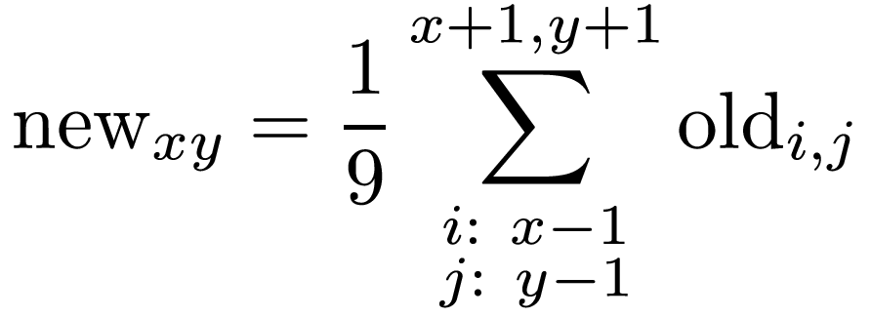
Real World by Example (blur)
R
G
B
R
G
B
R
G
B
=
cell_{xy} = Σcell_{ij} / 9

Slide 22
Boundary Conditions

Slide 23
Real World - gimp blur Filter
for( int y = 0; y < height; ++y )
for( int x = 0; x < width; ++x )
for ( int k = 0; k < channels; k++)
{
int sum = 0;
sum = row1[channels * MAX ((x - 1), 0) + k] +
row1[channels * x + k] +
row1[channels * MIN ((x + 1), width - 1) + k] +
row2[channels * MAX ((x - 1), 0) + k] +
row2[channels * x + k] +
row2[channels * MIN ((x + 1), width - 1) + k] +
row3[channels * MAX ((x - 1), 0) + k] +
row3[channels * x + k] +
row3[channels * MIN ((x + 1), width - 1) + k];
outrow[channels * x + k] = sum / 9;
}

Slide 24

Real World - gimp blur Filter (line wise)
8 MegaPixel (3x3 cells blur)
- slow: no memory reuse

Slide 25
Real World - gimp blur Filter (tiled)

Slide 26
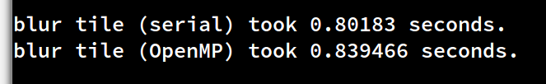

Real World - gimp blur Filter (tiled)
8 MegaPixel (3x3 cells)
- no speedup for parallel version
bamm
2 x faster
8 MegaPixel (25x25 cells)

Slide 27
Where the hack...
is the supercomputer?

Slide 28
Same Task – Now on Manycore
+
=
2

Slide 29
OpenMP 4.5
/* a,b = input images
* c = result image */
#pragma target in(a,b) out(c)
#pragma omp parallel for collapse(2)
for( int y = 0; y < height; ++y )
for( int x = 0; x < width; ++x )
{
const int idx = y * width + x;
c[ idx ] = ( a[ idx ] + b[ idx ] ) / 2;
}
$ clang -O3 -fopenmp=libomp \
-omptargets=nvptx64sm_35-nvidia-linux

Slide 30
OpenACC
/* a,b = input images
* c = result image */
#pragma acc data copy(a,b,c)
#pragma acc kernels
for( int y = 0; y < height; ++y )
for( int x = 0; x < width; ++x )
{
const int idx = y * width + x;
c[ idx ] = ( a[ idx ] + b[ idx ] ) / 2;
}
$ gcc -fopenacc main.c

Slide 31
OpenACC: Device Threads
/* a,b = input images
* c = result image */
#pragma acc data copy(a,b,c)
{
const int idx = blockOffset + threadIndex;
c[ idx ] = ( a[ idx ] + b[ idx ] ) / 2;
}
spawn on device: width x height threads for each pixel
threads: tiled into blocks

Slide 32
There is more than one Memory Layout
width
height
0
1
2
3
← thread 0
4
5
6
7
...
← thread 1
0
1
2
3
14
15
8
9
10
11
← thread 2
idx = y * width + x
12
13
14
15
← thread 3

Slide 33
There is more than one Memory Layout
width
height
0
1
2
3
4
5
6
7
...
8
9
10
11
0
4
8
12
11
15
12
13
14
15
idx = x * height + y
thr. 0 →
thr. 1 →
thr. 2 →
thr. 3 →

Slide 34
cupla
Move alpaka slides to backup, make CUDA / cupla slide

Slide 35
Alpaka speaks C++
struct VectorAdd
{
template<typename TAcc, typename TArray, typename TSize>
ALPAKA_FN_ACC auto operator()(
const TAcc const & acc,
const TSize & numElements,
const TArray a, const TArray b,
TArray c) const -> void
{
using alp = alpaka;
auto globalIdx = alp::idx::getIdx<alp::Grid, alp::Threads>(acc)[0u];
auto elemsPerThread = alp::workdiv::getWorkDiv<alp::Thread,
alp::Elems>(acc)[0u];
auto begin = globalIdx * elemsPerThread;
auto end = min(begin + elemsPerThread, numElements);
for(TSize i = begin; i < end; ++i)
c[i] = ( a[i] + b[i] ) / 2;
}
};

Slide 36
Alpaka speaks C++
// Configure Alpaka
using alp = alpaka;
using Dim = alp::dim::DimInt<1u>
using Size = std::size_t
using Acc = alp::acc::AccGpuCudaRt<Dim, Size>;
using DevAcc = alp::dev::Dev<Acc>;
using PltfAcc = alp::pltf::Pltf<DevAcc>;
using StreamAcc = alp::stream::StreamCudaRtSync;
using PltfHost = alp::pltf::PltfCpu;
using WorkDiv = alp::workdiv::WorkDivMembers<Dim, Size>;
using Elem = int;
const Size extent = 342;
// Retrieve devices and stream
auto devHost( alp::pltf::getDevByIdx<PltfHost>(0u) );
auto devAcc ( alp::pltf::getDevByIdx<PltfAcc>(0) );
StreamAcc stream( devAcc );
// Specify work division
auto elementsPerThread( alp::Vec<Dim, Size>(1u) );
auto threadsPerBlock ( alp::Vec<Dim, Size>(32u) );
auto blocksPerGrid ( alp::Vec<Dim, Size>( ( extent + threadsPerBlock - 1 ) / threadsPerBlock ) );
WorkDiv workdiv( WorkDiv(blocksPerGrid, threadsPerBlock, elementsPerThread) );

Slide 37
Alpaka speaks C++
// Memory allocation and host to device memory copy
auto a_h = alp::mem::buf::alloc<int, int>(devHost, extent);
auto b_h = alp::mem::buf::alloc<int, int>(devHost, extent);
auto c_h = alp::mem::buf::alloc<int, int>(devHost, extent);
auto a_d = alp::mem::buf::alloc<Val, Size>(devAcc, extent);
auto b_d = alp::mem::buf::alloc<Val, Size>(devAcc, extent);
auto c_d = alp::mem::buf::alloc<Val, Size>(devAcc, extent);
alp::mem::view::copy(stream, a_d, a_h, extent);
alp::mem::view::copy(stream, b_d, b_h, extent);
// Kernel creation and execution
VectorAdd kernel;
auto const exec(alp::exec::create<Acc>(
workDiv,
kernel,
AbstractArray(a_d),
AbstractArray(b_d),
AbstractArray(c_d),
extent));
alp::stream::enqueue(stream, exec);
// Copy memory back to host
alp::mem::view::copy(stream, c_h, c_d, extent);

Slide 38
More FOSS Libraries
Not in this talk, but recommended
to check out
Containers & STL-like Algorithms
Thrust
ViennaCL → reference Karl Rupp
Kokkos
Abstract Kernels in C++
cupla → alpaka

Slide 39
Thanks you!
Benjamin, Michael, Guido, Heiko, Alex, Benjamin, Alex, Alex, Richard, Wolfgang, Robert, ...

Slide 40
Syntax Highlighting
Open:
- writer
- impress
- https://tohtml.com/
Copy code to web page → C++
Copy&Paste to Writer
Copy & Paste again to Impress

