Slide 1
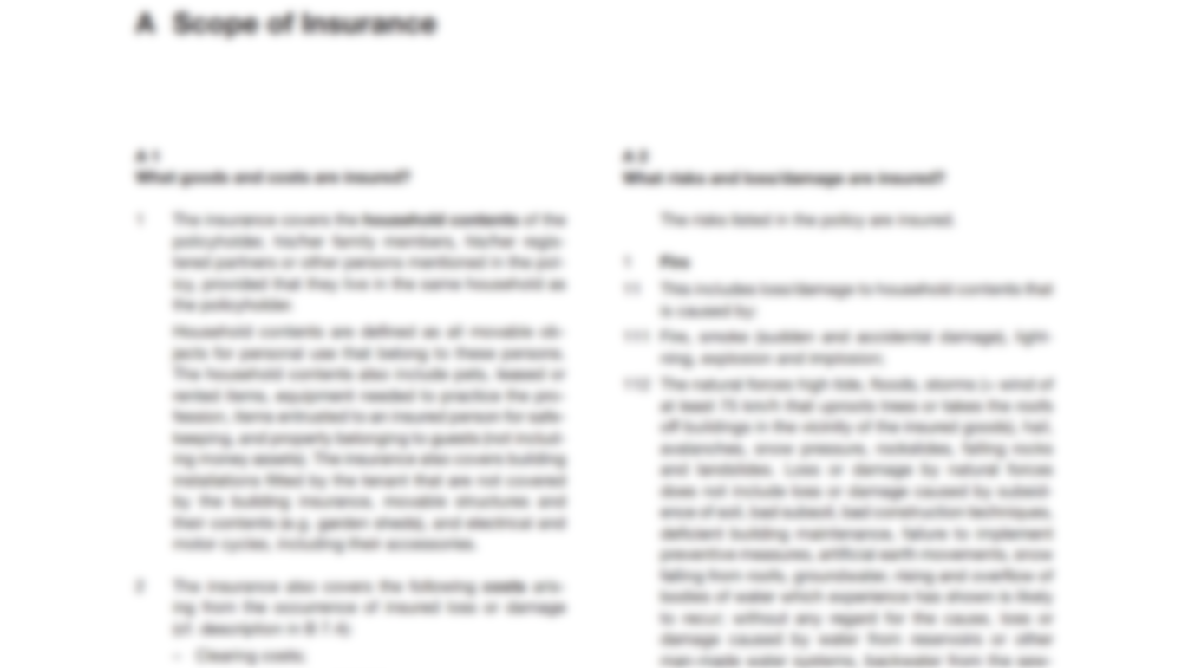


Insurance – is far too complex
NO FUN
48 pages legal terms in Arial 9
blurry
simplicity missing
too many options
User Interfaces
ugly & overloaded
black / white

Slide 2



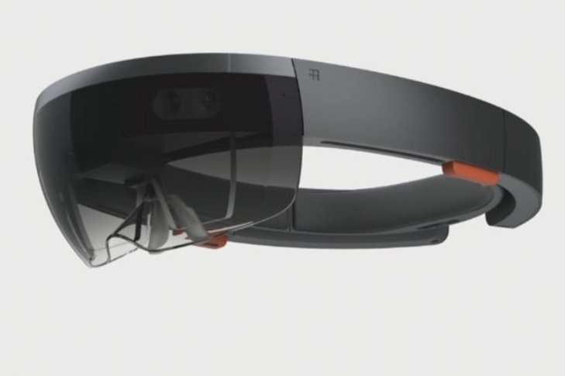
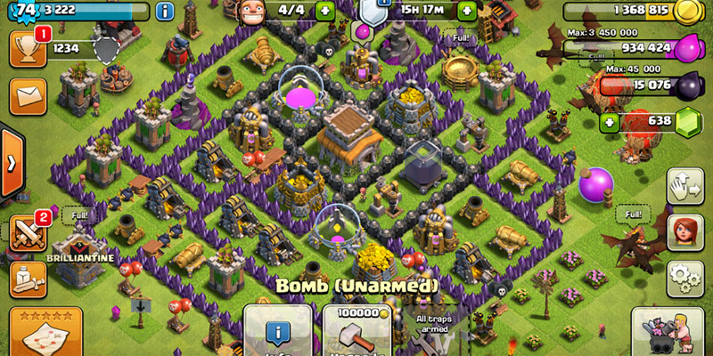

Games today – the opposite
interactive
FUN
colorful
simple for kids - seniors
holographic
complex, too.
But not from the beginning.

Slide 3


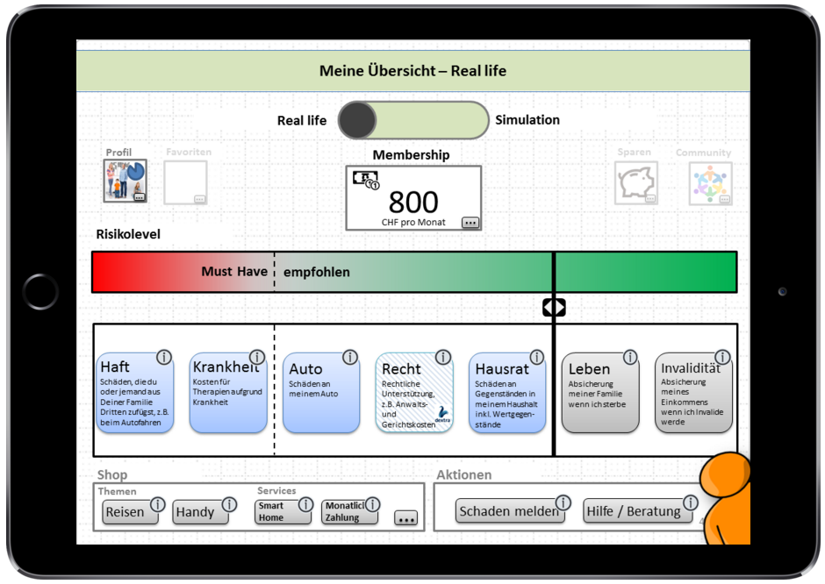

presents
"Insurance - As simple as a Game"
aka "Clash of Claims"
Show us
→ New insurance interfaces as a Game
→ Simplify: membership instead of premium
→ Augmented reality interactions
→ Insurance products within a Game

Slide 4

featuring
"Insurance - As simple as a Game"
aka "Clash of Claims"
Featuring
→ "Insurance APIs" > 200'000 data elements (customers, profiles, cars, favorites, agencies, claims, contracts, …)
→ Swagger docu + Sandbox +
→ Virtual reality devices to use at our booth
→ Hololens to use at our booth
→ Insurance knowhow to support you

Slide 5

see you
"Insurance - As simple as a Game"
aka "Clash of Claims"
Workshops
Room BASIC (2nd Floor)
Workshop 1 20:00 – 20:40
Workshop 2 20:40 – 21:30
Winner: 4x Samsung S6 + Gear VR

