Slide 1


WANTS YOUR BRAINS ON FIRE

Slide 2
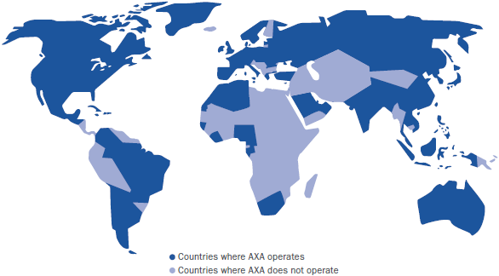

A global leader in insurance and asset management
1
103m
customers
€98.5bn
revenue
64
countries in which AXA operates
€5.6bn
underlying earnings
166,000
employees
€1,363bn
assets under management at Dec.31, 2015
A+
rating Standard & Poor’s
#1
Global Insurance brand - Interbrand

Slide 3


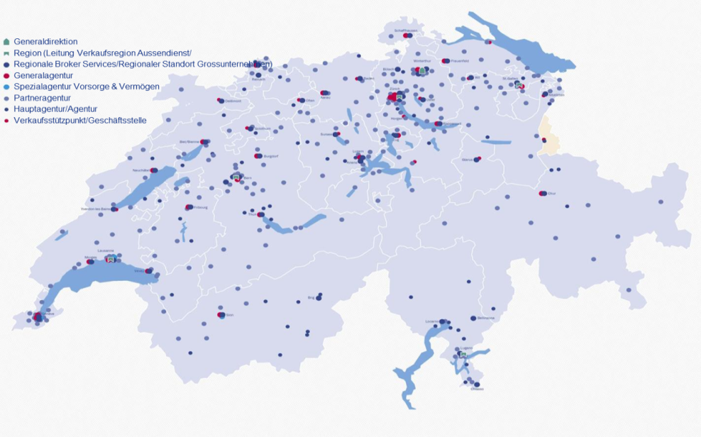
# 1 in Switzerland with c. 2 million customers
2
#1
1.89m
customers
(28% share in Life Ins.; 13% in Property & Casualty - P&C)
€11.1b
gross written premium
40%
of Swiss companies insured with AXA
140yrs
tradition
+4,000
employees
>1,000
crash tests since 1981 in own A&R centre
2,600
exclusive distribution partners

Slide 4
Insurance today

Slide 5
INSURANCE TOMMORROW - AS SIMPLE AS A GAME

Slide 6
BURN BABY BURN

