Slide 1

Capstone 2026
NOVAQ: AN INTEGRATED QUEUEING ANALYTICS AND SIMULATION SYSTEM FOR SERVICE OPERATIONS OPTIMIZATION
Presented By:
Bergonio, Mark A.
Guelas, John Paul J.
Revilla, Trisha Mae A.
Secondez, Axcell Jun B.
Simacas, Wilson V.

Slide 2
Capstone 2026
Review of Related Literature
  Erlang, A. K. (1917) — Formulated loss and waiting-time formulas for automatic telephone exchanges, establishing the mathematical foundation for Erlang-C calculations.
  Kendall, D. G. (1953) — Introduced the A/B/c notation system for classifying queueing models by arrival process, service process, and server count.
  Little, J. D. C. (1961) — Proved the fundamental queueing formula L = λW, connecting mean queue length to arrival rate and system time.
  Halfin, S. & Whitt, W. (1981) — Established heavy-traffic limiting behavior of many-server queues, forming the theoretical basis for utilization-based staffing rules.
  Garnett, O., Mandelbaum, A., & Reiman, M. (2002) — Extended Erlang-C to account for customer abandonment, establishing the Erlang-A framework.
  Cosmetatos, G. P. (1976) — Derived approximate mean waiting time formulas for multi-server queues with generally distributed service times (M/G/c).
  Metropolis, N. & Ulam, S. (1949) — Introduced the Monte Carlo method using repeated random sampling to evaluate stochastic system behavior under uncertainty.
  Wilson, E. B. (1927) — Derived the Wilson score confidence interval for binomial proportions, maintaining precision for small samples or extreme proportions.
  Newcombe, R. G. (1998) — Demonstrated that the Wilson score interval consistently outperforms normal-approximation methods for proportion confidence intervals.
  Sandhu, R., Coyne, E., Feinstein, H., & Youman, C. (1996) — Formalized Role-Based Access Control (RBAC) to restrict system permissions based on organizational roles.
  Miña, B. L., Ragodon-Vargas, K. A., Capillan, A., Malecdan, J. B., Acosta, S. M., & Faller, E. (2024) — Evaluated outpatient waiting times in a public hospital in Northern Philippines, confirming peak-hour timing as a key driver of queueing delay.

Slide 3
Capstone 2026
Review of Related Literature
  IEOM Society (2021) Bank Case Study — Applied queueing theory to a bank in Laguna, Philippines, finding waiting time differences for priority customers.
  IEOM Society (2023) OPD Study — Combined SERVQUAL, queueing theory, and ProModel simulation in a Philippine public hospital OPD.
  ACM (2023) LRT-1 Study — Analyzed ticketing booth queues at LRT-1 Central Station in Manila.
  Doctora et al. (2021) — Cited within a Davao supermarket study regarding Filipino consumer preferences for in-store checkout.
  ACM MSIE (2022) Supermarket Study — Modeled supermarket cashier systems using the M/M/c model.

Slide 4
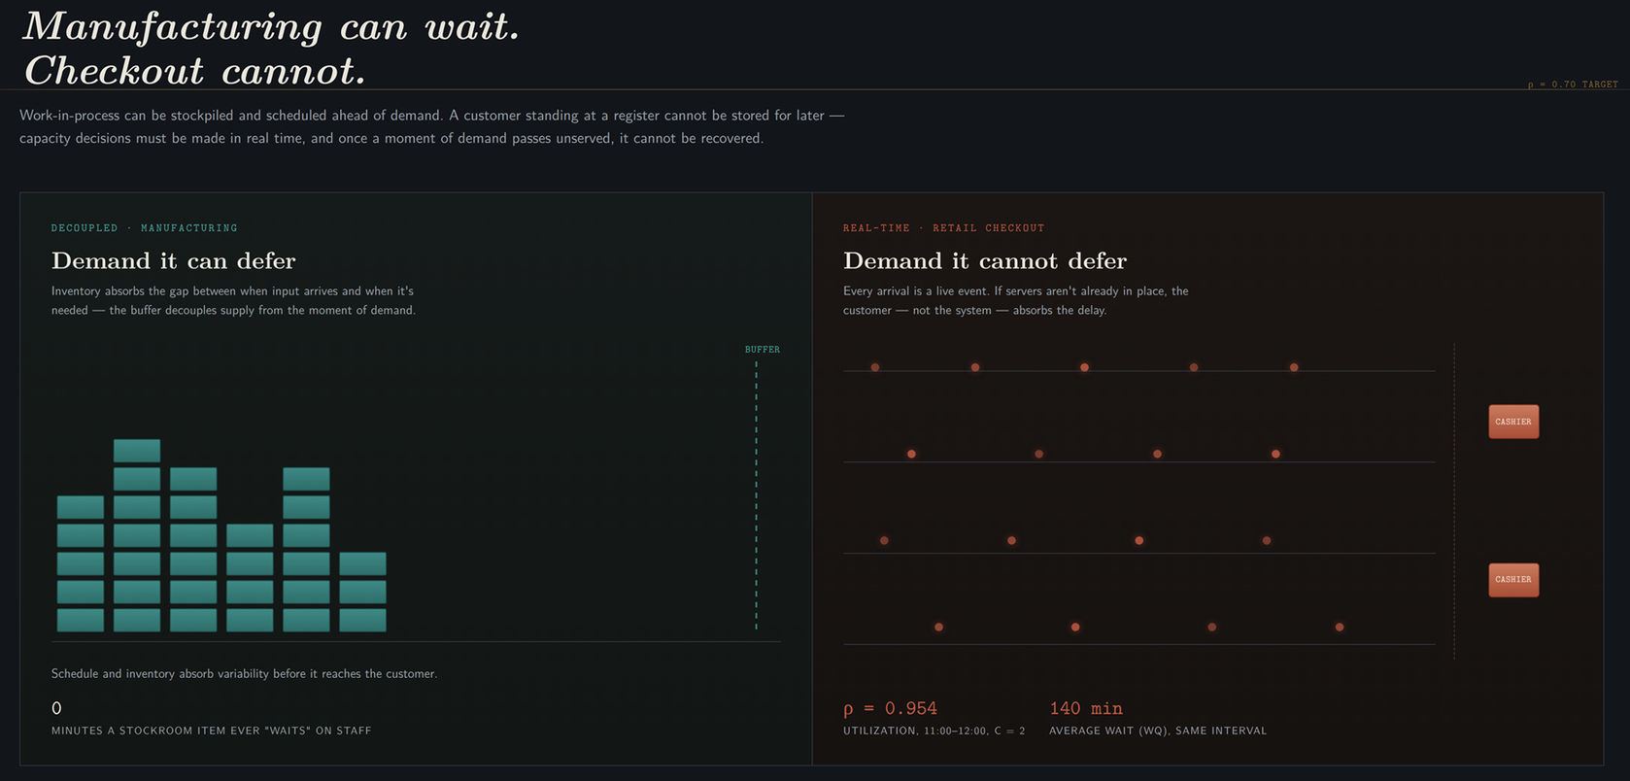
Capstone 2026
Service Operations & The Staffing Dilemma
  Real-time customer arrivals cannot be buffered or scheduled in advance.
  Capacity decisions are immediate; unserviced arrival demand creates waiting lines.
  Local retail staffing relies heavily on managerial habit or fixed rules.
  Question shifts from total headcount to matching capacity with time-varying demand.

Slide 5
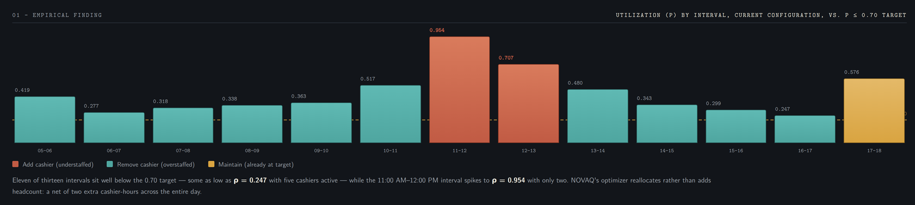
Capstone 2026
Empirical Bottleneck at Novamart Grocery
  6 intervals operate at ρ < 0.35 with c = 5 cashiers.
NOVAQ reallocates 14 cashier-hours removed from overstaffed periods and adds 2 during the peak, for a net reduction of 12 cashier-hours.

Slide 6
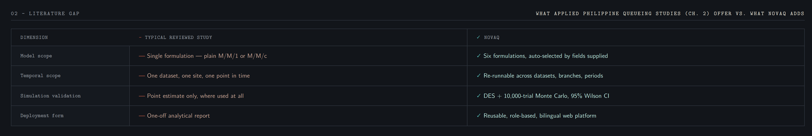
Capstone 2026
Operational Root Cause & Research Gap
  Local Applied Gap: The studies reviewed are generally single-site, single-model analyses rather than reusable decision-support tools.

Slide 7
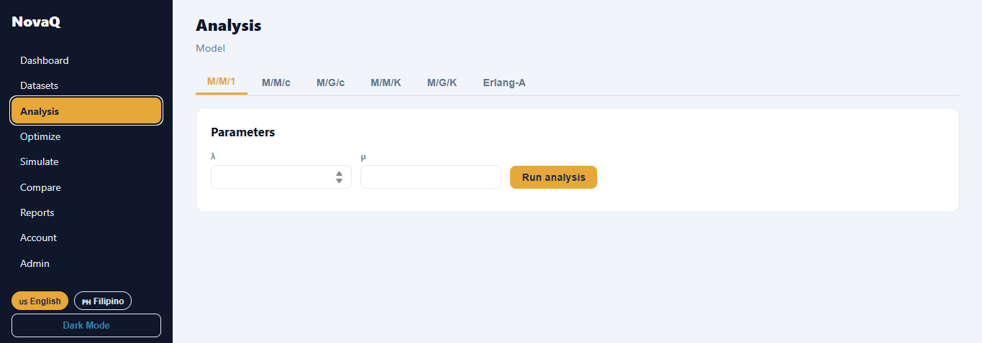
Capstone 2026
NOVAQ: Reusable Decision-Support Infrastructure
  Integrated multi-model analytics (M/M/1, M/M/c, M/G/c, M/M/K, M/G/K, Erlang-A).

Slide 8

Capstone 2026
NOVAQ: Reusable Decision-Support Infrastructure
  Cost-aware optimization targeting ρ ≤ 0.70 across labor, waiting, and abandonment costs.

Slide 9
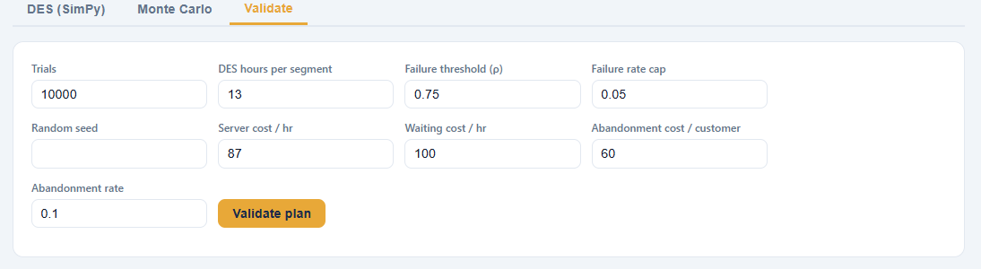
Capstone 2026
NOVAQ: Reusable Decision-Support Infrastructure
Complementary validation: DES checks queue behavior. Monte Carlo counts failure when ρ > 0.75 and applies a 5% failure-rate criterion with 95% Wilson intervals.

Slide 10
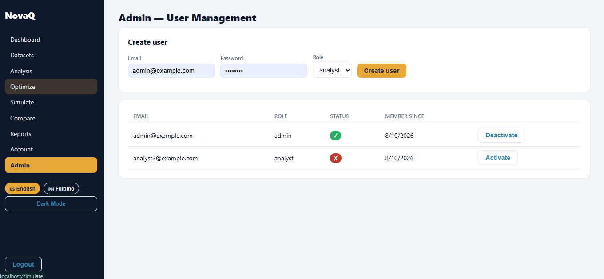
Capstone 2026
NOVAQ: Reusable Decision-Support Infrastructure
  Role-based, bilingual web platform for standing organizational deployment.

Slide 11
Capstone 2026
Study Objectives
  General Objective: Design, build, and empirically validate NOVAQ to improve checkout service performance and minimize operating cost.
  Build a multi-model engine and compute baseline metrics for 13 averaged hourly intervals.
  Optimize cashier staffing toward ρ ≤ 0.70 and quantify operational cost savings.
  Evaluate robustness through DES and Monte Carlo simulation. Monte Carlo uses ρ > 0.75 as the failure condition and a 5% failure-rate criterion with 95% Wilson intervals.

Slide 12
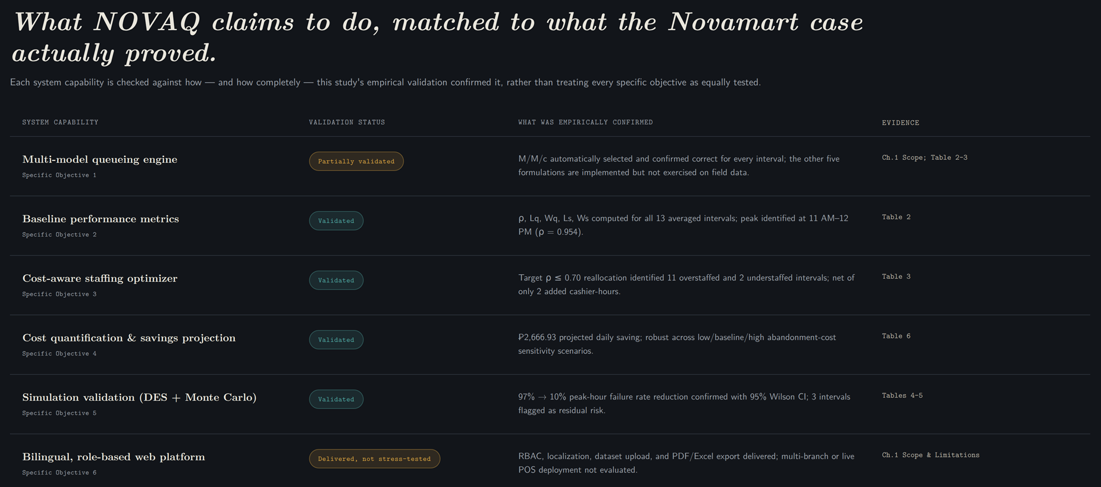
Capstone 2026

Slide 13
Capstone 2026
THANK YOU
FOR
LISTENING

