Slide 1
One-sided Communication: example
Balancing Sorted Data, revisited
© 2018 L. V. Kale at the University of Illinois Urbana

Slide 2
Balancing Sorted Data (revisited)
Consider the following situation:
Each processor i has K_{i} numbers
They are sorted within and across processors
But they are unequally distributed
How would you balance them, without losing the sorted-ness?

Slide 3
4
8
7
1
b e f g
i j k l m n p r
s t u v w x y
z
4
8
7
1
Average = 5
Sum of Previous Items obtained using Prefix Sum
b e f g
i j k l m n p r
s t u v w x y
z
0 4 12 19
5
5
5
5
b e f g i
J k l m n
p r s t u
v w x y z
Exercise: Implement this with two-sided communication..
It is hard because a process doesn’t know how many messages to receive
You can solve that by doing a reduce-scatter (or all-reduce, but that’s overkill) on a vector of count of messages destined for processor i

Slide 4
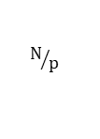
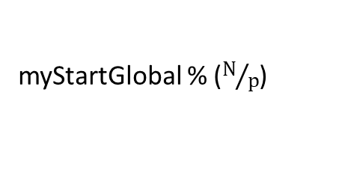
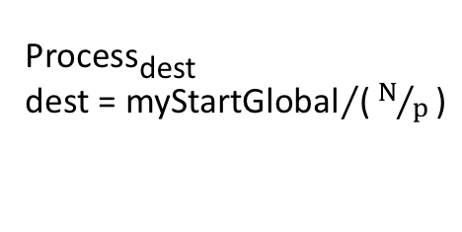
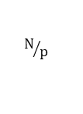
Obtained by MPI_Exscan
myStartGlobal
Process_{rank}
Sometimes you may have to send to multiple processes
$$N/p$$
myStartGlobal % ($N/p$)
…
…
$$N/p$$
Process_{dest}
dest = ${\text{myStartGlobal}}/{\text{(}N/p\text{)}}$
Process _{dest+1}
Process _{dest+2}
Solution using one-sided communication: basic idea
Identify where exactly my data goes
Put it there
Bracket this with fences to make sure its complete

Slide 5
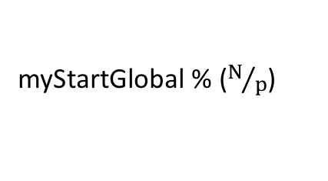

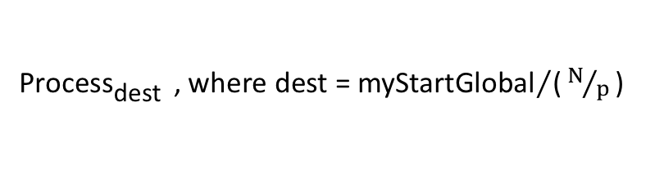
process_{rank}
Sometimes you may have to send to just one process
(or 0, if destination process i is same is my rank)
myStartGlobal
$$N/p$$
myStartGlobal % ($N/p$)
Process_{dest} , where dest = ${\text{myStartGlobal}}/{\text{(}N/p\text{)}}$
Precautions: if N is not a evenly divisible by P:
Take ceiling(N/P) to make sure you don’t overload last processor
If N/P is smaller than P, devise a more careful scheme to avoid leaving empty processors at the end

Slide 6
int myStartGlobal;
int *sorted, *data;
MPI_Win win;
…
MPI_Exscan(&myDataCount, &myStartGlobal, 1, MPI_INT, MPI_SUM, MPI_COMM_WORLD);
int myEnd = myStartGlobal + myDataCount - 1;
MPI_Win_allocate(dataPerProc*sizeof(int), sizeof(int), MPI_INFO_NULL, MPI_COMM_WORLD, &sorted, &win);
MPI_Win_fence(MPI_MODE_NOPRECEDE,win); //fence - there are no epochs before this int next = myStartGlobal;
while (next <= myEnd) {
int dest = next/dataPerProc;
int displacement = next%dataPerProc;
int size = std::min( dataPerProc*(dest+1), myEnd+1) - next;
MPI_Put(&data[next-myStartGlobal], size, MPI_INT, dest, displacement, size, MPI_INT, win);
next += size;
}
MPI_Win_fence(0,win); // Mark Epoch done.. After this collective call, data will be available in sorted array
… use sorted and balanced data …
MPI_Win_fence(MPI_MODE_NOSUCCEED,win); // fence to indicate no more epochs

