Slide 1
Hybrid Programming MPI and OpenMP
© 2018 L. V. Kale at the University of Illinois Urbana

Slide 2
MPI, OpenMP and Pthreads
MPI describes parallelism between processes (with separate address spaces)
Thread parallelism provides a shared-memory model within a process
OpenMP and Pthreads are common models
OpenMP provides convenient features for loop-level parallelism. Threads are created and managed by the compiler, based on user directives.
Pthreads provide more complex and dynamic approaches. Threads are created and managed explicitly by the user.

Slide 3
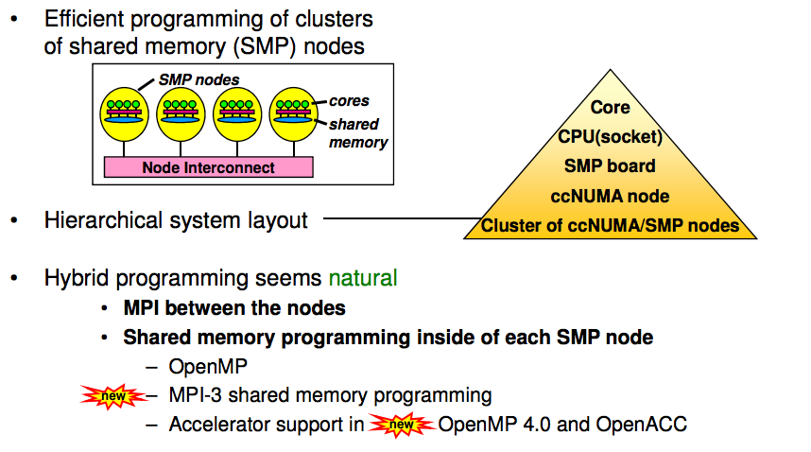
How to program on modern systems?
(Balaji, Gropp, Hoefler, Thakur, 2018)
Today’s clusters often comprise multiple CPUs per node sharing memory, and the nodes themselves are connected by a network

Slide 4
Hybridization and its benefits
(Balaji, Gropp, Hoefler, Thakur, 2018)
The use of inherently different models of programming in a complimentary manner, in order to achieve some benefit not possible otherwise;
A way to use different models of parallelization in a way that takes advantage of the good points of each
May help if
Introducing MPI into OpenMP applications can help scale across multiple SMP nodes
Introducing OpenMP into MPI applications can help make more efficient use of the shared memory on SMP nodes, thus mitigating the need for explicit intra-node communication

Slide 5
Basic Hybrid Stub
#include <omp.h>
#include "mpi.h”
#define _NUM_THREADS 4
int main (int argc, char *argv[]) {
int p,my_rank,c;
omp_set_num_threads(_NUM_THREADS);
MPI_Init(&argc, &argv);
MPI_Comm_size(MPI_COMM_WORLD,&p);
MPI_Comm_rank(MPI_COMM_WORLD,&my_rank);
#pragma omp parallel reduction(+:c)
{
c = omp_get_num_threads();
}
MPI_Finalize();

Slide 6
Compiling and running
Compilation:
mpicc -openmp test.c –o test
Running
export OMP_NUM_THREADS=8
mpirun -np 4 ./test

Slide 7
MPI + OpenMP
(Balaji, Gropp, Hoefler, Thakur, 2018)
MPI defines an alternative to MPI_Init: MPI_Init_thread(reqd, provided)
Application indicates what level of thread support it needs (reqd)
MPI returns the level of thread support it provides (provided)
MPI defines four levels of thread safety:
1. MPI_THREAD_SINGLE: There is no OpenMP multithreading in the program.
2. MPI_THREAD_FUNNELED: All of the MPI calls are made by the master thread, i.e. all MPI calls are: Outside OpenMP parallel regions, or Inside OpenMP master regions, or Guarded by call to MPI_Is_thread_main
3. MPI_THREAD_SERIALIZED
#pragma omp critical
{ …MPI calls allowed here… }
4. MPI_THREAD_MULTIPLE: Any thread may make an MPI call at any time

Slide 8
Specification of MPI_THREAD_MULTIPLE
(Balaji, Gropp, Hoefler, Thakur, 2018)
When multiple threads make MPI calls concurrently, the outcome will be as if the calls executed sequentially in some (any) order
Blocking MPI calls will block only the calling thread and will not prevent other threads from running or executing MPI functions
It is the user's responsibility to prevent races when threads in the same application post conflicting MPI calls
e.g., accessing an info object from one thread and freeing it from another thread
User must ensure that collective operations on the same communicator, window, or file handle are correctly ordered among threads
e.g., cannot call a broadcast on one thread and a reduce on another thread on the same communicator

Slide 9
Threads and MPI
(Balaji, Gropp, Hoefler, Thakur, 2018)
The MPI implementation is not required to support levels higher than MPI_THREAD_SINGLE; that is, it is not required to be thread safe
A fully thread-safe implementation will support MPI_THREAD_MULTIPLE
A program that calls MPI_Init (instead of MPI_Init_thread) should assume that only MPI_THREAD_SINGLE is supported
A threaded MPI program that does not call MPI_Init_thread is an incorrect program (common user error we see)

Slide 10
An Incorrect Program: What is wrong here?
(Balaji, Gropp, Hoefler, Thakur, 2018)
Process 0
MPI_Bcast(comm)
MPI_Barrier(comm)
Process 1
MPI_Bcast(comm)
MPI_Barrier(comm)
Thread 1
Thread 2
Here the user must use some kind of synchronization to ensure that either thread 1 or thread 2 gets scheduled first on both processes
Otherwise a broadcast may get matched with a barrier on the same communicator, which is not allowed in MPI

Slide 11
A Correct Example: why is this right?
(Balaji, Gropp, Hoefler, Thakur, 2018)
Process 0
MPI_Recv(src=1)
MPI_Send(dst=1)
Process 1
MPI_Recv(src=0)
MPI_Send(dst=0)
Thread 1
Thread 2
The MPI implementation must ensure that the above example never deadlocks for any ordering of thread execution
That means the implementation cannot simply acquire a thread lock and block within an MPI function. It must release the lock to allow other threads to make progress.

Slide 12
Performance with MPI_THREAD_MULTIPLE
(Balaji, Gropp, Hoefler, Thakur, 2018)
All MPI implementations support MPI_THREAD_SINGLE (duh).
They probably support MPI_THREAD_FUNNELED even if they don’t admit it.
Does require thread-safe malloc
Probably OK in OpenMP programs
Many (but not all) implementations support THREAD_MULTIPLE
Hard to implement efficiently though (lock granularity issue)
Thread safety does not come for free
The implementation must protect certain data structures or parts of code with mutexes or critical sections

Slide 13
Process Memory Requirements MPI vs. MPI + OpenMP
(Balaji, Gropp, Hoefler, Thakur, 2018)
Separate processes need separate address and memory space
There are much more lightweight memory requirements for OpenMP threads
Only one copy of MPI buffers etc. exists per process, and therefore only one copy exists shared between all threads launched from a process
Using MPI/OpenMP hybrid programming reduces the memory requirement overhead from multiple processes

Slide 14
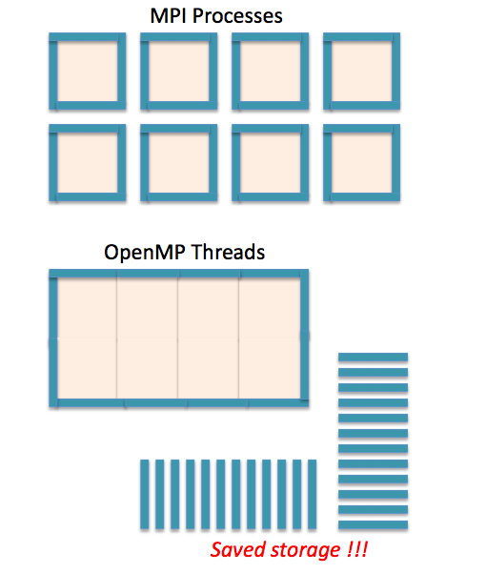
Halo Regions
(Balaji, Gropp, Hoefler, Thakur, 2018)
Halo regions are local copies of remote data that are needed for computations (remember jacobi example?)
Using OpenMP parallelism reduces the size of halos region copies that need to be stored
Reducing halo region sizes also reduces communication requirements

Slide 15
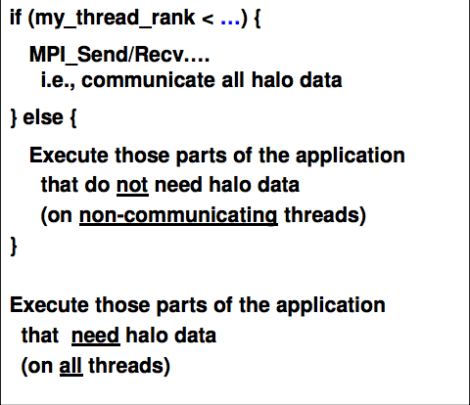
Overlapping Communication with Computation
(Balaji, Gropp, Hoefler, Thakur, 2018)
While some threads take care of communication, other threads can get the computation work done
Earlier, we were trying to achieve this using non-blocking operations and careful overlap

Slide 16
Hybrid Programming: Benefits and Pitfalls
Natural use is when master thread does communication, and then you parallelize computational loops using OpenMP, or Pthreads
The problem here is that you decreased computation time significantly, but kept the communication time the same, which means overall efficiency suffers
Attempt to overlap computation with communication
Complexity increases because of correctness issues and performance “gotcha”s (pitfalls.. Unexpected performance losses)
E.g. locking costs of shared data structures,
But is necessary: MPI-everywhere (i.e. a rank on each hardware thread or core) leaves too much capability un-exploited
E.g. Avoiding copies of common (shared, read-only or read-mostly) data

Slide 17
Reference
Pavan Balaji, William Gropp, Torsten Hoefler, and Rajiv Thakur
2018 [Retrieved from : https://anl.app.box.com/v/balaji-tutorials-2018/

