Slide 1
Implementing Reductions and Broadcasts
Laxmikant V. Kale
© 2018 L. V. Kale at the University of Illinois Urbana

Slide 2
Types of reductions
Scalar Reductions
Input: each processor holds a number
Output: at the end of the operation, one designated processor (say 0) has the sum of all numbers
Instead of sum, one can use any commutative-associative operation
Such as Max, min, and, or, product, ..
PE0
3
26
PE1
2
PE2
12
PE3
9

Slide 3
Types of reductions
Vector Reduction
Input: each processor holds an array of numbers
Output: at the end of the operation, a designated processor has the sum of all numbers, respectively
i.e. Sum[i] = sum{A[i]}
Instead of sum, one can use any commutative-associative operation
Such as Max, min, and, or, product, ..
[3,2,7]
[15,17,25]
PE0
PE1
[1,2,3]
PE2
[4,5,6]
[7,8,9]
PE3

Slide 4
Types of reductions
PE0
3
26
Scalar (and Vector) All-Reduce
Each processor holds a number
At the end of the operation, all processors have the sum of all numbers
Again, instead of sum, one can use any commutative-associative operation
Such as Max, min, and, or, product, ..
2
26
PE1
12
26
PE2
9
26
PE3

Slide 5
Optimizing Reductions and Broadcasts
Naïve algorithm: all send to PE 0. ( O(P) )
Basic Spanning tree algorithm:
Organize processors in a k-ary tree
Leaves: send contributions to parent
Internal nodes: wait for data from all children, add mine,
Then, if I am not the root, send to my parent
What is a good value of k? Minimize the total time
Broadcasts algorithms are similar to reductions, but in reverse direction

Slide 6
P = 1024, K = 2
α * 2 * log₂(1024) = 20α
P = 1024, K = 4
α * 4 * log₄(1024) = 20α

Slide 7
Better spanning trees:
Observation: Only 1 level of the tree is active at a time
Also, A PE can’t deal with data from second child until it has finished “receive” of data from 1st.
So, second child could delay sending its data, with no impact
It can collect data from someone else in the meanwhile
2
3
3
4
1
1
2
1
2
1

Slide 8
More complex ideas
Observation: Only 1 level of the tree is active at a time
Exploit the actual values of send overhead, latency, and receive overhead
The picture on the right is not necessarily optimal for all values of receive overhead and latency.. But you can make a more tuned spanning tree for that.
8 processes instead of 7,
But only 3 steps instead of 4
1
3
4
2
3
1
1
2
1
2
1

Slide 9
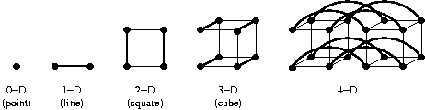
Hypercube topology
Recursive definition:
a single node is a hypercube (of 0 dimensions)
Starting with 2 hypercubes, and connecting the corresponding nodes of each to the other, gives you a hypercube (of higher dimension)

Slide 10
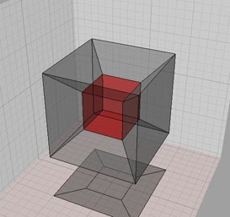
Hypercube topology
Alternative definition
A hypercube of dimension K includes 2^K nodes, each with a serial number between 0 and (2^k - 1)
Each node is connected to K neighbors, identified by changing exactly one bit in the k-bit representation of the node’s serial number

Slide 11
Hypercube topology
Alternative definition
A hypercube of dimension K includes 2^K nodes, each with a serial number between 0 and (2^k - 1)
Each node is connected to K neighbors, identified by changing exactly one bit in the k-bit representation of the node’s serial number
6
7
0
1
2
3
4
5
6
7
000
001
010
011
100
101
110
111
4
5
2
3
0
1

Slide 12
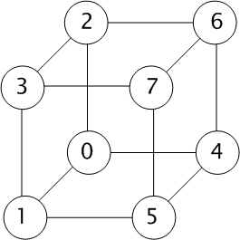
Hypercube based spanning tree
In each phase i, send data to neighbor in i^{th} dimension if its serial number is smaller than mine
Accumulate data from neighbors until it is my turn to send
log P phases, with at most one receive per processor per phase
0 000
1 001
2 010
3 011
4 100
5 101
6 110
7 111

Slide 13
How will you use a virtual hypercube for AllReduce?
Idea:
Send your data to your neighbor in i^{th} dimension, receive from it, and add up
Repeat
This is called dimensional exchange
It works because it partitions the hypercube in two parts in each step

Slide 14
15
26
+
15
8
51
8
104
26
51+
+
53
53+
20+
104
20
2
6
2
6
12
11
12
51
11
53
20
+
51+
26
+
104
26+
12
53+
11
20+
104
7
3
7
3
21
21
53
33
+
104
53+
104
33+
51
+
12
+
25
25
51+
25
12
0
4
0
4
+
53
13
12
104
12
12
33
51+
+
13
33+
51
25
13
104
25+
53+
25
1
1
5
5

Slide 15
Reductions with large datasets
What if n is large?
Example: simpler formulation of molecular dynamics:
Each PE has an array of forces for all atoms
Each PE is assigned a subset of pairs of atoms
Accumulated forces must be summed up across PEs
New optimizations become possible with large n:
Essential idea: use multiple concurrent reductions to keep all levels of the tree busy
Divide data (n bytes) into m segments of n/m bytes each
Start reduction for each segment.
n/m pipelined phases (I.e. phases overlap in time)
k: branching factor, as before
So, approximately:
Instead of

Slide 16
Concurrent reductions: load balancing!
Leaves of the spanning tree are doing little work
Use a different spanning tree for successive reductions in the pipeline
E.g. first reduction uses a normal spanning tree rooted at 0, while second reduction uses a mirror-image tree rooted at (P-1)
This load balancing improve performance considerably

