Slide 1
Scalability, and Isoefficiency
Efficiency, Speedups and How to Compare Parallel Algorithms
© 2018 L. V. Kale at the University of Illinois Urbana

Slide 2
Major Analytical/Theoretical Techniques
Typically involves simple algebraic formulae and ratios
  Typical variables are:
    Data size (N), number of processors (P), machine constants
  Model performance of individual operations, components, algorithms in terms of the above
    Be careful to characterize variations across processors, and model them with (typically) max operators
      E.g., max{Load _{I}}
  Remember that constants are important in practical parallel computing
    Be wary of asymptotic analysis: use it, but carefully
Notes:
2

Slide 3
Alpha-Beta Cost Model for Communication
Communication costs involve per-message cost 𝛂 and per-byte cost 𝛃
  These may arise in different contexts, each with its own 𝛂/ 𝛃 values
    Incurred by CPU in processing messages
    Latency on the network
Execution time for the program may involve
  Sum of computation and communication
  Max of computation and communication costs if overlapped
    With irecv, isend
  Critical paths
    E.g., reduction. Each processor may be sending a few messages, but the operation takes log P time, and you may be waiting for that duration
Alternative model: logP (and logNP)
  I prefer 𝛂 - 𝛃 model, as long as it is applied separately for overhead and latency when needed

Slide 4
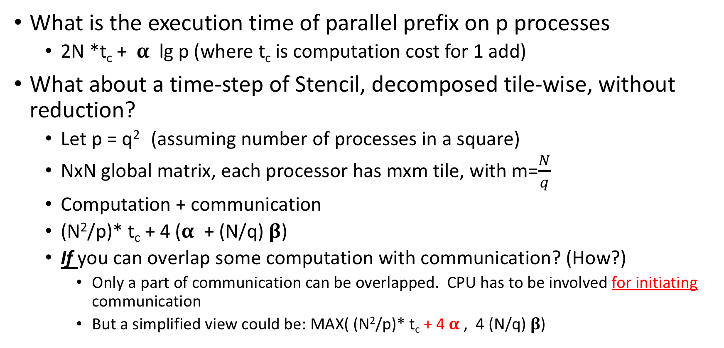
Example/s
What is the execution time of parallel prefix on p processes
  2N *t_{c} + 𝛂 lg p (where t_{c} is computation cost for 1 add)
What about a time-step of Stencil, decomposed tile-wise, without reduction?
  Let p = q² (assuming number of processes in a square)
  NxN global matrix, each processor has mxm tile, with m=$\frac{N}{q}$
  Computation + communication
  (N²/p)* t_{c} + 4 (𝛂 + (N/q) 𝛃)
  If you can overlap some computation with communication? (How?)
    Only a part of communication can be overlapped. CPU has to be involved for initiating communication
    But a simplified view could be: MAX( (N²/p)* t_{c} + 4 𝛂 , 4 (N/q) 𝛃)

Slide 5
Scalability
The program should scale up to use a large number of processors
  But what does that mean?
Any fixed individual simulation (computation) isn’t truly scalable
Why?
  Because with a fixed data (and computation) size, it will run out of parallelism eventually
Notes:
5

Slide 6
Parallel Efficiency
Efficiency: Sequential Time / (P · Parallel Time)
  Parallel time = computation + communication + idle
Speedup = Sequential Time / Parallel Time

Slide 7
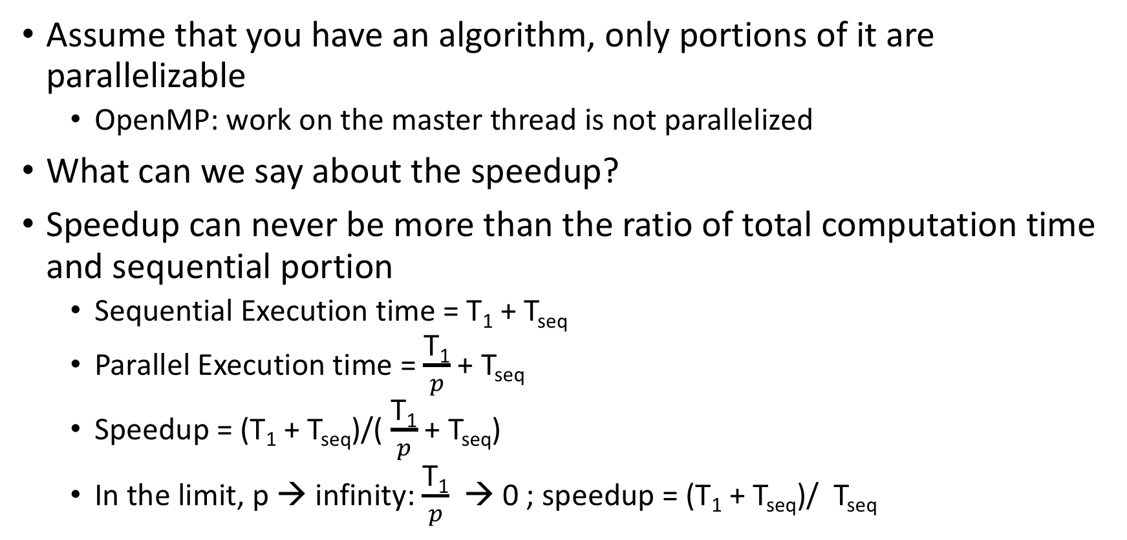
Amdahl’s Law
Assume that you have an algorithm, only portions of it are parallelizable
  OpenMP: work on the master thread is not parallelized
What can we say about the speedup?
Speedup can never be more than the ratio of total computation time and sequential portion
  Sequential Execution time = T₁ + T_{seq}
  Parallel Execution time = $\frac{\text{T}\text{1}}{p}$ + T_{seq}
  Speedup = (T₁ + T_{seq})/( $\frac{\text{T}\text{1}}{p}$ + T_{seq})
  In the limit, p → infinity: $\frac{\text{T}\text{1}}{p}$ → 0 ; speedup = (T₁ + T_{seq})/ T_{seq}

Slide 8
Scalability, and Isoefficiency: continued
Efficiency, Speedups and How to Compare Parallel Algorithms
© 2018 L. V. Kale at the University of Illinois Urbana

Slide 9
Strong Scaling
Given a particular problem instance
  I.e., a program with a given input
How many processors can we use profitably?
  What is “profitably”?
Depends on if your goal is:
  Best use of resources
    Middle region is not ok
  Shorter completion time
    Important problem with a deadline
    Middle region is ok
Bad:
stopped scaling
Good
Perfect speedup
Speedup
Ok?: “continues to scale”
Processors

Slide 10
Scalability
The program should scale up to use a large number of processors
  But what does that mean?
An individual simulation isn’t truly scalable
Better definition of scalability:
  If I double the number of processors, I should be able to retain parallel efficiency by increasing the problem size
Notes:
10

Slide 11
Isoefficiency
Quantify scalability
How much increase in problem size is needed to retain the same efficiency on a larger machine?
Efficiency: Sequential Time / (P · Parallel Time)
  Parallel time = computation + communication + idle
One way of analyzing scalability:
  Isoefficiency:
    Equation for equal-efficiency curves
  Use η(p,N) = η(x.p, y.N) to get this equation
    η(p,N) = C for some constant C
  If no solution: the problem is not scalable
    In the sense defined by isoefficiency
Equal efficiency curves
Problem size
Processors

Slide 12
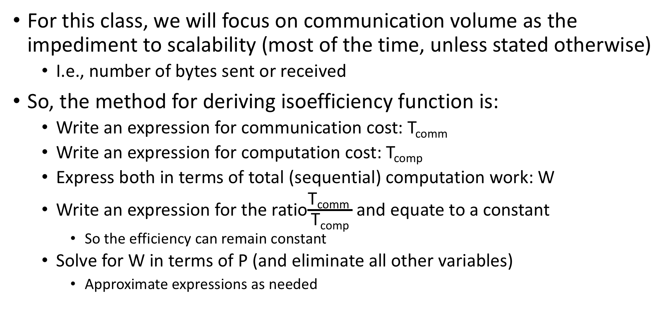
Isoefficiency Basics
For this class, we will focus on communication volume as the impediment to scalability (most of the time, unless stated otherwise)
  I.e., number of bytes sent or received
So, the method for deriving isoefficiency function is:
  Write an expression for communication cost: T_{comm}
  Write an expression for computation cost: T_{comp}
  Express both in terms of total (sequential) computation work: W
  Write an expression for the ratio$\frac{\text{T}\text{comm} }{\text{T}\text{comp}}$ and equate to a constant
    So the efficiency can remain constant
  Solve for W in terms of P (and eliminate all other variables)
    Approximate expressions as needed

Slide 13
Approximations
If the computation cost is a.N³ + b.N
  Approximate this as a.N³, because the cubic term dominates over the linear term, for large N
  N² + k.N.log N approximates to N²

Slide 14
Make Sure to Use the Total Work W
Example:
  For a matrix of size N, say, the algorithm requires doing N³ operations (across all processors (i.e., same as sequential if you are not doing extra work)
  W = N³; i.e., N = W ^{1/3}
  Make sure you replace all occurrences of N in the comm/comp ratio by W ^{1/3}

Slide 15
Using Other Metrics for Isoefficiency
Sometimes, the communication volume is not the metric for measuring inefficiency
  May be:
    Number of messages
    Fraction of bisection bandwidth used
    Critical path
Use the dominant metric for overhead to determine equal efficiency equation
  T_{parallel} = T_{comp} + T_{overhead}

Slide 16

Gauss-Jacobi Relaxation
Sequential Pseudocode:
Decomposition by:
while (maxError > Threshold) {
Re-apply Boundary conditions
maxError = 0;
for i = 0 to N-1 {
for j = 0 to N-1 {
B[i,j] = 0.2 * (A[i,j] + A[i,j-1] +
A[i,j+1] + A[i+1, j] + A[i-1,j]) ;
if (|B[i,j]- A[i,j]| > maxError)
maxError = |B[i,j]- A[i,j]|
}
}
swap B and A
}
Row
Blocks
Or Column

Slide 17
Isoefficiency of Jacobi Relaxation
Row decomposition
Computation per proc:
Communication:
Comm-to-comp ratio:
Efficiency:
Isoefficiency:
Block decomposition
Computation per proc:
Communication:
Comm-to-comp ratio:
Efficiency:
Isoefficiency:
Notes:
17

Slide 18
Isoefficiency of Jacobi Relaxation
Row decomposition
Computation per proc:
  A * N * (N/P)
Communication:
  16 * N
Comm-to-comp ratio:
  (16 * P) / (A * N) = γ
Efficiency: 1 / (1 + γ)
Isoefficiency:
  Keep γ constant
  16P/(A.N) = γ, ie P/N = k
  problem-size W = N², N = sqrt(W)
  P/sqrt(W) = k; W = (P/k)²
Block decomposition
Computation per proc:
  A * N * (N/P)
Communication:
  32 * N / P^{1/2}
Comm-to-comp ratio:
  (32 * P^{1/2}) / (A * N)
Efficiency: 1 / (1 + γ)
Isoefficiency:
  P^{1/2}/(w)^{1/2} = k; w = p/k
  Linear in p
Notes:
18

Slide 19
Scalability, and Isoefficiency: continued
Isoefficiency for Classical Molecular Dynamics Algorithms
© 2018 L. V. Kale at the University of Illinois Urbana

Slide 20
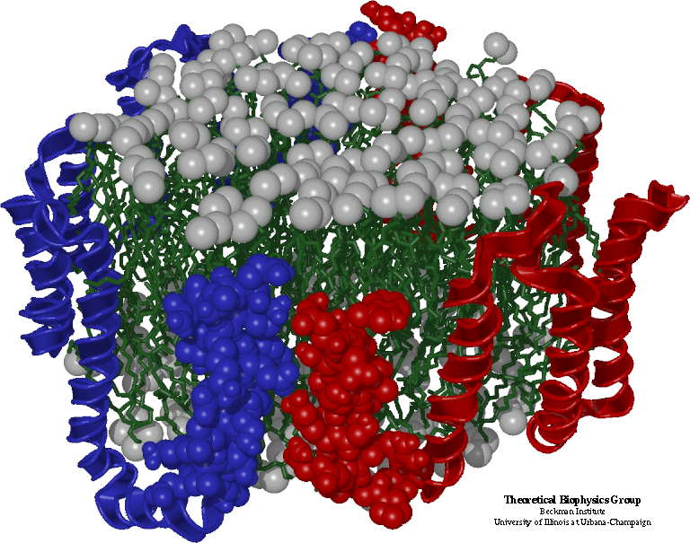
Simple Molecular Dynamics
Collection of [charged] atoms, with bonds
  Newtonian mechanics
  Thousands to millions of atoms
  1 femtosecond time-step, millions needed!
At each time step
  Calculate forces on each atom
    Bonds: treated like springs
    Non-bonded: electrostatic and van der Waal’s
      Short distance: every time step
      Long range: ignore for this discussion
  Calculate velocities and advance positions

Slide 21
The Basic Algorithm
Read atom info and initialize
for each timestep {
for i = 1, N
for j = 1, N
if (distance(A,i,j) < CutOff)
A[i].force = calculateForceBetween(A,i,j)
for i = 1,N
for each atom j that i is bonded to:
add forces on A[i] due to A[i]
// integrate
for I = 1, N
updatePositions(A,i)
}
A is an array of atoms
Each A[i] has:
double px,py,pz ; // positions
double vx, vy, vz; // velocities
double fx,fy,fz; // forces
double mass;
Aside: this ignores symmetry (Newton’s third law), which could be used to reduce the computation by half. It’s ok for now.

Slide 22
Parallelization Using Atom Replication
Done in early codes
  trying to extend their sequential code to run on parallel machines
Each processor keeps the entire array
Each processor calculates some subset of the interactions
  This may involve calculating forces on arbitrary sets of atoms
  So, need to add up all the forces and make them available to all processors (who then updates the positions for all N)
  All-reduce with an array of size N takes time N.logP
    This is the communication cost

Slide 23
Analysis of Replicated Data
Computation: for each atom, a constant number of atoms are within its cutoff radius
  Approx. 300 for typical simulations with 12 Angstrom cutoff
  With relatively uniform densities
  In any case, the number of interactions doesn’t increase with N
Computation time per processor: k.N/p
  (with some large k)
Communication: N. logP
Communication/Computation Ratio: (P log P)/k
  ! No N in the expression. Just keeps increasing with P, with no scope for reducing it with a larger problem size

Slide 24
Traditional Approaches: Non-isoefficient
Replicated data:
  All atom coordinates stored on each processor
    Communication/computation ratio: P log P
Partition the atoms array across processors
  Nearby atoms may not be on the same processor
  C/C ratio: O(P)
Distribute force matrix to processors
  Matrix is sparse, non uniform
  C/C ratio: sqrt(P)

Slide 25
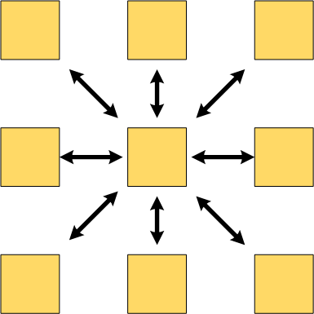
Spatial Decomposition
Atoms distributed to cubes based on their location
  Relatively uniform atom density
Size of each cube
  Just a bit larger than cut-off radius
  Communicate only with neighbors
  Work: for each pair of neighbor objects
Communication to computation ratio: O(1)
  E.g. imagine 1 cube per process
However:
  Load imbalance
  Limited parallelism

