Slide 1
Algorithms: Matrix-Matrix Multiplication

Slide 2
Simple Algorithm
A X B => C, matrices of size NxN, using p = q² procs
Start with a 2D (block) decomposition of A, B and C
Each process gets a (N/q)x(N/q) block

Slide 3
0,0
1,0
C
2,0
2,1
4,4
A
B

Slide 4
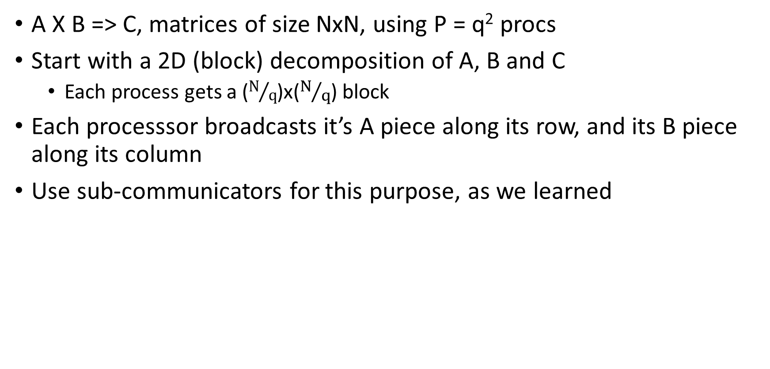
Simple Algorithm
A X B => C, matrices of size NxN, using P = q² procs
Start with a 2D (block) decomposition of A, B and C
Each process gets a ($N/q$)x($N/q$) block
Each processsor broadcasts it’s A piece along its row, and its B piece along its column
Use sub-communicators for this purpose, as we learned

Slide 5
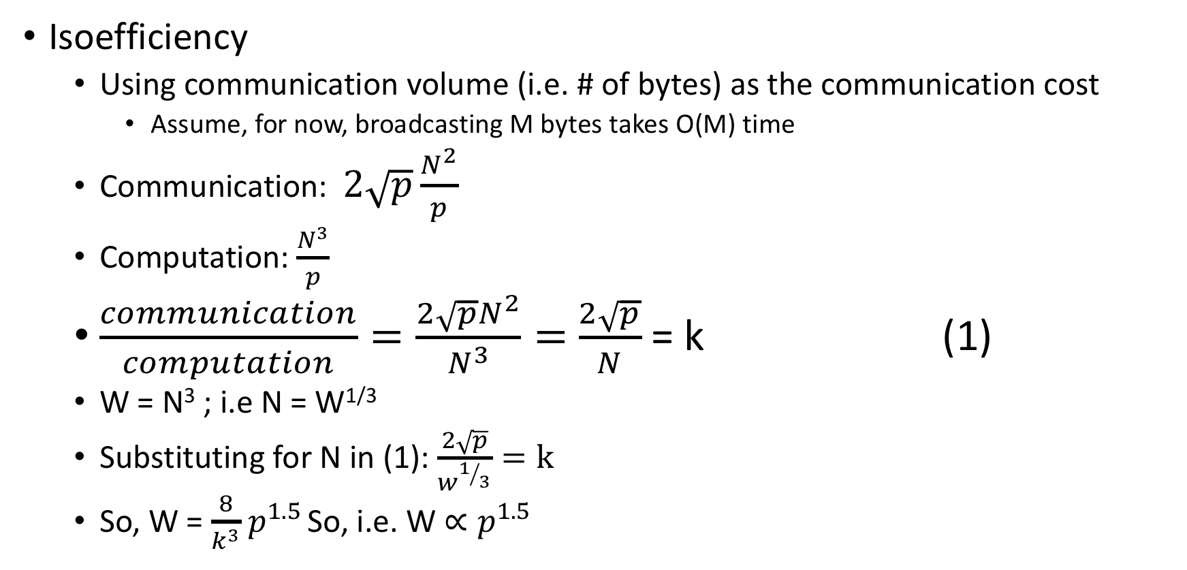
Simple Algorithm: Analysis
Isoefficiency
Using communication volume (i.e. # of bytes) as the communication cost
Assume, for now, broadcasting M bytes takes O(M) time
Communication: $2\sqrt{p}\frac{N^{2}}{p}$
Computation: $\frac{N^{3}}{p}$
$\frac{communication}{computation}=\frac{2\sqrt{p}N^{2}}{N^{3}}=$ $\frac{2\sqrt{p}}{N}$ = k (1)
W = N³ ; i.e N = W^{1/3}
Substituting for N in (1): $\frac{2\sqrt{p}}{w^{1/3}}=k$
So, W = $\frac{8}{k^{3}}$ $p^{1.5}$ So, i.e. W $∝p^{1.5}$

Slide 6
Simple Algorithm: Analysis
Isoefficiency
Using communication volume (i.e. # of bytes) as the communication cost
Assume, for now, broadcasting M bytes takes O(M) time
O(p^{1.5}), which is ok
What is the problem with this algorithm?
Memory on each processor increases to (q-1) times its original value..
q-1 blocks of A and q-1 blocks of B!

Slide 7
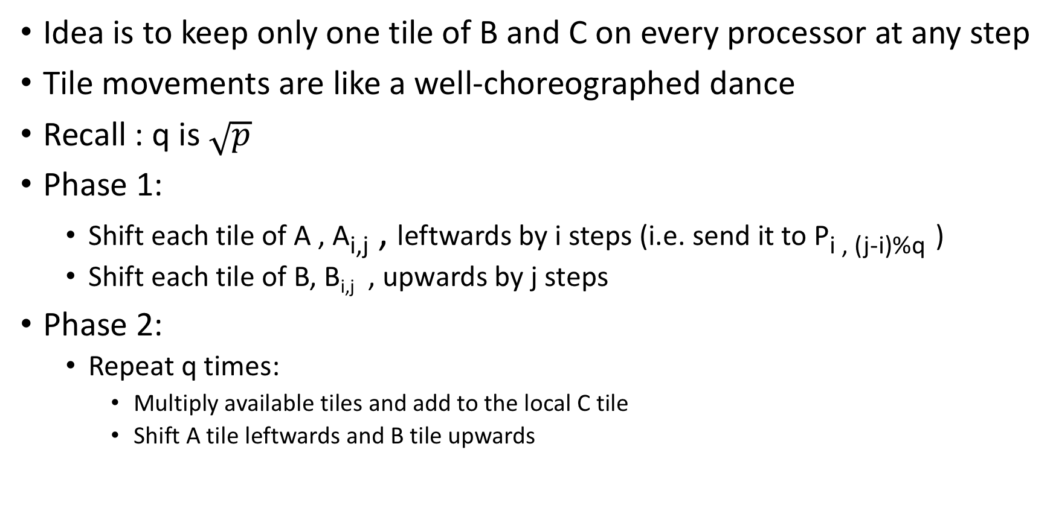
Cannon’s Matrix Multiplication Algorithm
Idea is to keep only one tile of B and C on every processor at any step
Tile movements are like a well-choreographed dance
Recall : q is $\sqrt{p}$
Phase 1:
Shift each tile of A , A_{i,j} , leftwards by i steps (i.e. send it to P_{i , (j-i)%q} )
Shift each tile of B, B_{i,j} , upwards by j steps
Phase 2:
Repeat q times:
Multiply available tiles and add to the local C tile
Shift A tile leftwards and B tile upwards

Slide 8
0,0
0,1
0,2
0,3
0,4
C
1,0
1,1
1,2
1,3
1,4
C[0,0] +=
A[0,0]*
B[0,0]
C[0,1] +=
A[0,1]*
B[1,1]
C[0,2] +=
A[0,2]*
B[2,2]
C[0,3] +=
A[0,3]*
B[3,3]
C[0,4] +=
A[0,4]*
B[4,4]
A
2,0
2,1
2,2
2,3
2,4
C[1,0] +=
A[1,1]*
B[1,0]
C[1,1] +=
A[1,2]*
B[2,1]
C[1,2] +=
A[1,3]*
B[3,2]
C[1,3] +=
A[1,4]*
B[4,3]
C[1,4] +=
A[1,0]*
B[0,4]
3,0
3,1
3,2
3,3
3,4
4,0
4,1
4,2
4,3
4,4
C[2,0] +=
A[2,2]*
B[2,0]
C[2,1] +=
A[2,3]*
B[3,1]
C[2,2] +=
A[2,4]*
B[4,2]
C[2,3] +=
A[2,0]*
B[0,3]
C[2,4] +=
A[2,1]*
B[1,4]
0,0
0,1
0,1
0,3
0,4
C[3,0] +=
A[3,3]*
B[3,0]
C[3,1] +=
A[3,4]*
B[4,1]
C[3,2] +=
A[3,0]*
B[0,2]
C[3,3] +=
A[3,1]*
B[1,3]
C[3,4] +=
A[3,2]*
B[2,4]
1,0
1,1
1,2
1,3
1,4
B
2,0
2,1
2,2
2,3
2,4
C[4,0] +=
A[4,4]*
B[4,0]
C[4,1] +=
A[4,0]*
B[0,1]
C[4,2] +=
A[4,1]*
B[1,2]
C[4,3] +=
A[4,2]*
B[2,3]
C[4,4] +=
A[4,3]*
B[3,4]
3,0
3,1
3,2
3,3
3,4
4,0
4,1
4,2
4,3
4,4

Slide 9
A(0,0)
A(0,1)
A(0,2)
C(0,0)
C(0,1)
C(0,2)
A(1,0)
A(1,1)
A(1,2)
C(1,0)
C(1,1)
C(1,2)
A(2,0)
A(2,1)
A(2,2)
C(2,0)
C(2,1)
C(2,2)
B(0,0)
B(0,1)
B(0,2)
B(1,0)
B(1,1)
B(1,2)
B(2,0)
B(2,1)
B(2,2)

Slide 10
A(0,0)
A(0,1)
A(0,2)
C(0,0)
C(0,1)
C(0,2)
C[0,0] =
A(1,0)
A(1,1)
A(1,2)
C(1,0)
C(1,1)
C(1,2)
A(2,0)
A(2,1)
A(2,2)
C(2,0)
C(2,1)
C(2,2)
B(0,0)
B(0,1)
B(0,2)
B(1,0)
B(1,1)
B(1,2)
B(2,0)
B(2,1)
B(2,2)

Slide 11
A(0,0)
A(0,1)
A(0,2)
C(0,0)
C(0,1)
C(0,2)
C[0,0] = A[0,0]*B[0,0]
A(1,0)
A(1,1)
A(1,2)
C(1,0)
C(1,1)
C(1,2)
A(2,0)
A(2,1)
A(2,2)
C(2,0)
C(2,1)
C(2,2)
B(0,0)
B(0,1)
B(0,2)
B(1,0)
B(1,1)
B(1,2)
B(2,0)
B(2,1)
B(2,2)

Slide 12
A(0,0)
A(0,1)
A(0,2)
C(0,0)
C(0,1)
C(0,2)
C[0,0] = A[0,0]*B[0,0] + A[0,1]*B[1,0]
A(1,0)
A(1,1)
A(1,2)
C(1,0)
C(1,1)
C(1,2)
A(2,0)
A(2,1)
A(2,2)
C(2,0)
C(2,1)
C(2,2)
B(0,0)
B(0,1)
B(0,2)
B(1,0)
B(1,1)
B(1,2)
B(2,0)
B(2,1)
B(2,2)

Slide 13
A(0,0)
A(0,1)
A(0,2)
C(0,0)
C(0,1)
C(0,2)
C[0,0] = A[0,0]*B[0,0] + A[0,1]*B[1,0] + A[0,2]*B[2,0]
A(1,0)
A(1,1)
A(1,2)
C(1,0)
C(1,1)
C(1,2)
A(2,0)
A(2,1)
A(2,2)
C(2,0)
C(2,1)
C(2,2)
B(0,0)
B(0,1)
B(0,2)
B(1,0)
B(1,1)
B(1,2)
B(2,0)
B(2,1)
B(2,2)

Slide 14
Cannon’s Algorithm

Slide 15
0
1
2
0
1
2
A(0,0)
A(0,1)
A(0,2)
B(0,0)
B(0,1)
B(0,2)
0
0
A(1,0)
A(1,1)
A(1,2)
B(1,0)
B(1,1)
B(1,2)
1
1
A(2,0)
A(2,1)
A(2,2)
B(2,0)
B(2,1)
B(2,2)
2
2

Slide 16
0
1
2
0
1
2
A(0,0)
A(0,1)
A(0,2)
B(0,0)
B(0,1)
B(0,2)
0
0
A(1,0)
A(1,1)
A(1,2)
B(1,0)
B(1,1)
B(1,2)
1
1
A(2,0)
A(2,1)
A(2,2)
B(2,0)
B(2,1)
B(2,2)
2
2

Slide 17
0
1
2
0
1
2
A(0,0)
A(0,1)
A(0,2)
B(0,0)
B(0,1)
B(0,2)
0
0
A(1,1)
A(1,2)
A(1,0)
B(1,0)
B(1,1)
B(1,2)
1
1
A(2,1)
A(2,2)
A(2,0)
B(2,0)
B(2,1)
B(2,2)
2
2

Slide 18
0
1
2
0
1
2
A(0,0)
A(0,1)
A(0,2)
B(0,0)
B(0,1)
B(0,2)
0
0
A(1,1)
A(1,2)
A(1,0)
B(1,0)
B(1,1)
B(1,2)
1
1
A(2,2)
A(2,0)
A(2,1)
B(2,0)
B(2,1)
B(2,2)
2
2

Slide 19
0
1
2
0
1
2
A(0,0)
A(0,1)
A(0,2)
B(0,0)
B(1,1)
B(1,2)
0
0
A(1,1)
A(1,2)
A(1,0)
B(1,0)
B(2,1)
B(2,2)
1
1
A(2,2)
A(2,0)
A(2,1)
B(2,0)
B(0,1)
B(0,2)
2
2

Slide 20
A(0,0)
A(0,1)
A(0,2)
B(0,0)
B(1,1)
B(2,2)
C[1,1] =
A(1,1)
A(1,2)
A(1,0)
B(1,0)
B(2,1)
B(0,2)
*
A(2,2)
A(2,0)
A(2,1)
B(2,0)
B(0,1)
B(1,2)
C(0,0)
C(0,1)
C(0,2)
=
C(1,0)
C(1,1)
C(1,2)
C(2,0)
C(2,1)
C(2,2)
Notes:
The grid on the right symbolizes a 64 processor machine. The highlighted region is the chare that is responsible for the computation of C[1,1].

Slide 21
A(0,0)
A(0,1)
A(0,2)
B(0,0)
B(1,1)
B(2,2)
C[1,1] = A[1,2]*B[2,1] +
A(1,1)
A(1,2)
A(1,0)
B(1,0)
B(2,1)
B(0,2)
*
A(2,2)
A(2,0)
A(2,1)
B(2,0)
B(0,1)
B(1,2)
C(0,0)
C(0,1)
C(0,2)
=
C(1,0)
C(1,1)
C(1,2)
C(2,0)
C(2,1)
C(2,2)
Notes:
The grid on the right symbolizes a 64 processor machine. The highlighted region is the chare that is responsible for the computation of C[1,1].

Slide 22
A(0,0)
A(0,1)
A(0,2)
B(0,0)
B(1,1)
B(2,2)
C[1,1] = A[1,2]*B[2,1] +
A(1,1)
A(1,2)
A(1,0)
B(1,0)
B(2,1)
B(0,2)
*
A(2,2)
A(2,0)
A(2,1)
B(2,0)
B(0,1)
B(1,2)
C(0,0)
C(0,1)
C(0,2)
=
C(1,0)
C(1,1)
C(1,2)
C(2,0)
C(2,1)
C(2,2)
Notes:
The grid on the right symbolizes a 64 processor machine. The highlighted region is the chare that is responsible for the computation of C[1,1].

Slide 23
A(0,1)
A(0,2)
A(0,0)
B(1,0)
B(2,1)
B(0,2)
C[1,1] = A[1,2]*B[2,1] + A[1,0]*B[0,1] +
A(1,2)
A(1,0)
A(1,1)
B(2,0)
B(0,1)
B(1,2)
*
A(2,0)
A(2,1)
A(2,2)
B(0,0)
B(1,1)
B(2,2)
C(0,0)
C(0,1)
C(0,2)
=
C(1,0)
C(1,1)
C(1,2)
C(2,0)
C(2,1)
C(2,2)
Notes:
The grid on the right symbolizes a 64 processor machine. The highlighted region is the chare that is responsible for the computation of C[1,1].

Slide 24
A(0,2)
A(0,0)
A(0,1)
B(2,0)
B(0,1)
B(1,2)
C[1,1] = A[1,2]*B[2,1] + A[1,0]*B[0,1] + A[1,1]*B[1,1]
A(1,0)
A(1,1)
A(1,2)
B(0,0)
B(1,1)
B(2,2)
*
A(2,1)
A(2,2)
A(2,0)
B(1,0)
B(2,1)
B(0,2)
C(0,0)
C(0,1)
C(0,2)
=
C(1,0)
C(1,1)
C(1,2)
C(2,0)
C(2,1)
C(2,2)
Notes:
The grid on the right symbolizes a 64 processor machine. The highlighted region is the chare that is responsible for the computation of C[1,1].

Slide 25
Cannon’s Algorithm: analysis
Same amount of communication
Think about what data comes in to a processor
So, same isoefficiency: O(p^{1.5})

Slide 26
Johnson’s 3D Matrix Multiplication
How can we reduce communication?
The matrix multiplication (sequential) has 3 nested loops, and we tiled only the outer 2.
What if we tile the 3rd (k) loop as well?
What does that mean in distributed memory context?
Note that the k loop is involves a reduction
Basic idea:
organize processes in a 3D cube of cubes,
distribute A on one face of the process cube
Distribute B on another phase of the process cube
Collect C on the 3rd phase of the process cube

Slide 27
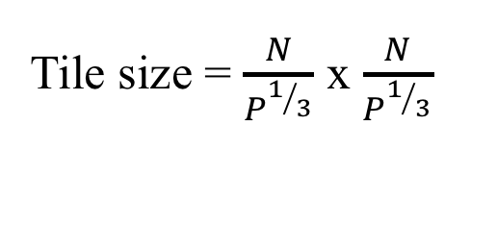
3D Matrix Multiplication
B on this surface
C on this surface
Tile size = $\frac{N}{P^{1/3}}$ x $\frac{N}{P^{1/3}}$
A on this surface

Slide 28
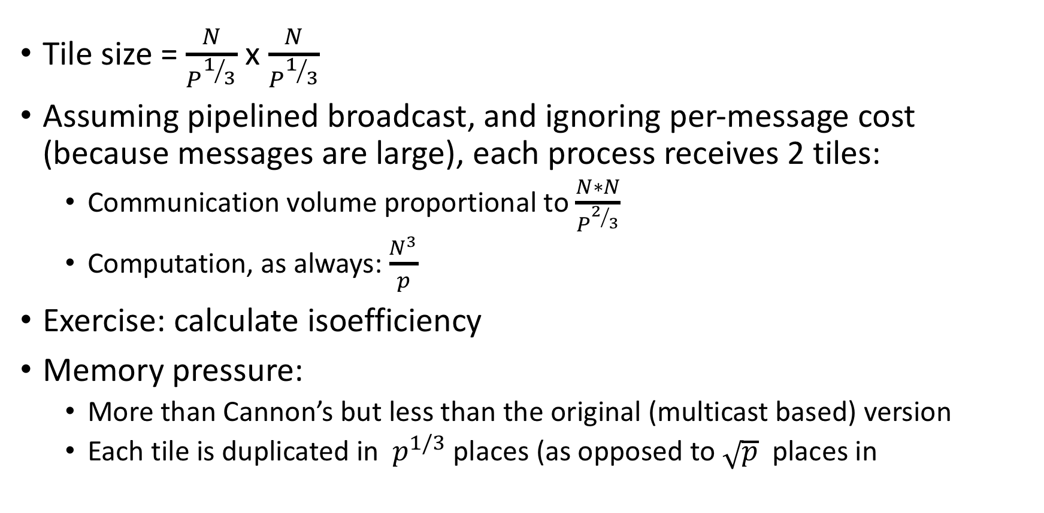
3D Matrix Multiplication: Analysis
Tile size = $\frac{N}{P^{1/3}}$ x $\frac{N}{P^{1/3}}$
Assuming pipelined broadcast, and ignoring per-message cost (because messages are large), each process receives 2 tiles:
Communication volume proportional to $\frac{N∗N}{P^{2/3}}$
Computation, as always: $\frac{N^{3}}{p}$
Exercise: calculate isoefficiency
Memory pressure:
More than Cannon’s but less than the original (multicast based) version
Each tile is duplicated in $p^{1/3}$ places (as opposed to $\sqrt{p}$ places in

Slide 29
Another new Algorithm: 2.5D matrix mpy
Optional reading for interested students
Edgar Solomonic (now at UIUC), and J. Demmel (Berkeley)
Communication-optimal parallel 2.5D matrix multiplication and LU factorization algorithms, 2011

