Slide 1


Divide and Conquer and State-Space Search
Balancing Task Queues and priorities
http://charm.cs.illinois.edu
Parallel Programming Laboratory
Department of Computer Science
University of Illinois at Urbana Champaign
© 2018 L. V. Kale at the University of Illinois Urbana

Slide 2
Task Parallelism
The applications in these domains need task parallelism
Task is a term that has been overused and overloaded
Basic idea of tasks here:
Closed-environment (i.e. fully described) tasks
No pointers to variables in the parent task
(unlike tasks that are limited to within one shared-memory domain, which is another interesting area of research in parallel programming)
These fully described tasks can execute on any node/cpu
The system has to move the seed for tasks (that fully describes the task) to some processor, to balance load
Tasks are transient: the execute, send the result if any and are done
In some applications, the tasks end up creating objects that persist:
e.g. there children may send results back to them

Slide 3
Balancing and Scheduling Tasks
In a single process, there are two main alternatives
Use a shared queue that all PEs (Pthreads) will use to enqueue/dequeue tasks
Use one queue per PE, but balance queues as needed
Work stealing: when idle, dequeue from someone else’s queue
Continuous rebalancing: monitor queue sizes and rebalance periodically
In multi-node multi-process scenario
Only Option 2 above is reasonable (with both sub-options possible)
Charm++ supports tasks, as singleton chares
Use a “seed balancer”
Load balancing is an interesting research topic

Slide 4
Continuous Rebalancing of Queues
Especially for multi-node execution
Organize processes in some virtual topology with a relatively small connectivity
Low diameter graphs inspired by Moore bound are good here!
Periodically exchange load information with neighbors in this topology
Load ≈ size of queue, for example
Or a more refined metric, if you have a heuristic for judging the load of each task
Send task seeds to neighbors if you detect “above threshold” imbalance
This method can, in practice, to better than work stealing alone
And can be combined with work-stealing (from a random processor globally)

Slide 5
Divide and Conquer
Steps:
Divide the work: create tasks (chares in Charm++) for sub-pieces
Combine solutions: send messages to parents
Judiciously set grainsize : below which, execute task sequentially

Slide 6
State Space Search
Example: N-Queens:
Place N queens on a NxN chessboard such that no two of them attack each other
Attack: are in the same row, column, or diagonal
General form:
Start state is given,
Goal state is either given or described (e.g. no 2 queens attack each other), and
A set of permissible moves (operators) is defined

Slide 7
State Space Search: Find All Solutions
If you are looking for all solutions, it is basically the same as divide-and-conquer
Send solutions up to the parent
When root get responses from all its children, you are done
Or collect them using some other mechanism (print, store locally)
But in that case, you need to know when your search is finished
This can be done via “Quiescence Detection” algorithms, which we will skip

Slide 8
State-Space Search
Finding The First Solution Faster
http://charm.cs.illinois.edu
Parallel Programming Laboratory
Department of Computer Science
University of Illinois at Urbana Champaign
© 2018 L. V. Kale at the University of Illinois Urbana

Slide 9
Search for any feasible solution
This can be thought of as divide-and-divide
No combining step
Question: how to stop search after a solution is found?
One solution: Broadcast and then exit or purge the queues..
It is a more interesting problem than that, in general, but we won’t go into that.

Slide 10
Finding first solution faster
The search tree is huge, how to quickly home in on a solution?
Various heuristics can rank children
Also, how to be consistent?
Search anomalies: more processors may slow it down and vice versa
We want monotonically increasing speedups, and consistency from run to run
Memory usage can be a big problem: exponential in depth
Left-to-right prioritization of the search tree

Slide 11
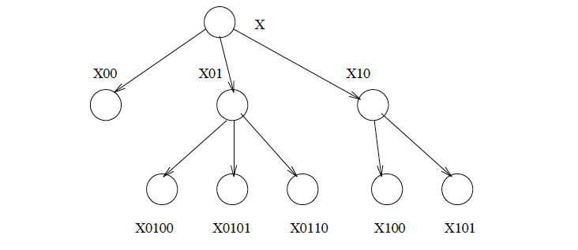
Left to right (prefix) prioritization
Priority is a bit-vector

Slide 12
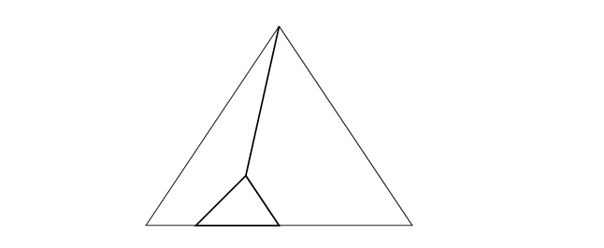
Broom-sweep search
With priorities, search tends proceed in this fashion,
Leading to very low memory usage: P +D
(P: processors, D: depth)

Slide 13
Graph Coloring
Given a bi-directional graph of V vertices and E edges
Find a way to color each vertex such that no two adjacent vertices are of the same color
Using no more than K colors
A very rich problem in terms of parallel issues
Basic parallel formulation:
Search tree
Each state:
Vector of vertices which have been colored
Optional/heuristic: # of colors available for each uncolored vertex
The graph itself is a replicated data structure (available on all nodes), not part of a state.

Slide 14
Heuristics
Which vertex to select next? (e.g. one with fewest alternatives)
Which color to color it with?
Try all available ones, of course, but in which order?
E.g. with a color that limits the neighbors the least
This leads to priorities among children, so left-to-right bitvector prioritization is useful
Once its colored, can we simplify the graph or prune the subtree?
Any node with k-1 neighbors:
Remove from the graph,
Repeat!
Impossibility: A vertex with k or more neighbors with distinct colors.. Prune the tree
Has the graph become partitioned?
I.e. two parts, and vertices that separate them are all already colored
If so, start 2 separate search problems and combine solutions later

Slide 15
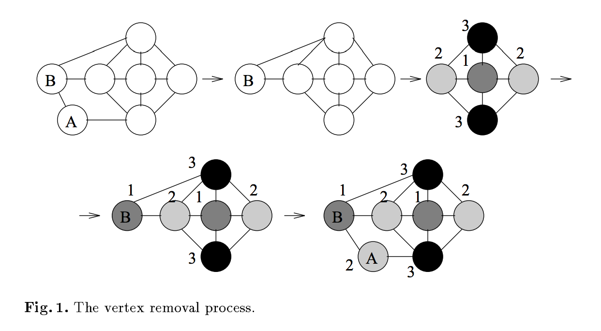
Vertex removal : 4 coloring

Slide 16
Heuristics
Which vertex to select next? (e.g. one with fewest alternatives)
Which color to color it with?
Try all available ones, of course, but in which order?
E.g. with a color that limits the neighbors the least
This leads to priorities among children, so left-to-right bitvector prioritization is useful
Once its colored, can we simplify the graph or prune the subtree?
Any node with k-1 neighbors:
Remove from the graph,
Repeat!
Impossibility: A vertex with k or more neighbors with distinct colors.. Prune the tree
Has the graph become partitioned?
I.e. two parts, and vertices that separate them are all already colored
If so, start 2 separate search problems and combine solutions later

Slide 17
Some more combinatorial search domains
A* seach and IDA* (Iterative Deepening A*) search
15-puzzle
Bi-directional search:
15-puzzle, rubik’s cube
Branch and bound:
Use bounds as integer priorities
Graph coloring and
AND-OR trees
Game trees
Common System Issues:
Duplication detection in search trees
Scalable prioritized load balancing

Slide 18
Duplication Detection
Same state may appear multiple times in the tree
(e.g. in 15 puzzle)
Solution?
Store active states in a distributed table
Before firing a task, check the table
First hash function (applied to the state) finds the processor where info about that task may be found
Second hash function finds the local table entry, if there is one

Slide 19
Scalable Prioritized Load Balancing
Continuous Balancing among queues across processes can balance loads, but what if each task has a priority?
This becomes a more complex task
A solution:
Hierarchical organization, with a manager for each subgroup maintaining the priority queue for that subgroup
Managers exchange high-priority task seeds among themselves

