Slide 1
More Collectives
Gather, Scatter, Allgather, All-to-All, etc.
Based on content from the MPI standard document

Slide 2
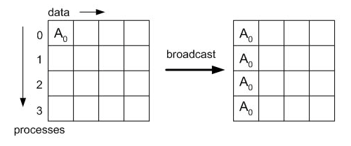
MPI Broadcast
int MPI_Bcast(void* buffer, int count, MPI_Datatype datatype, int root, MPI_Comm comm)
https://www.mpi-forum.org/docs/mpi-3.1/mpi31-report.pdf
When Syntax is omitted, this is where you are expected to go to look it up
MPI Standard, 2015

Slide 3
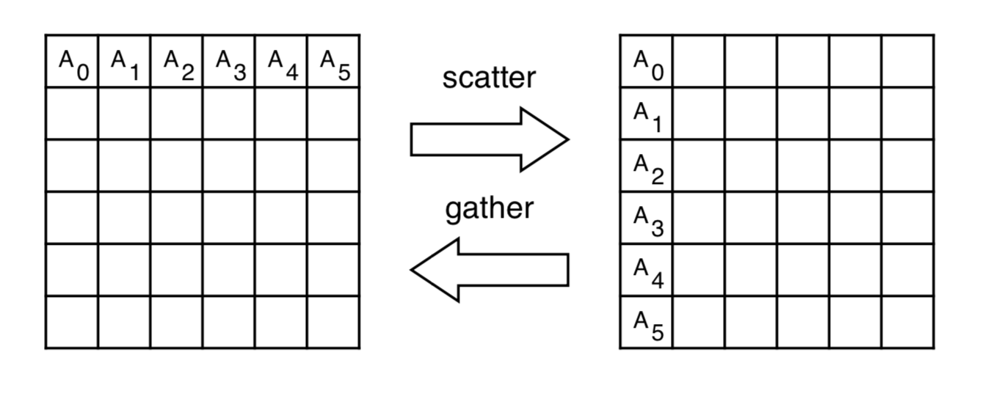
MPI_Gather and MPI_Scatter
Data
Processes

Slide 4
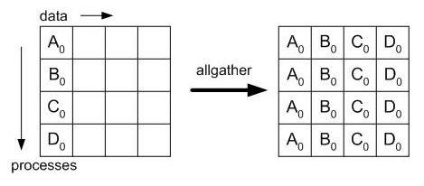
MPI Allgather
int MPI_Allgather(const void* sbuf, int scount,
MPI_Datatype stype, void* rbuf, int rcount,
MPI_Datatype rtype, MPI_Comm comm)

Slide 5
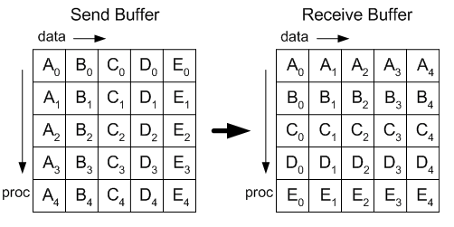
MPI AlltoAll
int MPI_Alltoall(const void* sbuf, int scount,
MPI_Datatype stype, void* rbuf, int rcount,
MPI_Datatype rtype, MPI_Comm comm)

Slide 6
Variable sizes per process
For some operations, e.g. MPI_Gather, , the amount of data contributed by each process is assumed to be constant
What if the data for each process is of different size?
Variants with “v” at the end handle that case with additional size parameters
MPI_Gatherv, MPI_Scatterv, MPI_Alltoallv, ..

Slide 7
More collectives
We omitted a few collective operations and modes that may be useful
Reduce_scatter : reduce a vector and scatter portions of it to processes
Equivalent of reduce followed by scatter
But may have faster implementation
Nonblocking modes
Added recently to the MPI standard
Indicated by letter I as with Irecv
E.g. MPI_Igather

Slide 8
Do-it-yourself Collective operations
May be implemented with MPI point-to-point
Implementations can optimize for small (latency), large (bandwidth), or both.
Generality of some MPI collective operations can limit performance
Routines must assume datatypes are general and non-contiguous
Time/memory tradeoffs (for internal temporary buffers)
So, occasionally, but hopefully rarely, you will want to use custom implementations

Slide 9
Some of the figures and content taken from material from the MPI forum
https://www.mpi-forum.org/docs/mpi-3.1/mpi31-report.pdf
MPI: A Message-Passing Interface Standard
Version 3.1
Message Passing Interface Forum
June 4, 2015
© 1993, 1994, 1995, 1996, 1997, 2008, 2009, 2012, 2015 University of Tennessee, Knoxville Tennessee. Permission to copy without fee all or part of this material is granted, provided the University of Tennessee copyright notice and the title of this document appear, and notice is given that copying is by permission of the University of Tennessee.

