Slide 1
Video Streaming and tracking
HW1 - Classification
Deadline: 2021/10/22

Slide 2
Objective
• Train a neural network to do classification.
• Recommend framework: pytorch
• Goal: Top-3 error rate < 15%
• Fewer parameters can get higher score!

Slide 3
Dataset
• The dataset consists 10 classes of 32 × 32 RGB images.
• The orders of the channels are B, G, R.
• We will give you 40000 images for training, 10000 for validation, 10000 for testing.
• For testing data, we will not give you labels.

Slide 4
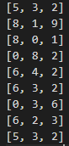
Top3 error
• Please predict the top 3 highest label for testing data(in order) into a txt file named StudentID.txt (ex: 1234567.txt)
• The format is showed below.
• Put it in the output/StudentID.txt. (if the path or format is wrong, you will get -10 points)
• TA will test the txt file.
top-3 highest label
image 1
image 2

Slide 5
Score
You should hand in both your code, txt file and report!
• Top-3 error rate <= 15% (70 points)
• 15% < Top-3 error rate <= 20% (65 points)
• 20% < Top-3 error rate <= 25% (60 points)
• 25% < Top-3 error rate (0 points)
• Number of parameters(10 points)
• Compare with your classmates(fewer parameters gets higher score)
• Top 1/5 get 10 points, second 1/5 get 8 points, etc.

Slide 6
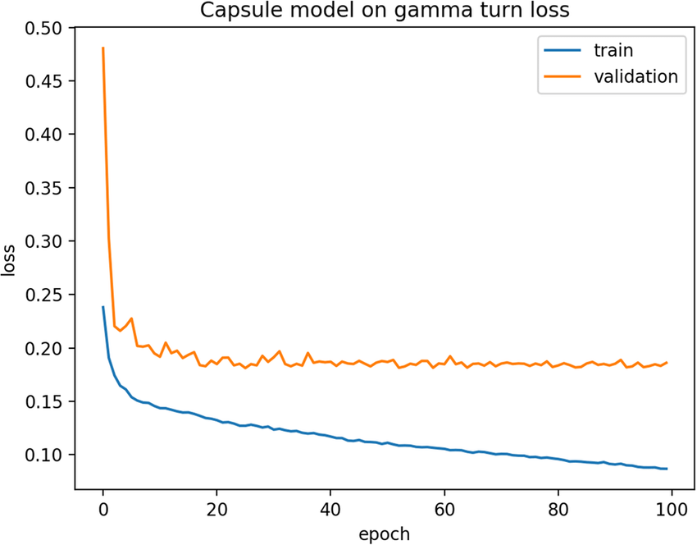
Report (20 points)
• 1. Experiment Setup (details of your model, # of parameters)
ex:
• 2. Screenshot and explain your code (as detail as possible)
• 3. Result (training and validation loss curve, validation data top-3 error rate)
• 4. Problems encountered and discussion

Slide 7
Reference
• Pytorch document: https://pytorch.org/docs/stable/index.html
• Pytorch tutorial: https://github.com/pytorch/examples

