Slide 1

GOOGLE WEB TOOLKIT
LOHITH R

Slide 2
What is GWT?
Google Web Toolkit (GWT) is an open source Java software development framework that makes writing AJAX based web applications easier.
GWT was released on May 16, 2006 at the JavaOne Conference.

Slide 3
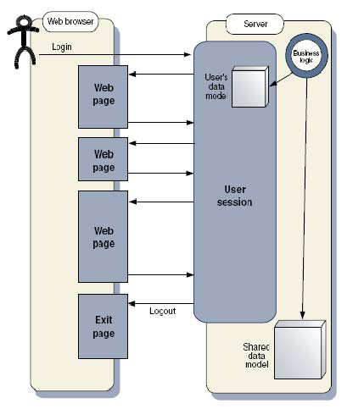
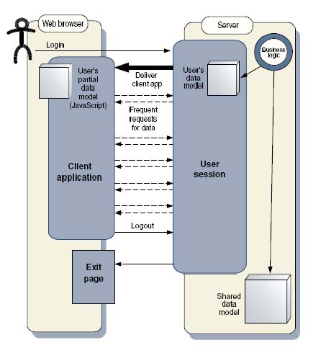
Traditional Web Apps vs. Ajax Apps
Infrequent large updates
Frequent small updates

Slide 4
Traditional web apps
Browsers are treated like HTML dumb terminals
Everything is an HTTP round trip + history entry
Every …page…is…so…sluggish…
…and…disconnected…that…I…
…keep…forgetting…where…I…am

Slide 5
Real world examples
Please do not use your browser’s Back button !!
Don’t click submit button twice, Your credit card may be charged twice !!

Slide 6




The Ajax Architectural Shift
HTML
Every User Action
Stateless
HTML View
Browser
Stateful
Server
Total new HTML page
Ajax
Remote procedure call
Stateful
JavaScript UI
Browser
Stateless
Server
Events handled locally
Data only, not HTML

Slide 7
The Ajax Advantage
Provide smoother experience than conventional web pages
No need to refresh the entire page
Snippets of information are updated as necessary
Technology behind interactive web sites
Personalised Google Page, Gmail, Orkut, Myspace etc

Slide 8
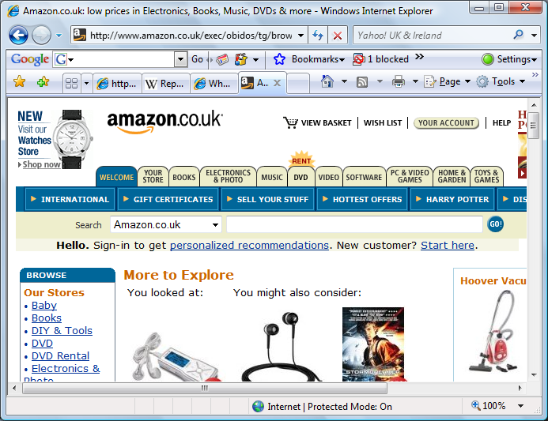
Non-Ajax: Amazon

Slide 9
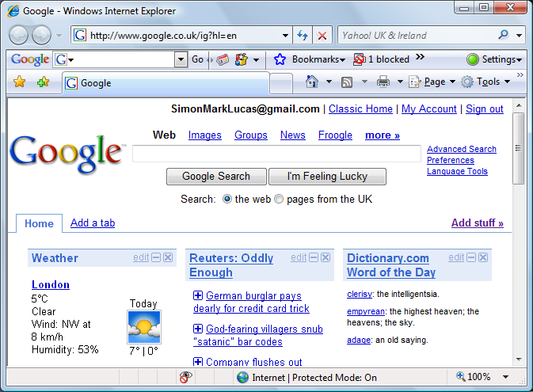
Example: Personalised Google

Slide 10

Ajax disadvantages
Browsers support Ajax methods in different ways: hard to get apps that work the same across all main browsers
« Javascript PhD »
Bugs (javascript is a dynamic language)
Security
Poor planned investment leads to
Consequences for long time.

Slide 11
What is GWT?
Build Ajax apps with Java technology
What makes GWT interesting ?
GWT is not equal to applets
GWT is much more than a compiler

Slide 12
GWT manifest
GWT should help to code stable, efficient and cross-browser applications
GWT should be friendly for developers
Compatible with IDE, support debugging, refactoring, strong typing…
The based line : « First the user, second the developer »

Slide 13
The approach
Code in java
Compile the java to Javascript

Slide 14
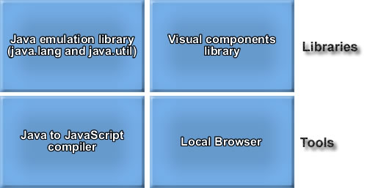
Framework architecture

Slide 15
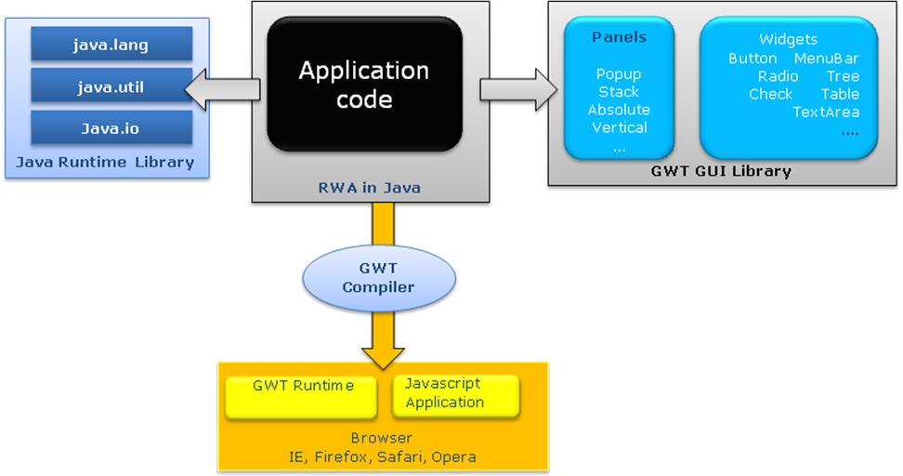
GWT Working Architecture:

Slide 16
Hello.java example
public class Hello implements EntryPoint {
public void onModuleLoad() {
// define a Button to add
Button b = new Button( “Say Hello", new ClickListener() {
public void onClick(Widget sender) {
Window.alert("Hello World!");
}
}); // add the Button // get is a static method of class RootPanel
RootPanel.get("hi").add(b);
}
}

Slide 17
Output of hello.java

Slide 18
FEATURES:
Be productive with your choice of development tools – Refactoring, debugging
Communicate with your server through really simple RPC
Use other JavaScript libraries and native JavaScript code

Slide 19







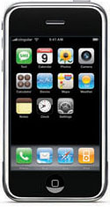

Cross browser, cross platform

Slide 20
Deferred Binding
Optimize the JavaScript script downloads based on user profile
Firefox
FF_EN
FF_FR
FF_ZH
Opera
OP_EN
OP_FR
OP_ZH
Safari
SF_EN
SF_FR
SF_ZH
IE6
IE_EN
IE_FR
IE_ZH
English
French
Chinese

Slide 21
Internationalization(I18n)
Enable applications for international usage
Enable localization of applications through Resource Separation
Externalize localizable resource and later bind them for serving.
Handles three I18n Barriers
Another Language – FIGS (French, Italian, German, Spanish)
More Characters – CJK (中文, 日本語, 한국어)
Right Direction – BiDi (Bidirectional Languages as Arabic and Hebrew)

Slide 22

GWT faster, faster
ImageBundle, kind of database for images
From 12 requests to 1 request…
Introducted in GWT 1.4

Slide 23
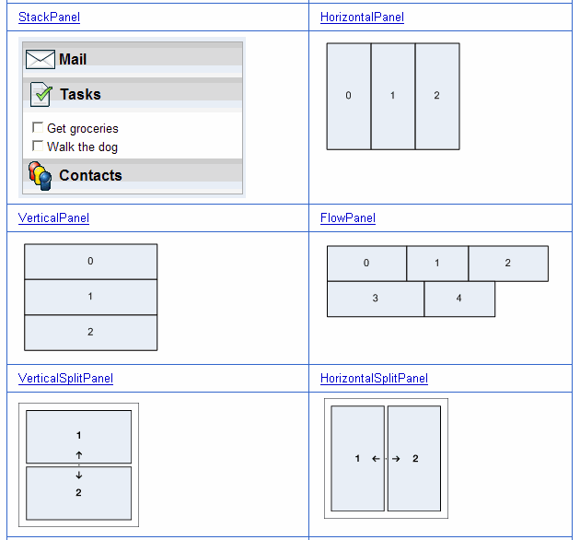
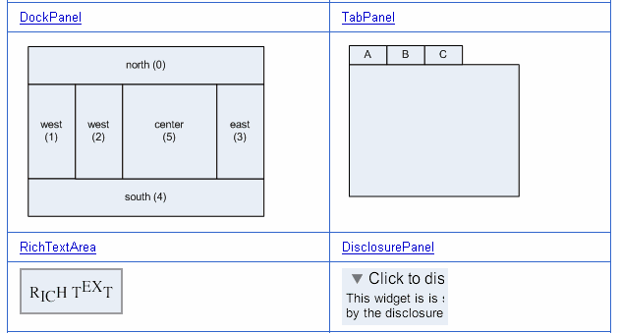
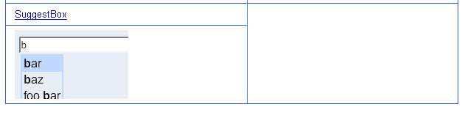
Reuse UI components across projects

Slide 24
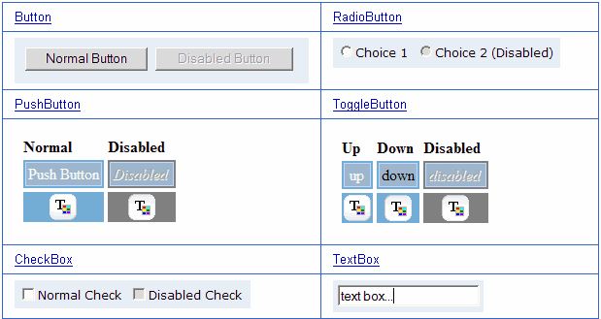
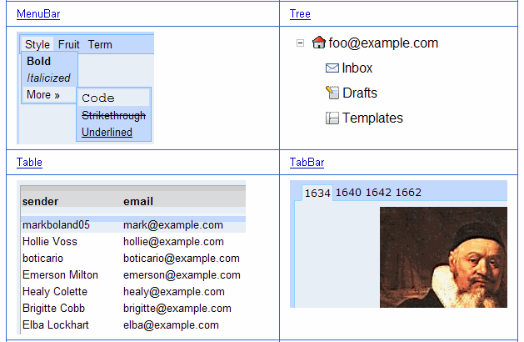
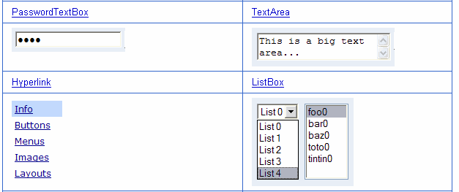
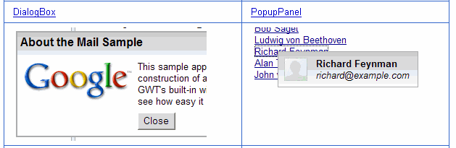
Rich UI LIBRARY

Slide 25




FEATURES:
Easily support the browser's back button and history
Localize applications efficiently
Test your code with Junit
Extend or contribute - Google Web Toolkit is open source software

Slide 26
Advantages
Reuse UI components across projects
GWT is supported by all the java IDE : Eclipse, NetBeans, IntelliJ IDEA, JDeveloper,…
No JavaScript syntax errors
Can use complex Java on the client
Hosted mode browser
GWT server could be stateless
Security
Brings software engineering to AJAX

Slide 27
limitations
May loose some benefits of JavaScript and XML.
For very small applications JavaScript native applications may run faster. GWT may be overkill.
Currently GWT is only for Java developers.

Slide 28

GWT : summary
It is 5 times faster to build a GWT application
Refactoring
Debugging
Stateless server
Cross-browsers
I18N
Hosted mode

Slide 29
What coming next
GWT 1.6
New Project Structure
Hosted Mode Enhancements
New EventHandler System
New Widgets DatePicker, DateBox
LazyPanel improves startup performance

Slide 30
Thank you ☺ !!

