Slide 1
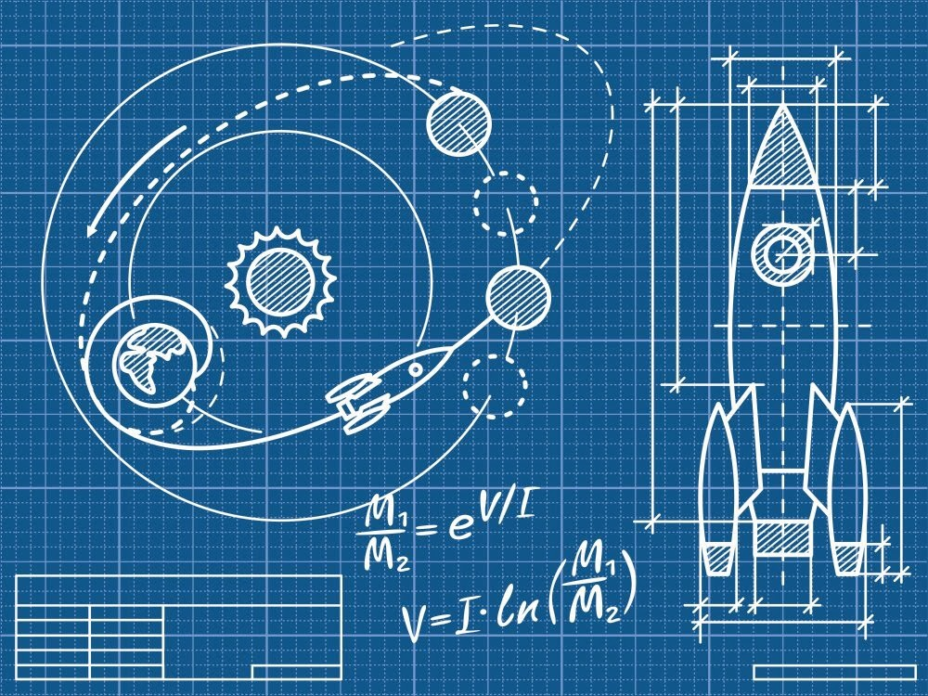
INFOM451 : Conception d’applications mobiles
Groupe environnement
Dorian Lecomte Cyril Carlier Axel Halin

Slide 2
Instructions
Mandatory :
Based on the command-line interpreter, design and implement a simulation environment, which allows to depict the blackboard contents and to launch processes around it.
Optional but strongly suggested:
For simulation and animation purposes, design a language that allow to display images on the basis of the contents of the blackboard. Some inspiration can be taken from the BMotionStudio developed for Event-B.

Slide 3
Question 1

Slide 4
Question 1 - Structure
Inspired by pictures for an extension of BachT (see webcampus)
4 windows
Main
Autonomous Agent
Interactive Agent
Visual Blackboard (Question 2)
Shared blackboard

Slide 5
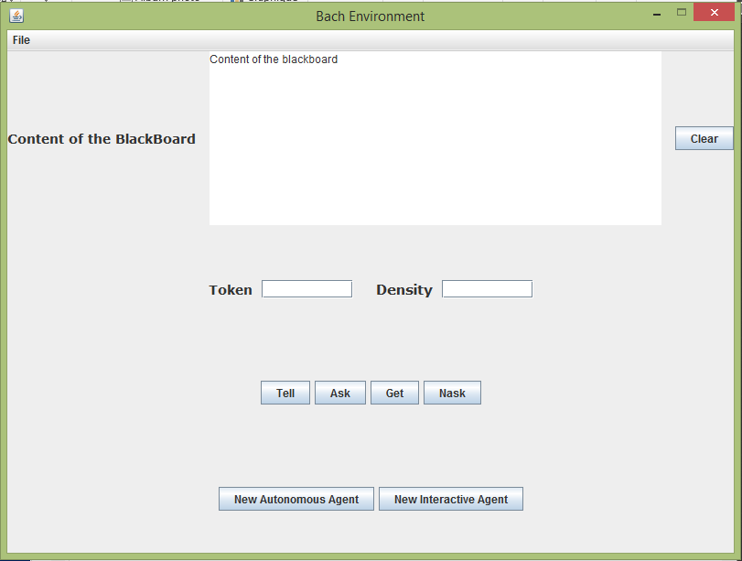
Main page - Implementation

Slide 6
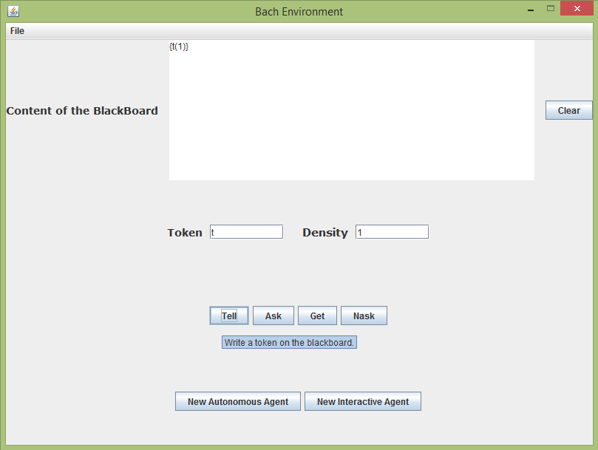
Main page - Primitive

Slide 7
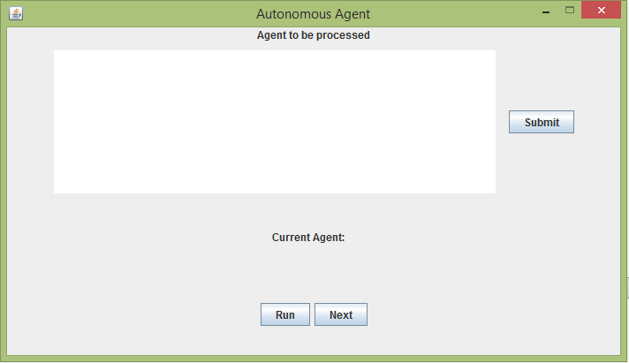
Autonomous Agent - Implementation

Slide 8
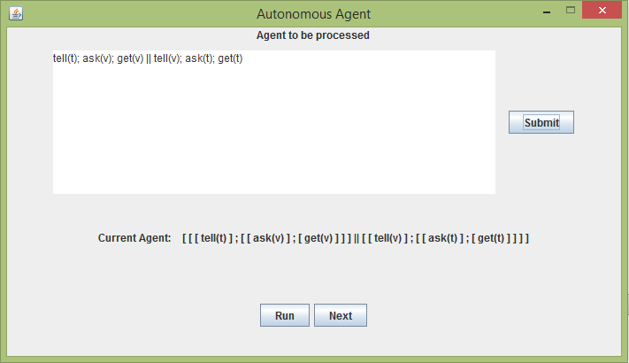
Autonomous Agent - Parsing

Slide 9
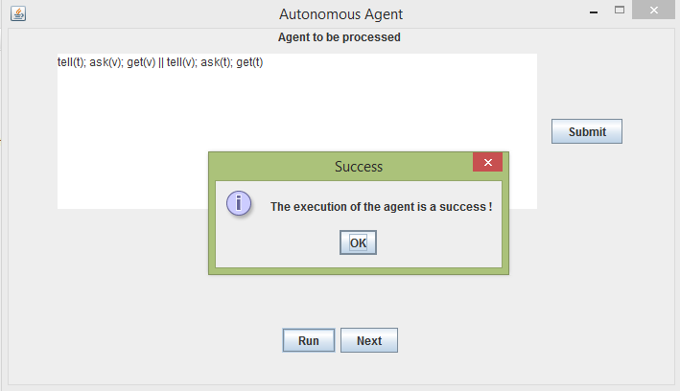
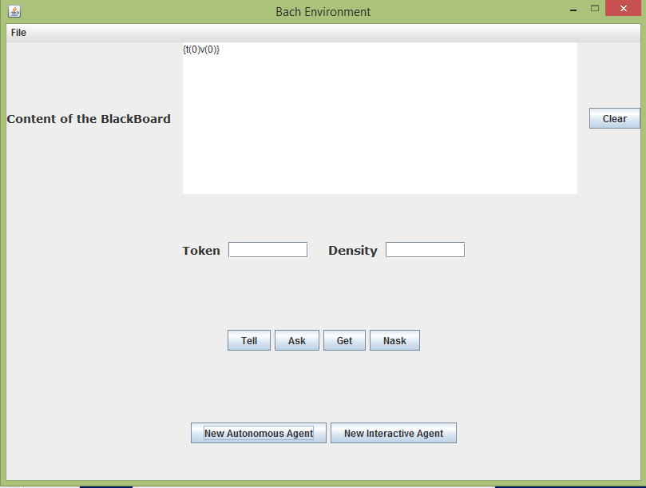
Autonomous Agent - Run

Slide 10
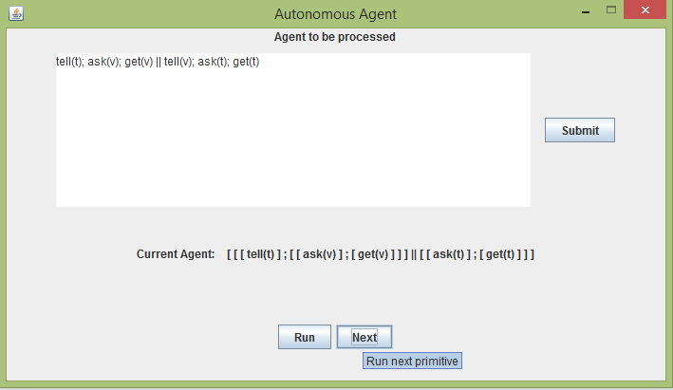
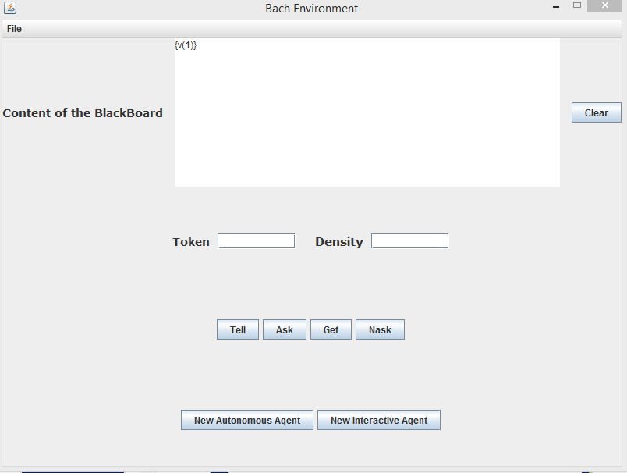
Autonomous Agent – Next

Slide 11
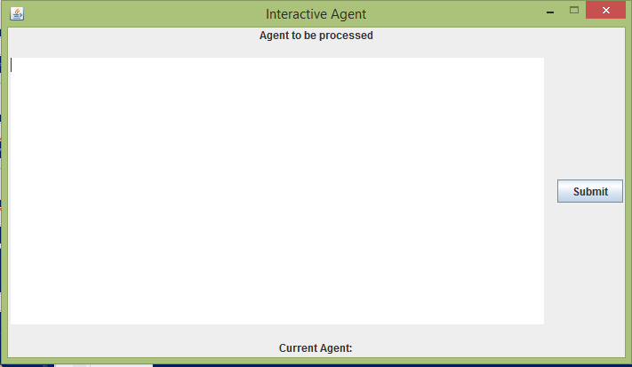
Interactive Agent – Implementation

Slide 12
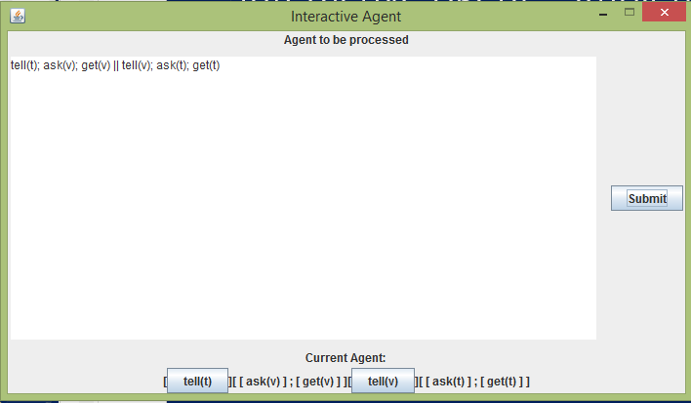
Interactive Agent – Parsing

Slide 13
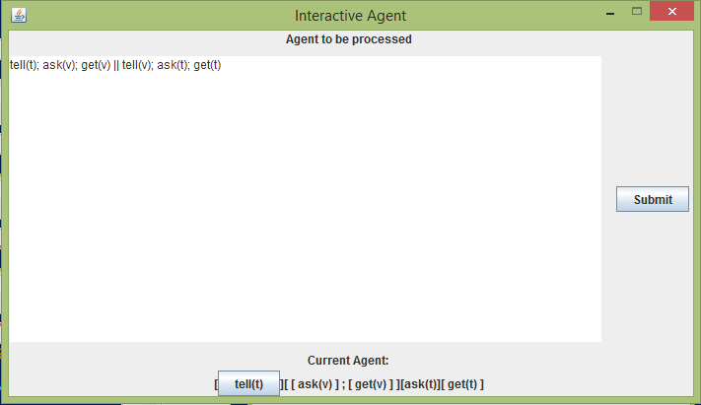
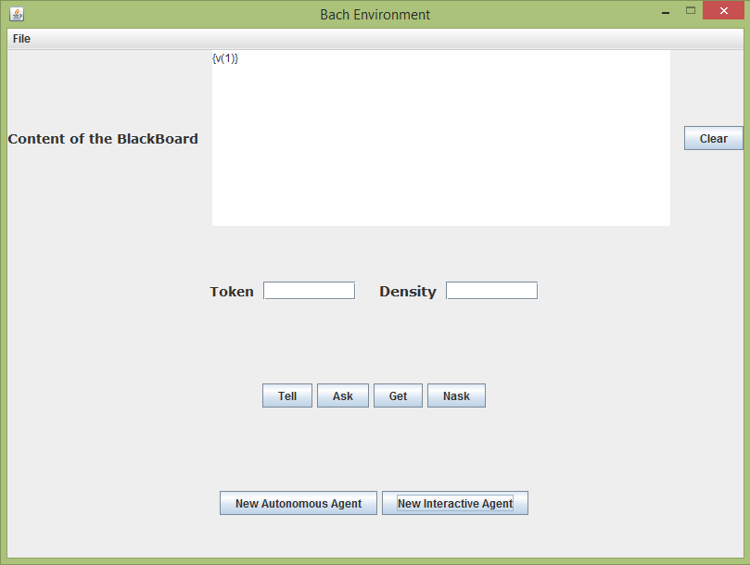
Interactive Agent – Execution

Slide 14
Question 2

Slide 15
Question 2 - Structure
4th window
VisualBlackboard.scala
Blackboard
Listeners
Display
Tokens density based
Filling jar images

Slide 16
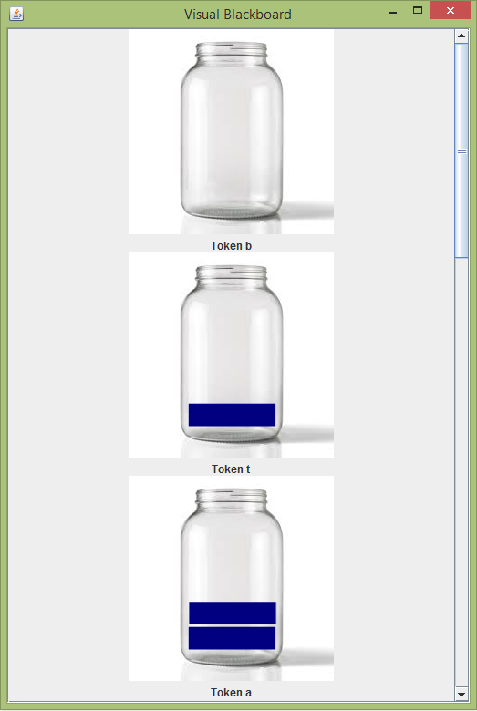
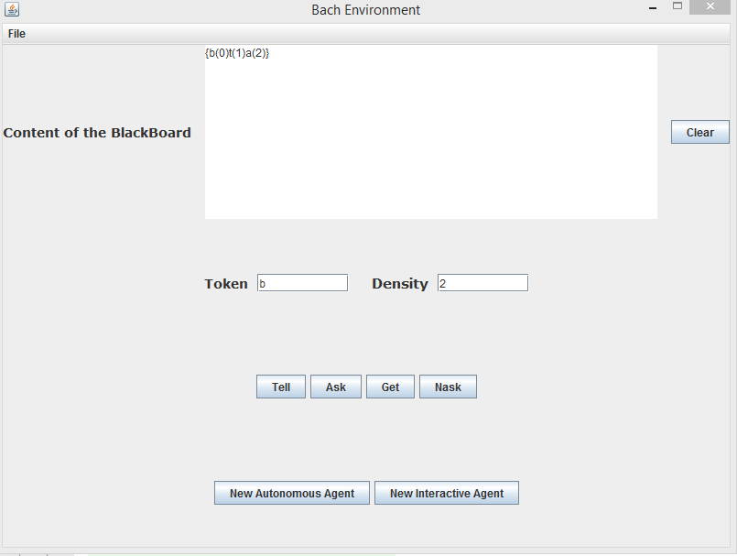
Visual Blackboard – Implementation

Slide 17
Merci

