Slide 1

Using Visual A.I to check commercial viability
Axel Scicluna
Institute of Information & Communication Technology
MCAST, Paola, Malta

Slide 2

Problem Definition
Can we use computer vision to help with decision making of choosing a business location?

Slide 3
Literature
Computer vision has been used in a lot of different ways over a lot of fields
Energy and Utility
Detects Defects in electric poles
Hospitality
Used to check if people are wearing masks
Healthcare
Breast cancer screenings

Slide 4
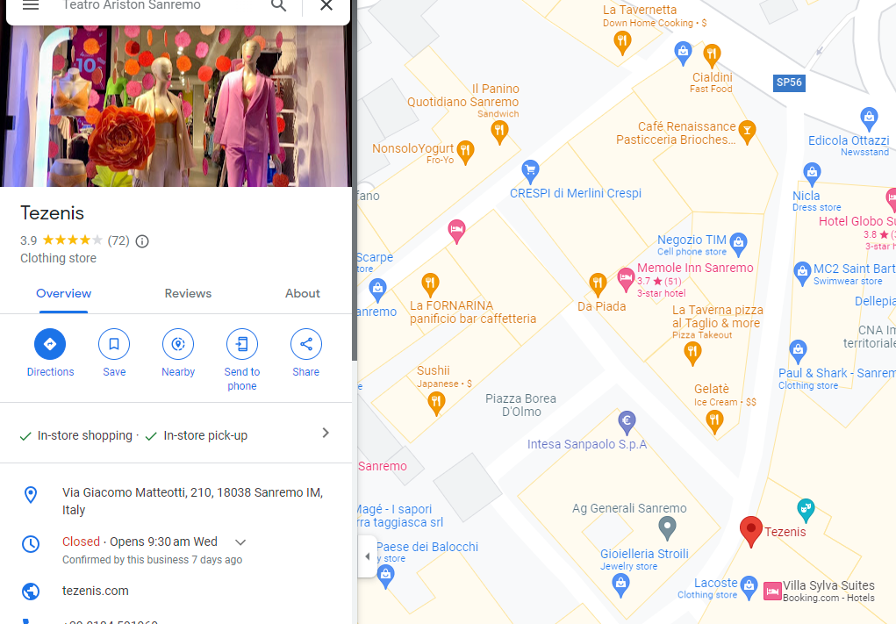
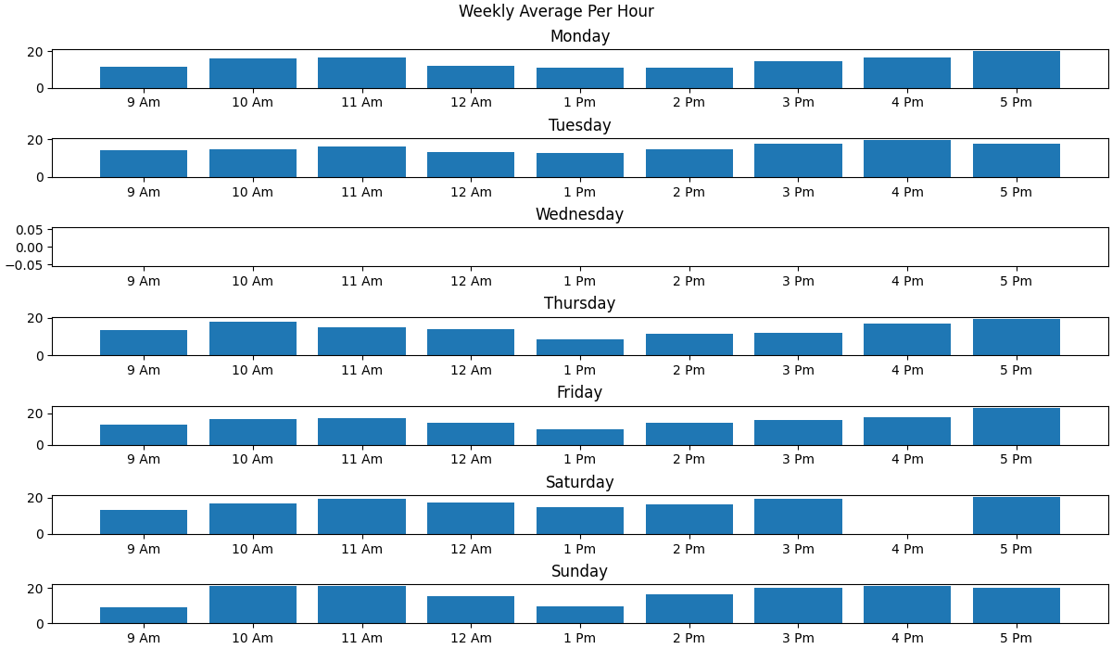
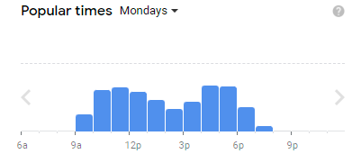
Literature
The data Collected over the 2 week period shows a trend in the crowd on the street, with supporting google visitation.

Slide 5
Methodology – Aim, Hypothesis, Questions
Hypothesis:
If someone knows how busy a street is, they can make a more informed decision
Question:
Is it feasible to use computer vision to evaluate store customer traffic?
Aim:
Allow people to have more accessible data to improve their success

Slide 6
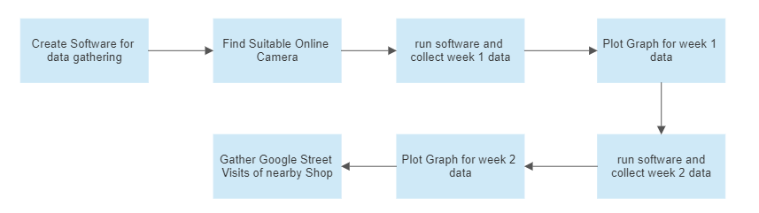
Methodology – Pipeline

Slide 7
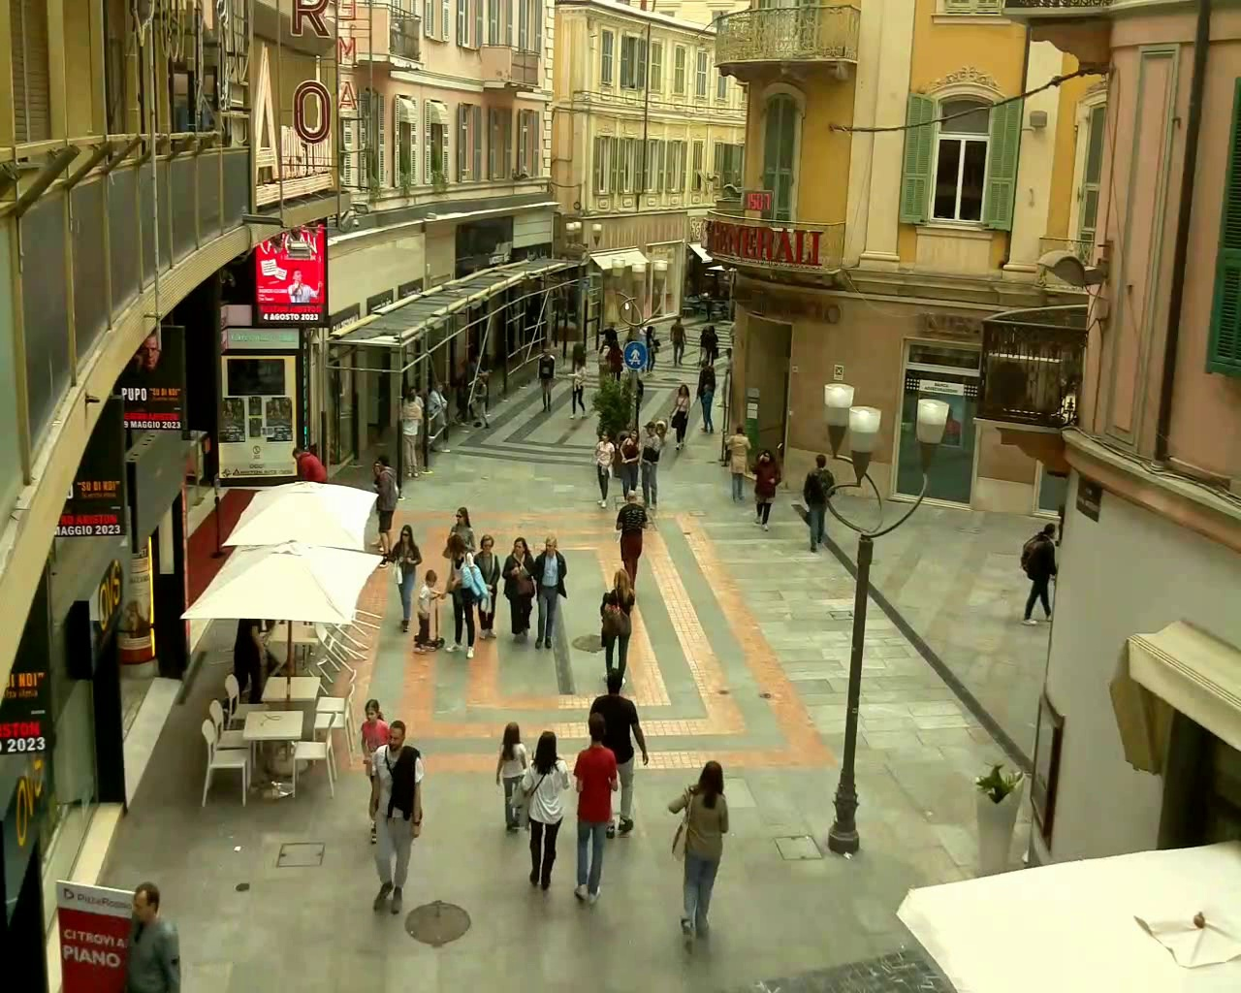
Methodology – Methods
I used an online live stream to capture data and then counted how many people there are using computer vision.

Slide 8
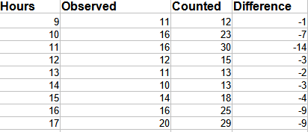
Data Evaluation
Overall it seems that the data collected is consistent and when you account for missed people its not by a large margin.
Observed are what the Computer Vision counted and Counted are what I manually counted

Slide 9
Prototype
Video Link:
https://www.youtube.com/watch?v=JMYnkEMs_ng&ab_channel=loj114

Slide 10
Evaluation / Argumentation
Program works however for more high accuracy a change in computer vision technology would be better for bigger crowds.
With current system one can still have an idea how many people would visit approximately at least

Slide 11
3rd party comparison
To compare my data I used google visit data since no other entity would gather such data.
It takes the average popularity of the location over a period of months to plot the popular times trough the week.

Slide 12
Pipeline evaluation
The pipeline worked pretty well for me it was a step by step progress, the hardest part is creating the program and trying to stay consistent in data gathering trough the 2 weeks of data

Slide 13

Research Question evaluation
There is no other feasible way to check crowd traffic apart from staying on location and physically counting.
With this method one can set up multiple recordings at the same time to check a whole block

Slide 14
Conclusions - Achievements
The data collected reflects what I believe to be true which is foot traffic is important to establishing a successful business, identifying a good street should be done before you decide on what location to buy to weed out any potential duds

Slide 15
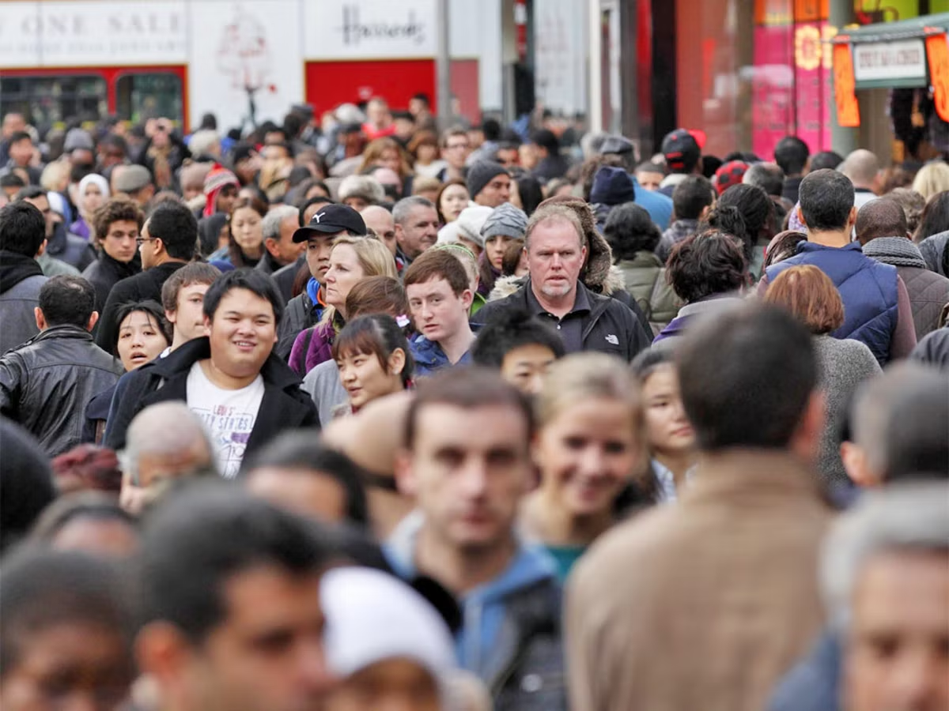
Conclusions - Recommendations
I would have researched a bit more on different Computer vision technologies as Object detection is not accurate on crowds of people

Slide 16
Conclusions - Limitations
The software I coded had some flaws in it which can be fixed with some more work. The gathering of data had to be started and stopped manually which can be inefficient when doing multiple streets at once.

Slide 17
Future Recommendations
Implement an automated scheduled start and stop to gather more accurate data
Use more streets and provide an overview of crowd statistics over each other
Identify heat maps where people tend to visit over the street

Slide 18
Thank you Axel Scicluna

