Slide 1

ScalaMeter
Performance regression testing framework
Aleksandar Prokopec, Josh Suereth

Slide 2
Goal
List(1 to 100000: _*).map(x => x * x)
26 ms

Slide 3
Goal
List(1 to 100000: _*).map(x => x * x)
26 ms
class List[+T]
extends Seq[T] {
// implementation 1
}

Slide 4

Goal
List(1 to 100000: _*).map(x => x * x)
26 ms
class List[+T]
extends Seq[T] {
// implementation 1
}

Slide 5
Goal
List(1 to 100000: _*).map(x => x * x)
49 ms
class List[+T]
extends Seq[T] {
// implementation 2
}

Slide 6
First example
def measure() {
val buffer = mutable.ArrayBuffer(0 until 2000000: _*)
val start = System.currentTimeMillis()
var sum = 0
buffer.foreach(sum += _)
val end = System.currentTimeMillis()
println(end - start)
}

Slide 7
First example
def measure() {
val buffer = mutable.ArrayBuffer(0 until 2000000: _*)
val start = System.currentTimeMillis()
var sum = 0
buffer.foreach(sum += _)
val end = System.currentTimeMillis()
println(end - start)
}

Slide 8
First example
def measure() {
val buffer = mutable.ArrayBuffer(0 until 2000000: _*)
val start = System.currentTimeMillis()
var sum = 0
buffer.foreach(sum += _)
val end = System.currentTimeMillis()
println(end - start)
}

Slide 9
First example
def measure() {
val buffer = mutable.ArrayBuffer(0 until 2000000: _*)
val start = System.currentTimeMillis()
var sum = 0
buffer.foreach(sum += _)
val end = System.currentTimeMillis()
println(end - start)
}

Slide 10
First example
def measure() {
val buffer = mutable.ArrayBuffer(0 until 2000000: _*)
val start = System.currentTimeMillis()
var sum = 0
buffer.foreach(sum += _)
val end = System.currentTimeMillis()
println(end - start)
}
measure()

Slide 11
First example
def measure() {
val buffer = mutable.ArrayBuffer(0 until 2000000: _*)
val start = System.currentTimeMillis()
var sum = 0
buffer.foreach(sum += _)
val end = System.currentTimeMillis()
println(end - start)
}
measure()
26 ms

Slide 12
The warmup problem
def measure() {
val buffer = mutable.ArrayBuffer(0 until 2000000: _*)
val start = System.currentTimeMillis()
var sum = 0
buffer.foreach(sum += _)
val end = System.currentTimeMillis()
println(end - start)
}
measure()
measure()
26 ms, 11 ms

Slide 13
The warmup problem
def measure() {
val buffer = mutable.ArrayBuffer(0 until 2000000: _*)
val start = System.currentTimeMillis()
var sum = 0
buffer.foreach(sum += _)
val end = System.currentTimeMillis()
println(end - start)
}
measure()
measure()
Why?
Mainly:
- JIT compilation
- dynamic optimization
26 ms, 11 ms

Slide 14
The warmup problem
def measure() {
val buffer = mutable.ArrayBuffer(0 until 2000000: _*)
val start = System.currentTimeMillis()
var sum = 0
buffer.foreach(sum += _)
val end = System.currentTimeMillis()
println(end - start)
}
26 ms, 11 ms
45 ms, 10 ms

Slide 15
The warmup problem
def measure2() {
val buffer = mutable.ArrayBuffer(0 until 4000000: _*)
val start = System.currentTimeMillis()
buffer.map(_ + 1)
val end = System.currentTimeMillis()
println(end - start)
}

Slide 16
The warmup problem
def measure2() {
val buffer = mutable.ArrayBuffer(0 until 4000000: _*)
val start = System.currentTimeMillis()
buffer.map(_ + 1)
val end = System.currentTimeMillis()
println(end - start)
}
241, 238, 235, 236, 234

Slide 17
The warmup problem
def measure2() {
val buffer = mutable.ArrayBuffer(0 until 4000000: _*)
val start = System.currentTimeMillis()
buffer.map(_ + 1)
val end = System.currentTimeMillis()
println(end - start)
}
241, 238, 235, 236, 234, 429

Slide 18
The warmup problem
def measure2() {
val buffer = mutable.ArrayBuffer(0 until 4000000: _*)
val start = System.currentTimeMillis()
buffer.map(_ + 1)
val end = System.currentTimeMillis()
println(end - start)
}
241, 238, 235, 236, 234, 429, 209

Slide 19
The warmup problem
def measure2() {
val buffer = mutable.ArrayBuffer(0 until 4000000: _*)
val start = System.currentTimeMillis()
buffer.map(_ + 1)
val end = System.currentTimeMillis()
println(end - start)
}
241, 238, 235, 236, 234, 429, 209, 194, 195, 195

Slide 20
The warmup problem
Bottomline: benchmark has to be repeated until the running time becomes “stable”.
The number of repetitions is not known in advance.
241, 238, 235, 236, 234, 429, 209, 194, 195, 195

Slide 21
Warming up the JVM
Can this be automated?
Idea: measure variance of the running times.
When it becomes sufficiently small, the test has stabilized.
241, 238, 235, 236, 234, 429, 209, 194, 195, 195,
194, 194, 193, 194, 196, 195, 195

Slide 22
The interference problem
val buffer = ArrayBuffer(0 until 900000: _*)
buffer.map(_ + 1)
val buffer = ListBuffer(0 until 900000: _*)
buffer.map(_ + 1)

Slide 23
The interference problem
val buffer = ArrayBuffer(0 until 900000: _*)
buffer.map(_ + 1)
val buffer = ListBuffer(0 until 900000: _*)
buffer.map(_ + 1)
Lets measure the first map 3 times with 7 repetitions:
61, 54, 54, 54, 55, 55, 56
186, 54, 54, 54, 55, 54, 53
54, 54, 53, 53, 53, 54, 51

Slide 24
The interference problem
val buffer = ArrayBuffer(0 until 900000: _*)
buffer.map(_ + 1)
val buffer = ListBuffer(0 until 900000: _*)
buffer.map(_ + 1)
Now, lets measure the list buffer map in between:
61, 54, 54, 54, 55, 55, 56
186, 54, 54, 54, 55, 54, 53
54, 54, 53, 53, 53, 54, 51
59, 54, 54, 54, 54, 54, 54
44, 36, 36, 36, 35, 36, 36
45, 45, 45, 45, 44, 46, 45
18, 17, 18, 18, 17, 292, 16
45, 45, 44, 44, 45, 45, 44

Slide 25
The interference problem
val buffer = ArrayBuffer(0 until 900000: _*)
buffer.map(_ + 1)
val buffer = ListBuffer(0 until 900000: _*)
buffer.map(_ + 1)
Now, lets measure the list buffer map in between:
61, 54, 54, 54, 55, 55, 56
186, 54, 54, 54, 55, 54, 53
54, 54, 53, 53, 53, 54, 51
59, 54, 54, 54, 54, 54, 54
44, 36, 36, 36, 35, 36, 36
45, 45, 45, 45, 44, 46, 45
18, 17, 18, 18, 17, 292, 16
45, 45, 44, 44, 45, 45, 44

Slide 26
Using separate JVM
Bottomline: always run the tests in a new JVM.

Slide 27
Using separate JVM
Bottomline: always run the tests in a new JVM.
This may not reflect a real-world scenario, but it gives a good idea of how different several alternatives are.

Slide 28
Using separate JVM
Bottomline: always run the tests in a new JVM.
It results in a reproducible, more stable measurement.

Slide 29
The List.map example
val list = (0 until 2500000).toList
list.map(_ % 2 == 0)

Slide 30
The List.map example
val list = (0 until 2500000).toList
list.map(_ % 2 == 0)
37, 38, 37, 1175, 38, 37, 37, 37, 37, …, 38, 37, 37, 37, 37, 465, 35, 35, …

Slide 31
The garbage collection problem
val list = (0 until 2500000).toList
list.map(_ % 2 == 0)
This benchmark triggers GC cycles!
37, 38, 37, 1175, 38, 37, 37, 37, 37, …, 38, 37, 37, 37, 37, 465, 35, 35, …

Slide 32
The garbage collection problem
val list = (0 until 2500000).toList
list.map(_ % 2 == 0)
This benchmark triggers GC cycles!
37, 38, 37, 1175, 38, 37, 37, 37, 37, …, 38, 37, 37, 37, 37, 465, 35, 35, … -> mean: 47 ms

Slide 33
The garbage collection problem
val list = (0 until 2500000).toList
list.map(_ % 2 == 0)
This benchmark triggers GC cycles!
37, 38, 37, 1175, 38, 37, 37, 37, 37, …, 38, 37, 37, 37, 37, 465, 35, 35, … -> mean: 47 ms
37, 37, 37, 647, 37, 36, 38, 37, 36, …, 36, 37, 36, 37, 36, 37, 534, 36, 33, … -> mean: 39 ms

Slide 34
The garbage collection problem
val list = (0 until 2500000).toList
list.map(_ % 2 == 0)
This benchmark triggers GC cycles!
37, 38, 37, 1175, 38, 37, 37, 37, 37, …, 38, 37, 37, 37, 37, 465, 35, 35, … -> mean: 47 ms
37, 37, 37, 647, 37, 36, 38, 37, 36, …, 36, 37, 36, 37, 36, 37, 534, 36, 33, … -> mean: 39 ms

Slide 35
The garbage collection problem
val list = (0 until 2500000).toList
list.map(_ % 2 == 0)
Solutions:
repeat A LOT of times –an accurate mean, but takes A LONG time

Slide 36
The garbage collection problem
val list = (0 until 2500000).toList
list.map(_ % 2 == 0)
Solutions:
repeat A LOT of times –an accurate mean, but takes A LONG time
ignore the measurements with GC – gives a reproducible value, and less measurements

Slide 37
The garbage collection problem
val list = (0 until 2500000).toList
list.map(_ % 2 == 0)
Solutions:
repeat A LOT of times –an accurate mean, but takes A LONG time
ignore the measurements with GC – gives a reproducible value, and less measurements
  how to do this?

Slide 38
The garbage collection problem
val list = (0 until 2500000).toList
list.map(_ % 2 == 0)
manually - verbose:gc

Slide 39
Automatic GC detection
val list = (0 until 2500000).toList
list.map(_ % 2 == 0)
manually - verbose:gc
automatically using callbacks in JDK7
37, 37, 37, 647, 37, 36, 38, 37, 36, …, 36, 37, 36, 37, 36, 37, 534, 36, 33, …

Slide 40
Automatic GC detection
val list = (0 until 2500000).toList
list.map(_ % 2 == 0)
manually - verbose:gc
automatically using callbacks in JDK7
raises a GC event
37, 37, 37, 647, 37, 36, 38, 37, 36, …, 36, 37, 36, 37, 36, 37, 534, 36, 33, …

Slide 41
The runtime problem
there are other runtime events beside GC – e.g. JIT compilation, dynamic optimization, etc.
these take time, but cannot be determined accurately

Slide 42
The runtime problem
there are other runtime events beside GC – e.g. JIT compilation, dynamic optimization, etc.
these take time, but cannot be determined accurately
heap state also influences memory allocation patterns and performance

Slide 43
The runtime problem
there are other runtime events beside GC – e.g. JIT compilation, dynamic optimization, etc.
these take time, but cannot be determined accurately
heap state also influences memory allocation patterns and performance
val list = (0 until 4000000).toList
list.groupBy(_ % 10)
(allocation intensive)

Slide 44
The runtime problem
there are other runtime events beside GC – e.g. JIT compilation, dynamic optimization, etc.
these take time, but cannot be determined accurately
heap state also influences memory allocation patterns and performance
val list = (0 until 4000000).toList
list.groupBy(_ % 10)
120, 121, 122, 118, 123, 794, 109, 111, 115, 113, 110

Slide 45
The runtime problem
there are other runtime events beside GC – e.g. JIT compilation, dynamic optimization, etc.
these take time, but cannot be determined accurately
heap state also influences memory allocation patterns and performance
val list = (0 until 4000000).toList
list.groupBy(_ % 10)
affects the mean – 116 ms vs 178 ms
120, 121, 122, 118, 123, 794, 109, 111, 115, 113, 110

Slide 46
Outlier elimination
120, 121, 122, 118, 123, 794, 109, 111, 115, 113, 110

Slide 47
Outlier elimination
120, 121, 122, 118, 123, 794, 109, 111, 115, 113, 110
sort
109, 110, 111, 113, 115, 118, 120, 121, 122, 123, 794

Slide 48
Outlier elimination
120, 121, 122, 118, 123, 794, 109, 111, 115, 113, 110
sort
109, 110, 111, 113, 115, 118, 120, 121, 122, 123, 794
inspect tail and its variance contribution
109, 110, 111, 113, 115, 118, 120, 121, 122, 123

Slide 49
Outlier elimination
120, 121, 122, 118, 123, 794, 109, 111, 115, 113, 110
sort
109, 110, 111, 113, 115, 118, 120, 121, 122, 123, 794
inspect tail and its variance contribution
109, 110, 111, 113, 115, 118, 120, 121, 122, 123
redo the measurement
109, 110, 111, 113, 115, 118, 120, 121, 122, 123, 124

Slide 50

Doing all this manually

Slide 51
ScalaMeter
Does all this analysis automatically, highly configurable.
Plus, it detects performance regressions.
And generates reports.

Slide 52
ScalaMeter example
object ListTest extends PerformanceTest.Microbenchmark {
A range of predefined benchmark types

Slide 53
ScalaMeter example
object ListTest extends PerformanceTest.Microbenchmark {
val sizes = Gen.range("size”)(500000, 1000000, 100000)
Generators provide input data for tests

Slide 54
ScalaMeter example
object ListTest extends PerformanceTest.Microbenchmark {
val sizes = Gen.range("size”)(500000, 1000000, 100000)
val lists = for (sz <- sizes) yield (0 until sz).toList
Generators can be composed a la ScalaCheck

Slide 55
ScalaMeter example
object ListTest extends PerformanceTest.Microbenchmark {
val sizes = Gen.range("size”)(500000, 1000000, 100000)
val lists = for (sz <- sizes) yield (0 until sz).toList
using(lists) in { xs =>
xs.groupBy(_ % 10)
}
}
Concise syntax to specify and group tests

Slide 56
ScalaMeter example
object ListTest extends PerformanceTest.Microbenchmark {
val sizes = Gen.range("size”)(500000, 1000000, 100000)
val lists = for (sz <- sizes) yield (0 until sz).toList
measure method “groupBy” in {
using(lists) in { xs =>
xs.groupBy(_ % 10)
}
using(ranges) in { xs =>
xs.groupBy(_ % 10)
}
}
}

Slide 57
Automatic regression testing
using(lists) in { xs =>
var sum = 0
xs.foreach(x => sum += x)
}

Slide 58
Automatic regression testing
using(lists) in { xs =>
var sum = 0
xs.foreach(x => sum += x)
}
[info] Test group: foreach
[info] - foreach.Test-0 measurements:
[info] - at size -> 2000000, 1 alternatives: passed
[info] (ci = <7.28, 8.22>, significance = 1.0E-10)

Slide 59
Automatic regression testing
using(lists) in { xs =>
var sum = 0
xs.foreach(x => sum += math.sqrt(x))
}

Slide 60
Automatic regression testing
using(lists) in { xs =>
var sum = 0
xs.foreach(x => sum += math.sqrt(x))
}
[info] Test group: foreach
[info] - foreach.Test-0 measurements:
[info] - at size -> 2000000, 2 alternatives: failed
[info] (ci = <14.57, 15.38>, significance = 1.0E-10)
[error] Failed confidence interval test: <-7.85, -6.60>
[error] Previous (mean = 7.75, stdev = 0.44, ci = <7.28, 8.22>) [error] Latest (mean = 14.97, stdev = 0.38, ci = <14.57, 15.38>)

Slide 61
Automatic regression testing
configurable: ANOVA (analysis of variance) or confidence interval testing
can apply noise to make unstable tests more solid
various policies on keeping the result history

Slide 62
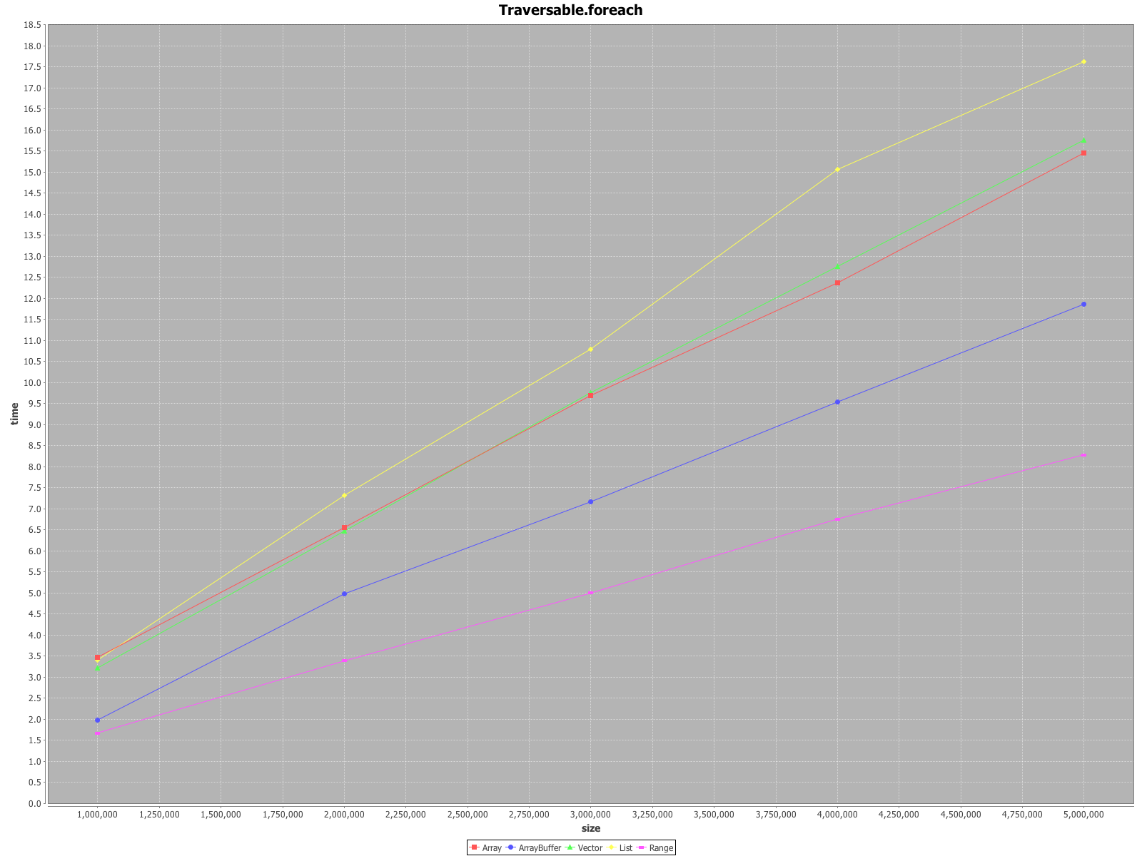
Report generation

Slide 63
Tutorials online!
http://axel22.github.com/scalameter
Questions?

