Slide 1
Lab 1: Touring Santa Barbara Landscape using ArcGIS
Ben Best
January 7, 2015

Slide 2
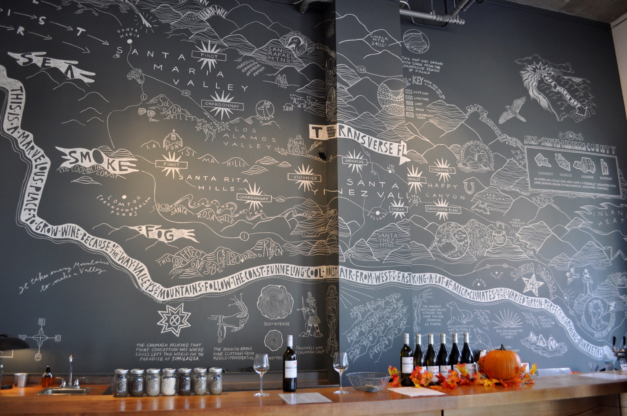

Slide 3

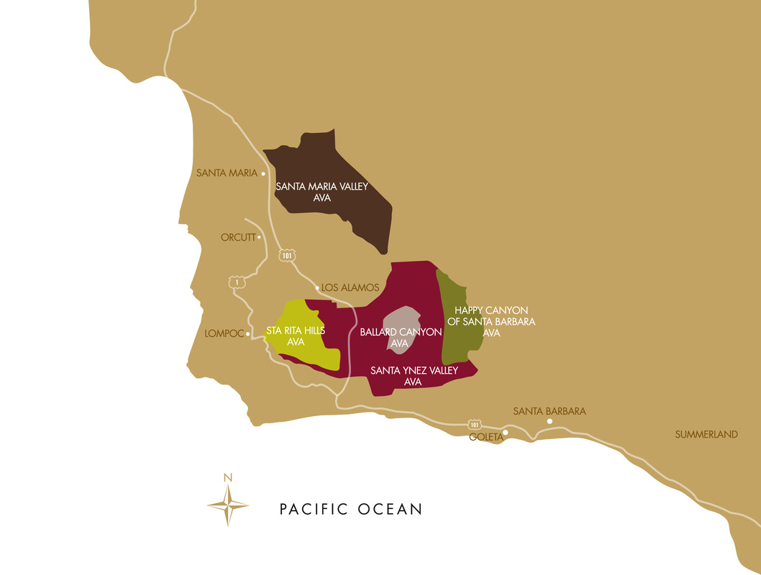
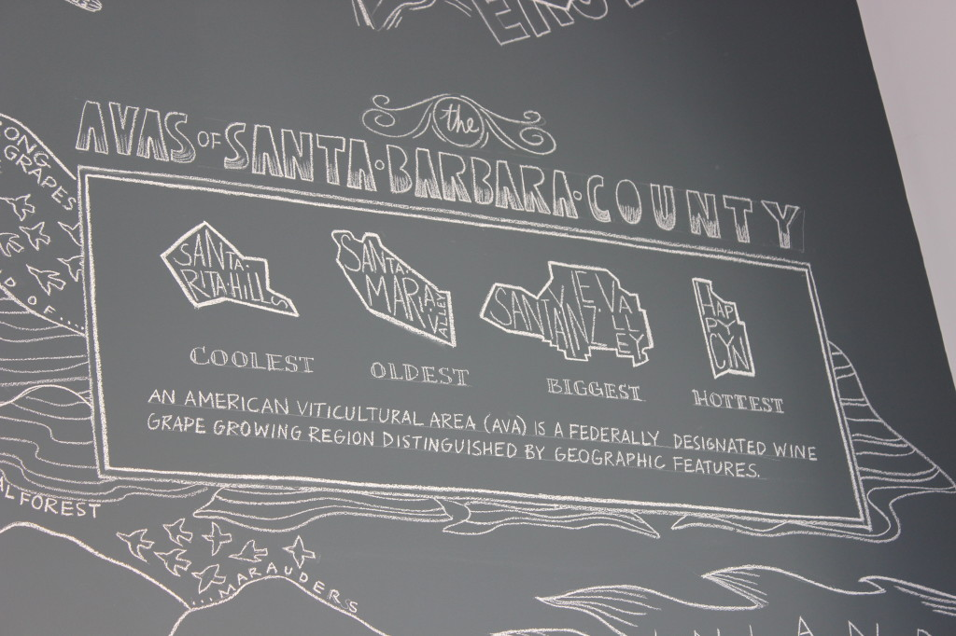
Notes:
From http://www.sbcountywines.com/uploads/2/2/1/6/22166752/santa_barbara_wine_country_touring_guide_2014.pdf
Santa Maria Valley
The often foggy and windswept Santa Maria Valley is the northern most appellation in Santa Barbara County. The region’s first officially approved
American Viticultural Area (AVA) enjoys extremely complex soil conditions and diverse microclimates. Chardonnay and Pinot Noir are two varietals which especially benefit from the ocean’s influence, and are the flagship wines of this appellation.
Santa Ynez Valley
Santa Ynez Valley is a long, east-west corridor with very cool temperatures on the coast that become progressively warmer inland. Consequently, several varietals do well from Pinot Noir in the west to Cabernet Sauvignon and Merlot in the east. Several Rhône and Italian grape varietals have also gained acclaim in this versatile Santa Barbara County AVA. The largest concentration of wineries is in the Santa Ynez Valley appellation. From one-person labors of love to multi-thousand case operations, each has a dedication to producing wine that truly reflects the high quality and broad diversity of local grapes.
Sta. Rita Hills
Sta. Rita Hills is an AVA within the Santa Ynez Valley AVA. Located on the far western end of the long corridor, the marine influence is directly off the ocean providing an extremely cool climate. It is an optimal place to grow its hallmark Pinot Noir and Chardonnay.
Happy Canyon
Happy Canyon is a relatively new winegrowing region recently granted its own AVA. Located in the far eastern edge of the Santa Ynez Valley AVA, it delves into the San Rafael Mountains just northwest of Lake Cachuma. Its inland position means a significantly warmer climate. This region is best suited for growing Bordeaux varieties Cabernet Franc, Cabernet Sauvignon, Merlot, Petit Verdot and Sauvignon Blanc.
Ballard Canyon
Ballard Canyon became the fifth official AVA of Santa Barbara County
on October 30th 2013. The 7,800 acre viticultural area’s soils and climate
is known for producing distinctive and unique wines, a preponderance of
which are Rhône varietals.

Slide 4
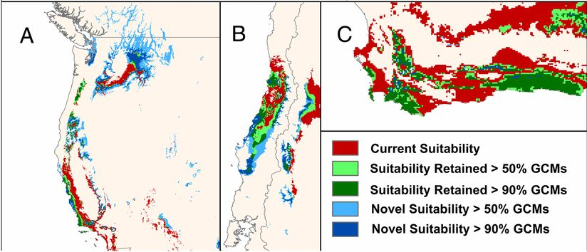
Hannah et al (2013) Climate Change, Wine, and Conservation. PNAS

Slide 5


