Slide 1




COVID-19 Trials@Charité
Charité COVID-19
Trial Platform
Pa-COVID-19 CoronaBoXX Charité COVID Master
U N I V E R S I T Ä T S M E D I Z I N B E R L I N

Slide 2

Charité COVID-19 Trial Platform
Pa-COVID-19 – Charité sampling trial (surveillance, minimal invasive diagnostics, deep phenotyping)
CoronaBoXX – Charité COVID-19 patient data box and reporting app (PROM)
Charité COVID Master – Charité COVID-19 WHO intervention prototype

Slide 3
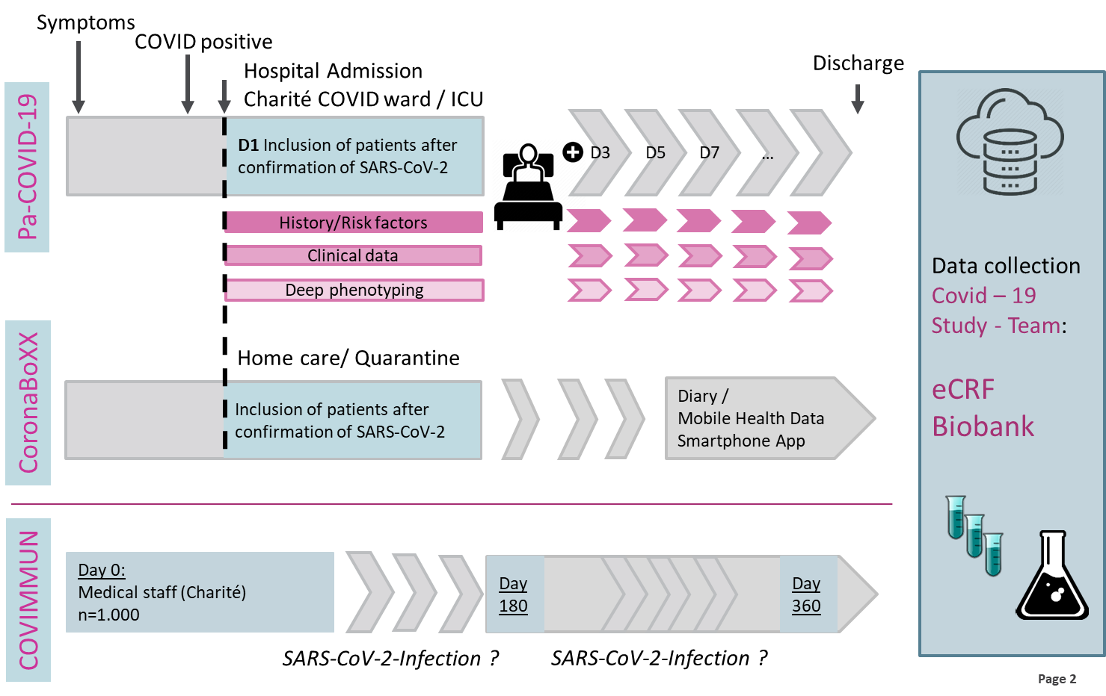
Overview Charité COVID-19 Trials

Slide 4
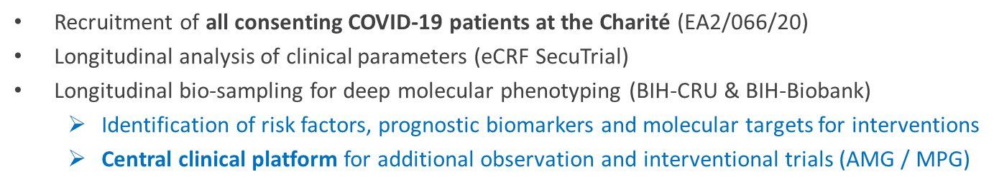
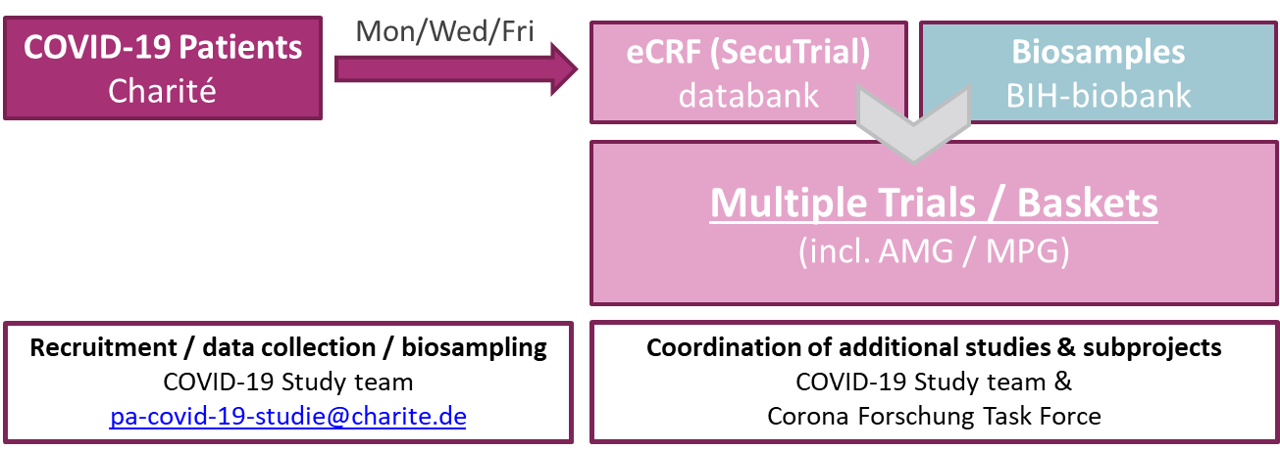
Pa-COVID-19

Slide 5
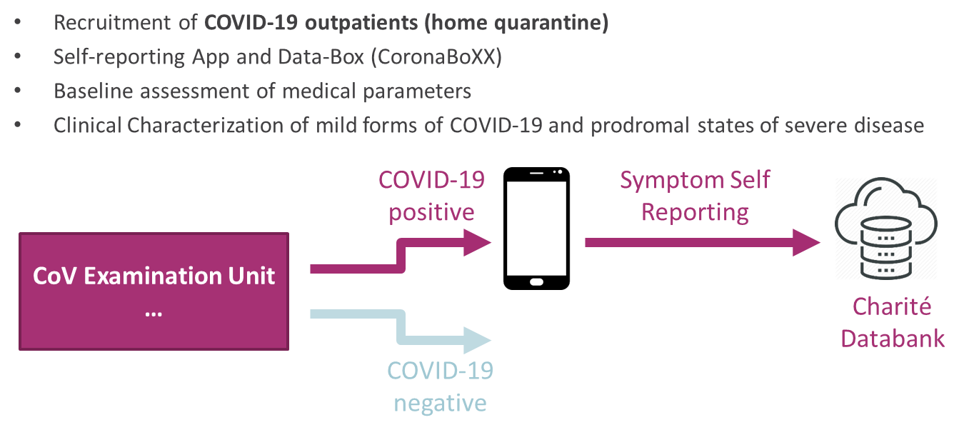
CoronaBoXX

Slide 6
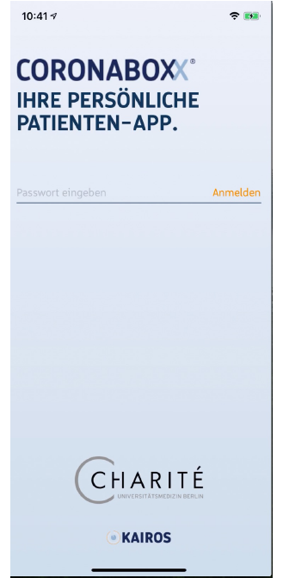
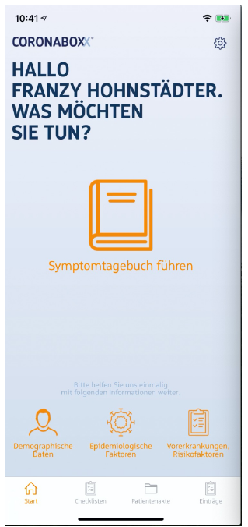
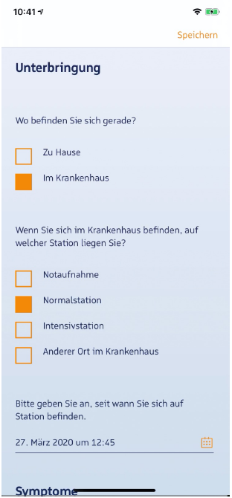
CoronaBoXX

Slide 7








Master Trial Concept
Creation of an adaptive Master Trial with multi-arm design as a way to develop different therapy strategies for several subpopulations.

Slide 8


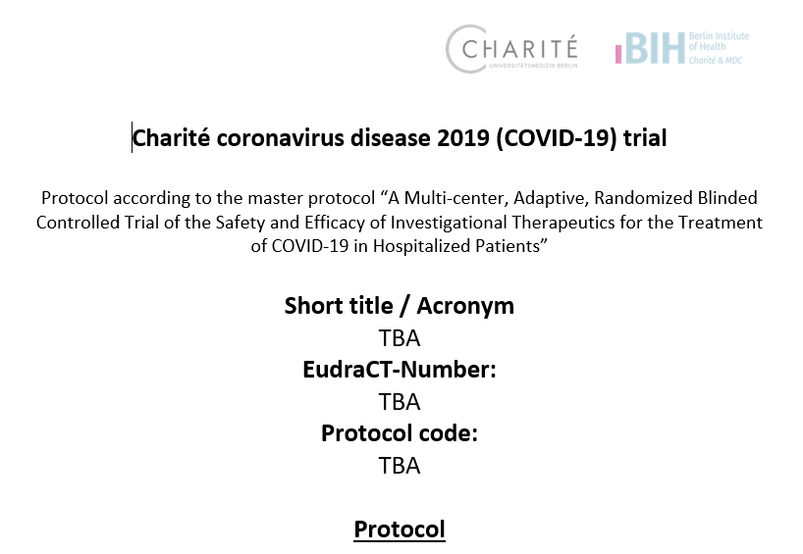
COVID-19 Master Trial Protocol

