Slide 1
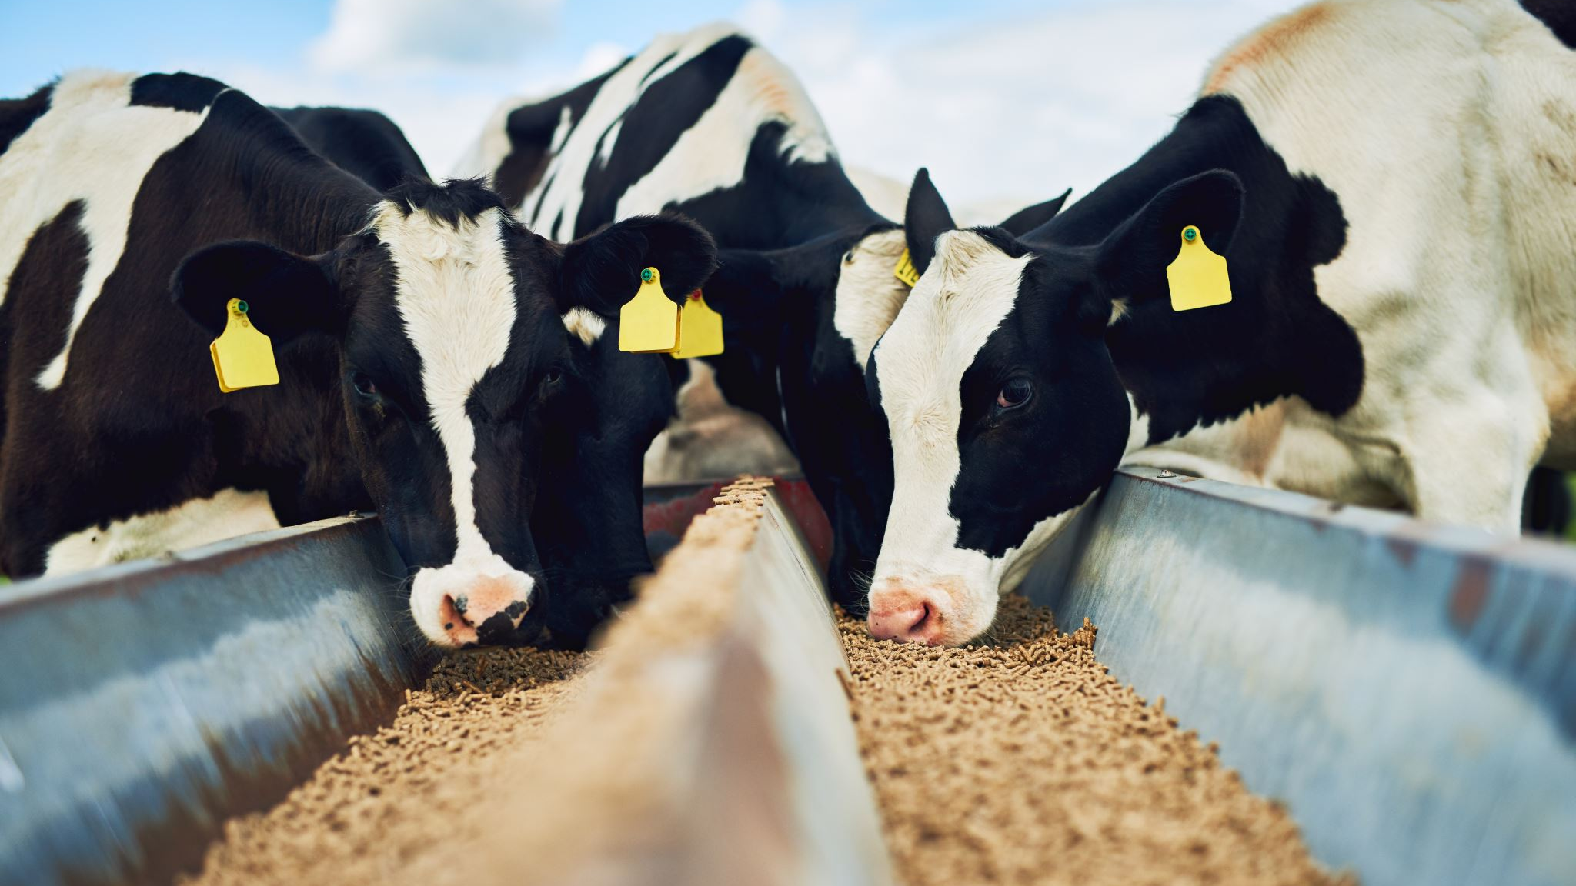
ON THE IMPLENTATION OF A DATA PIPELINE FOR UNITED STATES NATIONAL CATTLE AUCTION DATA
Axel Eschholz

Slide 2
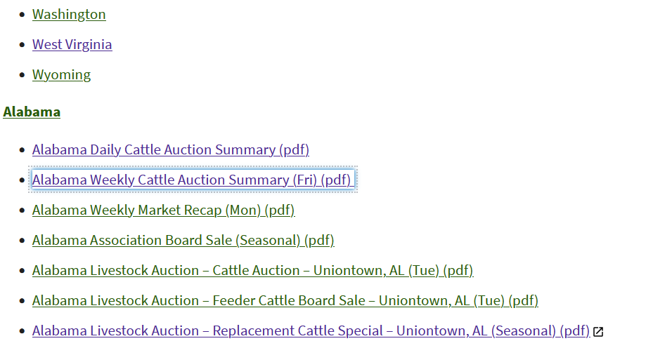
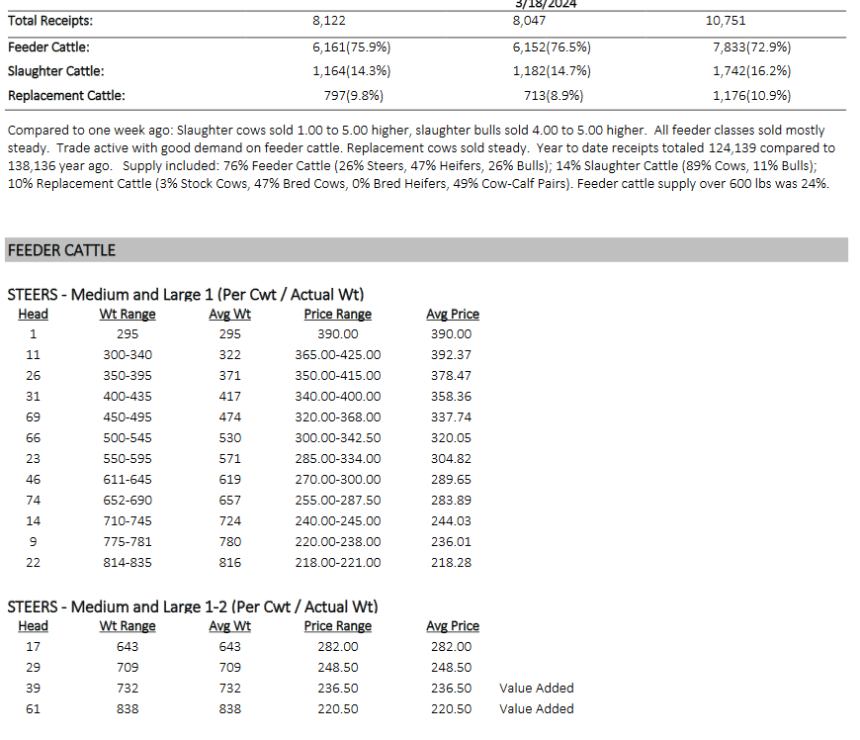
Problem
Stakeholder Proposal
Source Investigation
Scope

Slide 3
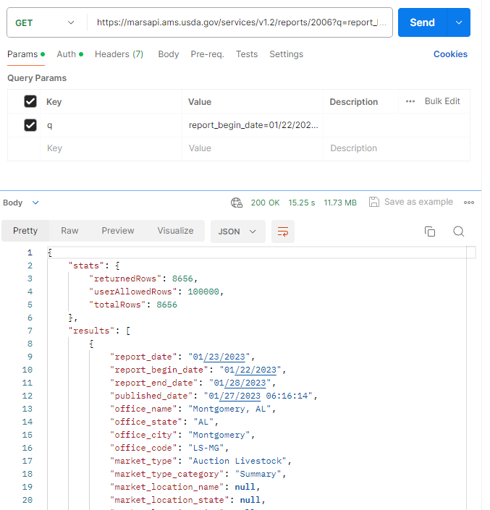
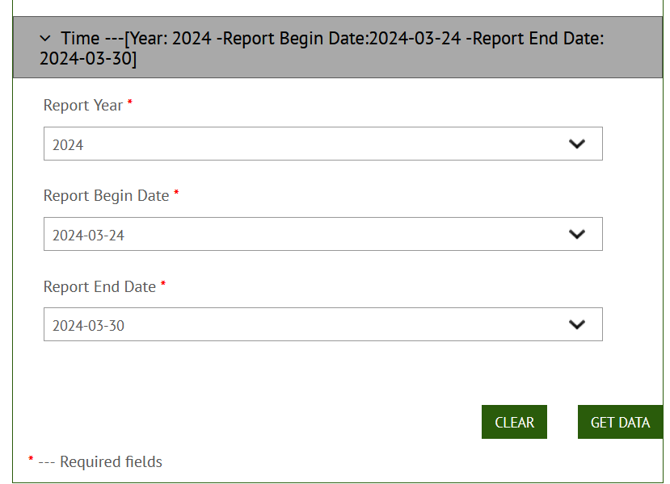
Investigation
API rabbit hole
Data schema (MDR report)
Retrieval

Slide 4
Design
ETLT Model
Storage Design

Slide 5
Implementation
Pipeline actions:
Extract
Review
Update
Analyze
Notes:
This slide will take a long time, consider splitting into multiple

Slide 6
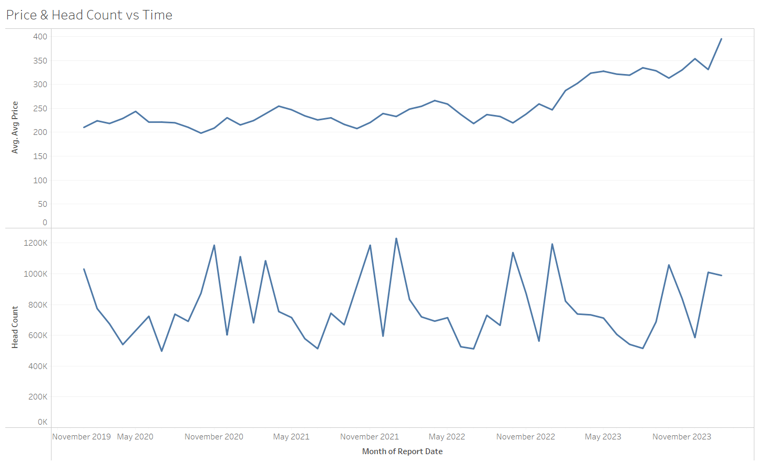
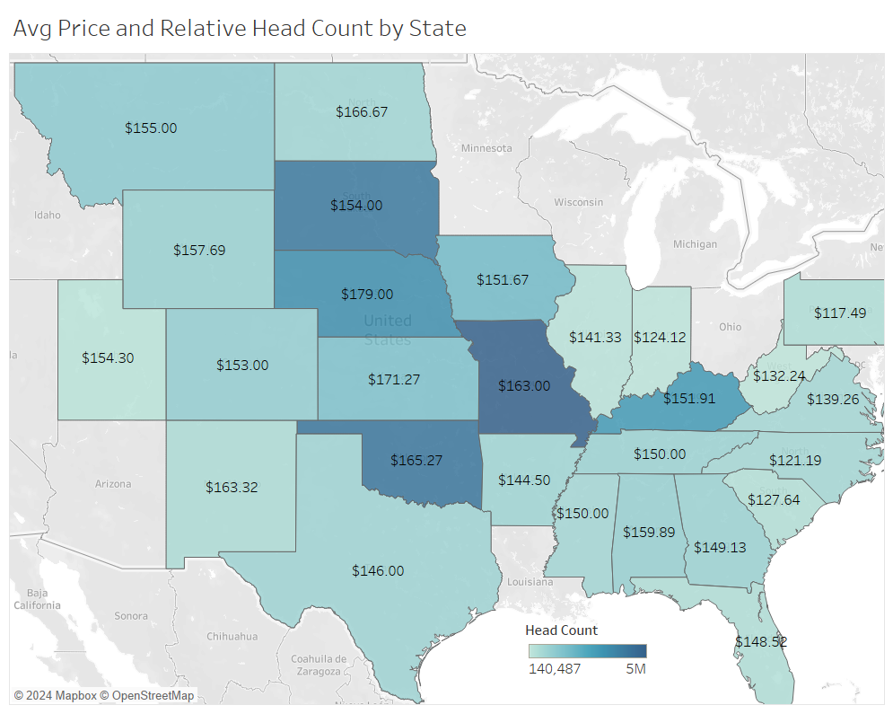
Evaluation
Data Results
Visualization using tableau
Insights
Notes:
Graphs should have their own slides

Slide 7
Reflection
External stakeholders make things tricky
Data analysis is 99% planning
Expert knowledge is super necessary
Notes:
This slide will take a long time, consider splitting into multiple

