Slide 2
Enhancing Acoustic Echogram Analysis with Deep Learning
A Game-Changer for Marine Surveying

Slide 3
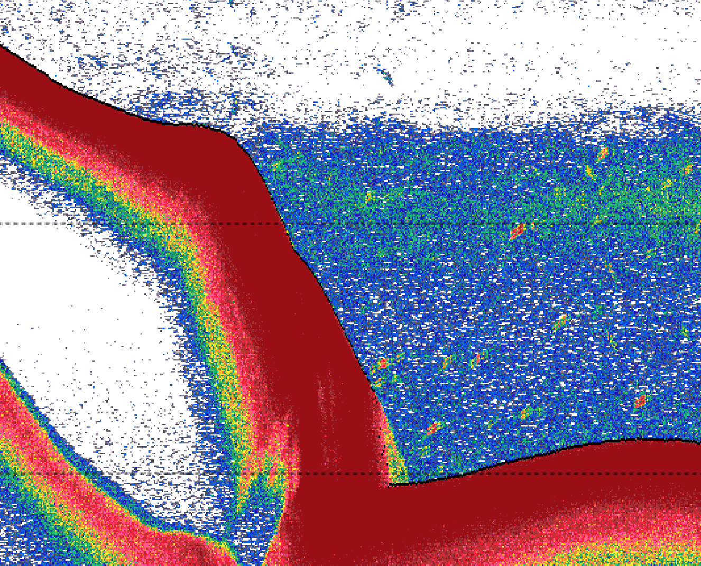
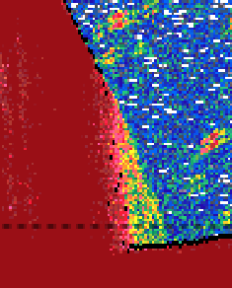
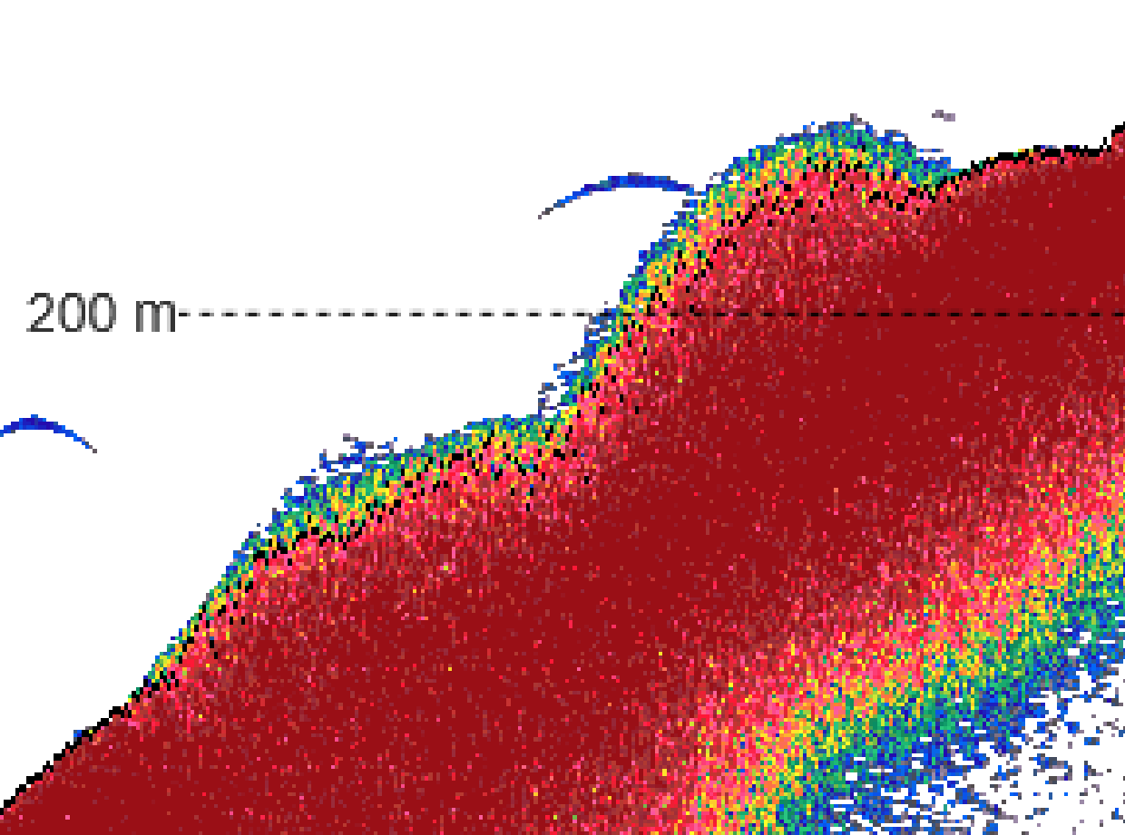
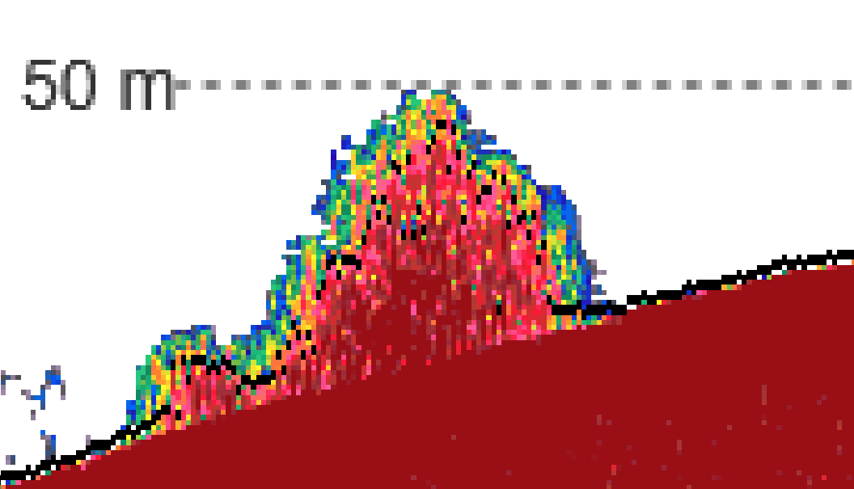
Limitations of Current Algorithmic Methods
Limited Historical Context
Only processes last 3 pings
Historically constrained by computational limits
(no longer an issue with modern computers)
Key Failure Modes
Vulnerable to second-backscatter echoes
Can "get stuck" on false bottoms
Produces noisy results in challenging conditions
While effective for ~99% of cases,
critical failures do happen
Examples of failure:
Black line represents algorithmic bottom.

Slide 4
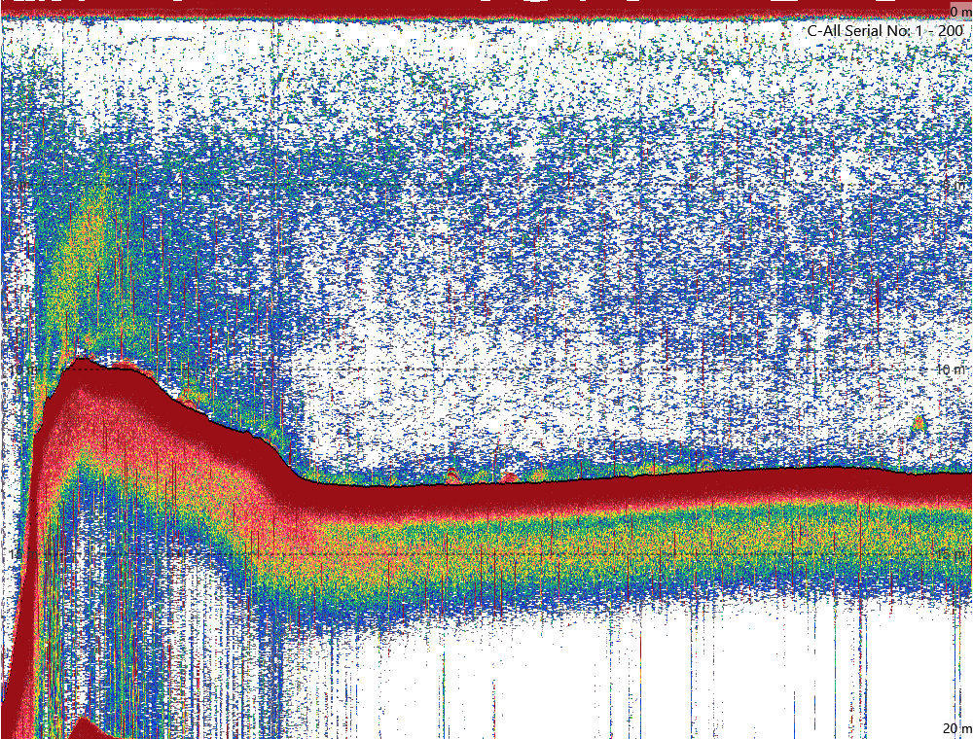
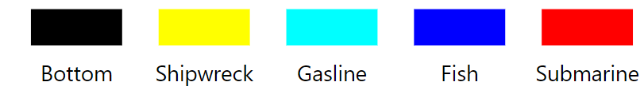
The Deep Learning Advantage (U-Net)
Enhanced Bottom Detection
U-Net can leverage broader spatial context
More robust against second-backscatter and noise
Acts as a reliable fallback when traditional methods fail
Extensible Architecture
Same U-Net framework easily extends to multiple classes
Classifies each pixel in the image
Potential applications:
Sediment classification
Fish school detection
Infrastructure mapping (gas lines, pipelines)
Shipwreck identification
Submarines or torpedo detection
Single unified model for multiple detection tasks
Example result

Slide 5
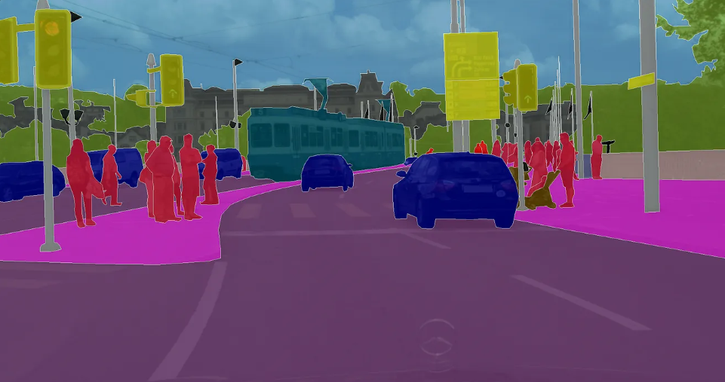
Classical U-Net usage analogy
Image source: Mastering the Art of Image Segmentation: A Comprehensive Guide to Image Segmentation Techniques | by Marcus angella | Medium
Image is segmented into different classes (car, human, road, tram, traffic light, etc…)

