Slide 1

Welcome to My Portfolio
Axel Joshua Bagaskara

Slide 2



Skills
Data Processing & Visualization
Data Conversion
Using Microsoft Excel & Google Sheet
Data Cleaning
Pivot Table & Data Summarization
Dashboard & Data Visualization
Convert data (PDF/CSV) to formats Excel
Data Extraction & Reformatting

Slide 3

Case Project
This dataset is based on individual transaction from a supermarket in Myanmar and includes data such as gender, invoice id, branch, city, customer type, product line, unit price, quantity, tax 5%.
Scope of Problem:
Identify performance across product categories.
Analyze the effectiveness of the customer loyalty program (Members vs Non-Members).
Comparing transaction productivity in each branch.
Click the data source

Slide 4
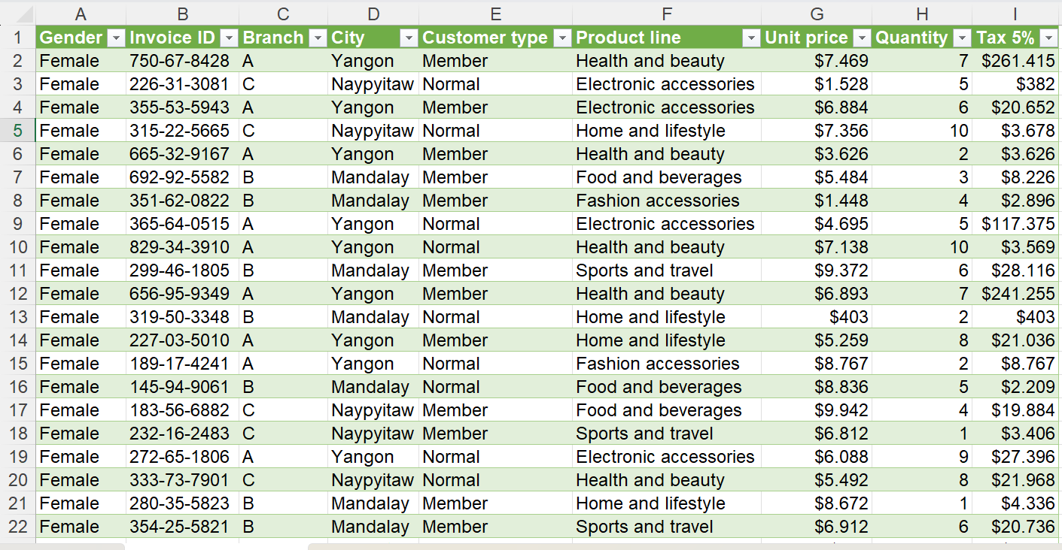
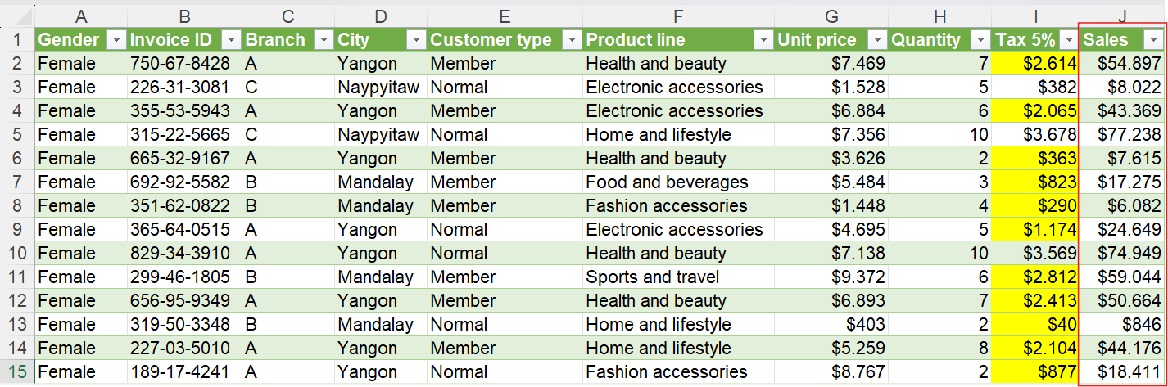

Data Wrangling
Before
After
Data Wrangling Steps:
Fix typo numbers in the “Tax 5%” column with entering the formula
Modify the number format of the “Unit Price” & “Tax 5%” fields to currency format
Create a “Sales” column to find the total sales

Slide 5
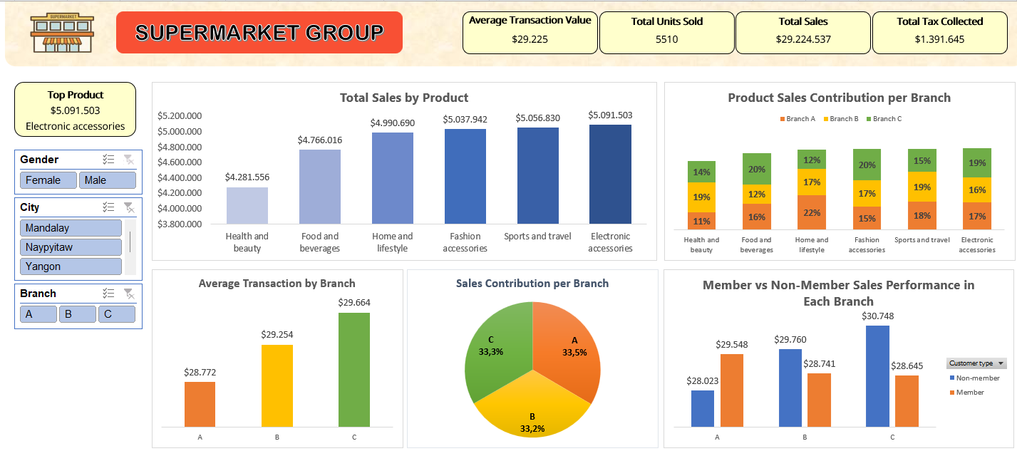
Dashboard Overview
Supermarket Dashboard

Slide 6
Sales Insights Dashboard
Top sales
Electronic Accessories has impact for sales, indicating strong demand (Top Sales).
The average transaction value across Branches does not differ significantly.
Most product categories show consistent sales contribution across branches, except for Health and Beauty, which underperforms relative to others.
All Branches have almost the same sales contribution, indicating strong financial health.
Non-Member have higher sales than Members in most branches.

Slide 7

Recommendation
Increase sales volume and sales contribution of Health and Beauty product with bundle deals.
Branches A and B can increase average transaction value by implementing a segment-based upselling and bundling strategy, and adopt the best strategy from Branch C.
Offer discounts to first-time members to increase customer loyalty and average transaction value.

Slide 8



Let’s Work Together
Axel Joshua
axeljoshua58@gmail.com
Pontianak, West Borneo

