Slide 1
Intermediate Macroeconomics Axelle Ferriere, Sciences Po, Spring 2025
Ch. 5
Growth and ideas

Slide 2
Goal of this chapter
Previous lecture – Solow growth model
Capital accumulation alone cannot generate long-run growth.
Diminishing MPK implies convergence to steady state.
Source of growth that does not suffer from diminishing MPK
Ideas: non-rivalrous goods – one person’s use of an idea does not limit the availability of the idea to others.
Innovation as a source of growth.
Romer model – model of technological progress.
Tools
Fixed cost and increasing returns to scale ⇒ scale effects
Romer model + Solow model ⇒ long-run growth

Slide 3
Outline
The economics of ideas
Fixed cost of R&D, increasing returns to scale.
Providing monopoly power through patents.
Romer model (1990)
Sustained long-run growth.
Romer model + Solow model
Long-run growth and transition dynamics

Slide 4
Objects versus ideas
Objects are rivalrous
One person’s use of an object reduces the usefulness of the object to somebody else. This holds for most goods.
Ideas are non-rivalrous
What are ideas: instructions, designs for making/using objects.
Examples: computer designs, production technologies, medical treatment, management techniques, knowledge of the impact of macroeconomic policy, …
Many people can use the same idea independently.
Non-rivalry of ideas and the production function
Coming up with an idea (producing an idea) is costly
Once the cost is paid, everybody can use it
Increasing returns to scale
Notes:
Examples constitute intangible capital

Slide 5
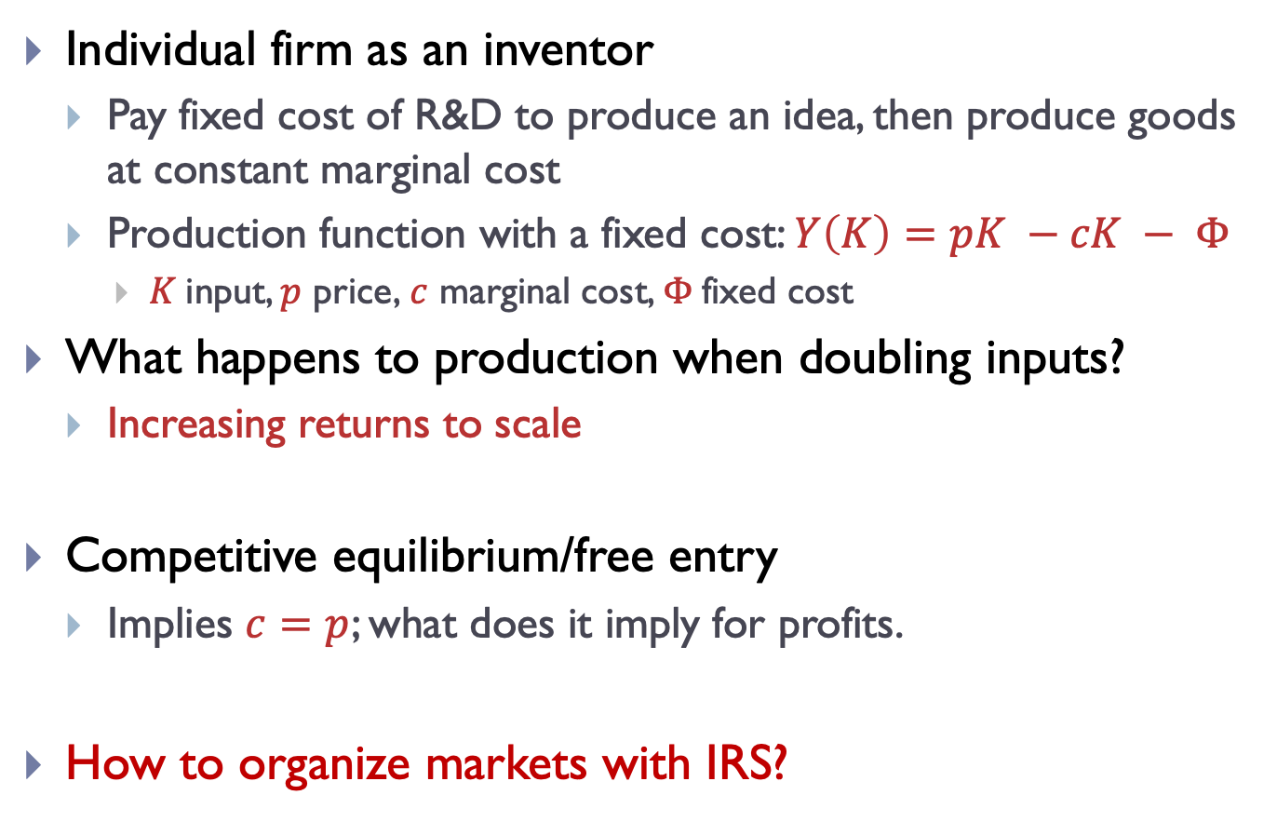
Ideas and increasing returns to scale
Individual firm as an inventor
Pay fixed cost of R&D to produce an idea, then produce goods at constant marginal cost
Production function with a fixed cost: $Y\left(K\right)=pK −cK − Φ$
$K$input, $p$ price,$c$ marginal cost, $Φ$fixed cost
What happens to production when doubling inputs?
Increasing returns to scale
Competitive equilibrium/free entry
Implies $c=p$; what does it imply for profits.
How to organize markets with IRS?

Slide 6
Two market arrangements under IRS
New ideas are published and can be used by anybody
Firms can now produce at constant returns to scale.
Competitive equilibrium emerges, every firm charges a price equal to marginal cost.
Why? Competition for customers erodes all economic profits.
Inventor cannot cover fixed cost of R&D ⇒ would not engage in R&D in the first place ⇒ no inventions happen.
New ideas are kept private after they are invented
Competitors must pay cost of R&D again to use the idea.
Optimal allocation: Inventor should supply the whole market
Why? We achieve the lowest average cost of production (cost of R&D paid only once)
But then the firm has a tendency to behave as a monopoly

Slide 7
R&D and market failure
Fixed cost of R&D can lead to market failures
If ideas are made public, competition will not allow inventors to recoup cost of R&D ⇒ no incentives to invent.
If ideas can be kept private, IRS leads to natural monopolies.
If firms attempt to reinvent the same ideas and compete, the process of R&D is unnecessarily costly for the society.
Inventions are desirable
But who should be the one who pays the cost?
Role for the government to improve allocations
Grant inventor a temporary monopoly right to use the idea
Legally exclude others from using the idea

Slide 8
Optimal amount of patent protection
Government faces a time-consistency problem
It promises to grant a patent to promote innovation activity BEFORE the idea is discovered.
But AFTER the discovery, it wants to limit monopoly power.
Tradeoff: How to balance the benefits of innovation and cost of monopoly power appropriately?
We want to generate ideas whose social return exceeds cost of invention.
Inventor’s private return must cover cost of innovation.
Measuring the benefits and costs of innovation is extremely hard (massive amount of uncertainty)
Does increasing the patent protection increase innovation activity? Very weak evidence on incentives...

Slide 9
Intellectual property rights – criticism
Many changes in intellectual property rights target the strengthening of protection of existing ideas.
This makes no sense: Protecting ideas that have been already discovered only strengthens monopoly power.
There are large administrative costs.
Lawsuits, law-making, lobbying, patent applications, research to avoid patent violations, patent trolls, …
Inventor can benefit even without patent protection
If inventors bring products to the market quickly, they can recoup R&D cost before competitors imitate the ideas.
Most inventions and ideas are never patented, and they still happen.
Many by accident: penicillin, microwave, …
Innovation and imitation is often hard to tell apart
A lot of imitation is convergence toward optimal product design.
Boldrin, Levine – Against Intellectual Monopoly

Slide 10
Intellectual property rights – alternatives
Competing for innovation
Prizes for best innovation – DARPA challenge, X-Prize
Maybe suitable for radically new innovations (space flight).
Government buys out developed ideas and provides them to the public
How to price newly developed ideas appropriately? Very difficult, especially for the government who is not an expert.
Example: Orphan drugs (currently, the government does not buy drugs out but provides special incentives to develop treatments for rare disorders)
Direct research subsidies and financing (NSF, NASA, military)
Protection across countries: growth and welfare considerations?

Slide 11
Outline
The economics of ideas
Fixed cost of R&D, increasing returns to scale.
Providing monopoly power through patents.
Romer model (1990)
Sustained long-run growth.
Romer model + Solow model
Long-run growth and transition dynamics

Slide 12
Infinite growth on a finite Earth
Ever heard about criticism of “infinite growth” theories?
About economic models that use a simplifying assumption of an infinite time horizon and constant growth rates.
Argument: Earth is finite, growth therefore cannot be infinite.
How economists think of infinite growth
Economic modeling argument: the infinite horizon is a simplification – maybe growth will stop at some distant point in the future but it is so distant that it is irrelevant today.
Empirical argument: Growth does not mean just more steel, cars, and bigger houses. Developed economies today grow mainly through technological progress.
Better cars, smaller and faster computers, …
Physical resources may be finite, but ideas are virtually unlimited.

Slide 13
Romer model (1990)
Distinction between ideas and objects
Output is produced by combining ideas and labor
Ideas are non-rivalrous
No diminishing marginal returns.
Long-run growth with finite resources through accumulation of ideas possible – new ideas allow to use the finite resources in better and better ways.
Population divided into two groups
Producers of ideas (“researchers”)
Producers of output (“workers”)

Slide 14
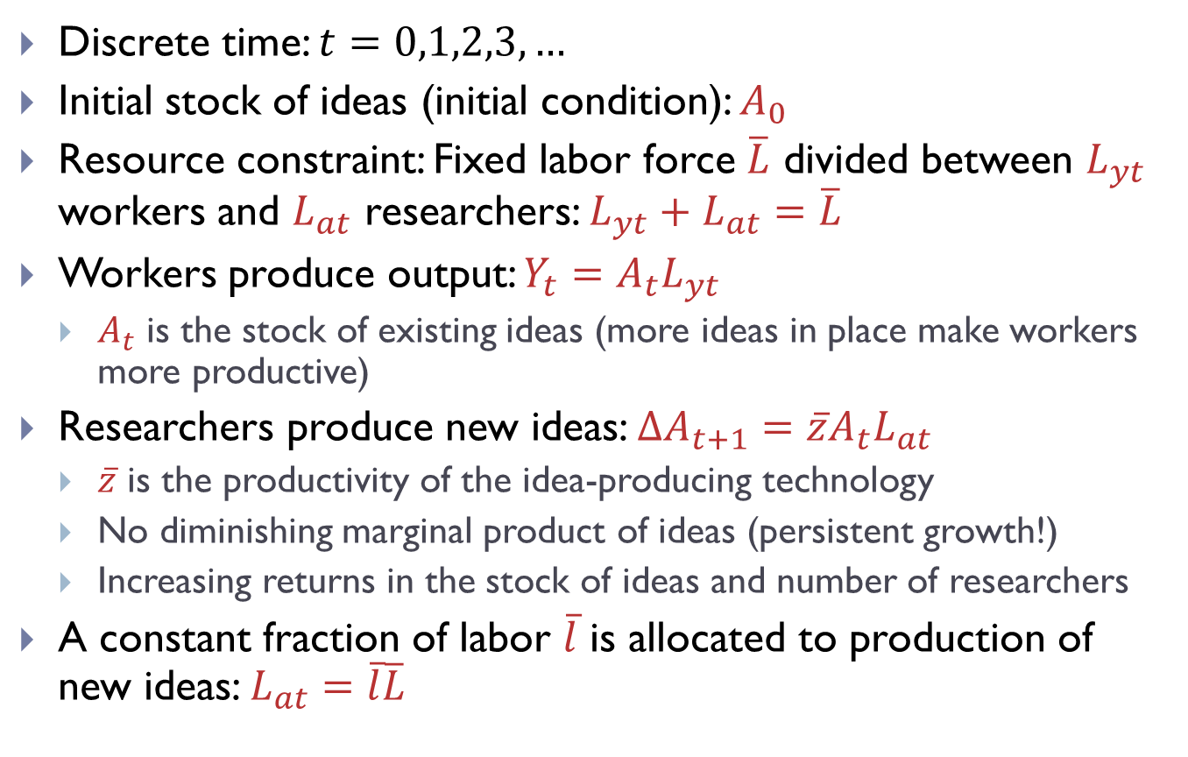
Framework of the model
Discrete time: $t=0,1,2,3,…$
Initial stock of ideas (initial condition): $A_{0}$
Resource constraint: Fixed labor force $\overline{L}$ divided between $L_{yt}$ workers and $L_{at}$ researchers: $L_{yt}+L_{at}=\overline{L}$
Workers produce output: $Y_{t}=A_{t}L_{yt}$
$A_{t}$ is the stock of existing ideas (more ideas in place make workers more productive)
Researchers produce new ideas: $∆A_{t+1}=\overline{z}A_{t}L_{at}$
$\overline{z}$ is the productivity of the idea-producing technology
No diminishing marginal product of ideas (persistent growth!)
Increasing returns in the stock of ideas and number of researchers
A constant fraction of labor $\overline{l}$ is allocated to production of new ideas: $L_{at}=\overline{l}\overline{L}$

Slide 15
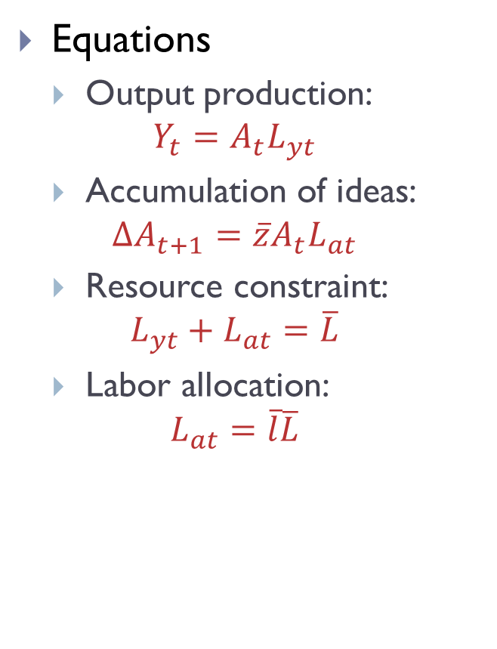
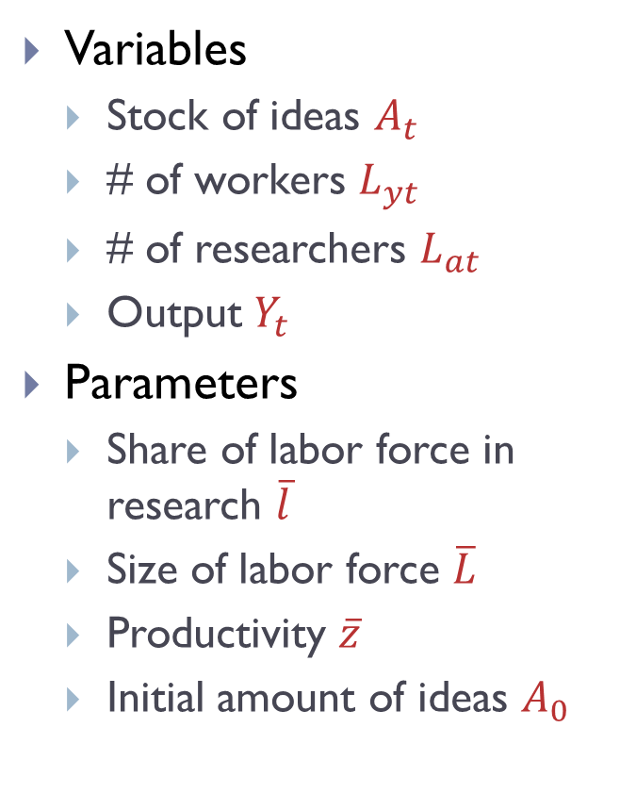
Framework of the model
Variables
Stock of ideas $A_{t}$
# of workers $L_{yt}$
# of researchers $L_{at}$
Output $Y_{t}$
Parameters
Share of labor force in research $\overline{l}$
Size of labor force $\overline{L}$
Productivity $\overline{z}$
Initial amount of ideas $A_{0}$
Equations
Output production:
$$Y_{t}=A_{t}L_{yt}$$
Accumulation of ideas:
$$∆A_{t+1}=\overline{z}A_{t}L_{at}$$
Resource constraint:
$$L_{yt}+L_{at}=\overline{L}$$
Labor allocation:
$$L_{at}=\overline{l}\overline{L}$$
4 equations
4 variables

Slide 16
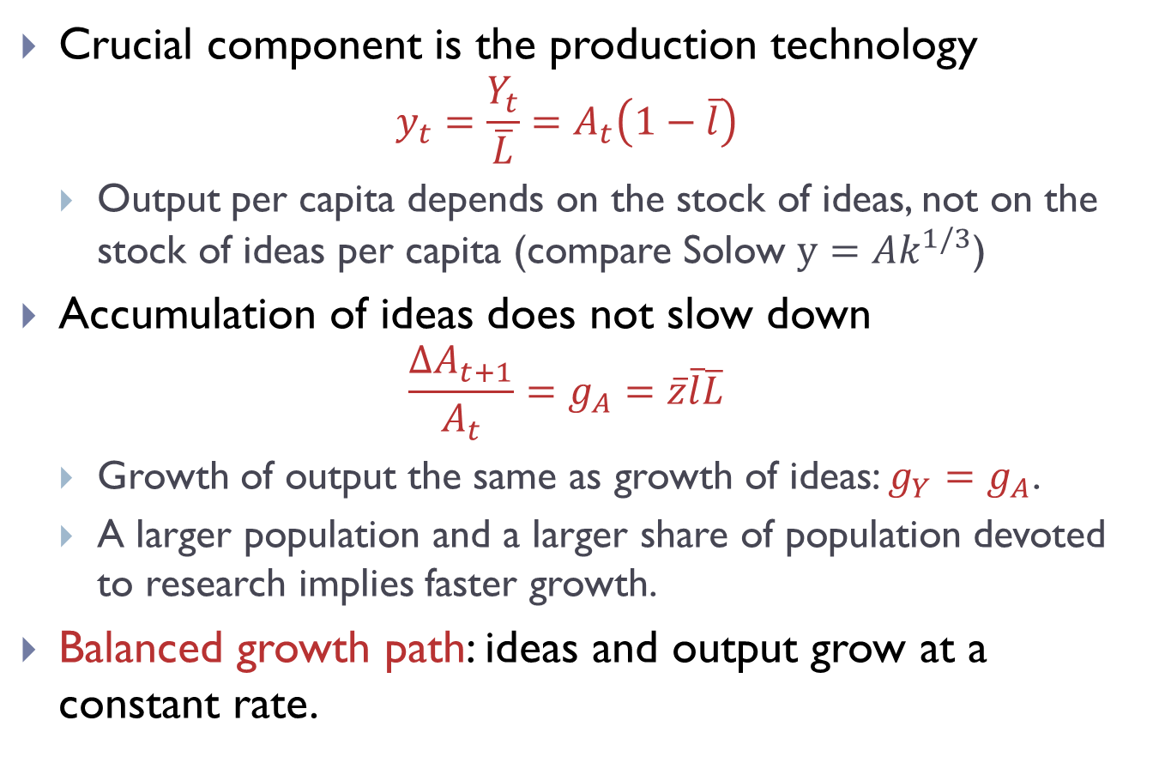
Model solution
Crucial component is the production technology
$$y_{t}=\frac{Y_{t}}{\overline{L}}=A_{t}\left(1−\overline{l}\right)$$
Output per capita depends on the stock of ideas, not on the stock of ideas per capita (compare Solow $y=Ak^{1/3}$)
Accumulation of ideas does not slow down
$$\frac{∆A_{t+1}}{A_{t}}=g_{A}=\overline{z}\overline{l}\overline{L}$$
Growth of output the same as growth of ideas: $g_{Y}=g_{A}$.
A larger population and a larger share of population devoted to research implies faster growth.
Balanced growth path: ideas and output grow at a constant rate.
Notes:
Cite Kremer - 1993 - Population growth and technological change - One million B.C. to 1990

Slide 17
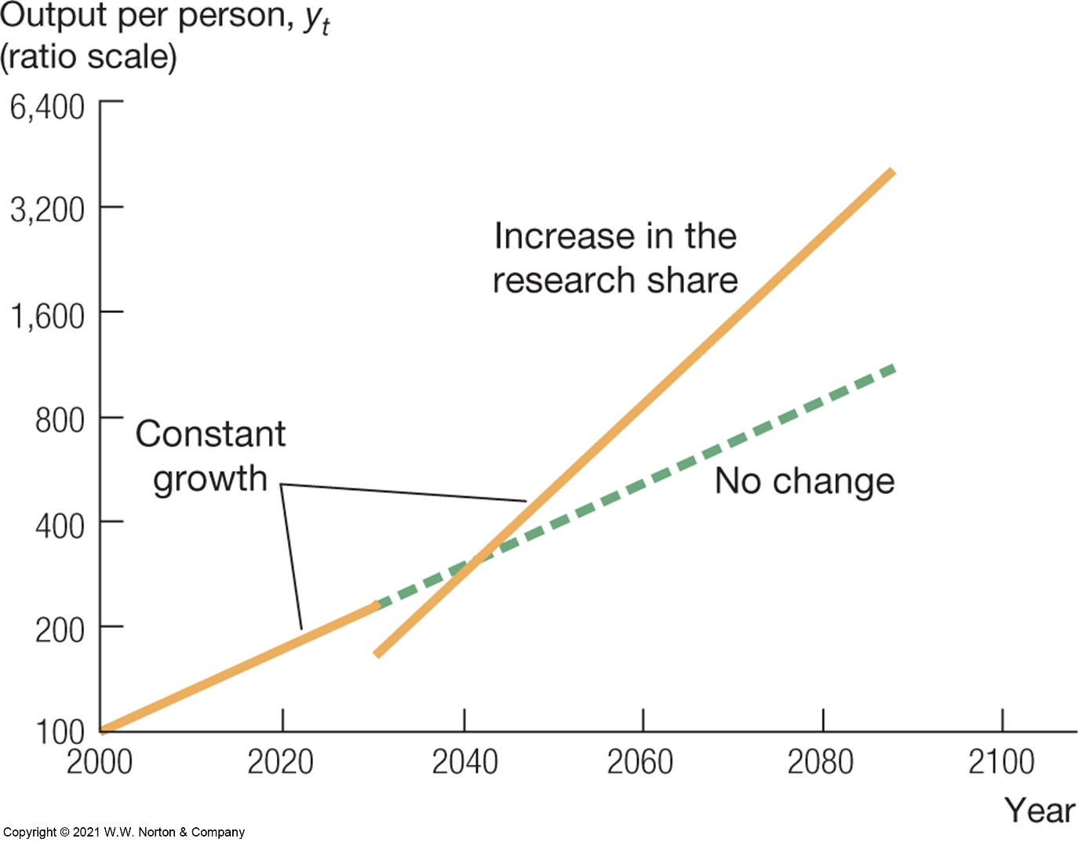
Experiments – increase in share of researchers
Initial reallocation to research decreases the level of output
Higher growth rate from that point on.
Source: Jones – Macroeconomics
Notes:
Alternative experiments: Inflow of skilled and unskilled immigrants.

Slide 18
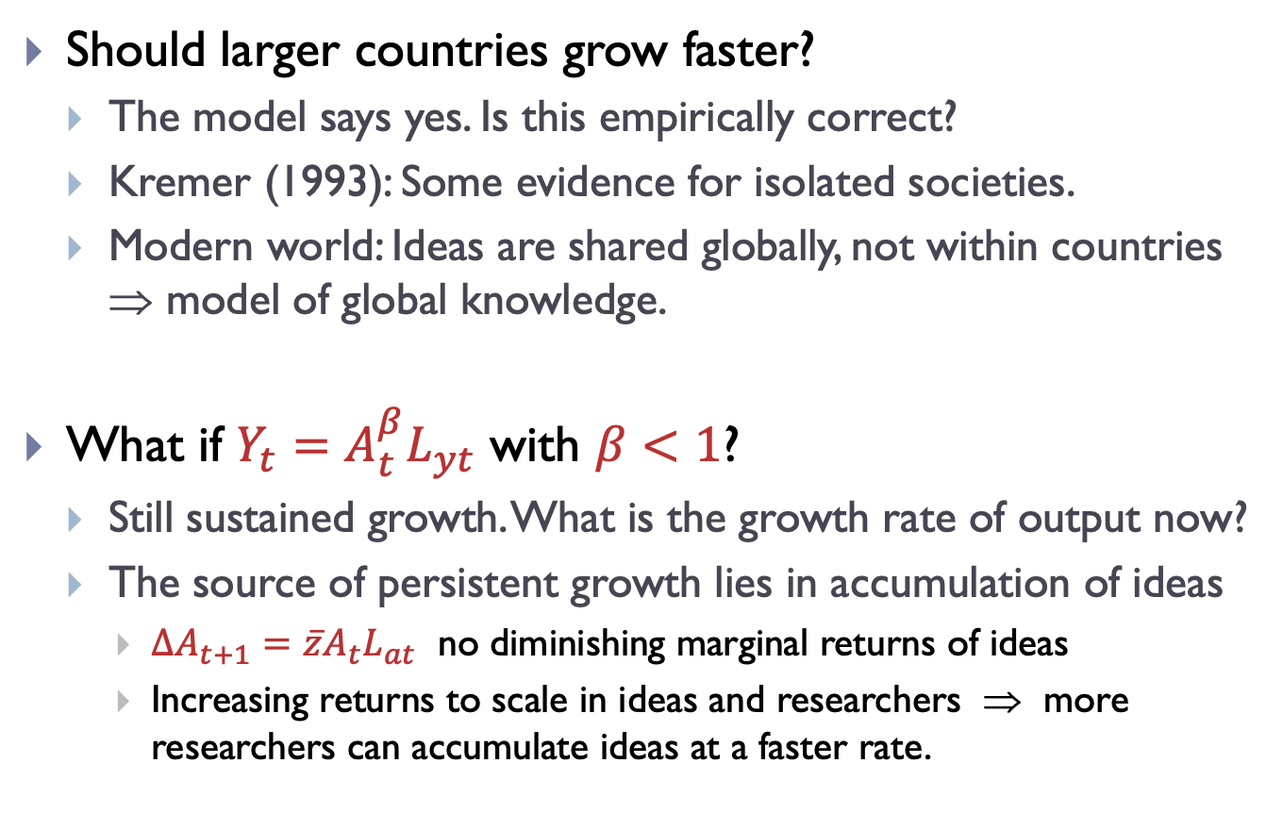
Romer model – discussion
Should larger countries grow faster?
The model says yes. Is this empirically correct?
Kremer (1993): Some evidence for isolated societies.
Modern world: Ideas are shared globally, not within countries ⇒ model of global knowledge.
What if $Y_{t}=A_{t}^{β}L_{yt}$ with $β<1$?
Still sustained growth. What is the growth rate of output now?
The source of persistent growth lies in accumulation of ideas
$∆A_{t+1}=\overline{z}A_{t}L_{at}$ no diminishing marginal returns of ideas
Increasing returns to scale in ideas and researchers ⇒ more researchers can accumulate ideas at a faster rate.
Notes:
What if A_t+1 = z*A_t^\gamma*L_at

Slide 19
Solow vs Romer model
Solow model
Capital is rivalrous.
Therefore capital per person matters for growth.
Capital per person is subject to diminishing returns.
Constant returns to scale – size of population does not matter for growth.
Romer model
Ideas are non-rivalrous.
Total stock of ideas matters for growth (anybody can use any idea).
Accumulation of ideas not subject to diminishing returns ⇒ sustained growth.
Increasing returns to scale – larger economies more productive.
No transition dynamics – always on a balanced growth path.

Slide 20
Outline
The economics of ideas
Fixed cost of R&D, increasing returns to scale.
Providing monopoly power through patents.
Romer model (1990)
Sustained long-run growth.
Romer model + Solow model
Long-run growth and transition dynamics

Slide 21
Combining Solow and Romer models
Advantages of the two models:
Solow model
Capital accumulation – transition dynamics
Romer model
Accumulation of ideas – sustained growth
Combine these two models
Accumulation of ideas will determine the long-run trend (growth rate of most developed countries).
Capital accumulation will determine transition dynamics around this long-run trend (catching-up periods).
Each country will have a steady state relative to the growing frontier (determined by factors like institutions).

Slide 22
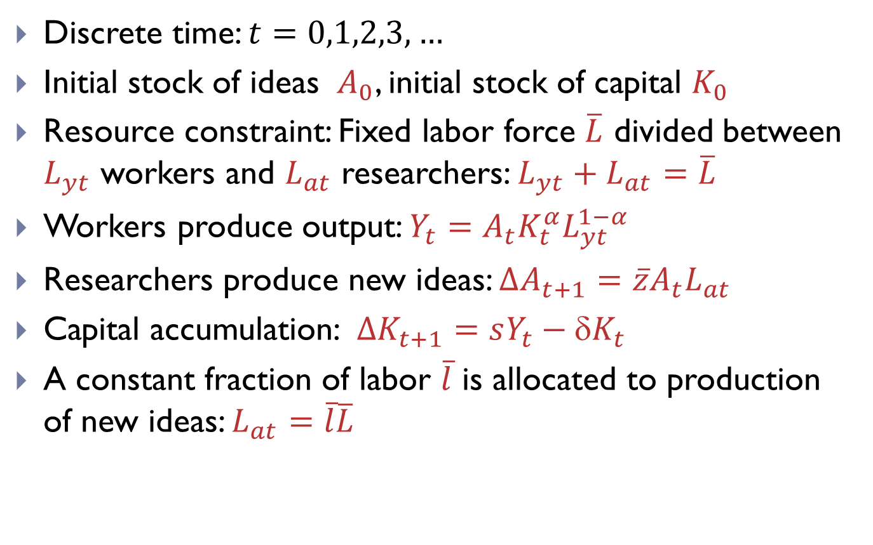
Framework of the combined model
Discrete time: $t=0,1,2,3,…$
Initial stock of ideas $A_{0}$, initial stock of capital $K_{0}$
Resource constraint: Fixed labor force $\overline{L}$ divided between $L_{yt}$ workers and $L_{at}$ researchers: $L_{yt}+L_{at}=\overline{L}$
Workers produce output: $Y_{t}=A_{t}K_{t}^{α}L_{yt}^{1−α}$
Researchers produce new ideas: $∆A_{t+1}=\overline{z}A_{t}L_{at}$
Capital accumulation: $∆K_{t+1}=sY_{t}−{K}_{t}$
A constant fraction of labor $\overline{l}$ is allocated to production of new ideas: $L_{at}=\overline{l}\overline{L}$

Slide 23
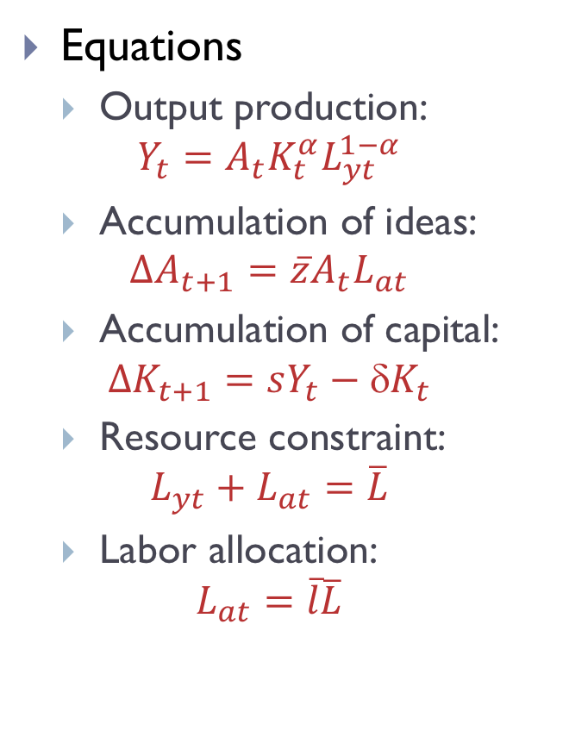
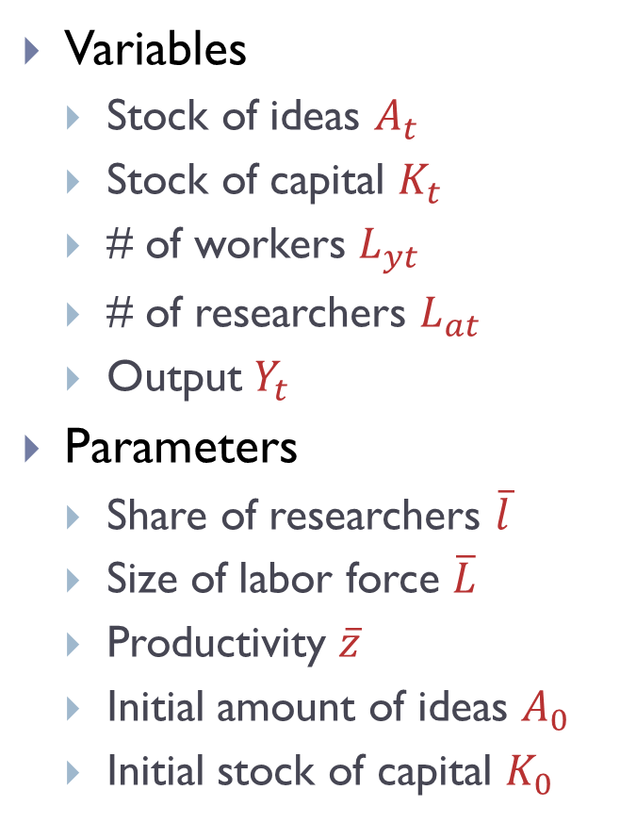
Framework of the model
Variables
Stock of ideas $A_{t}$
Stock of capital $K_{t}$
# of workers $L_{yt}$
# of researchers $L_{at}$
Output $Y_{t}$
Parameters
Share of researchers $\overline{l}$
Size of labor force $\overline{L}$
Productivity $\overline{z}$
Initial amount of ideas $A_{0}$
Initial stock of capital $K_{0}$
Equations
Output production:
$$Y_{t}=A_{t}K_{t}^{α}L_{yt}^{1−α}$$
Accumulation of ideas:
$$∆A_{t+1}=\overline{z}A_{t}L_{at}$$
Accumulation of capital:
$$∆K_{t+1}=sY_{t}−{K}_{t}$$
Resource constraint:
$$L_{yt}+L_{at}=\overline{L}$$
Labor allocation:
$$L_{at}=\overline{l}\overline{L}$$
5 equations
5 variables

Slide 24
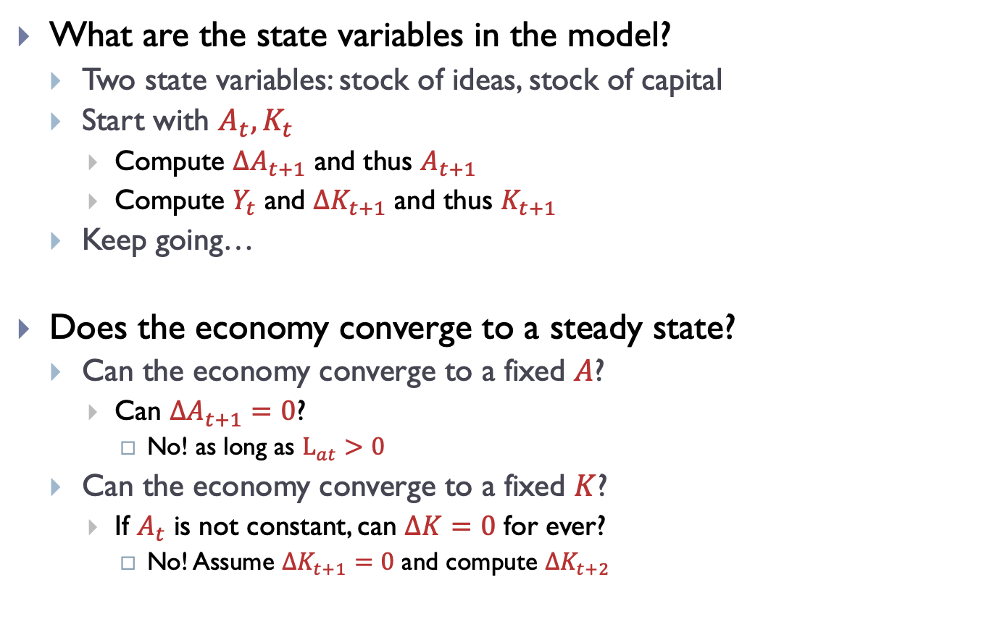
How to solve this model?
What are the state variables in the model?
Two state variables: stock of ideas, stock of capital
Start with $A_{t},K_{t}$
Compute $∆A_{t+1}$ and thus $A_{t+1}$
Compute $Y_{t}$ and $∆K_{t+1}$ and thus $K_{t+1}$
Keep going…
Does the economy converge to a steady state?
Can the economy converge to a fixed $A$?
Can $∆A_{t+1}=0$?
No! as long as $L_{at}>0$
Can the economy converge to a fixed $K$?
If $A_{t}$ is not constant, can $∆K=0$ for ever?
No! Assume $∆K_{t+1}=0$ and compute $∆K_{t+2}$
Notes:
Derivation of scaled law of motion: Divide the whole equation by A_{t+1}^{1/(1-\alpha)} and then readjust the RHS.
Rewrite recitation problem 6.3 to be in line with this.

Slide 25
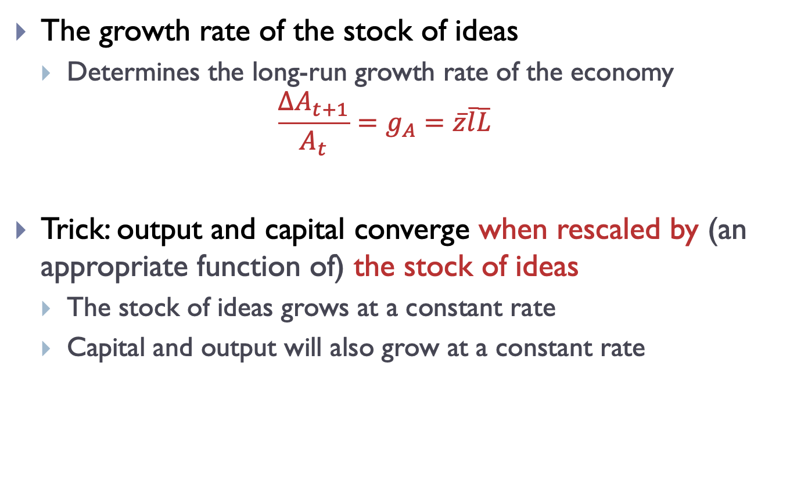
Model solution: long-run
The growth rate of the stock of ideas
Determines the long-run growth rate of the economy
$$\frac{∆A_{t+1}}{A_{t}}=g_{A}=\overline{z}\overline{l}\overline{L}$$
Trick: output and capital converge when rescaled by (an appropriate function of) the stock of ideas
The stock of ideas grows at a constant rate
Capital and output will also grow at a constant rate
Notes:
Derivation of scaled law of motion: Divide the whole equation by A_{t+1}^{1/(1-\alpha)} and then readjust the RHS.
Rewrite recitation problem 6.3 to be in line with this.

Slide 26
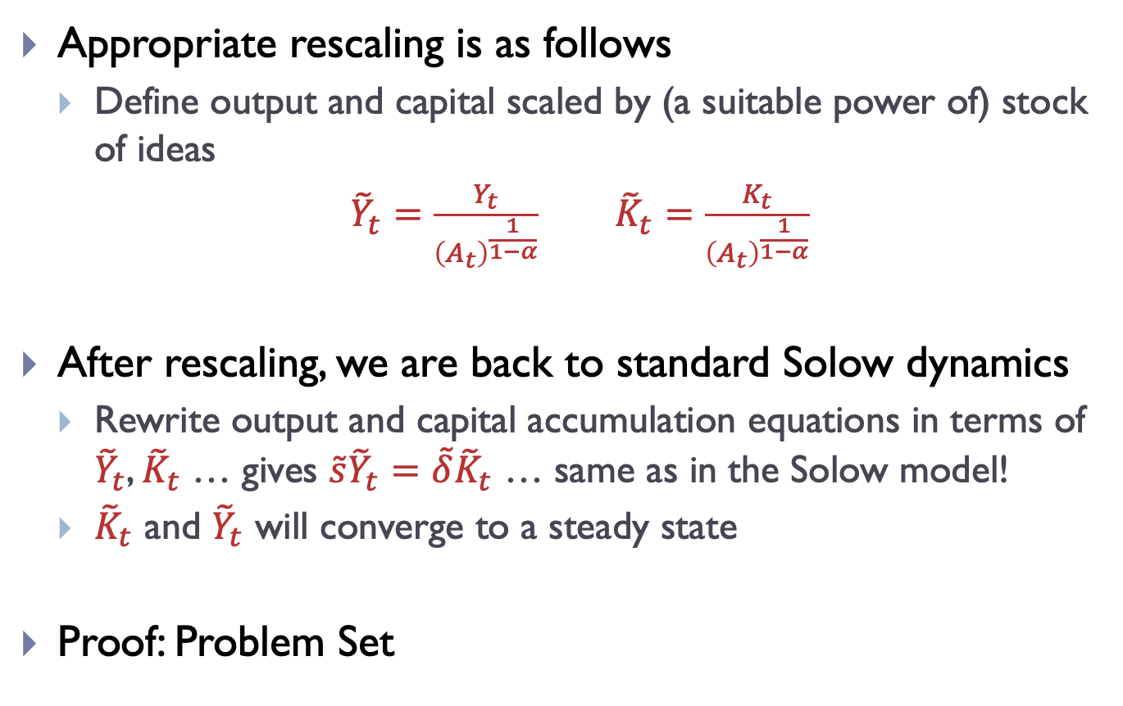
Model solution: rescaling
Appropriate rescaling is as follows
Define output and capital scaled by (a suitable power of) stock of ideas
${\tilde{Y}}_{t}=\frac{Y_{t}}{{\left(A_{t}\right)}^{\frac{1}{1−α}}}$ ${\tilde{K}}_{t}=\frac{K_{t}}{{\left(A_{t}\right)}^{\frac{1}{1−α}}}$
After rescaling, we are back to standard Solow dynamics
Rewrite output and capital accumulation equations in terms of ${\tilde{Y}}_{t}$, ${\tilde{K}}_{t}$ … gives $\tilde{s}{\tilde{Y}}_{t}=\tilde{δ}{\tilde{K}}_{t}$ … same as in the Solow model!
${\tilde{K}}_{t}$ and ${\tilde{Y}}_{t}$ will converge to a steady state
Proof: Problem Set
Notes:
Derivation of scaled law of motion: Divide the whole equation by A_{t+1}^{1/(1-\alpha)} and then readjust the RHS.
Rewrite recitation problem 6.3 to be in line with this.

Slide 27
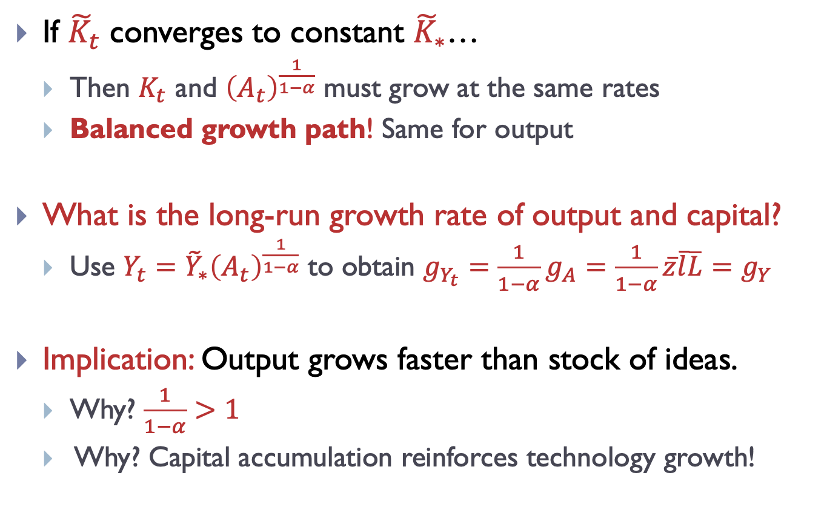
Model solution: long-run
If ${\tilde{K}}_{t}$ converges to constant ${\tilde{K}}_{∗}$…
Then $K_{t}$ and ${\left(A_{t}\right)}^{\frac{1}{1−α}}$ must grow at the same rates
Balanced growth path! Same for output
What is the long-run growth rate of output and capital?
Use ${Y_{t}=\tilde{Y}}_{∗}{\left(A_{t}\right)}^{\frac{1}{1−α}}$ to obtain $g_{Y_{t}}=\frac{1}{1−α}g_{A}=\frac{1}{1−α}\overline{z}\overline{l}\overline{L}=g_{Y}$
Implication: Output grows faster than stock of ideas.
Why? $\frac{1}{1−α}>1$
Why? Capital accumulation reinforces technology growth!
Notes:
Derivation of scaled law of motion: Divide the whole equation by A_{t+1}^{1/(1-\alpha)} and then readjust the RHS.
Rewrite recitation problem 6.3 to be in line with this.

Slide 28
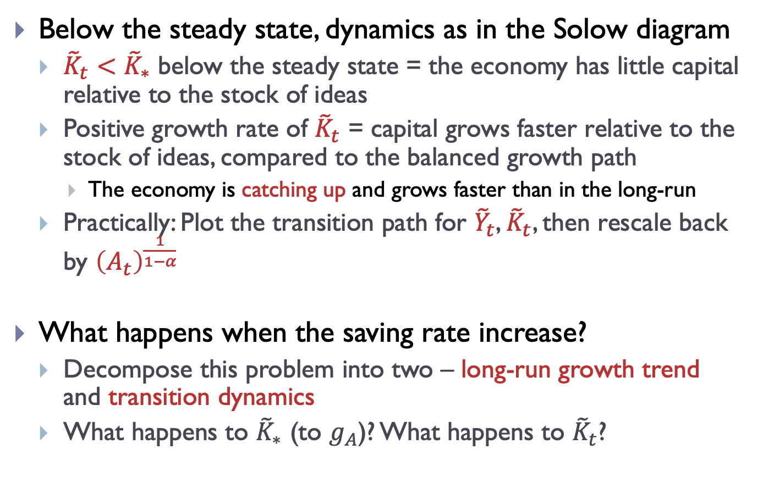
Model solution: transitions
Below the steady state, dynamics as in the Solow diagram
${\tilde{K}}_{t}<{\tilde{K}}_{∗}$ below the steady state = the economy has little capital relative to the stock of ideas
Positive growth rate of ${\tilde{K}}_{t}$ = capital grows faster relative to the stock of ideas, compared to the balanced growth path
The economy is catching up and grows faster than in the long-run
Practically: Plot the transition path for ${\tilde{Y}}_{t}$, ${\tilde{K}}_{t}$, then rescale back by ${\left(A_{t}\right)}^{\frac{1}{1−α}}$
What happens when the saving rate increase?
Decompose this problem into two – long-run growth trend and transition dynamics
What happens to ${\tilde{K}}_{∗}$ (to $g_{A}$)? What happens to ${\tilde{K}}_{t}$?

Slide 29
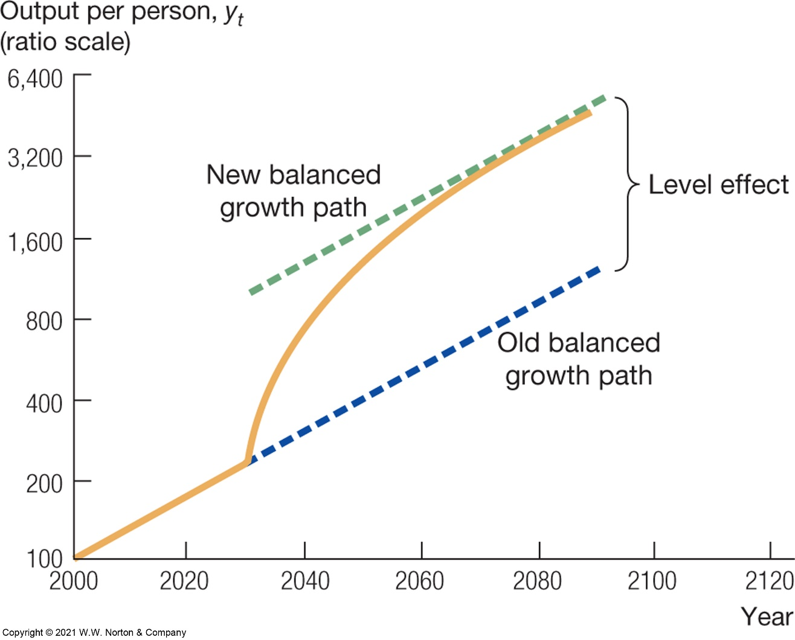
Experiment – increase in saving rate
Long-run growth trend and transition dynamics
Source: Jones – Macroeconomics

Slide 30
Review questions
Going further: Chapter 6, Jones
What is the distinction between objects and ideas?
Why is the distinction important from the point of modeling of economic growth?
Why do increasing returns and perfect competition interfere?
Are there too many or too few resources devoted to discovering new ideas?
How does population size influence the rate of growth in the Romer model? Do we see larger countries grow faster? Why or why not?

