Slide 1
Intermediate Macroeconomics Axelle Ferriere, Sciences Po, Spring 2025
Chapter 6
Consumption and Savings

Slide 2
Outline
Why consumption? Why savings?
Neoclassical consumption model
Utility maximization problem
Implications of the neoclassical consumption model
Permanent income hypothesis
Ricardian equivalence
MPC and borrowing constraints

Slide 3
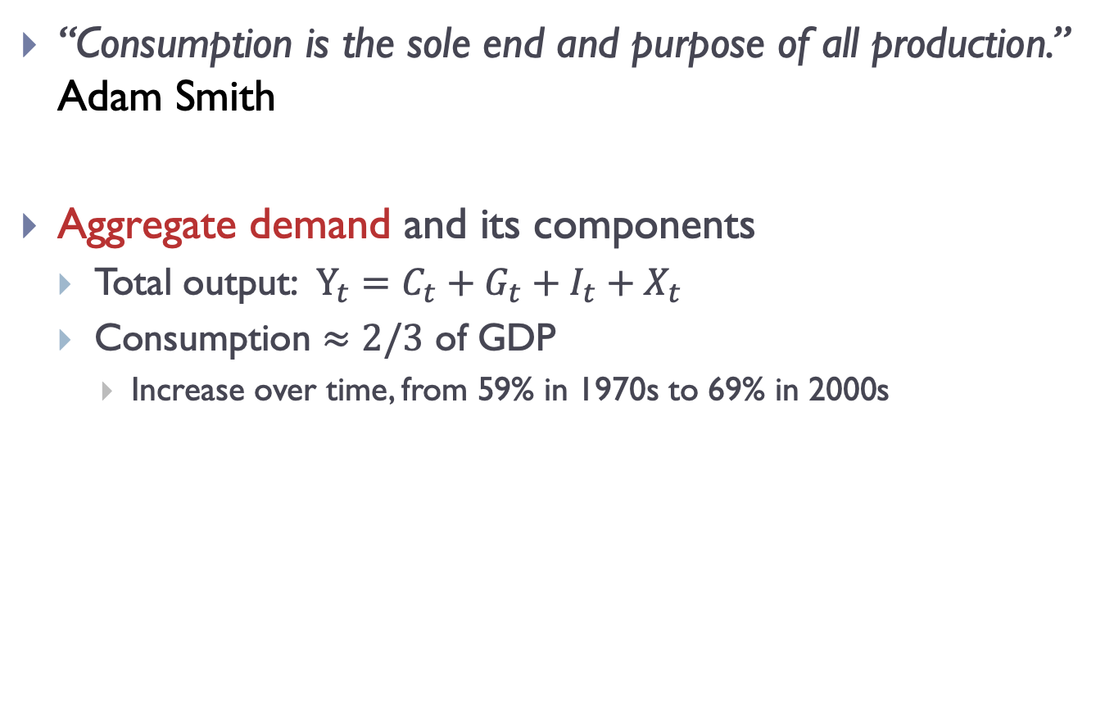
Consumption
“Consumption is the sole end and purpose of all production.” Adam Smith
Aggregate demand and its components
Total output: $Y_{t}=C_{t}+G_{t}+I_{t}+X_{t}$
Consumption $≈2/3$ of GDP
Increase over time, from 59% in 1970s to 69% in 2000s

Slide 4
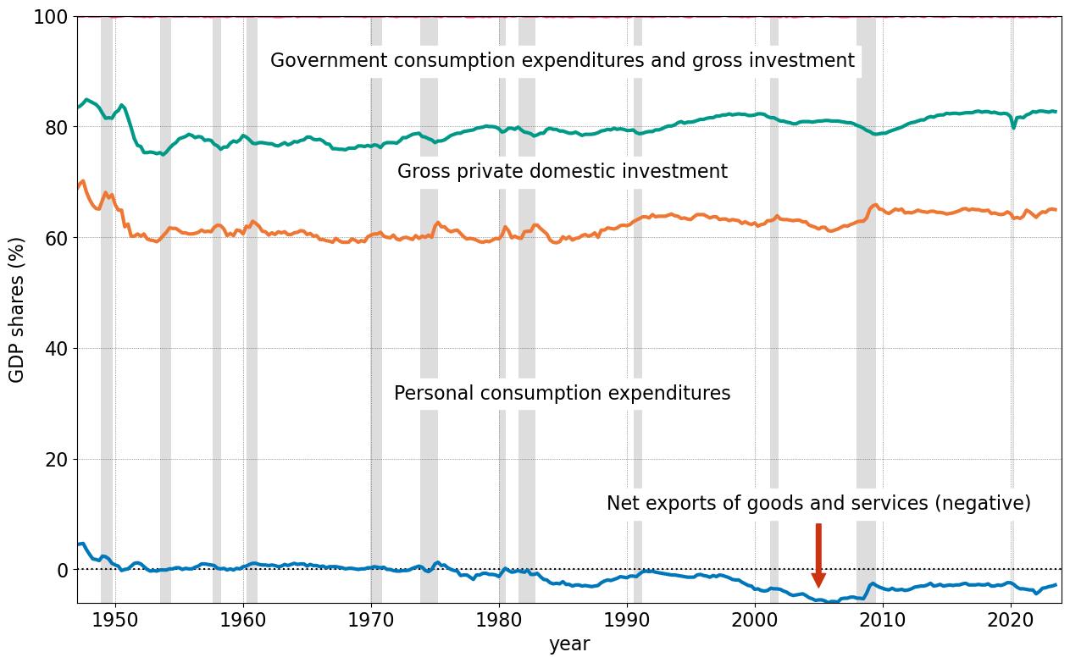
Percentage shares of GDP
Consumption: largest share of GDP
Source: BEA NIPA data

Slide 5
Consumption and savings
Private consumption constitutes a large share of GDP
We want to understand how people decide to save and consume.
Macro interest for consumption and savings
Long-run savings rate, capital accumulation and long-run growth (Solow)
Lifecycle profile of consumption, retirement
Insurance against unemployment, health, …
Response of consumption to business cycle fluctuations
Consumption fluctuates less than GDP, much less than investment
Fiscal stimulus during recessions: consumption response to checks

Slide 6
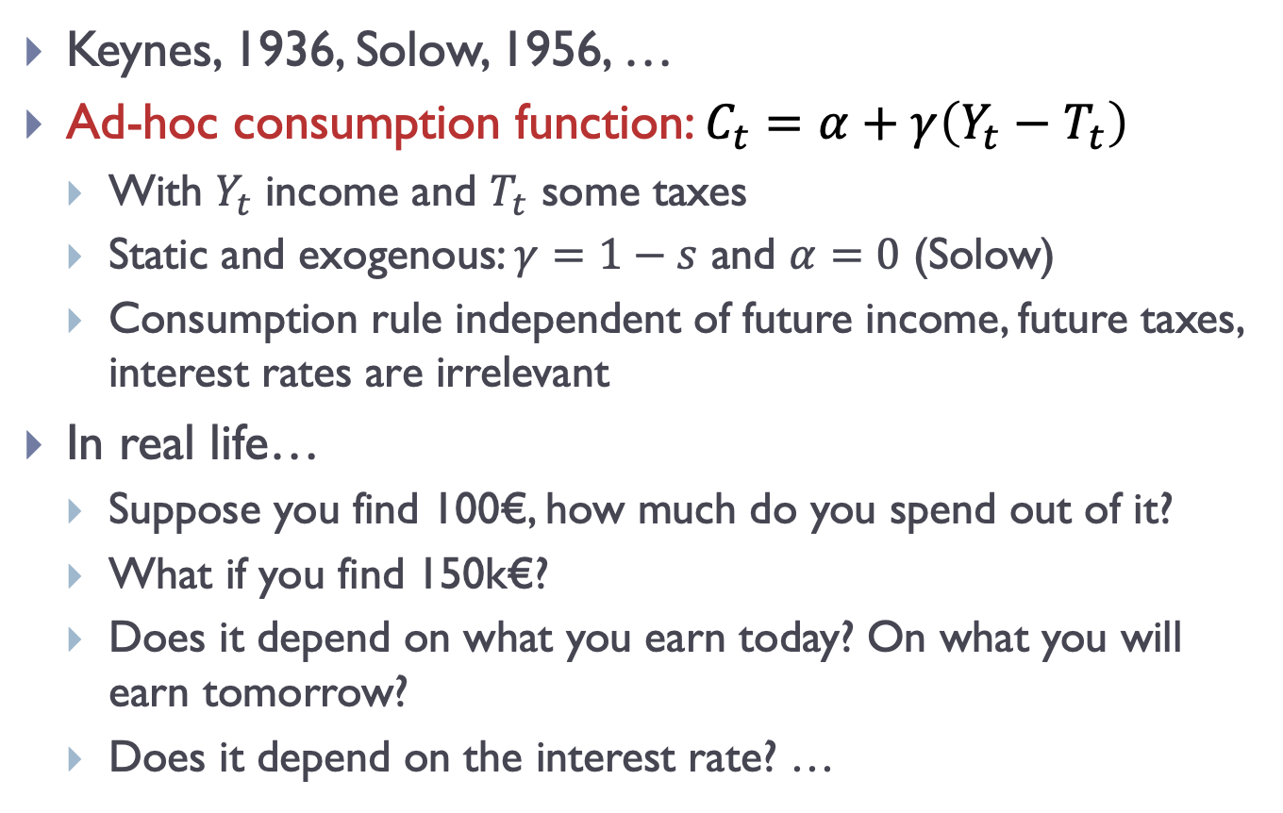
Consumption in Old School Macro
Keynes, 1936, Solow, 1956, …
Ad-hoc consumption function: $C_{t}=α+γ\left(Y_{t}−T_{t}\right)$
With $Y_{t}$ income and $T_{t}$ some taxes
Static and exogenous: $γ=1−s$ and $α=0$ (Solow)
Consumption rule independent of future income, future taxes, interest rates are irrelevant
In real life…
Suppose you find 100€, how much do you spend out of it?
What if you find 150k€?
Does it depend on what you earn today? On what you will earn tomorrow?
Does it depend on the interest rate? …

Slide 7
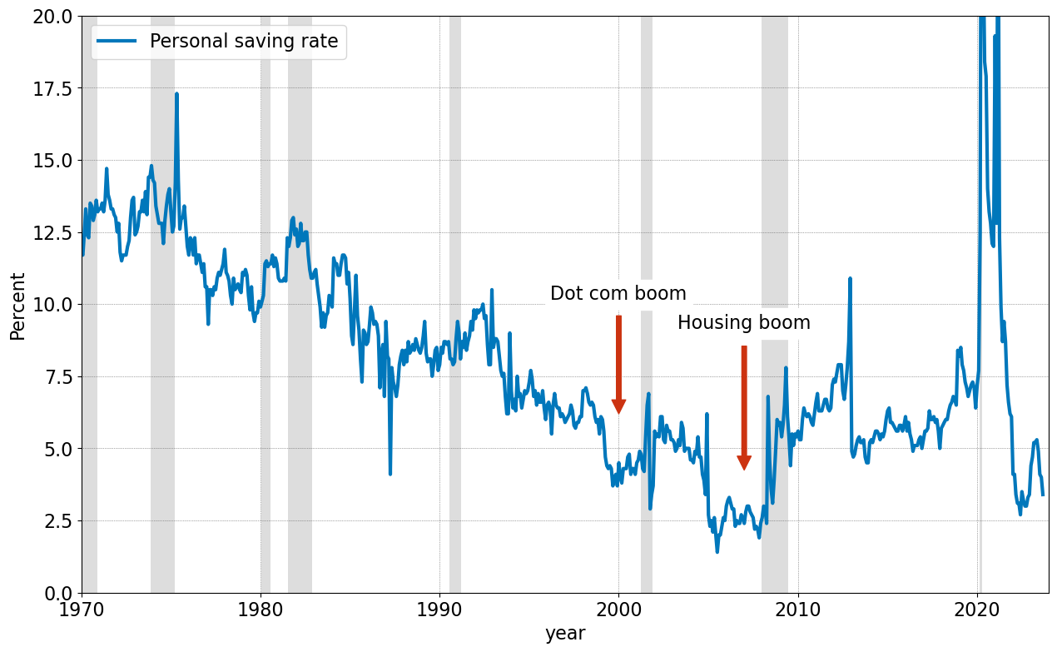
Empirical evidence – aggregate data
Personal saving rate decreasing over several decades, recovered somewhat after the financial crisis.
At the same time:
Substantial borrowing from abroad.
Accumulation of savings by firms.
Source: Jones – Macroeconomics, Bureau of Economic Analysis, FRED (series PSAVERT)

Slide 8
Goal of this chapter
Optimal saving and consumption decision
Utility-maximizing household facing intertemporal budget constraint
Response of consumption to the real interest rate
Permanent income hypothesis
Consumption smoothing and precautionary saving
Transitory vs permanent income shocks
Role of borrowing constraints
Ricardian equivalence
Tools
Utility maximization
Construction of the intertemporal budget constraint

Slide 9
Outline
Why consumption? Why savings?
Neoclassical consumption model
Utility maximization problem
Implications of the neoclassical consumption model
Permanent income hypothesis
Ricardian equivalence
MPC and borrowing constraints

Slide 10
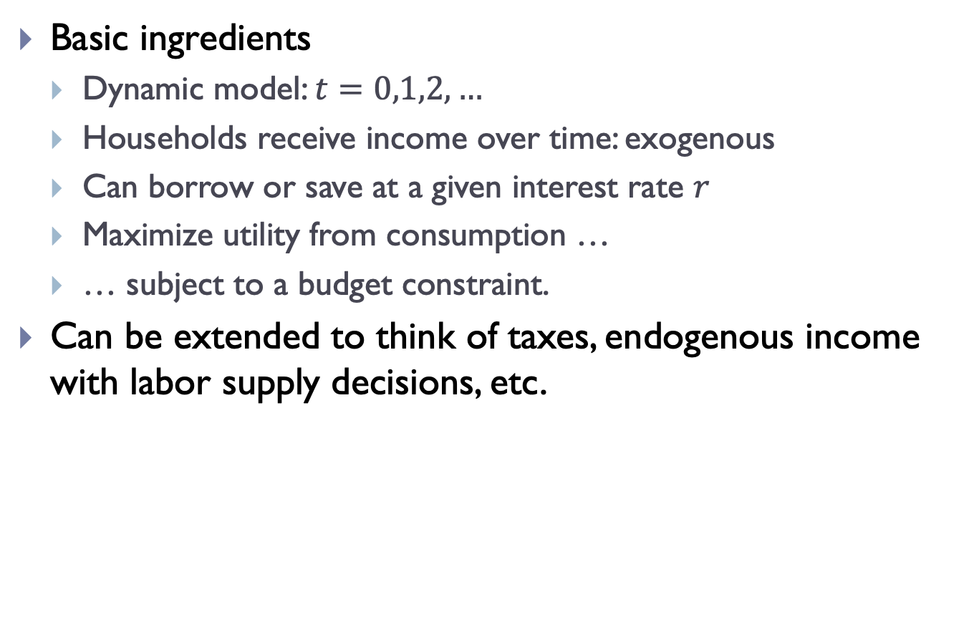
Neoclassical consumption model
Basic ingredients
Dynamic model: $t=0,1,2,…$
Households receive income over time: exogenous
Can borrow or save at a given interest rate $r$
Maximize utility from consumption …
… subject to a budget constraint.
Can be extended to think of taxes, endogenous income with labor supply decisions, etc.

Slide 11
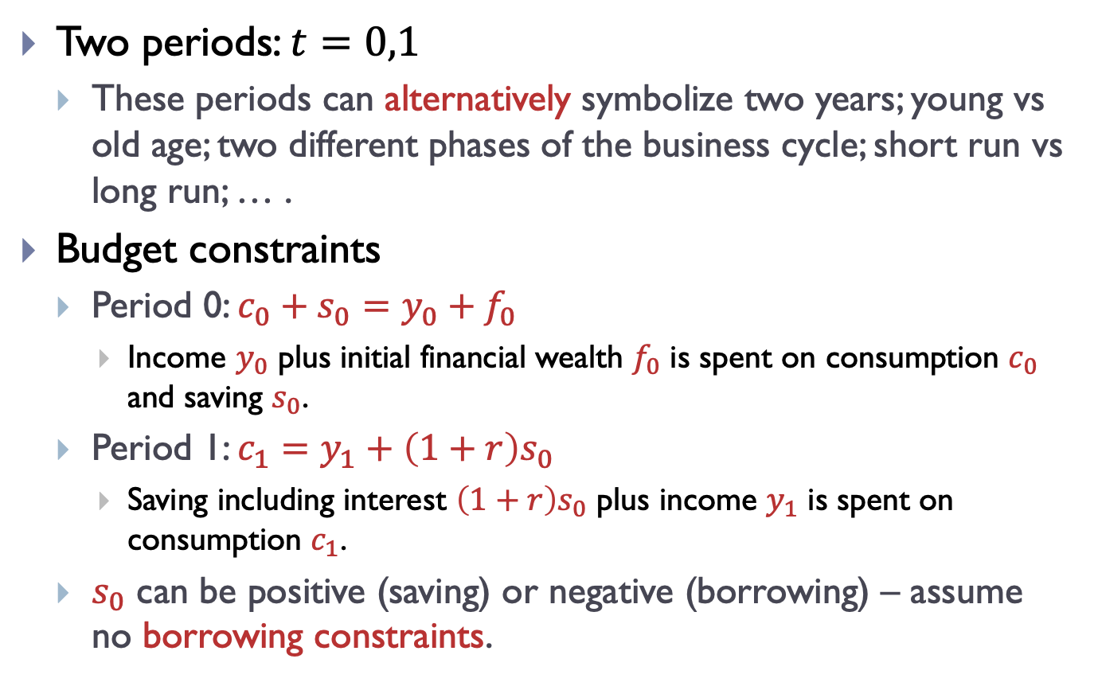
Framework of the model
Two periods: $t=0,1$
These periods can alternatively symbolize two years; young vs old age; two different phases of the business cycle; short run vs long run; … .
Budget constraints
Period 0: $c_{0}+s_{0}=y_{0}+f_{0}$
Income $y_{0}$ plus initial financial wealth $f_{0}$ is spent on consumption $c_{0}$ and saving $s_{0}$.
Period 1: $c_{1}=y_{1}+\left(1+r\right)s_{0}$
Saving including interest $\left(1+r\right)s_{0}$ plus income $y_{1}$ is spent on consumption $c_{1}$.
$s_{0}$ can be positive (saving) or negative (borrowing) – assume no borrowing constraints.

Slide 12
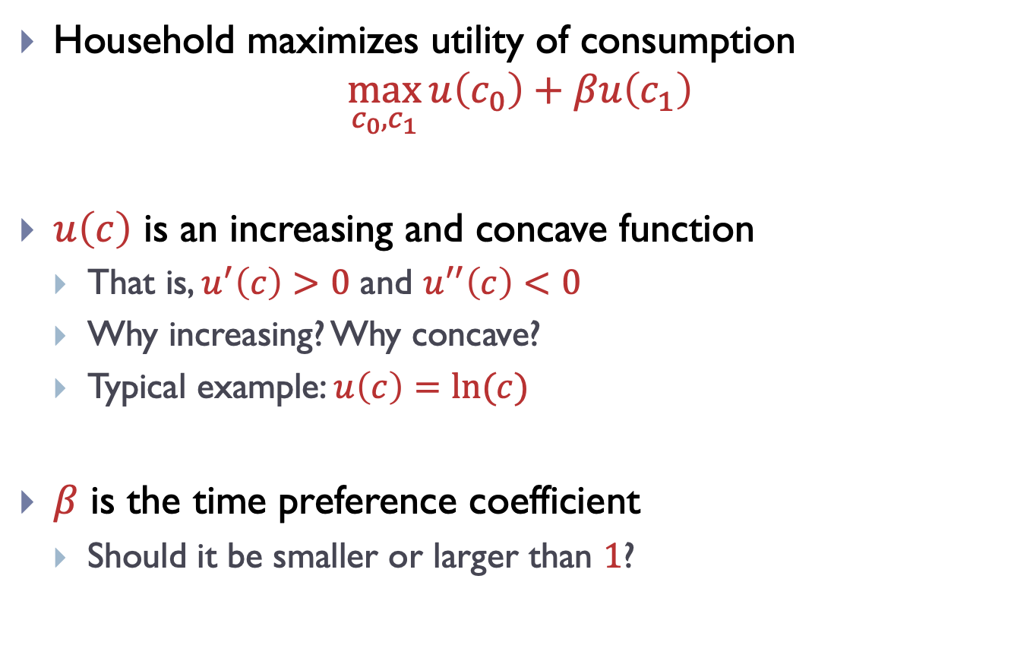
Framework of the model
Household maximizes utility of consumption
$$\max_{c_{0},c_{1}}{u\left(c_{0}\right)+βu\left(c_{1}\right)}$$
$u\left(c\right)$ is an increasing and concave function
That is, $u^{′}\left(c\right)>0$ and $u^{′′}\left(c\right)<0$
Why increasing? Why concave?
Typical example: $u\left(c\right)=ln⁡(c)$
$β$ is the time preference coefficient
Should it be smaller or larger than $1$?

Slide 13
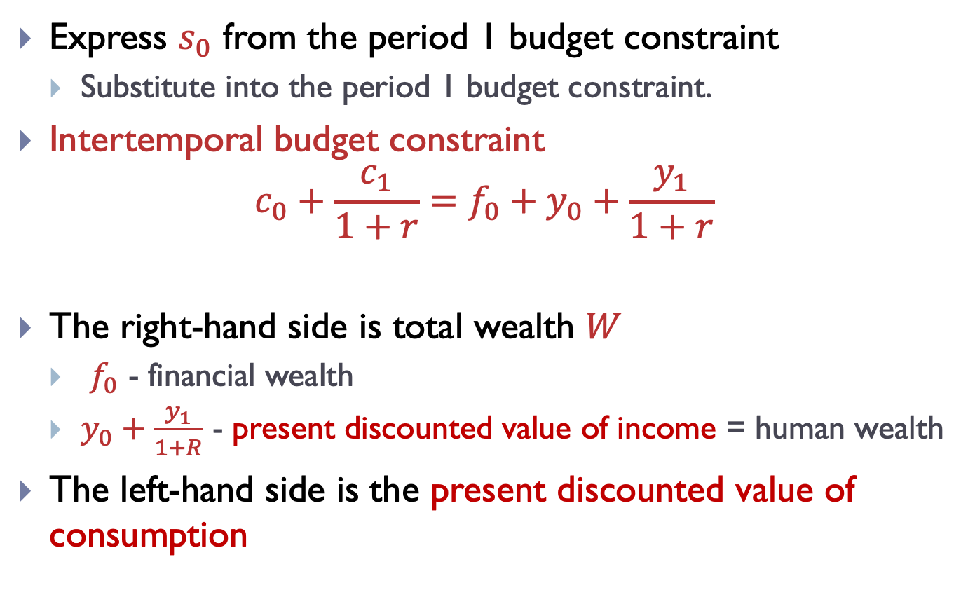
Intertemporal budget constraint
Express $s_{0}$ from the period 1 budget constraint
Substitute into the period 1 budget constraint.
Intertemporal budget constraint
$$c_{0}+\frac{c_{1}}{1+r}=f_{0}+y_{0}+\frac{y_{1}}{1+r}$$
The right-hand side is total wealth $W$
$f_{0}$ - financial wealth
$y_{0}+\frac{y_{1}}{1+R}$ - present discounted value of income = human wealth
The left-hand side is the present discounted value of consumption

Slide 14
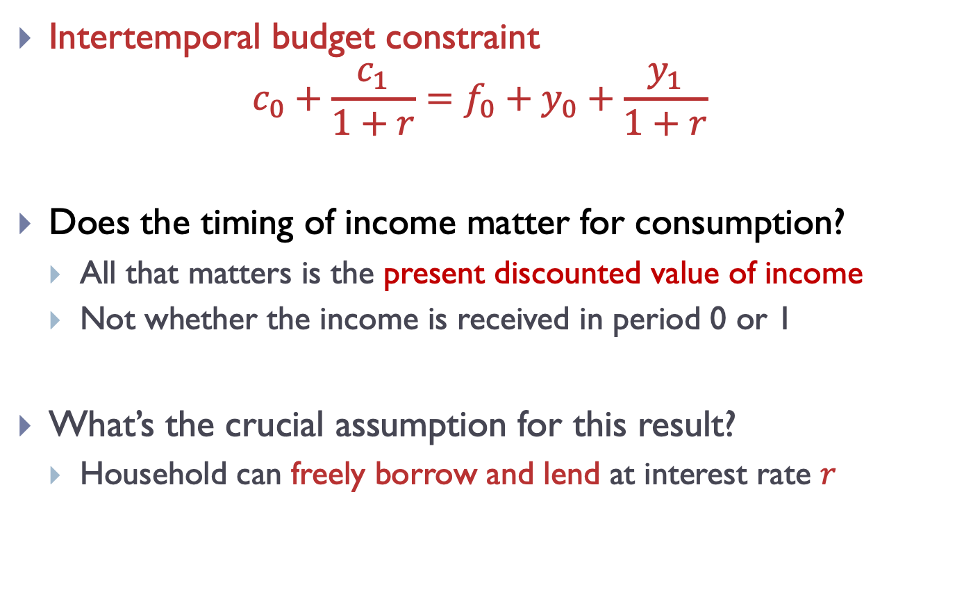
Intertemporal budget constraint
Intertemporal budget constraint
$$c_{0}+\frac{c_{1}}{1+r}=f_{0}+y_{0}+\frac{y_{1}}{1+r}$$
Does the timing of income matter for consumption?
All that matters is the present discounted value of income
Not whether the income is received in period 0 or 1
What’s the crucial assumption for this result?
Household can freely borrow and lend at interest rate $r$

Slide 15
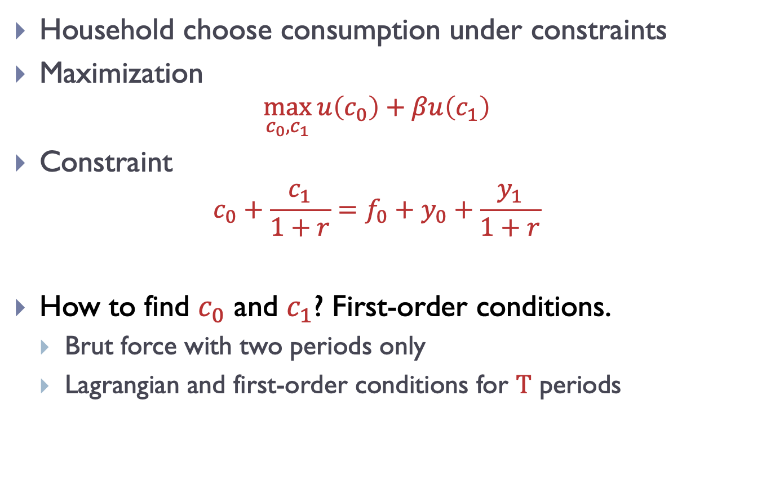
Household optimization problem
Household choose consumption under constraints
Maximization
$$\max_{c_{0},c_{1}}{u\left(c_{0}\right)+βu\left(c_{1}\right)}$$
Constraint
$$c_{0}+\frac{c_{1}}{1+r}=f_{0}+y_{0}+\frac{y_{1}}{1+r}$$
How to find $c_{0}$ and $c_{1}$? First-order conditions.
Brut force with two periods only
Lagrangian and first-order conditions for $T$ periods

Slide 16
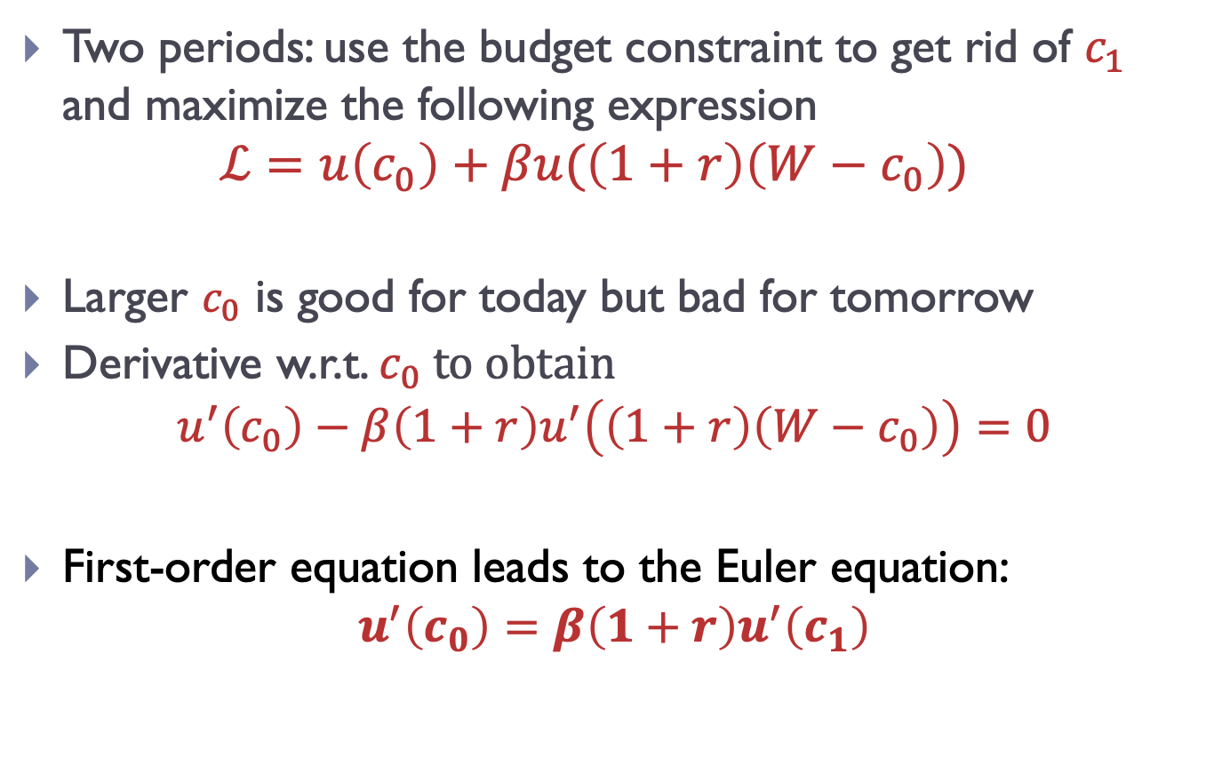
Household optimization: two periods
Two periods: use the budget constraint to get rid of $c_{1}$ and maximize the following expression
$$ℒ=u\left(c_{0}\right)+βu(\left(1+r\right)\left(W−c_{0}\right))$$
Larger $c_{0}$ is good for today but bad for tomorrow
Derivative w.r.t. $c_{0}$ to obtain
$$u^{′}\left(c_{0}\right)−β\left(1+r\right)u^{′}\left(\left(1+r\right)\left(W−c_{0}\right)\right)=0$$
First-order equation leads to the Euler equation:
$$u^{′}\left(c_{0}\right)=β\left(1+r\right)u^{′}\left(c_{1}\right)$$

Slide 17
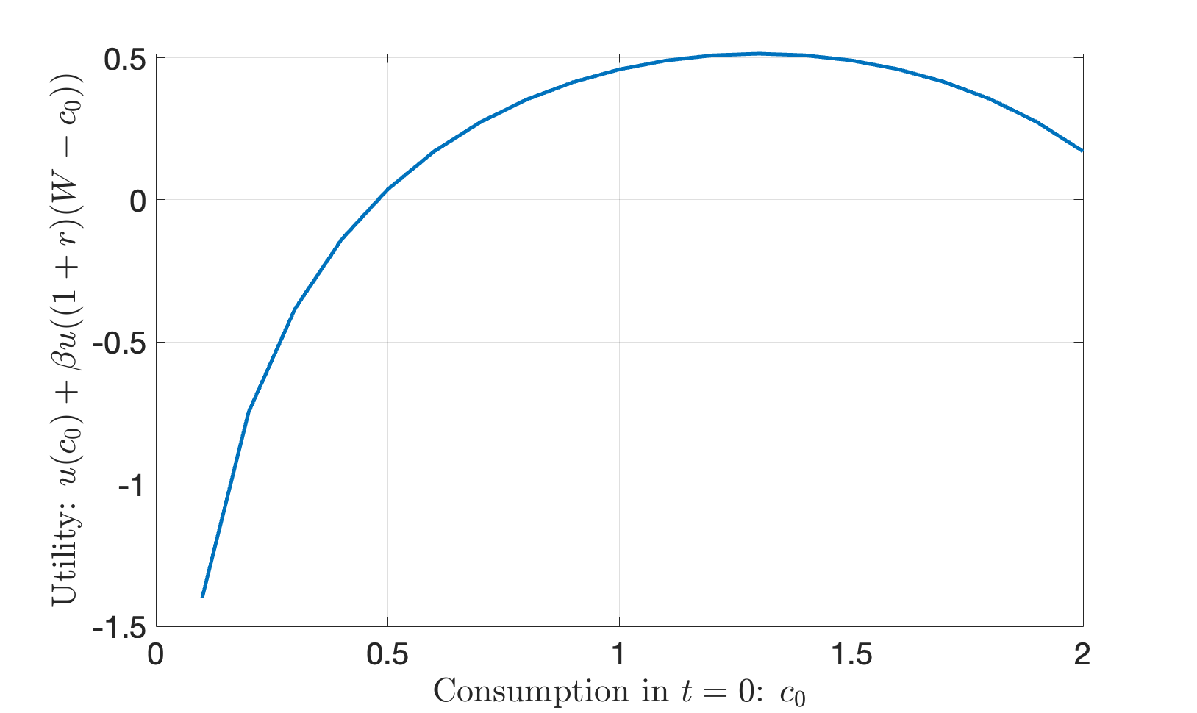
Consumption with two periods
Why first-order conditions?

Slide 18
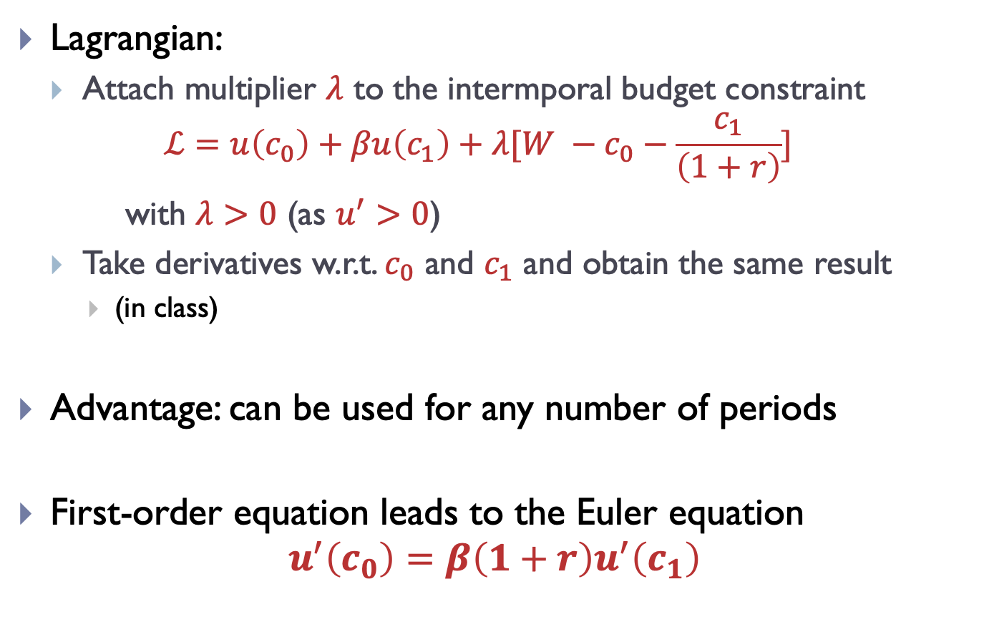
Household optimization: Lagrangian
Lagrangian:
Attach multiplier $λ$ to the intermporal budget constraint
$$ℒ=u\left(c_{0}\right)+βu\left(c_{1}\right)+λ[W −c_{0}−\frac{c_{1}}{\left(1+r\right)}]$$
with $λ>0$ (as $u^{′}>0$)
Take derivatives w.r.t. $c_{0}$ and $c_{1}$ and obtain the same result
(in class)
Advantage: can be used for any number of periods
First-order equation leads to the Euler equation
$$u^{′}\left(c_{0}\right)=β\left(1+r\right)u^{′}\left(c_{1}\right)$$

Slide 19
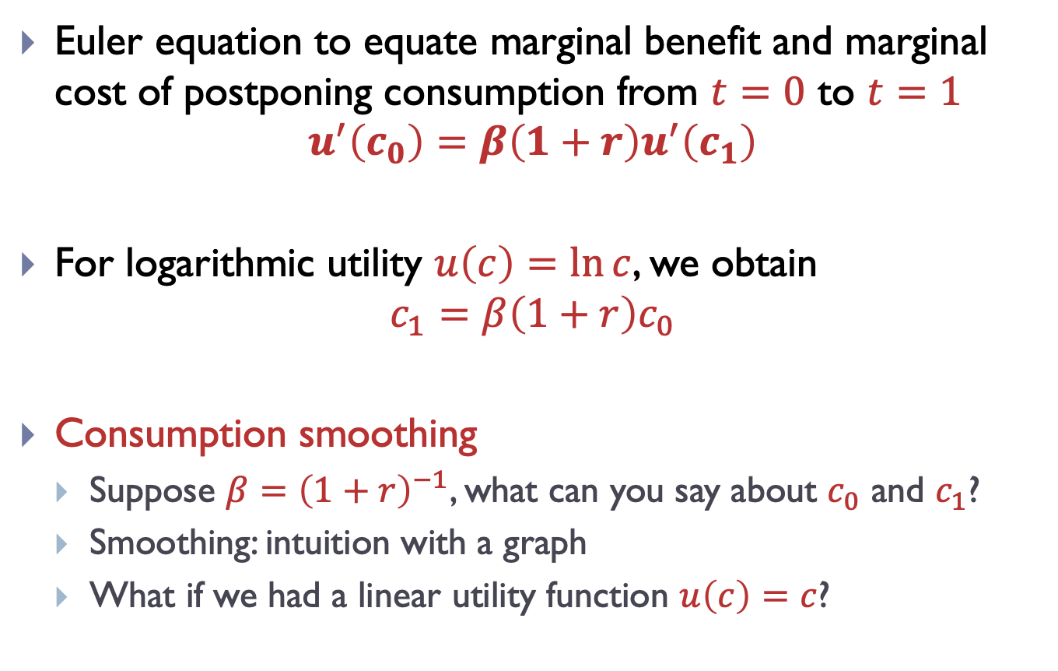
Euler equation
Euler equation to equate marginal benefit and marginal cost of postponing consumption from $t=0$ to $t=1$
$$u^{′}\left(c_{0}\right)=β\left(1+r\right)u^{′}\left(c_{1}\right)$$
For logarithmic utility $u\left(c\right)=\ln{c}$, we obtain
$$c_{1}=β\left(1+r\right)c_{0}$$
Consumption smoothing
Suppose $β={\left(1+r\right)}^{−1}$, what can you say about $c_{0}$ and $c_{1}$?
Smoothing: intuition with a graph
What if we had a linear utility function $u\left(c\right)=c$?
Notes:
The key distinction here is that consumption depends only on total wealth, while savings depends on the distribution of income over time.
Consumption smoothing: saving and borrowing allows the agent to choose consumption that is not affected by consumption fluctuations.
Experiment: imagine that y_1 increases and y_2 decreases so that W stays the same. Then consumption stays the same and s_1 therefore increases to save part of the higher income in period 1 for period 2.

Slide 20
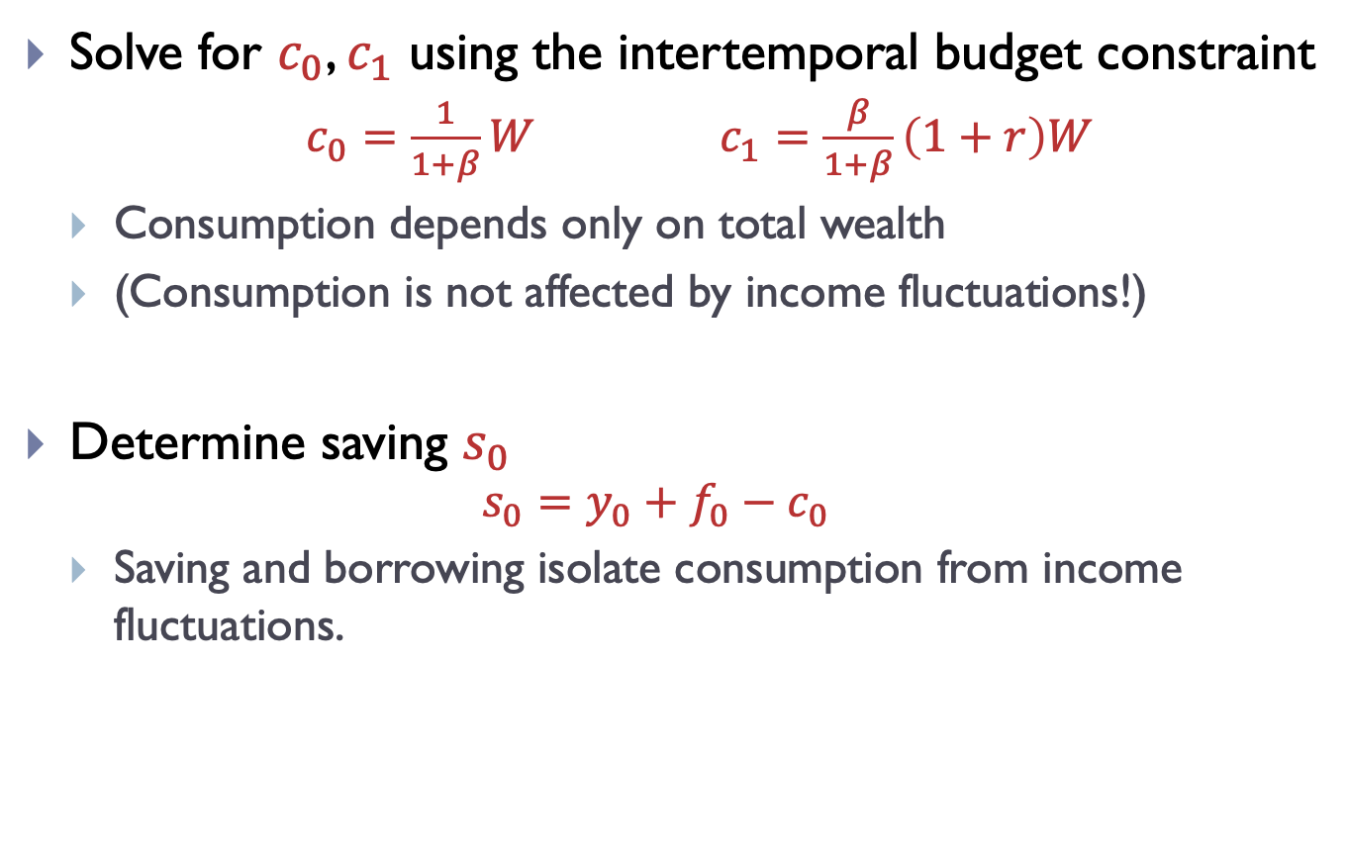
Analysis of the Euler equation
Solve for $c_{0}$, $c_{1}$ using the intertemporal budget constraint
$c_{0}=\frac{1}{1+β}W$ $c_{1}=\frac{β}{1+β}\left(1+r\right)W$
Consumption depends only on total wealth
(Consumption is not affected by income fluctuations!)
Determine saving $s_{0}$
$$s_{0}=y_{0}+f_{0}−c_{0}$$
Saving and borrowing isolate consumption from income fluctuations.
Notes:
The key distinction here is that consumption depends only on total wealth, while savings depends on the distribution of income over time.
Consumption smoothing: saving and borrowing allows the agent to choose consumption that is not affected by consumption fluctuations.
Experiment: imagine that y_1 increases and y_2 decreases so that W stays the same. Then consumption stays the same and s_1 therefore increases to save part of the higher income in period 1 for period 2.

Slide 21
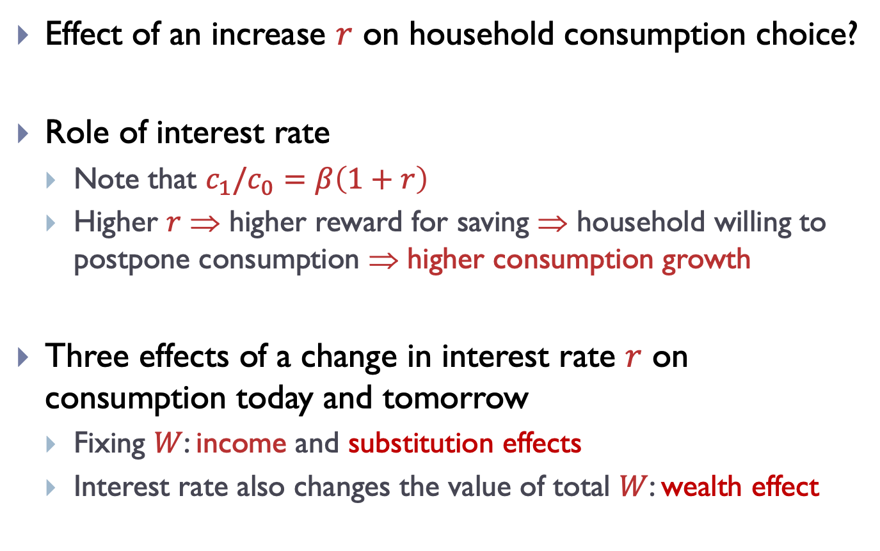
Consumption and interest rate
Effect of an increase $r$ on household consumption choice?
Role of interest rate
Note that $c_{1}/c_{0}=β\left(1+r\right)$
Higher $r$ $$ higher reward for saving $$ household willing to postpone consumption $$ higher consumption growth
Three effects of a change in interest rate $r$ on consumption today and tomorrow
Fixing $W$: income and substitution effects
Interest rate also changes the value of total $W$: wealth effect
Notes:
Decide whether the original slide in dropped slides isn’t better.
Show on board that c_1 indeed decreases and c_2 increases
Explain that the magnitude of the wealth effect depends on how large y_2 is
Explain that the substitution and wealth effects operate in the budget constraint, holding W constant.

Slide 22
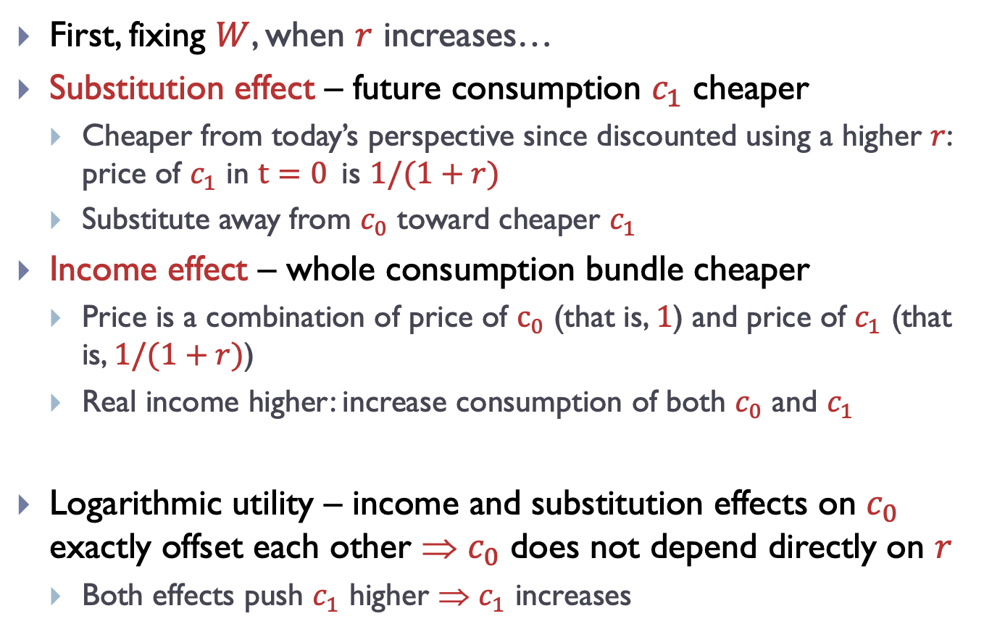
Substitution and income effects
First, fixing $W$, when $r$ increases…
Substitution effect – future consumption $c_{1}$ cheaper
Cheaper from today’s perspective since discounted using a higher $r$: price of $c_{1}$ in $t=0$is $1/(1+r)$
Substitute away from $c_{0}$ toward cheaper $c_{1}$
Income effect – whole consumption bundle cheaper
Price is a combination of price of $c_{0}$ (that is, $1$) and price of $c_{1}$ (that is, $1/(1+r)$)
Real income higher: increase consumption of both $c_{0}$ and $c_{1}$
Logarithmic utility – income and substitution effects on $c_{0}$ exactly offset each other $$ $c_{0}$ does not depend directly on $r$
Both effects push $c_{1}$ higher $$ $c_{1}$ increases
Notes:
Decide whether the original slide in dropped slides isn’t better.
Show on board that c_1 indeed decreases and c_2 increases
Explain that the magnitude of the wealth effect depends on how large y_2 is
Explain that the substitution and wealth effects operate in the budget constraint, holding W constant.

Slide 23
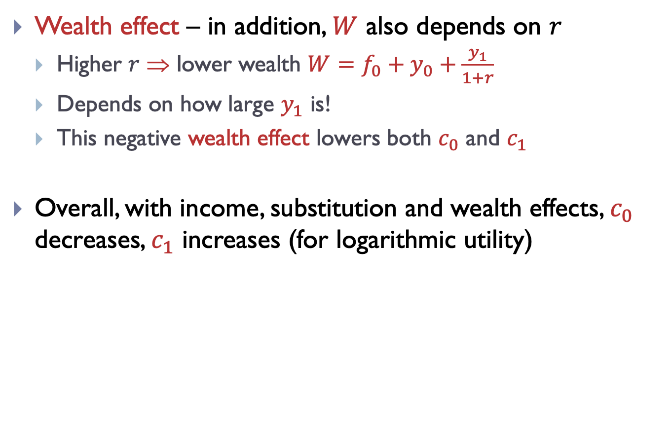
Wealth effects
Wealth effect – in addition, $W$ also depends on $r$
Higher $r$ $$ lower wealth $W=f_{0}+y_{0}+\frac{y_{1}}{1+r}$
Depends on how large $y_{1}$ is!
This negative wealth effect lowers both $c_{0}$ and $c_{1}$
Overall, with income, substitution and wealth effects, $c_{0}$ decreases, $c_{1}$ increases (for logarithmic utility)
Notes:
Decide whether the original slide in dropped slides isn’t better.
Show on board that c_1 indeed decreases and c_2 increases
Explain that the magnitude of the wealth effect depends on how large y_2 is
Explain that the substitution and wealth effects operate in the budget constraint, holding W constant.

Slide 24
Outline
Aggregate demand and its components
Neoclassical consumption model
Utility maximization problem
Implications of the neoclassical consumption model
Permanent income hypothesis
Ricardian equivalence
MPC and borrowing constraints

Slide 25
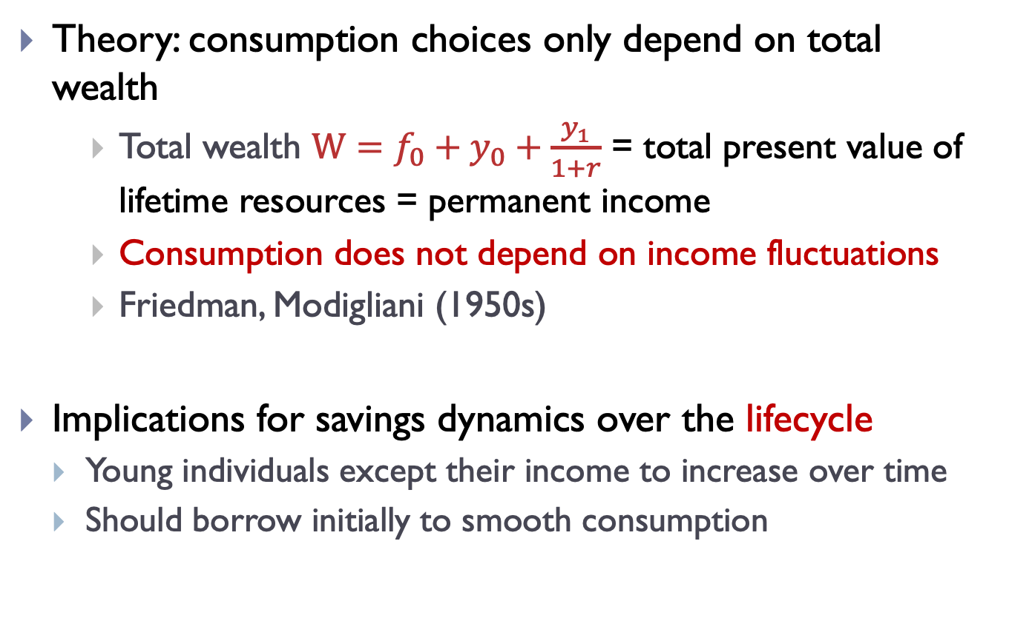
Permanent income hypothesis
Theory: consumption choices only depend on total wealth
Total wealth $W=f_{0}+y_{0}+\frac{y_{1}}{1+r}$ = total present value of lifetime resources = permanent income
Consumption does not depend on income fluctuations
Friedman, Modigliani (1950s)
Implications for savings dynamics over the lifecycle
Young individuals except their income to increase over time
Should borrow initially to smooth consumption

Slide 26
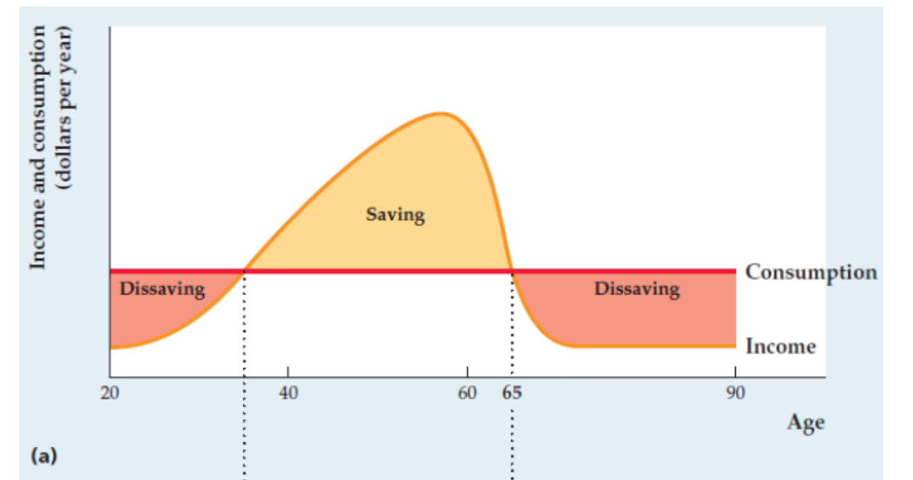
PHI and lifecycle dynamics
Implications for savings dynamics over the lifecycle

Slide 27
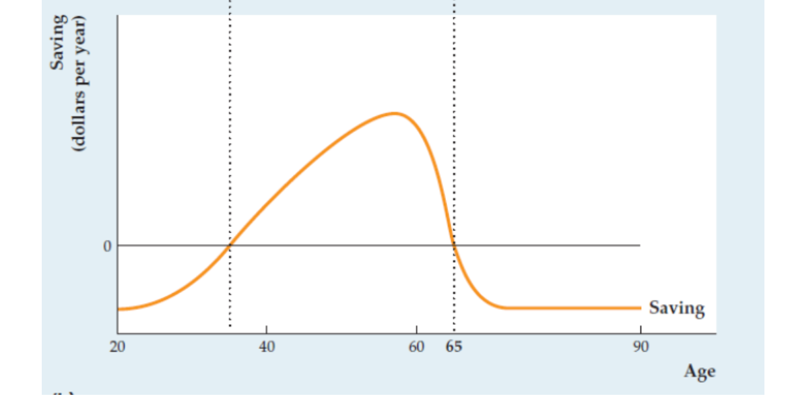
PHI and lifecycle dynamics
Implications for savings dynamics over the lifecycle

Slide 28
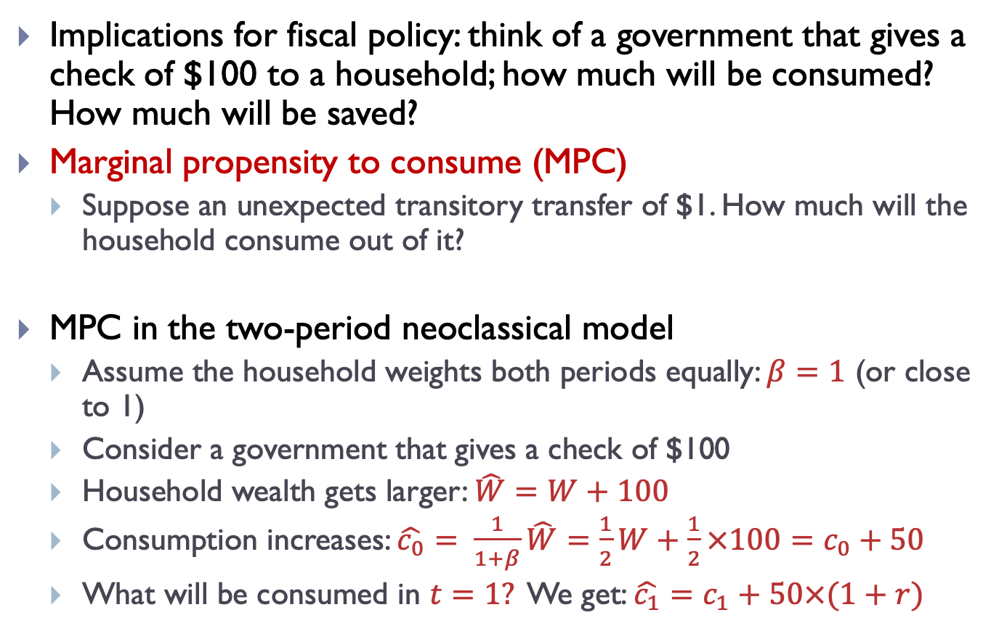
PIH and MPC
Implications for fiscal policy: think of a government that gives a check of $100 to a household; how much will be consumed? How much will be saved?
Marginal propensity to consume (MPC)
Suppose an unexpected transitory transfer of $1. How much will the household consume out of it?
MPC in the two-period neoclassical model
Assume the household weights both periods equally: $β=1$ (or close to 1)
Consider a government that gives a check of $100
Household wealth gets larger: $\hat{W}=W+100$
Consumption increases: $\hat{c_{0}}= \frac{1}{1+β}\hat{W}=\frac{1}{2}W+\frac{1}{2}×100=c_{0}+50$
What will be consumed in $t=1?$ We get: $\hat{c_{1}}=c_{1}+50×(1+r)$

Slide 29
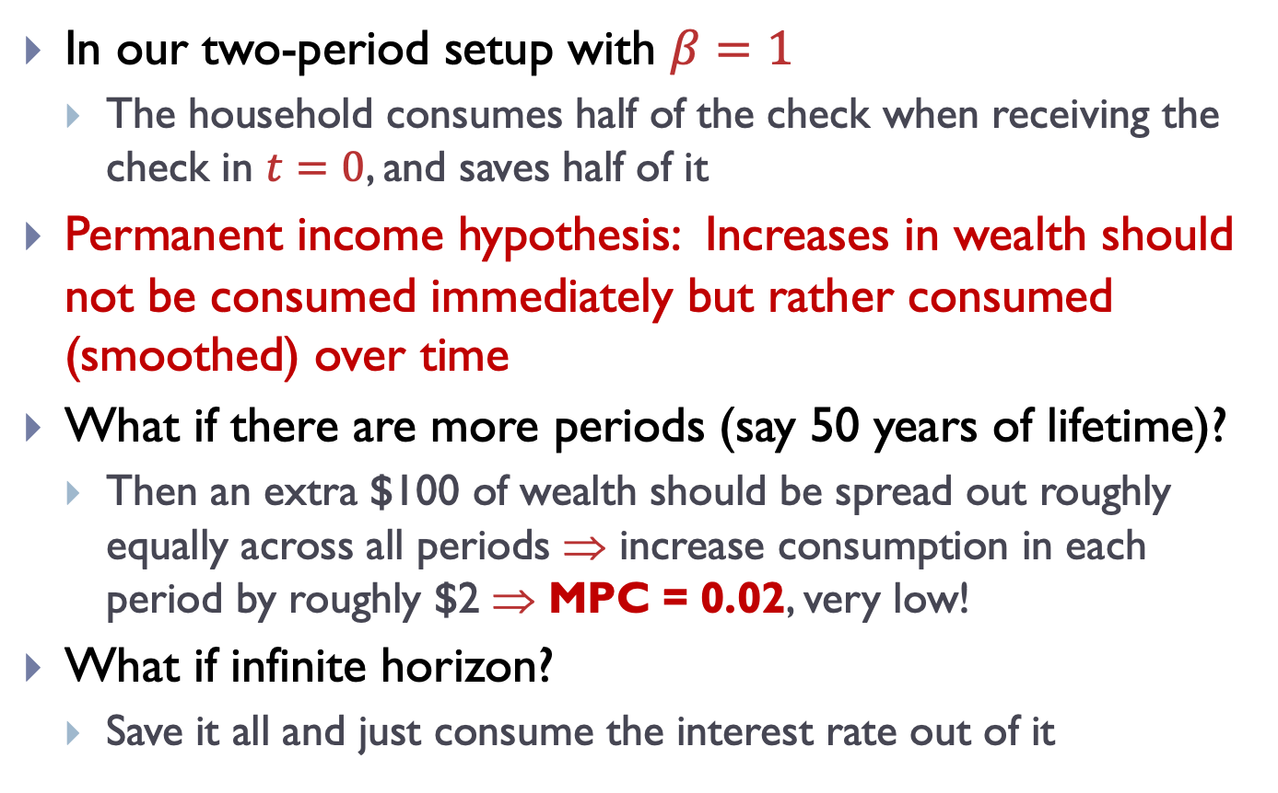
PIH and MPC
In our two-period setup with $β=1$
The household consumes half of the check when receiving the check in $t=0$, and saves half of it
Permanent income hypothesis: Increases in wealth should not be consumed immediately but rather consumed (smoothed) over time
What if there are more periods (say 50 years of lifetime)?
Then an extra $100 of wealth should be spread out roughly equally across all periods $$ increase consumption in each period by roughly $2 $$ MPC = 0.02, very low!
What if infinite horizon?
Save it all and just consume the interest rate out of it

Slide 30
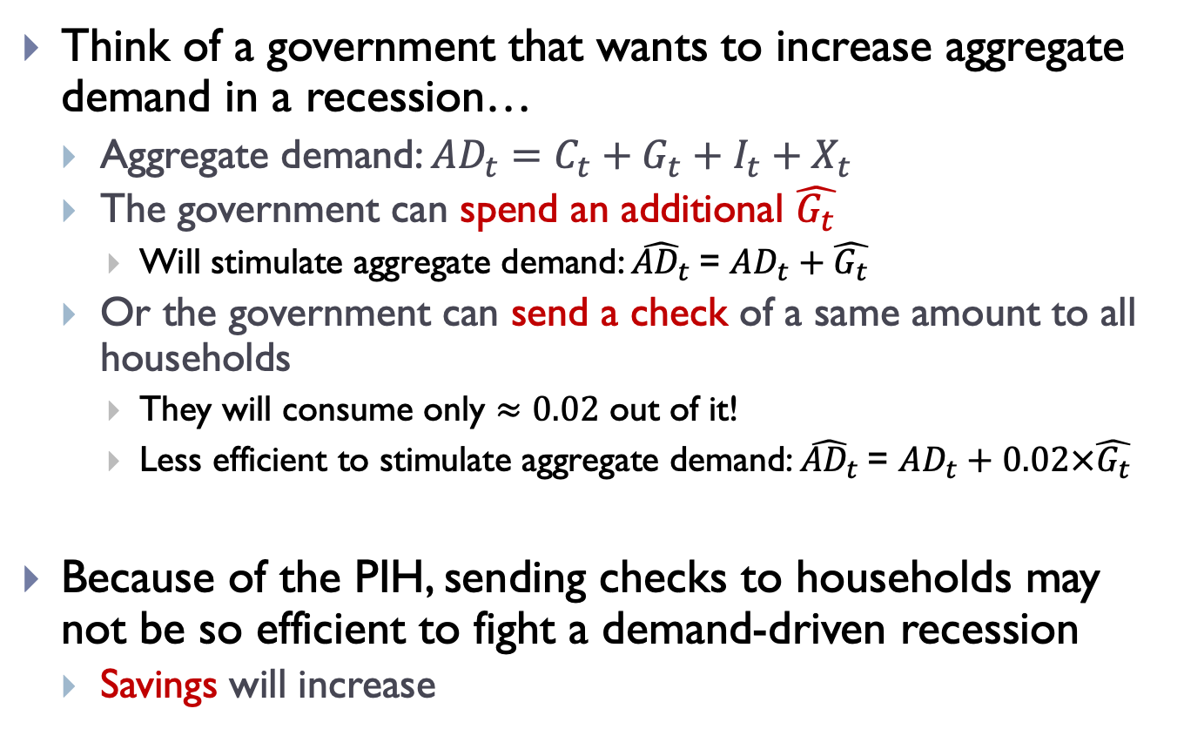
PIH and fiscal stimulus
Think of a government that wants to increase aggregate demand in a recession…
Aggregate demand: ${AD_{t}=C}_{t}+G_{t}+I_{t}+X_{t}$
The government can spend an additional $\hat{G_{t}}$
Will stimulate aggregate demand: $\hat{{AD}_{t}}$= $AD_{t}+\hat{G_{t}}$
Or the government can send a check of a same amount to all households
They will consume only $≈0.02$ out of it!
Less efficient to stimulate aggregate demand: $\hat{{AD}_{t}}$= $AD_{t}+0.02×\hat{G_{t}}$
Because of the PIH, sending checks to households may not be so efficient to fight a demand-driven recession
Savings will increase

Slide 31
PIH and fiscal stimulus
Think of a government that wants to increase aggregate demand in a recession…
What about announcing a check that will be given next period only?
What are the effects of news?

Slide 32
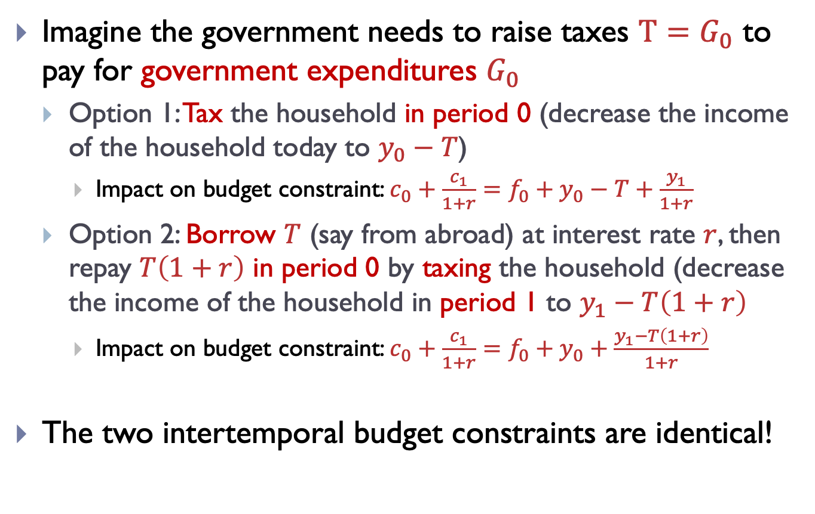
PIH and Ricardian Equivalence
Imagine the government needs to raise taxes $T=G_{0}$ to pay for government expenditures $G_{0}$
Option 1: Tax the household in period 0 (decrease the income of the household today to $y_{0}−T$)
Impact on budget constraint: $c_{0}+\frac{c_{1}}{1+r}=f_{0}+y_{0}−T+\frac{y_{1}}{1+r}$
Option 2: Borrow $T$ (say from abroad) at interest rate $r$, then repay $T\left(1+r\right)$ in period 0 by taxing the household (decrease the income of the household in period 1 to $y_{1}−T\left(1+r\right)$
Impact on budget constraint: $c_{0}+\frac{c_{1}}{1+r}=f_{0}+y_{0}+\frac{y_{1}−T\left(1+r\right)}{1+r}$
The two intertemporal budget constraints are identical!

Slide 33
PIH and RE
Same impact of both policies!
Ricardian equivalence: the timing of taxes does not matter, only the present value of taxes (which is the same in both cases).
Why? If households are taxed a lot today, they borrow to smooth out the impact of taxes on their income today, and vice versa.
What’s irrelevant is the timing of taxes, not their amount
Supported by the data?
Hard to answer this question. Why?
All spending shocks happen at different points in time
Exogenous government spending but endogenous response of public finance?

Slide 34
Outline
Aggregate demand and its components
Neoclassical consumption model
Utility maximization problem
Implications of the neoclassical consumption model
Permanent income hypothesis
Ricardian equivalence
MPC and borrowing constraints

Slide 35
PIH in the data
What is MPC in the data?
How much do households consume when receiving a check from the government?
Several examples in the data
Sending check is not an unusual policy in the United States
In 2001, in 2008, during Covid …
Depends on details of implementation of the fiscal program
Persistent or temporary; and known or not known
Typical program: temporary (one-off) and announced
MPC should be small or zero

Slide 36
MPC in the data
Booming literature since 2000s
Using US data
Using lotteries in Sweden
Using UK data
…
“Consumer Spending and the Economic Stimulus Payments of 2008”, by Parker, Souleles, Johnson and McClelland (2013)
“A Model of the Consumption Response to Fiscal Stimulus Payments”, by Kaplan and Violante (2014)
“Consumption, Income Changes, and Heterogeneity: Evidence from Two Fiscal Stimulus Programs”, by Misra and Surico (2014)
“Does Consumption Respond to Transitory Shocks? Reconciling Natural Experiments and Semistructural Methods”, Commault (2022)
…

Slide 37
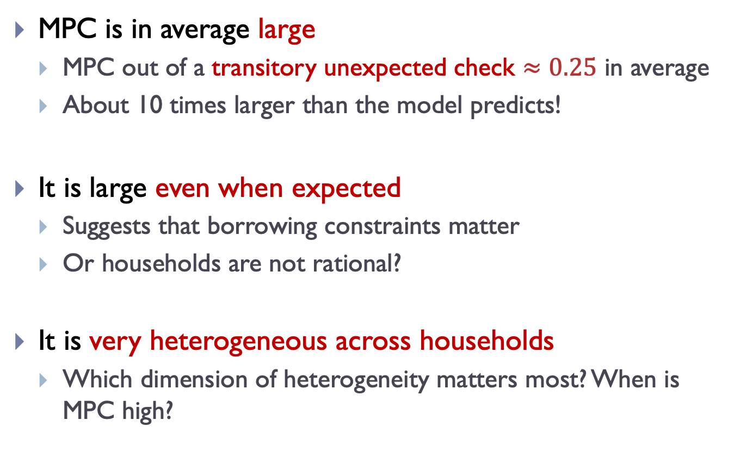
MPC in the data: Main findings
MPC is in average large
MPC out of a transitory unexpected check $≈0.25$ in average
About 10 times larger than the model predicts!
It is large even when expected
Suggests that borrowing constraints matter
Or households are not rational?
It is very heterogeneous across households
Which dimension of heterogeneity matters most? When is MPC high?

