Slide 1
The Battle of Neighborhoods
Axel Morales Alfaro

Slide 2
Introduction/buSiness problem
Currently many people come to the city of Toronto or Manhattan to seek and obtain better and more job opportunities and for that reason they need to hear about recommendations or suggestions on appropriate and effective neighborhoods to live, for example in which there are nearby places such as supermarkets, hospitals , shops, and schools that help improve the quality of life

Slide 3
This project is going to be carried out with the purpose of knowing which neighborhoods are the best indicated and which are adjusted to the respective needs and which have greater nearby facilities.

Slide 4
Problem description
The problem to be solved in this analysis is to find the best and most appropriate neighborhood to live according to the characteristics mentioned above and that contributes to giving a better quality of life especially for people who come from other cities or towns to seek new and greater job opportunities in Toronto and Manhattan.

Slide 5
Clustering approach
The analysis of each neighborhood will be carried out using the clustering technique that consists of exploring and reviewing the neighborhoods, segmenting them and finally grouping them into clusters to obtain the results.

Slide 6
Data description
The data on the neighborhoods will be extracted from the website Wikipedia.com by means of the scrapping technique and this data will be stored in a dataframe for .
A geocoder library will be used in order to extract the latitude and longitude of each neighborhood.
The Foursquare API will be used in order to obtain the main characteristics of each neighborhood, such as:
Neighborhood
Neighborhood Longitude
Neighborhood Latitude
Venue
Venue name
Venue Category
Venue Longitude
Venue Latitude
Venue Rating
Columns that are unnecessary or unrelated to the analysis will be cleaned.

Slide 7
Data preparation
Here we are going to extract the data from the web page Wikipedia (Used in this course for another analysis) and put this data into a dataframe.
Then we will clean the data that is not needed for this study or analysis and to replace null columns or values.

Slide 8
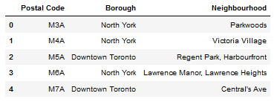
Toronto table

Slide 9
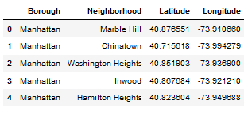
Manhattan table

Slide 10

After that data is cleaned and prepared we are going to follow with the analysis.

Slide 11
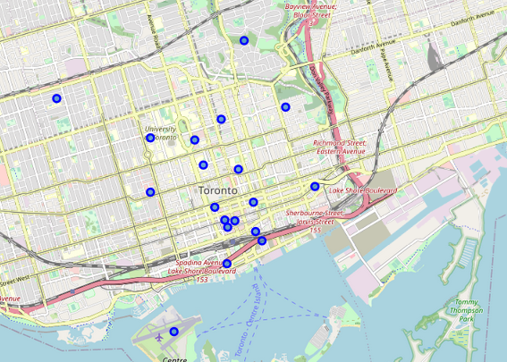
TORONTO MAPS

Slide 12
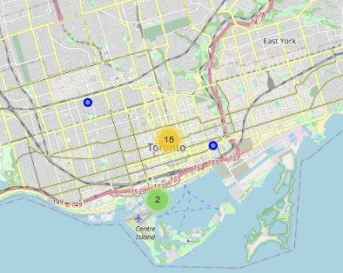

Slide 13
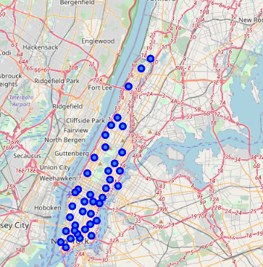
Manhattan maps

Slide 14
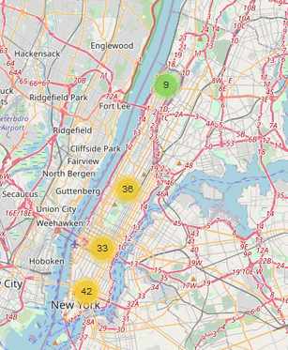

Slide 15
Analysis of data

Slide 16
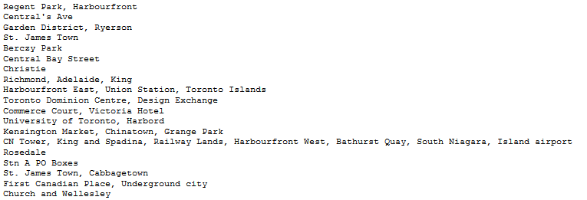
WE ARE GOING TO EXPLORE NEIGHBORHOODS IN DOWNTOWN TORONTO

Slide 17
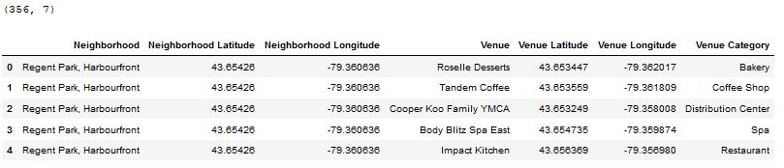

Slide 18
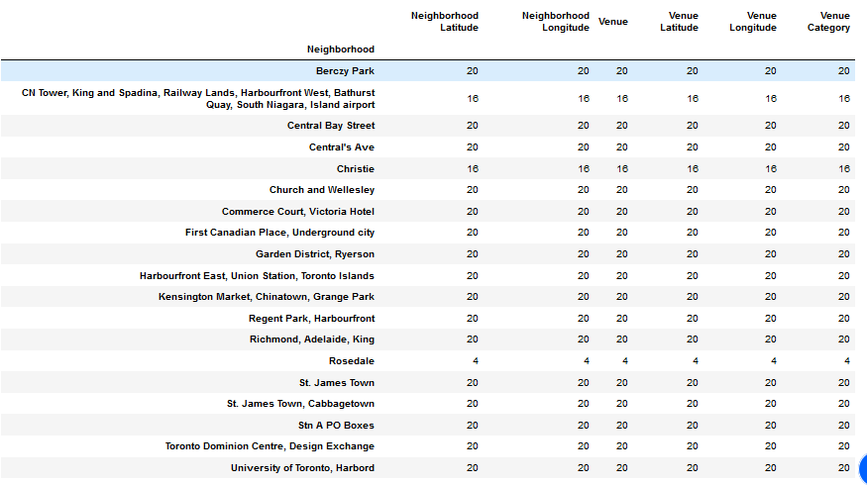

Slide 19
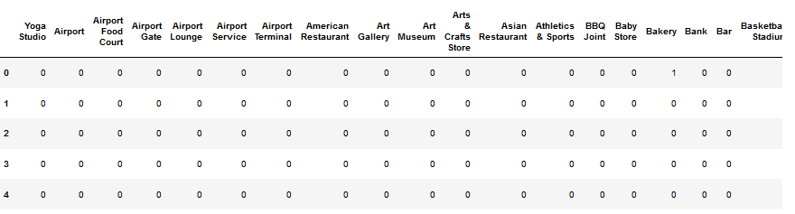

Slide 20
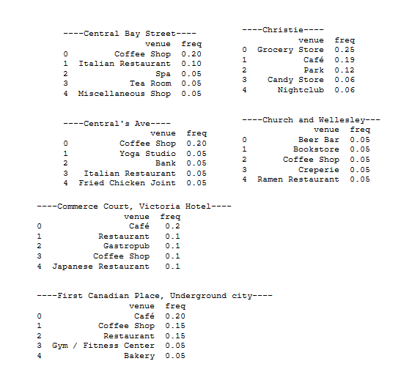
Some examples of places

Slide 21
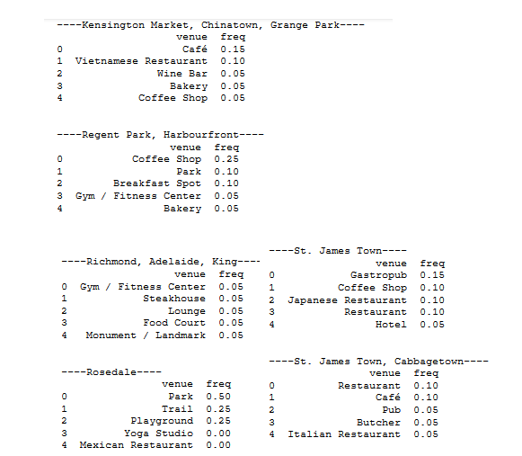
Some examples of places

Slide 22
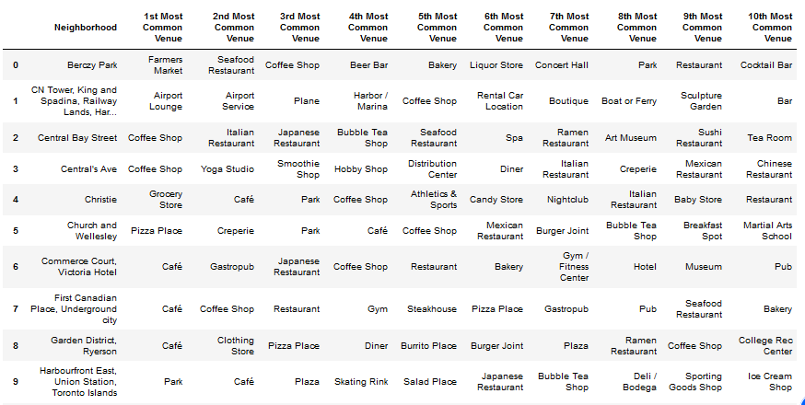

Slide 23
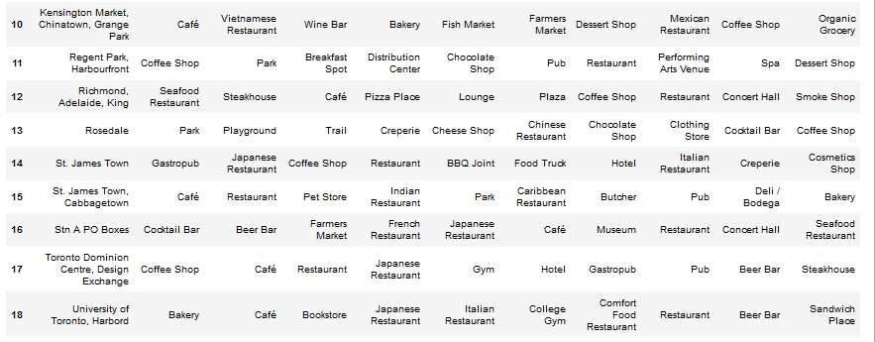

Slide 24
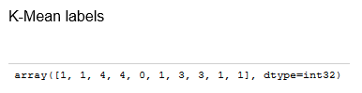

Slide 25
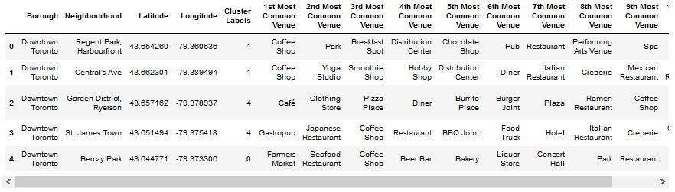


Slide 26
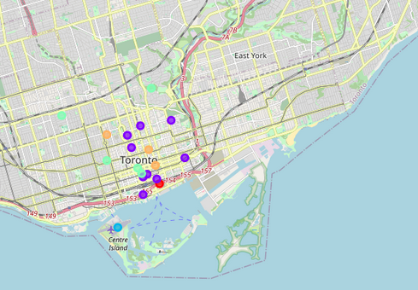

Slide 27
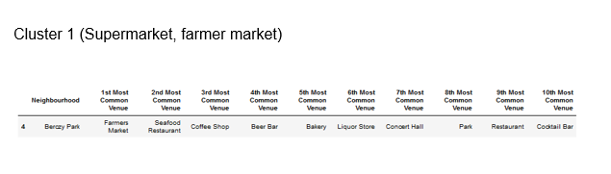

Slide 28
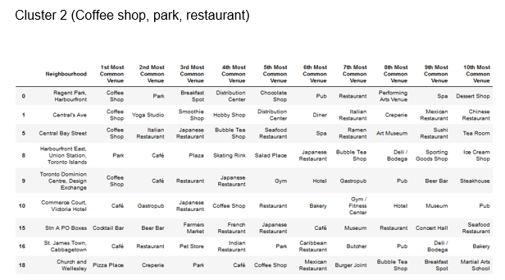

Slide 29
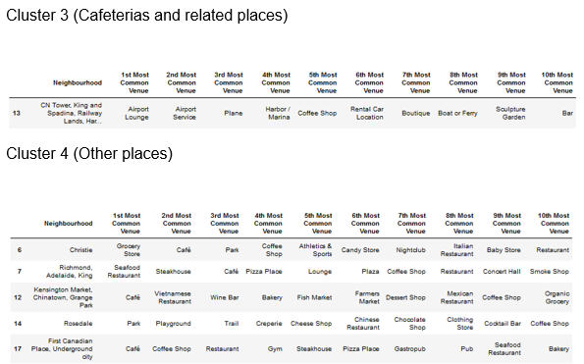

Slide 30
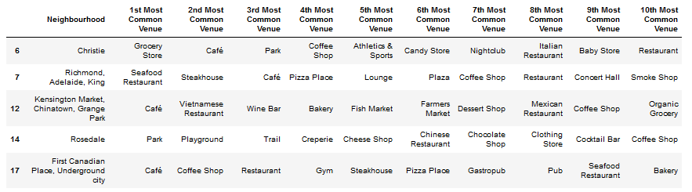

Slide 31
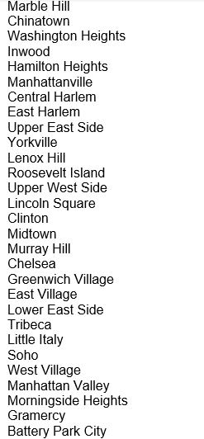

We are going to explore neighborhoods in Manhattan

Slide 32
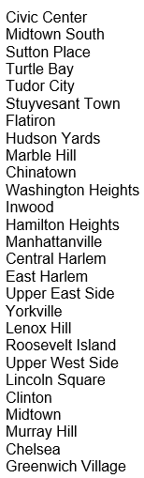
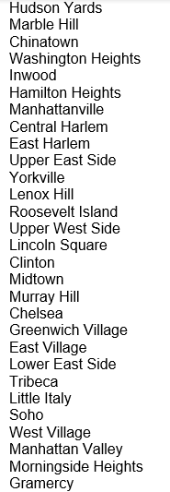
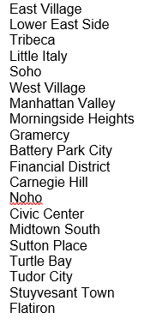
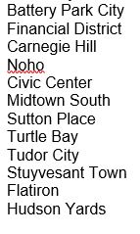

Slide 33
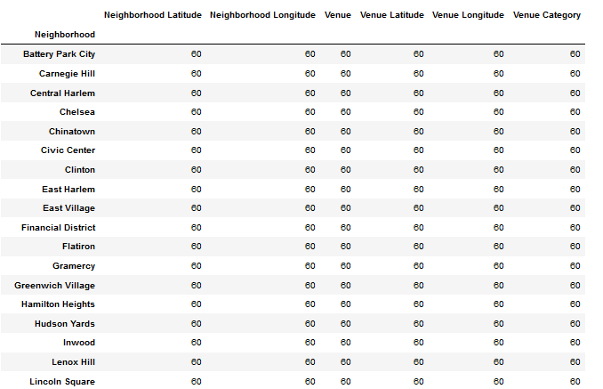

Slide 34
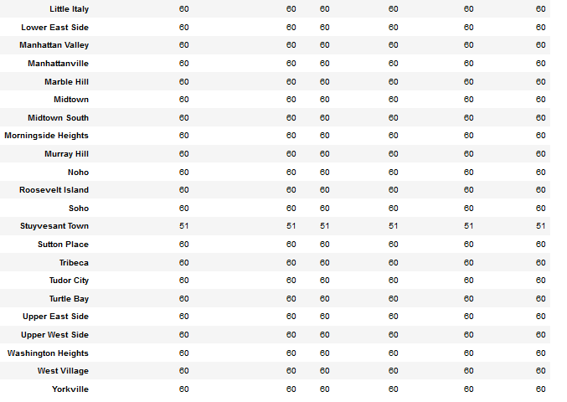

Slide 35
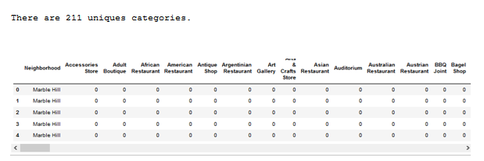

Slide 36
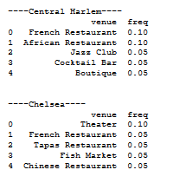
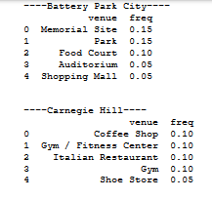
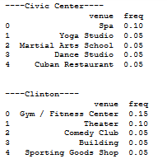
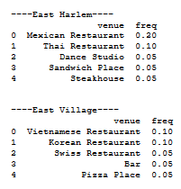
Some examples of places

Slide 37
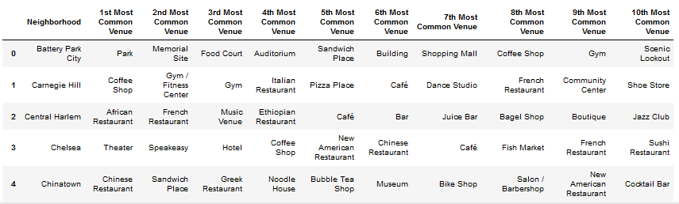

Slide 38
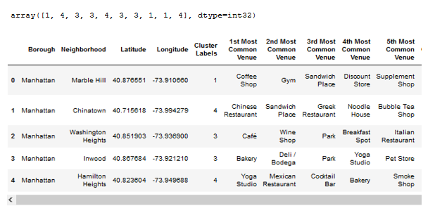

Slide 39
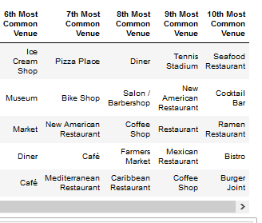

Slide 40
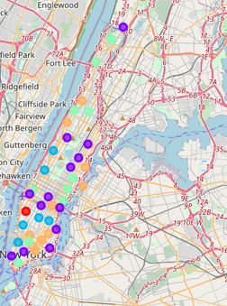

Slide 41
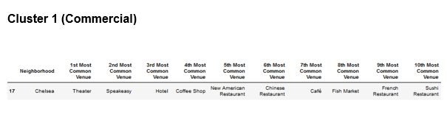

Slide 42
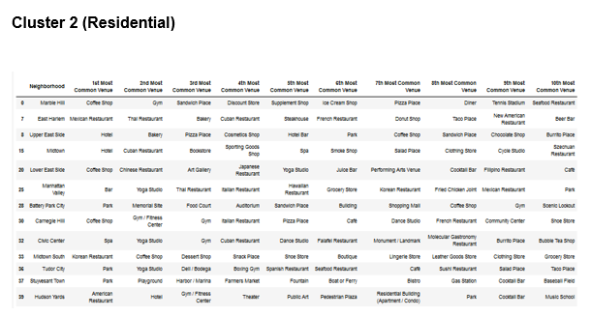

Slide 43
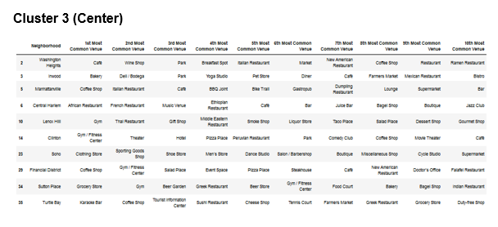

Slide 44
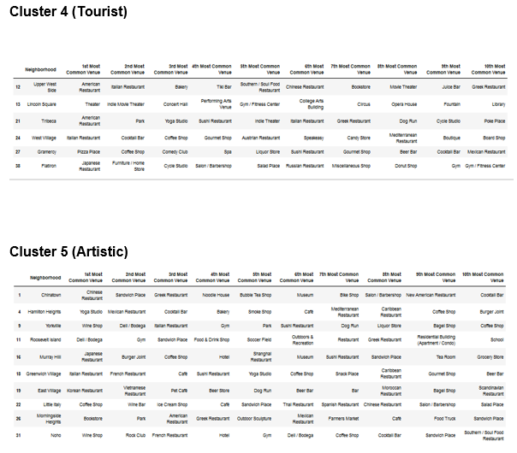

Slide 45
Conclusions and final results
For Toronto , at the end of the clustering, it is concluded that cluster number two is the one that shows the largest amounts of records and that means that people have greater interest in this area group respectively compared to the other areas.
For Manhattan , at the end of clustering, it can be stated that clusters 2 to 5 have similar amounts and that means that people residing in that area or tourists show a greater attraction to this type of area compared to the commercial area that only returned a result or record.
Carrying out this analysis is very important because more people are coming to these types of cities to find better job opportunities or just for tourism and pleasure and it is very important that there is a statistical record of the places that are most frequented or with the best rating to give better advertising.

