Slide 1
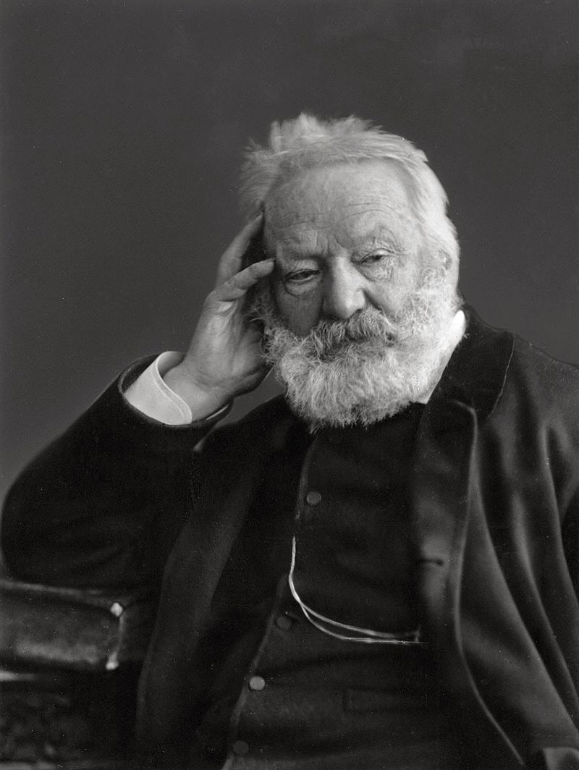
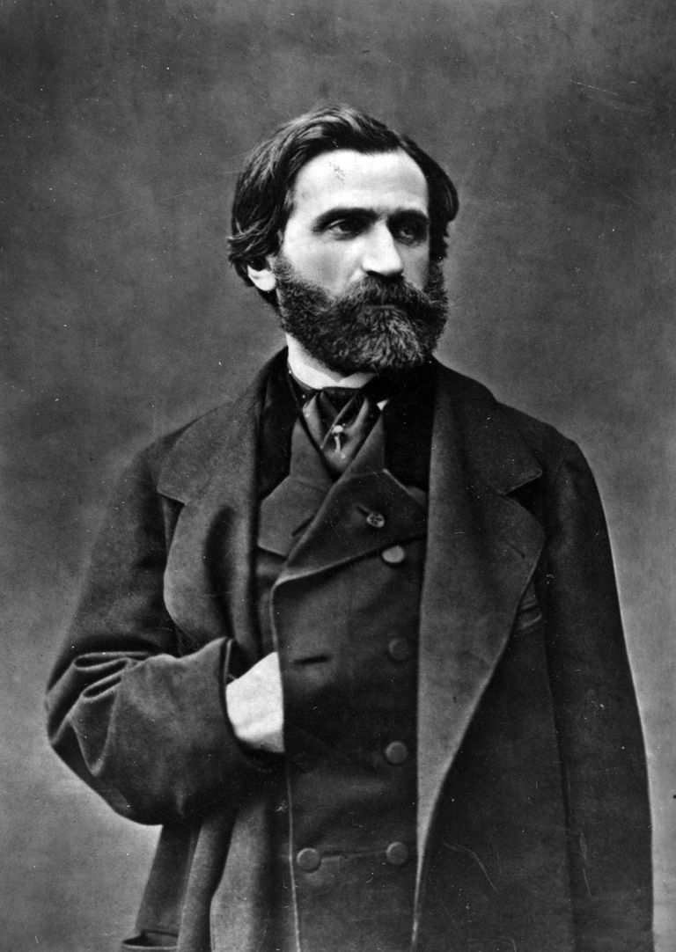

Theatre-Libretto comparison
Verdi – Hugo : “le roi s’amuse” and “Rigoletto”

Slide 2
