Slide 1
React (Native) Workshop
10.09. – 11.09.2018

Slide 2
Browser???
The purpose of a web browser is to fetch information resources and display them on a user's device.
Once a web page has been retrieved, the browser's rendering engine displays it on the user's device.
To implement all of this, modern browsers are a combination of numerous software components.
https://medium.com/@monica1109/how-does-web-browsers-work-c95ad628a509

Slide 3
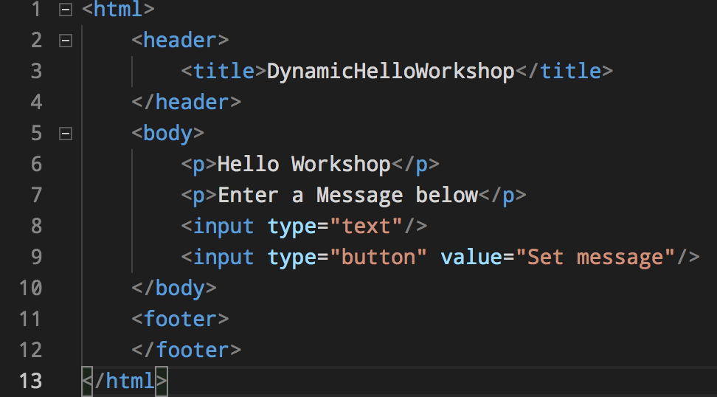
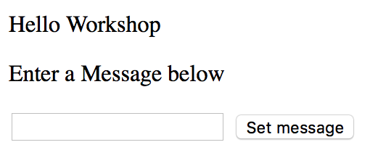
HTML???
Hypertext Markup Language (HTML) is the standard markup language for creating web pages and web applications. With Cascading Style Sheets(CSS) and JavaScript, it forms a triad of cornerstone technologies for the World Wide Web.^{[4]}

Slide 4
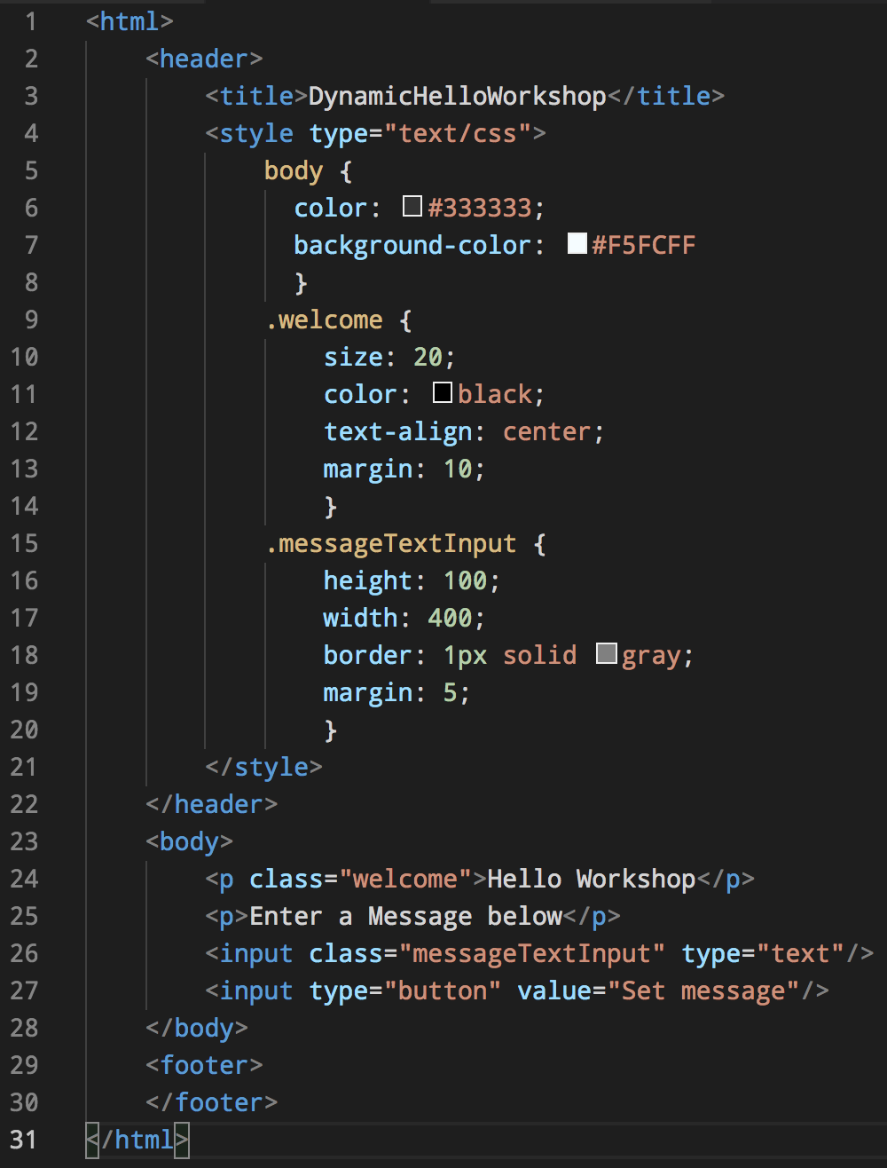
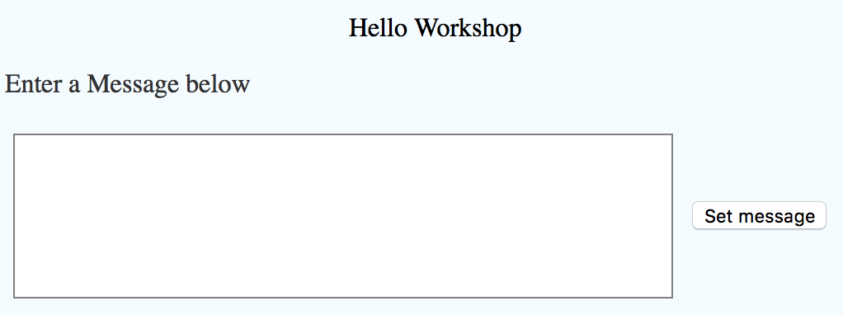
CSS???

Slide 5
Javascript???
JavaScript (/ˈdʒɑːvəˌskrɪpt/),^{[7]} often abbreviated as JS, is a high-level, interpreted programming language. It is a language which is also characterized as dynamic, weakly typed, prototype-based and multi-paradigm.
As a multi-paradigm language, JavaScript supports event-driven, functional, and imperative (including object-oriented and prototype-based) programming styles. It has an API for working with text, arrays, dates, regular expressions, and basic manipulation of the DOM, but the language itself does not include any I/O, such as networking, storage, or graphics facilities, relying for these upon the host environment in which it is embedded.
Initially only implemented client-side in web browsers, JavaScript engines are now embedded in many other types of host software, including server-side in web servers and databases, and in non-web programs such as word processors and PDF software, and in runtime environments that make JavaScript available for writing mobile and desktop applications, including desktop widgets.
ECMAScript is based on several originating technologies, the most well-known being JavaScript (Netscape) and JScript (Microsoft). The language was invented by Brendan Eich at Netscape and first appeared in that company's Navigator 2.0 browser. It has appeared in all subsequent browsers from Netscape and in all browsers from Microsoft starting with Internet Explorer 3.0.
ECMAScript is commonly used for client-side scripting on the World Wide Web, and it is increasingly being used for writing server applications and services using Node.js.

Slide 6
JSON???
In computing, JavaScript Object Notation or JSON (/ˈdʒeɪsən/ "jay-son", /dʒeɪˈsɒn/)^{[1]} is an open-standard file format that uses human-readable text to transmit data objects consisting of attribute–value pairs and array data types (or any other serializable value). It is a very common data format used for asynchronous browser–server communication, including as a replacement for XML in some AJAX-style systems.^{[2]}
JSON is a language-independent data format. It was derived from JavaScript, but as of 2017 many programming languages include code to generate and parse JSON-format data. The official Internet media type for JSON is application/json. JSON filenames use the extension .json
{
"firstName": "John",
"lastName": "Smith",
“interests": [„football“, „soccer“],
"address": {
"streetAddress": "21 2nd Street",
"city": "New York“
}
}

Slide 7
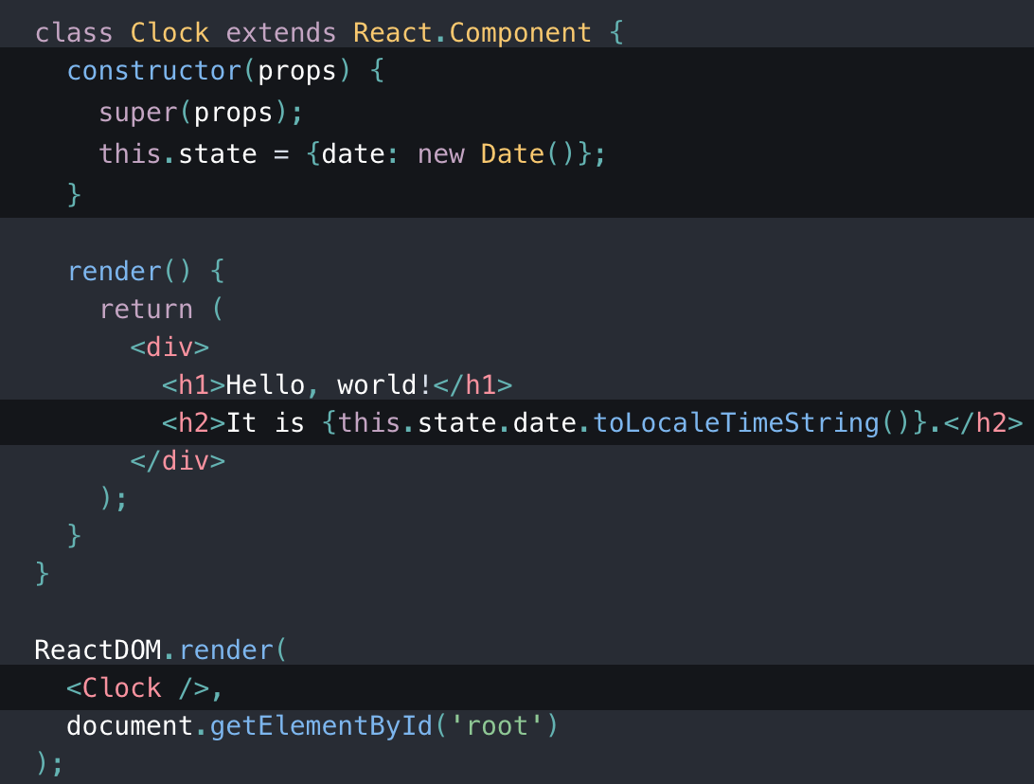
React??? https://reactjs.org/
In computing, React (also known as React.js or ReactJS) is a JavaScript library^{[2]} for building user interfaces. It is maintained by Facebookand a community of individual developers and companies.^{[3][4][5]}
React can be used as a base in the development of single-page or mobile applications. Complex React applications usually require the use of additional libraries for state management, routing, and interaction with an API.^{[6][7]}

Slide 8
Redux??? https://redux.js.org/
Redux is a predictable state container for JavaScript apps.
Store
Includes the App State as immutable(read-only) objects
Actions
Called by components to „create“ data
Reducer
Change the App State by creating and adding a new data object
Single source of truth - The state of your whole application is stored in an object tree within a single store.
State is read-only - The only way to change the state is to emit an action, an object describing what happened.
Changes are made with pure functions - To specify how the state tree is transformed by actions, you write pure reducers.

Slide 9
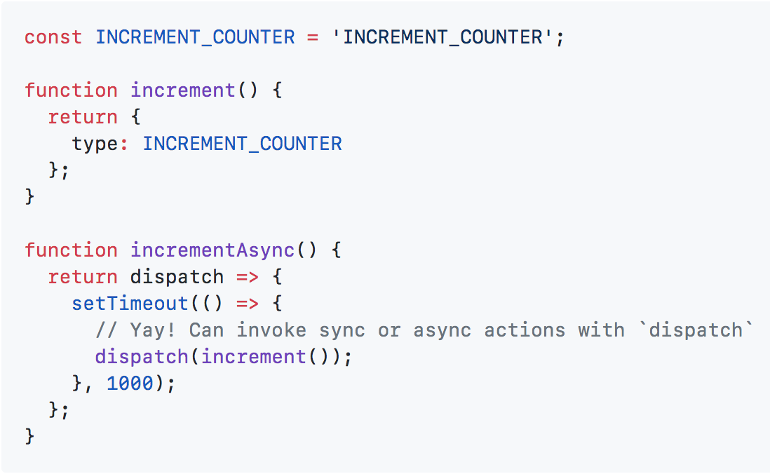
Thunk??? https://github.com/reduxjs/redux-thunk
Redux Thunk middleware allows you to write action creators that return a function instead of an action. The thunk can be used to delay the dispatch of an action, or to dispatch only if a certain condition is met. The inner function receives the store methods dispatch and getState as parameters.
Deeper guide https://medium.com/@stowball/a-dummys-guide-to-redux-and-thunk-in-react-d8904a7005d3

Slide 10
React + Redux + Thunk = App
Reducer
Container
Components
Actions
Server

Slide 11
DynamicHelloWorkshop
messageReducer
message = „Hi Guys!“
AppContainer
SET_MESSAGE
setMessage(„Hi Guys!“)
messageAction

Slide 12
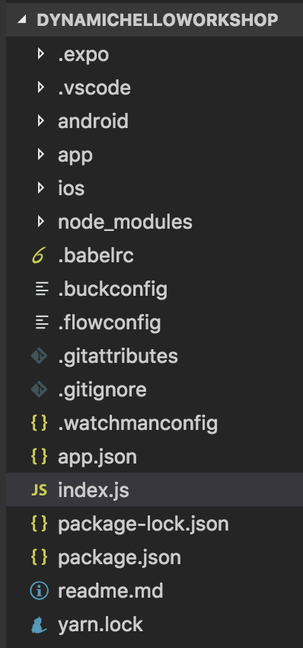
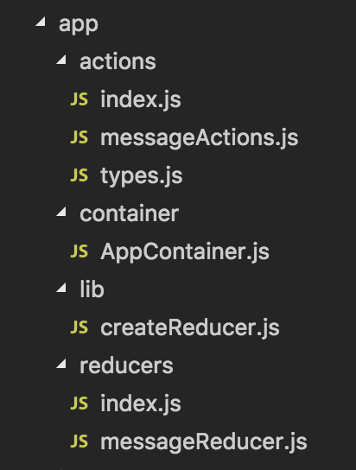
Folder Structure
Android Studio Project
React Native Javascript App
Xcode Project
Meta Configuration
Entry Point
Dependencies

