Slide 1



debbis
Deep Electrocardiogram Based Biometric Identification System
Axel Mukwena, DB727501, Group 20 | Supervised by Prof. Liming Zhang
2021 FYP, Computer Science, Faculty of Science and Technology

Slide 2
Overview
Objectives
Background
System Structure
Data Processing
Neural Network Architectures
Results
Challenges
Conclusions

Slide 3
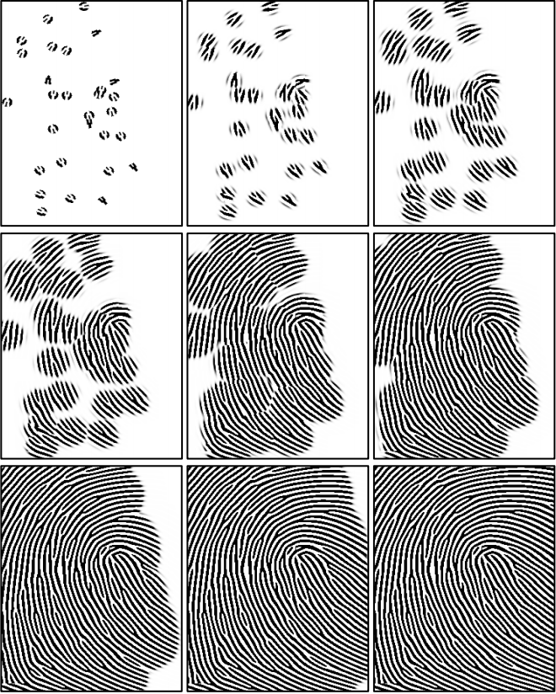
Objectives
Explore ECG biometrics using Deep Learning: CNN and Siamese NN.
Why ECGs?
Universal, unique and guarantees liveness detection
Harder to replicate*
Passwords, pins etc. can get lost, stolen or can be guessed
Fingerprints [1], iris [2] and facial features [3] can be falsified or reverse engineered from templates
Figure 1: Steps during fingerprint reverse engineering from ISO templates. Source [1]

Slide 4
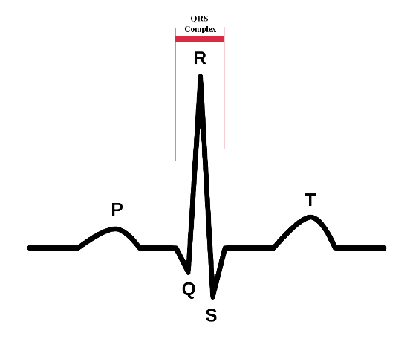
Background
What is Biometric Recognition (BR)?
Establishing an identity based on physiological or physical data.
Current works use [4]:
Fiducial method i.e P, Q, R, S and T
Non-fiducial methods
Partially fiducial methods i.e R-peak detection
Existing Deep Learning implementations [5]
Generic and Temporal CNN
RNN
Autoencoders
Figure 2: Representation of the QRS complex [Wikipedia]

Slide 5
System Structure
Stages of Biometric System
Enrolment
Saving user details on database
Creating templates
Recognition
Verification and or Authentication
Compare test samples to templates and output a match
Notes:
“Biometric recognition” refers to the process of establishing a person’s identity based on their biometric data.

Slide 6
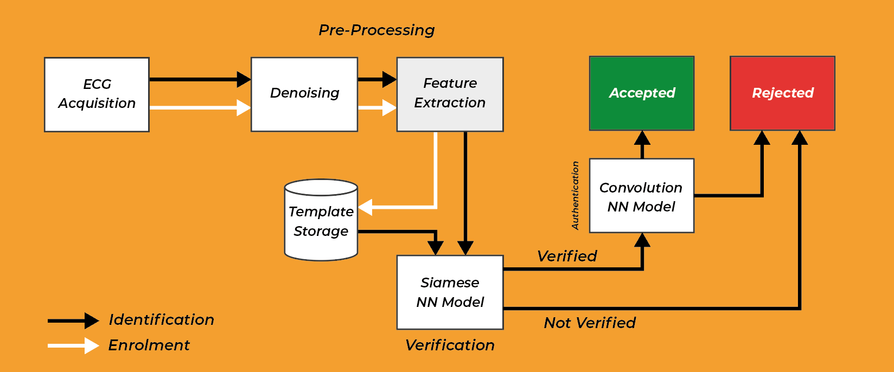
System Structure
Figure 3: a) System flow structure with verification and authentication
Notes:
“Biometric recognition” refers to the process of establishing a person’s identity based on their biometric data.

Slide 7
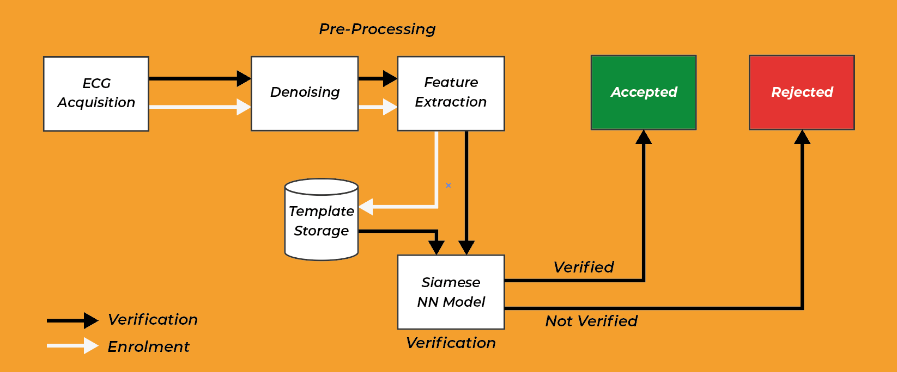
System Structure
Figure 3: b) System flow structure with verification
Notes:
“Biometric recognition” refers to the process of establishing a person’s identity based on their biometric data.

Slide 8
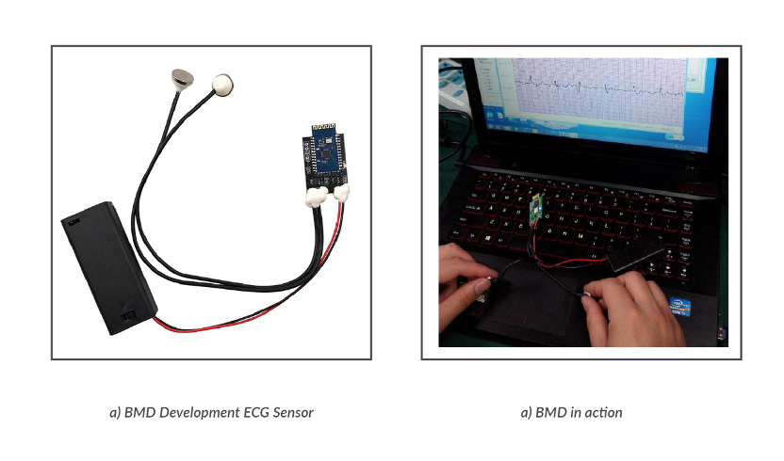
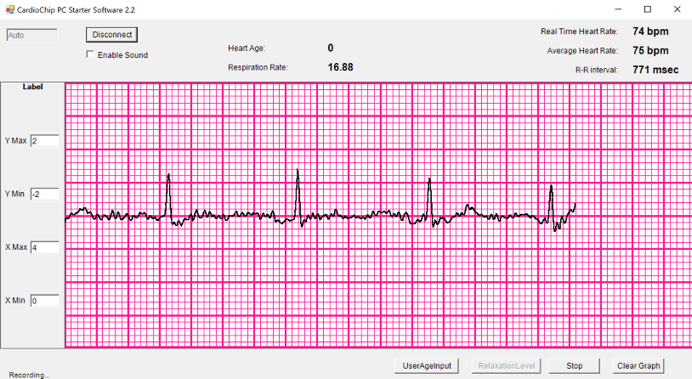
Data processing
Data Sources
MIT-BIH Physionet
ECG-ID Physionet
BMD101 Sensor Chip
Non-intrusive
Subject to hold the two dry metal electrodes with each thumb
Figure 4: a) Shows the BMD device used to extract signals; b) Demonstrate live signal Acquisition
Figure 5: BMD Windows-OS Graphical User Interface
Notes:
“Biometric recognition” refers to the process of establishing a person’s identity based on their biometric data.

Slide 9
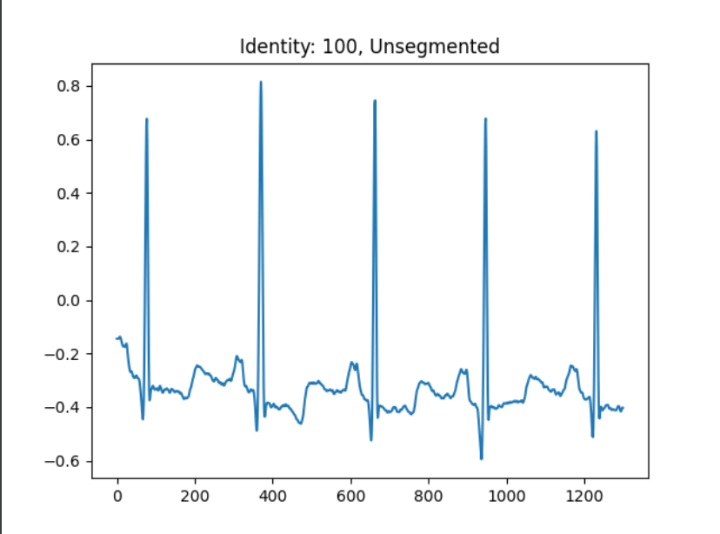
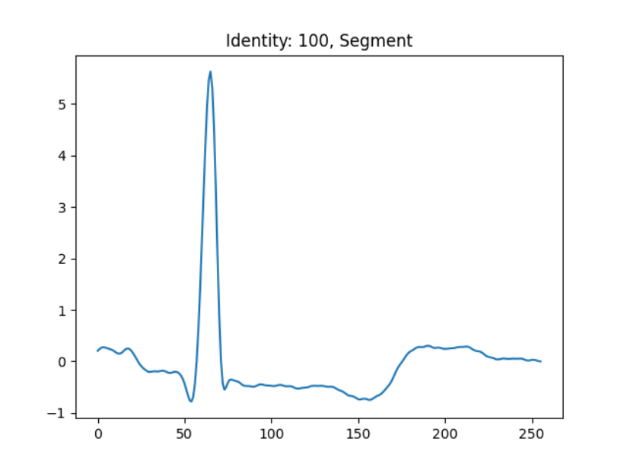
Data processing
ECG Segmentation
No filters applied
R-peak segmentation using Christov algorithm [6]
Resampled to 256
Figure 6: Unsegmented ECG wave section
Figure 7: One ECG segment of size 256
Notes:
“Biometric recognition” refers to the process of establishing a person’s identity based on their biometric data.

Slide 10
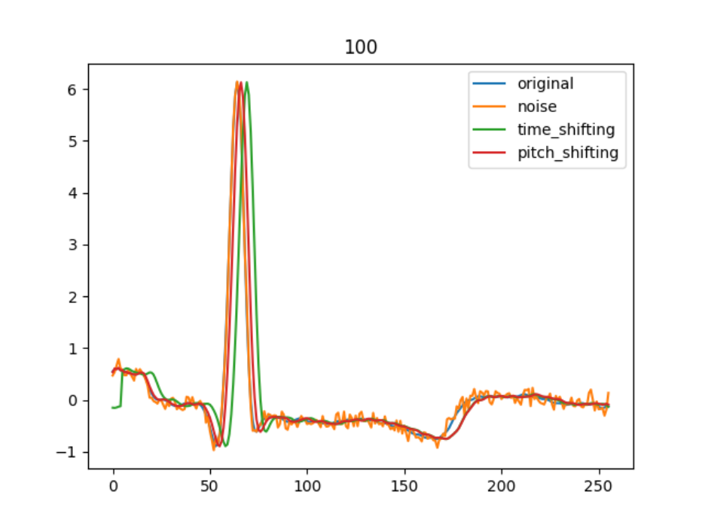
Data processing
Data Augmentation
Gaussian Noise
Time Shifting
Pitch Shifting
Figure 8: One ECG segment of size 256
Notes:
“Biometric recognition” refers to the process of establishing a person’s identity based on their biometric data.

Slide 11
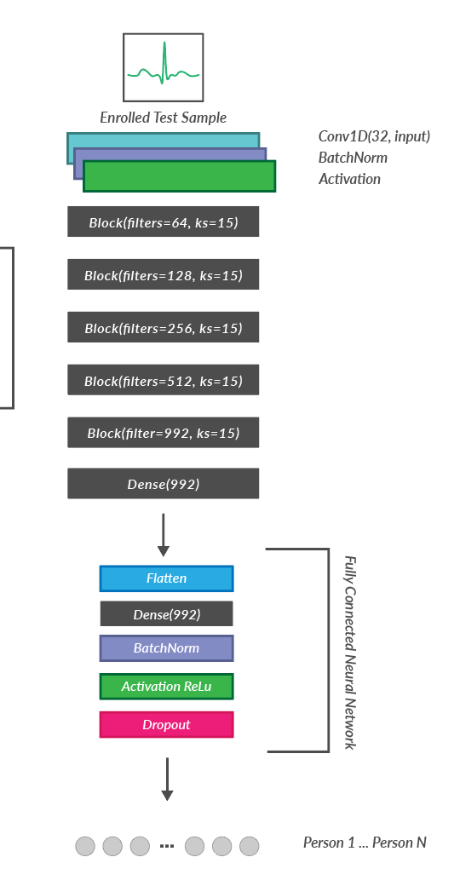
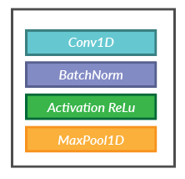
Neural Network Architectures
Block
Convolution Neural Network
4 block structure inherited from VGG19 [7] architecture
256-size 1D signal input
Figure 9: Block structure used in the CNN
Figure 10: Convolution Neural Network Architecture
Notes:
“Biometric recognition” refers to the process of establishing a person’s identity based on their biometric data.

Slide 12
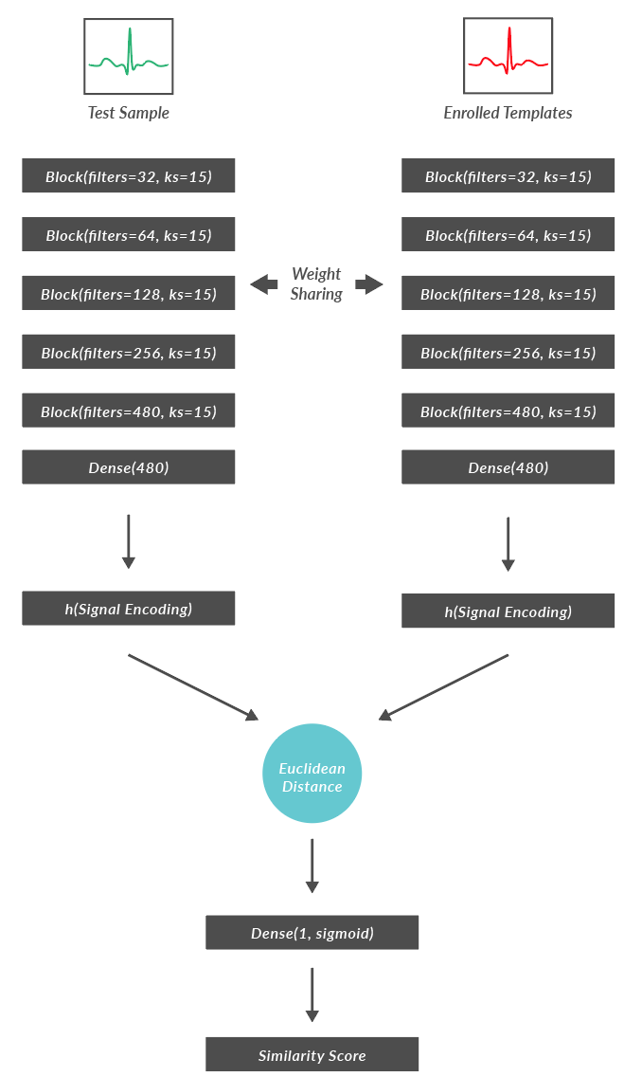
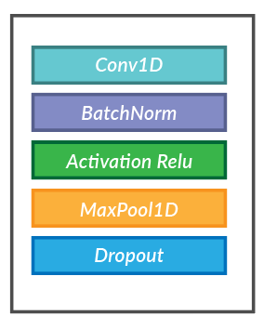
Neural Network Architectures
Block
Siamese Neural Network
5 block structure also inherited from VGG19 [7] architecture
256-size 1D signal pair input
Positive and Negative pairs
Uses Euclidean Distance for similarity score
Figure 11: Block structure used in SNN
Figure 12: Siamese Neural Network Architecture
Notes:
“Biometric recognition” refers to the process of establishing a person’s identity based on their biometric data.

Slide 13
Results
 | SNN | CNN
Input Type | Segment Pair | 1 Segment
Sample size | 400 000 | 397 740
Training time | 13 min | 54 min
Valid Acc | - | 0.9993
Valid Loss | 0.4969 | 0.0029
Threshold, Decision Margin | 0.000999 | 0.99
Data from MIT-BIH and two classes from BMD101 Sensor
ECG-ID dataset failed to produce materialistic results due to limited data.
Figure 10: Convolution Neural Network Architecture
Notes:
“Biometric recognition” refers to the process of establishing a person’s identity based on their biometric data.

Slide 14
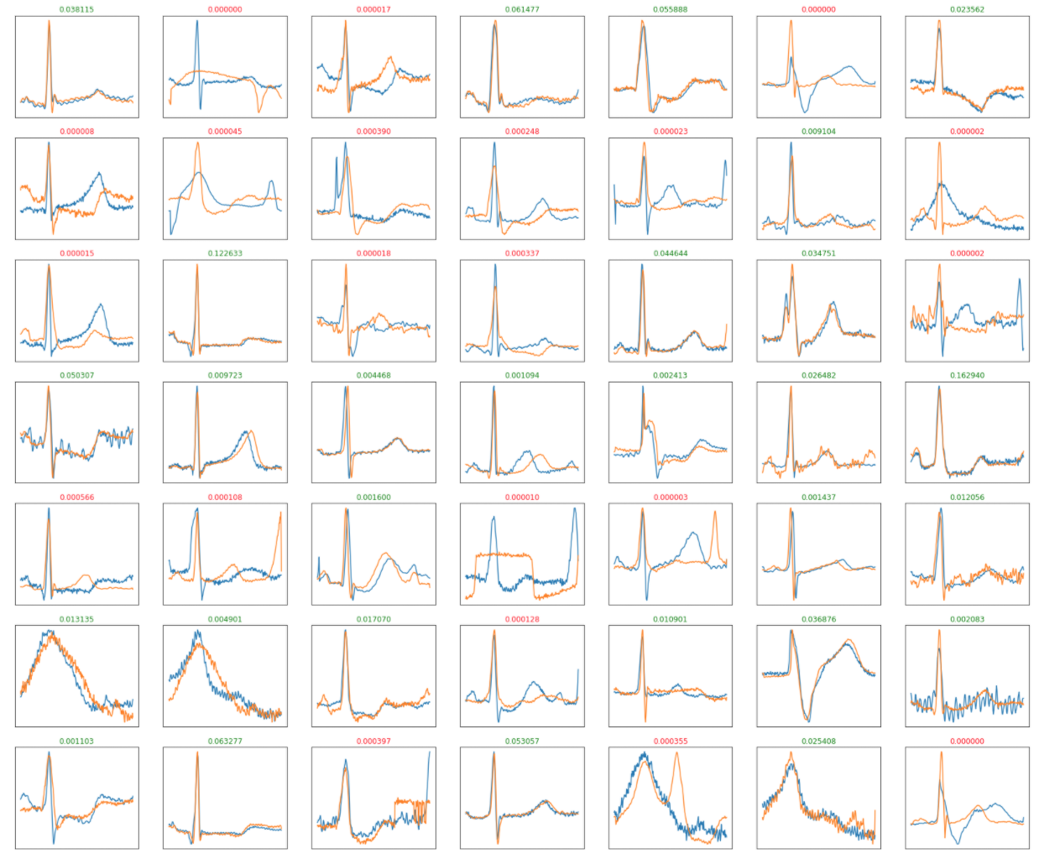
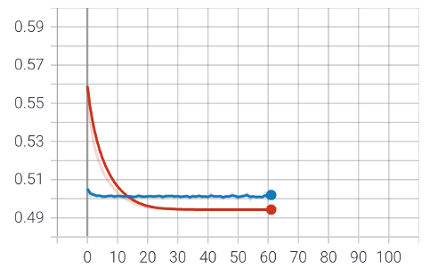
Results
SNN Training
Figure 13: a) Training results for the SNN. In Blue is the Training loss and Red is Validation Loss:
Figure 13: b) Predicted test samples from the SNN model
Notes:
“Biometric recognition” refers to the process of establishing a person’s identity based on their biometric data.

Slide 15
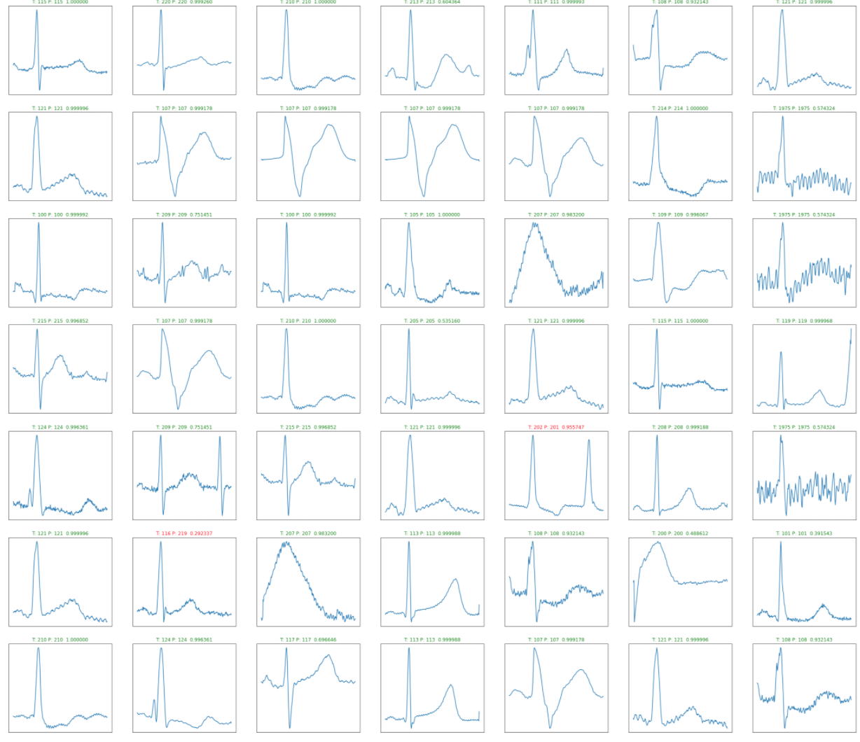
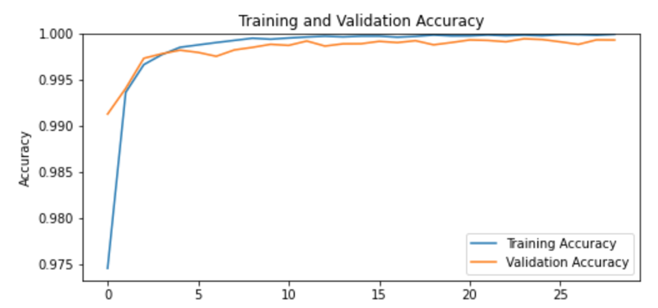
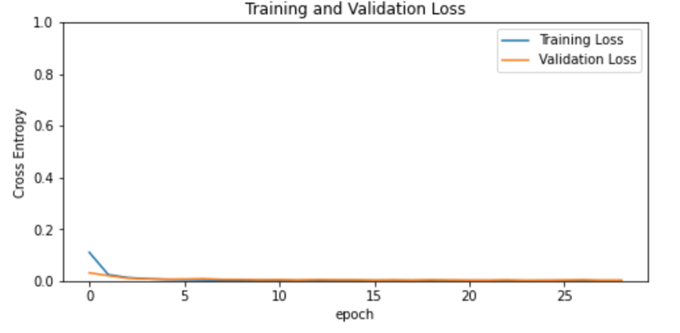
Results
CNN Training
Figure 14: a) Training results for the CNN. In Blue is the Training loss and Red is Validation Loss:
Figure 14: b) Predicted test samples from the CNN model
Notes:
“Biometric recognition” refers to the process of establishing a person’s identity based on their biometric data.

Slide 16
Challenges
Closed-set vs Open-set classification
Binary Classification vs Multi-class classification
Subjects with cardiac diseases have non-uniform ECGs
ECGs are susceptible to noise
Notes:
“Biometric recognition” refers to the process of establishing a person’s identity based on their biometric data.

Slide 17
Conclusions
Increased efforts for better authentication system and overcoming their limitations.
3D face recognition used to counteract 2D limitations, but 3D models are also vulnerable to attacks [8].
Notes:
“Biometric recognition” refers to the process of establishing a person’s identity based on their biometric data.

Slide 18
References
[1] Cappelli et al (2006, December). Can Fingerprints be reconstructed from ISO Templates?. [2] Venugopalan et al (2013). Iris spoofing: Reverse engineering the daugman feature encoding scheme. [3] Mai et al. (2018). On the reconstruction of face images from deep face templates. [4] Hassan et al. Review of Fiducial and Non-Fiducial Techniques of Feature Extraction in ECG based Biometric Systems [5] Eduardo et al. ECG-based biometrics using a deep autoencoder for feature learning-an empirical study on transferability. [6] Christov, I. I. (2004). Real time electrocardiogram QRS detection using combined adaptive threshold. [7] Simonyan et al (2014). Very deep convolutional networks for large-scale image recognition. [8] Jia et al (2019). A database for face presentation attack using wax figure faces.
Notes:
“Biometric recognition” refers to the process of establishing a person’s identity based on their biometric data.

Slide 19
The End
Q & As
Notes:
“Biometric recognition” refers to the process of establishing a person’s identity based on their biometric data.

