Slide 1
Ab initio Alloy Thermodynamics:
Recent Progress and Future Directions
Axel van de Walle
Mark Asta
Materials Science and Engineering Department, Northwestern University
Gerbrand Ceder
Materials Science and Engineering Department, MIT
Chris Woodward
Air Force Research Laboratory, Wright-Patterson AFB
This work was supported by:
NSF under program DMR-0080766 and DMR-0076097.
DOE under contract no. DE-F502-96ER 45571.
AFOSR-MEANS under grant no. F49620-01-1-0529

Slide 2
Goals
Describe the current capabilities of ab initio thermodynamic calculations
Illustrate how the Alloy Theoretic Automated Toolkit (ATAT) can help perform such calculations
ATAT homepage: http://cms.northwestern.edu/atat/

Slide 3
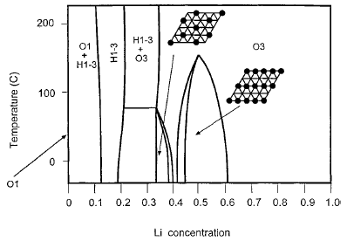
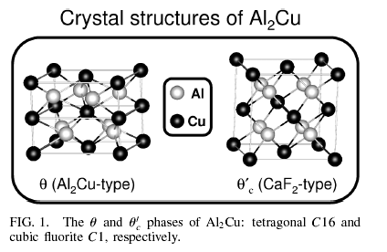
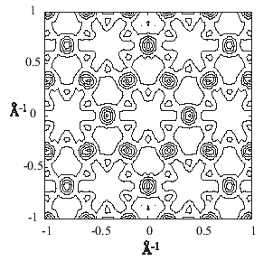
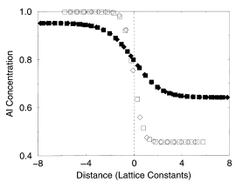
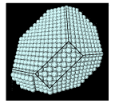
What can first-principles thermodynamic calculations do for you?
Composition-temperature
phase diagrams
Thermodynamics of stable
and metastable phases,
Short-range order
in solid solutions
Thermodynamic properties
of planar defects
Precipitate morphology and
Microstructures
Ducastelle (1991), Fontaine (1994), Zunger (1994,1997), Ozolins et al. (1998),
Wolverton et al. (2000), Ceder et al. (2000), Asta et al. (2000,2001)

Slide 4
Ab initio thermodynamic calculations
First-principles thermodynamic data
ATAT
Large number of atoms
Many configurations
Lattice model &
Monte Carlo Simulations
Enthalpy
Vibrational entropy
Electronic entropy
Small number of atoms
Few configurations
Quantum Mechanical Calculations

Slide 5
Outline
Methodology
  Modeling configurational disorder
  Modeling lattice vibrations
Applications (Ti-Al and Al-Mo-Ni)
  Sample input files
  Sample outputs
Recent innovations

Slide 6
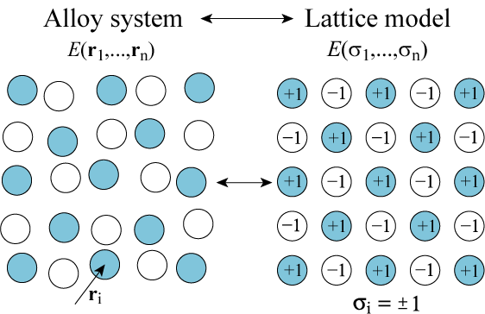


The Cluster Expansion Formalism

Slide 7






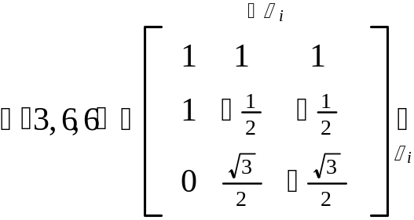
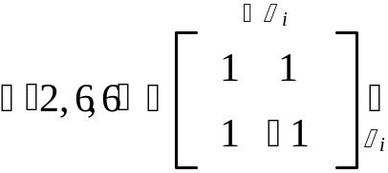
Coupled Sublattices
Multicomponent Cluster Expansion
Same basic form:
Occupation variables:
“Decorated” clusters:
1
1
“Not in cluster”
1
2
Example: binary fcc sublattice with
ternary octahedral sites sublattice
Sanchez, Ducastelle and Gratias (1984)
Tepesch, Garbulski and Ceder (1995)

Slide 8
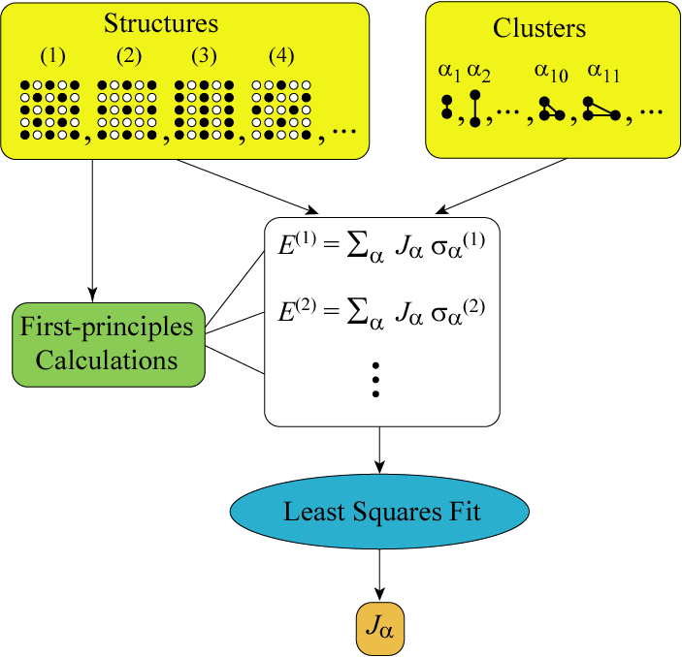
Cluster expansion fit
Which structures and
which clusters
to include in the fit?

Slide 9
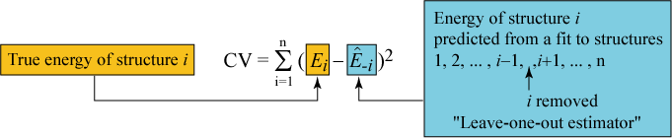
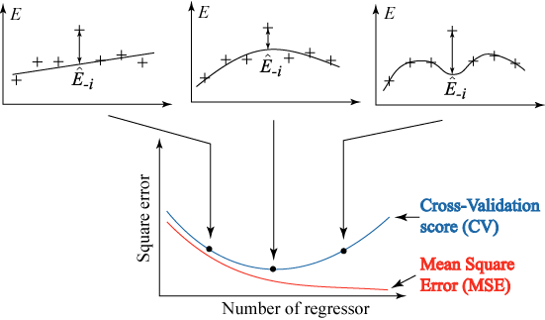
Cross-validation
Example of polynomial fit:

Slide 10


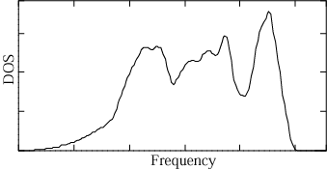
First-principles lattice dynamics
First-principles data
Computationally
intensive!
Least-squares fit to
Spring model
Phonon density of states
Thermodynamic
Properties
Direct force constant method
(Wei and Chou (1992), Garbuski and Ceder (1994),
among many others)

Slide 11
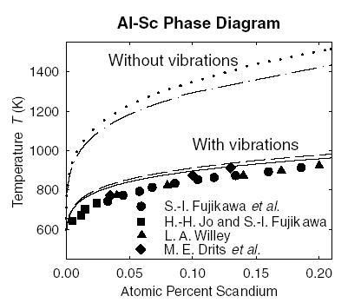
Effect of lattice vibrations on phase stability
Stable without vibrations
(incorrect)
Stable with vibrations
(correct)
Ozolins and Asta (2001)
(Wolverton and Ozolins (2001))
How to handle alloy phase diagrams?

Slide 12
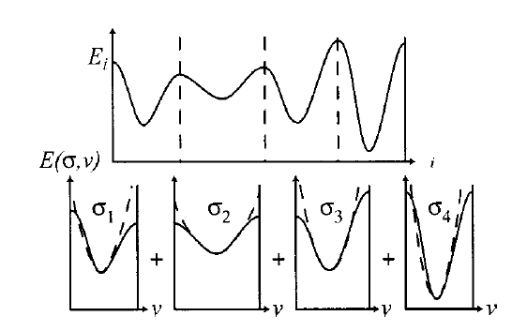

Coarse-Graining of the Free Energy
Graphical representation:
Formally: (Ceder (1993), Garbulski and Ceder (1994-1996))

Slide 13
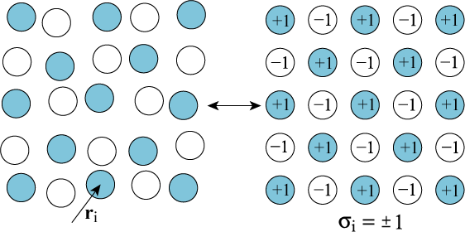


Coupling vibrational and configurational disorder
Need to calculate vibrational free energy for many configurations

Slide 14
Efficient modeling of lattice vibrations
Infer the vibrational entropies from bulk moduli
(Moruzzi, Janak, and Schwarz, (1988))
(Turchi et al. (1991), Sanchez et al. (1991), Asta et al. (1993), Colinet et al. (1994))
Calculate full lattice dynamics using tractable energy models
(Ackland (1994), Althoff et al., (1997), Ravello et al (1998), Marquez et al. (2003))
Calculate lattice dynamics from first principles in a small set of structures (Tepesch et al. (1996), Ozolins et al. (1998))
Transferable force constants (Sluiter et al. (1999))

Slide 15
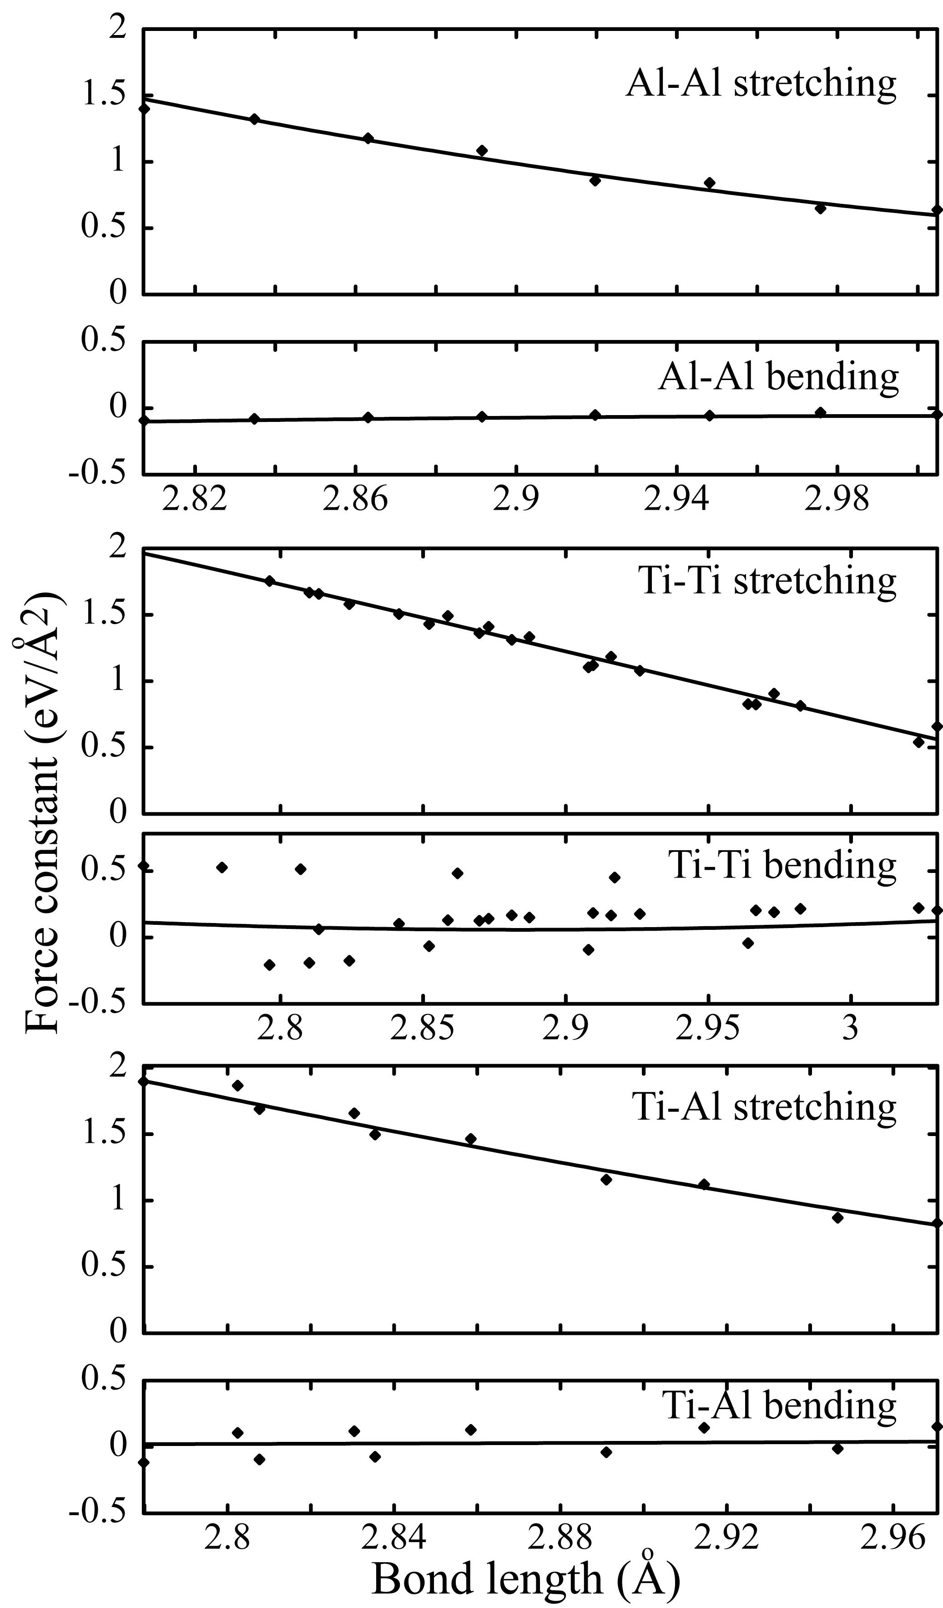
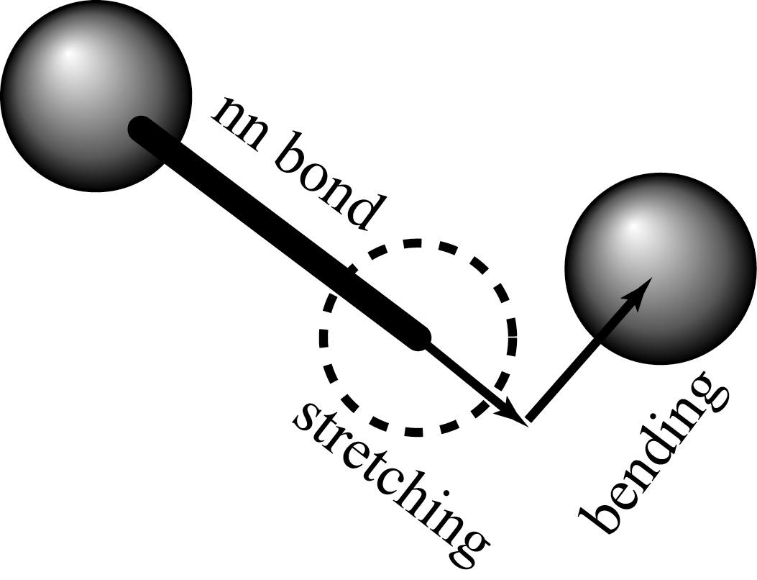
Bond length vs. Bond stiffness
Chemical bond type and
bond length:
Good predictor
of nearest-neighbor force constants
(stretching and bending terms)
Relationship holds across different structures
van de Walle and Ceder (2000,2002)

Slide 16
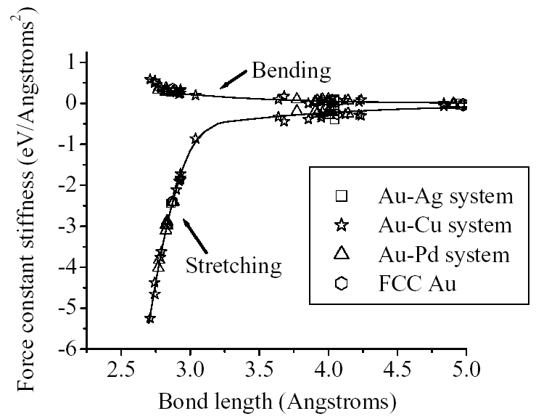
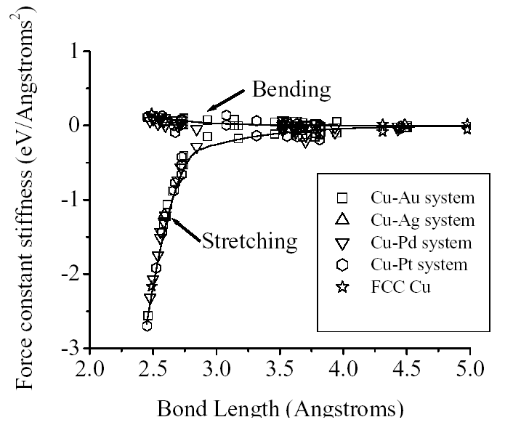
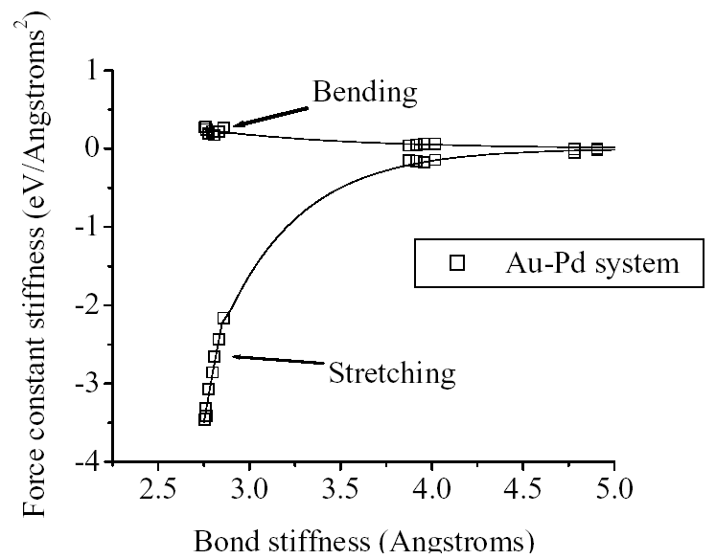
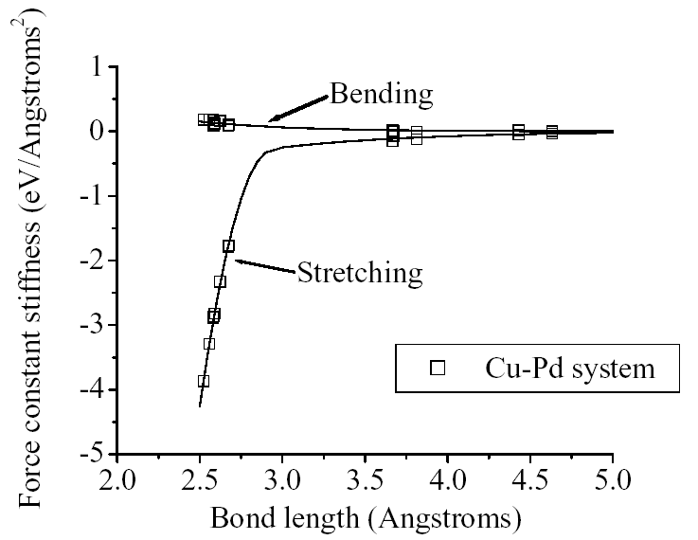
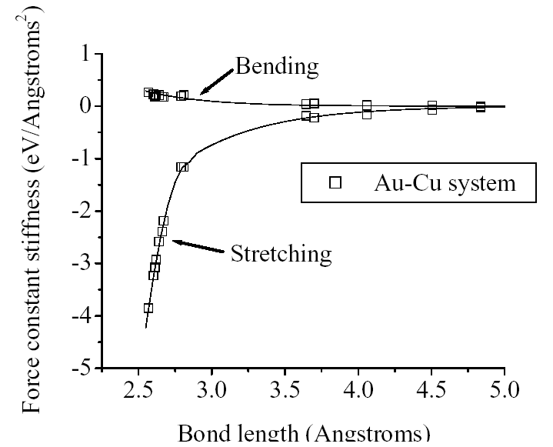
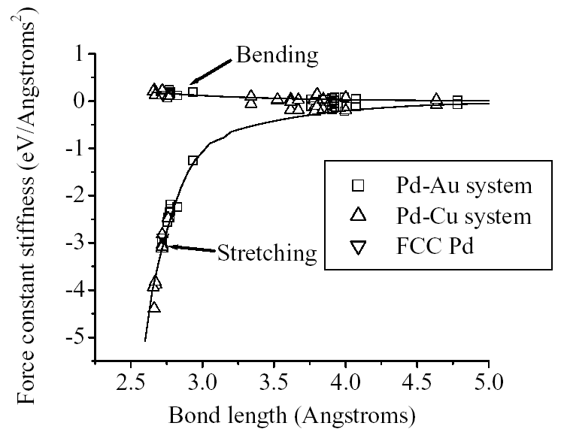
Further tests...
Wu, Ceder, van de Walle (2002)
Au-Au bonds
Cu-Cu bonds
Au-Pd bonds
Pd-Pd bonds
Cu-Pd bonds
Au-Cu bonds
Accuracy ~ 0.03 k_{B}

Slide 17
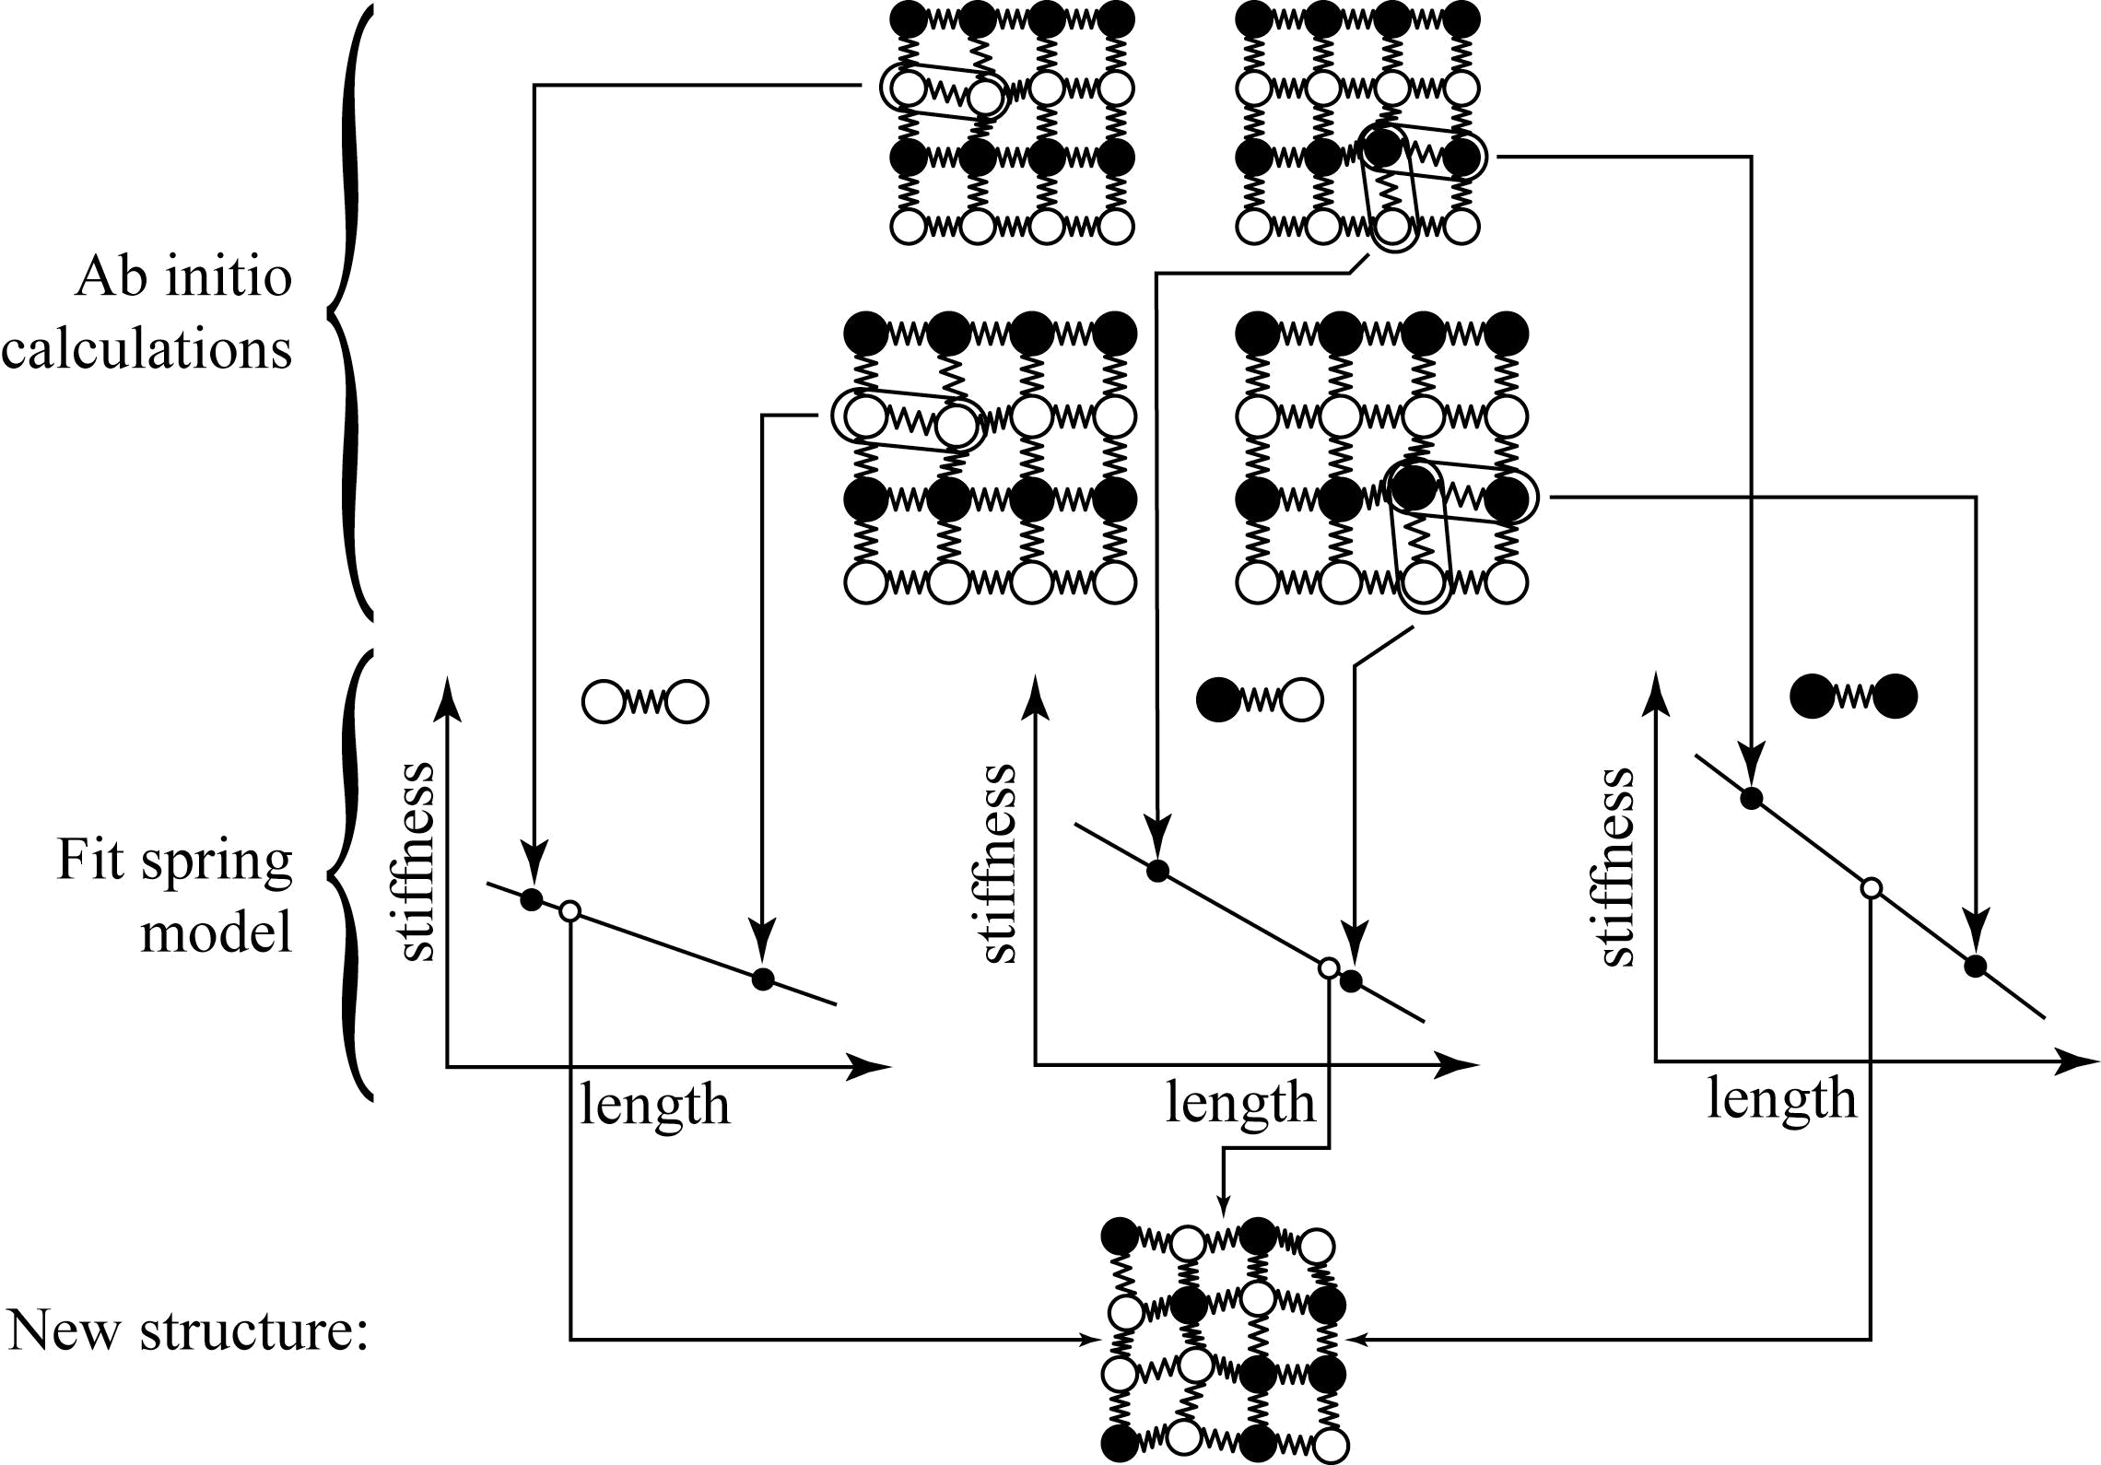
Length-Dependent Transferable
Force Constants (LDTFC)
van de Walle and Ceder (2000,2002)

Slide 18
A matter of time…
Time needed to complete a given first-principles calculation
Human
Time
Computer
1980
2003
The procedure needs to be automated

Slide 19
The Alloy Theoretic Automated Toolkit
Lattice geometry
Ab initio code parameters
MAPS (MIT Ab initio
Phase Stability Code)
Cluster expansion construction
Ab initio code
(e.g. VASP, Abinit)
Effective cluster interactions
Ground states
Emc2 (Easy Monte Carlo Code)
Thermodynamic properties
Phase diagrams

Slide 20
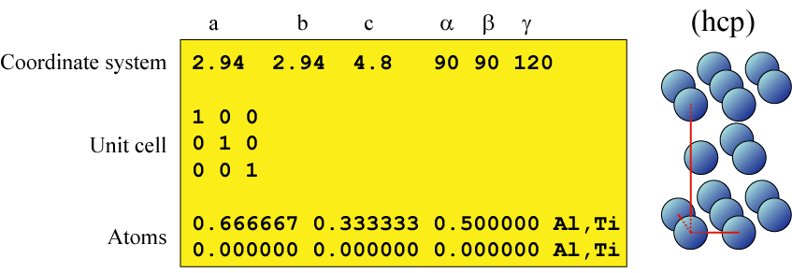
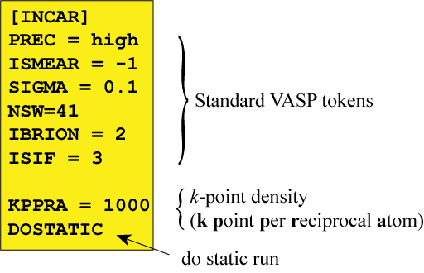
Application to Ti-Al Alloys
Simple lattice input file
Simple ab initio code input file

Slide 21
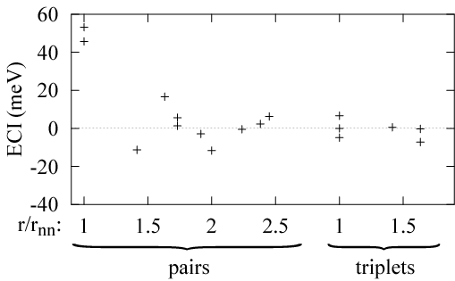
Effective Cluster Interactions

Slide 22
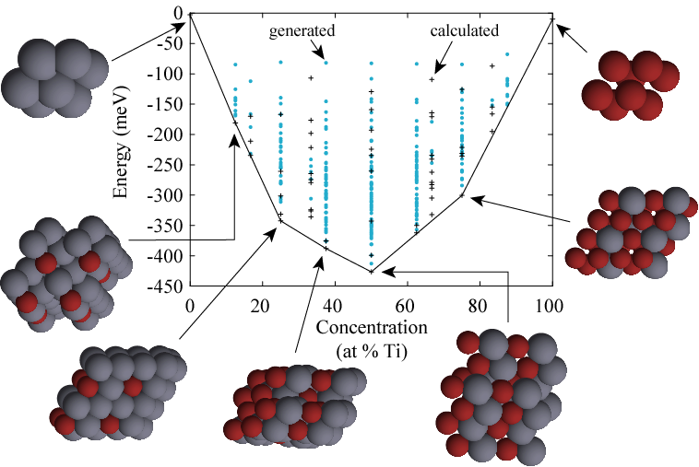
Ground States Search

Slide 23

Ground state search in
Al-Mo-Ni system
Mo (bcc)
Ni (fcc)
Al (fcc)
E
Mo
Ni
Ni₃Al (L1₂)
NiAl (B2)
Al

Slide 24
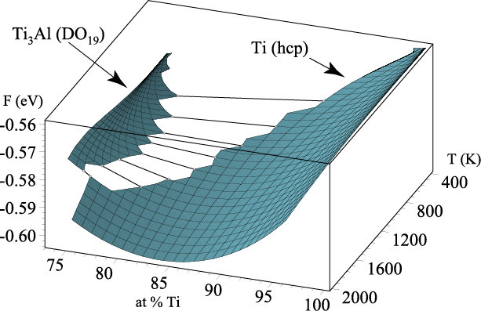
Monte Carlo output:
Free energies
Can be used as input to CALPHAD approach

Slide 25
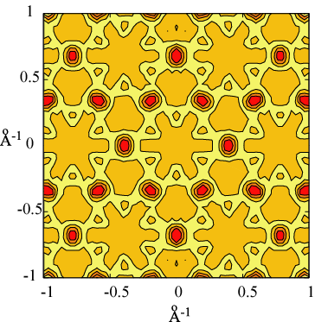
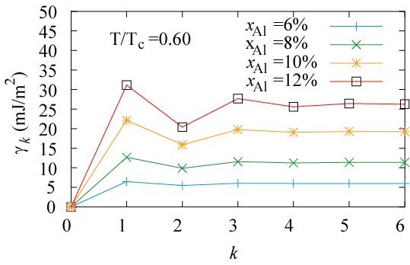
Short-range order calculations
Energy cost of creating a diffuse anti-phase boundary in a Ti-Al short-range ordered alloy by sliding k dislocations
Calculated diffuse X-ray scattering in Ti-Al hcp solid-solution

Slide 26
Length-dependent force constants

Slide 27
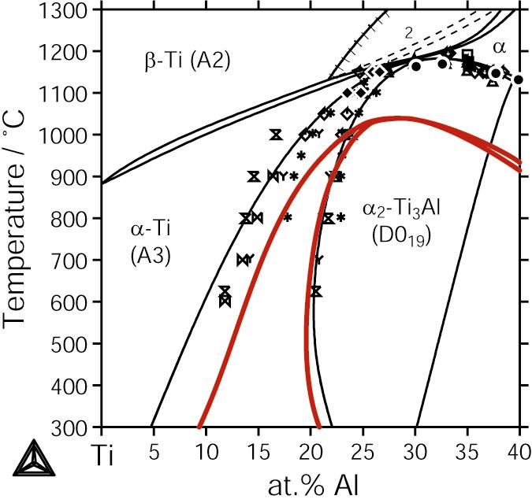
Calculated Ti-Al Phase Diagram
Assessed Phase Diagram:
I. Ohnuma et al., Acta Mater. 48, 3113 (2000)
1st-Principles Calculations:
van de Walle and Asta
Temperature Scale
off by ~150 K

Slide 28
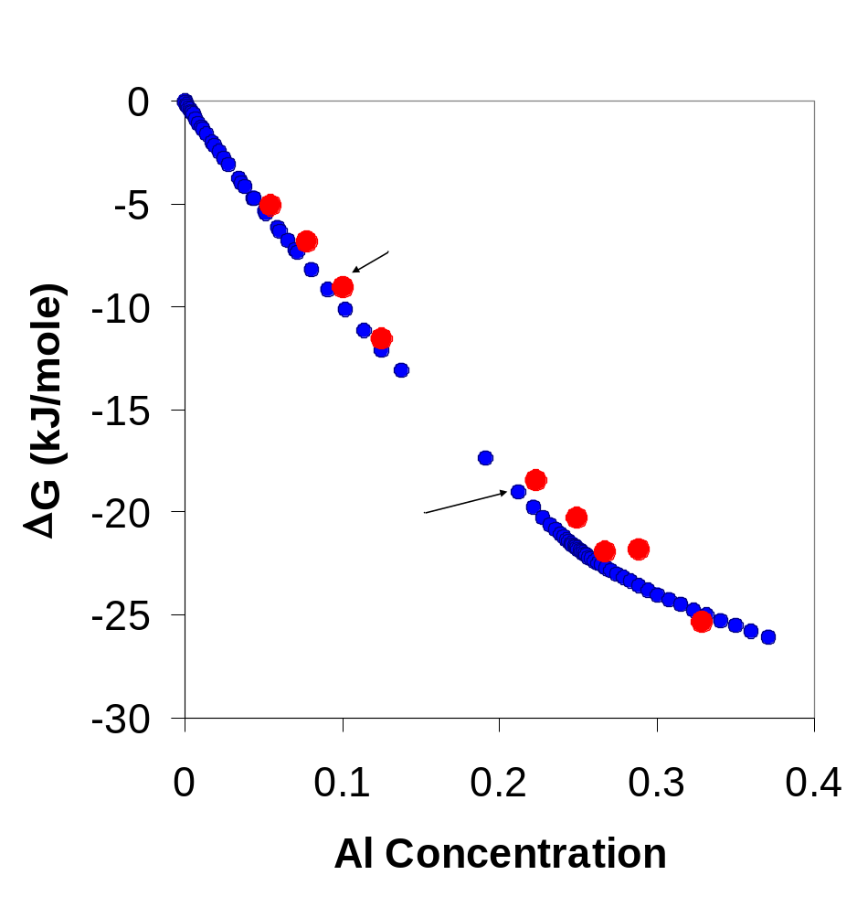
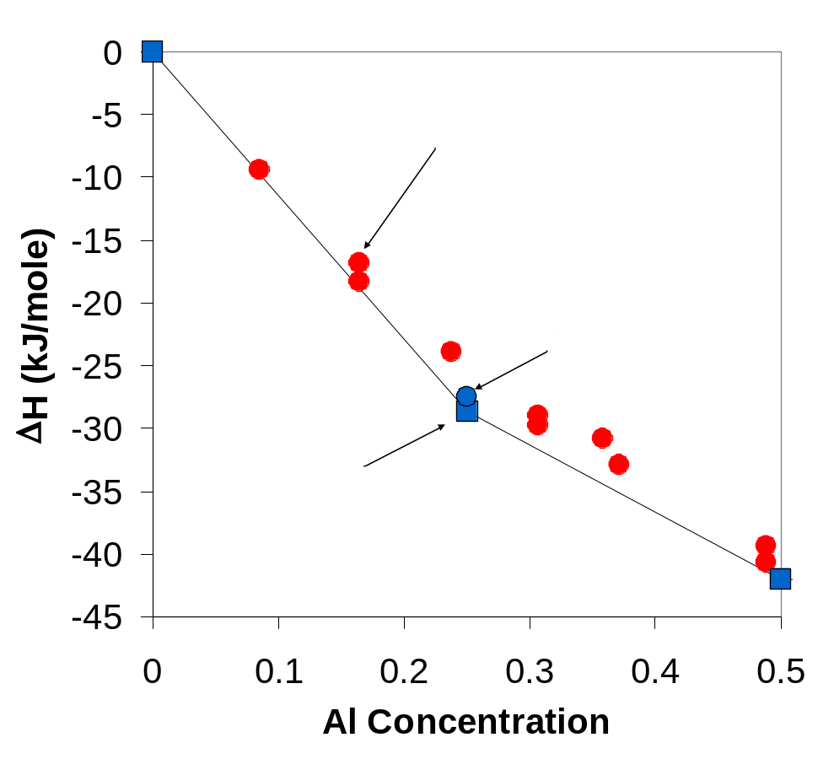
Ti-Al Thermodynamic Properties
1st-Principles Calculations vs. Measurements
Heats of Formation
Gibbs Free Energies (T=960 K)

Slide 29
Recent Additions to ATAT
Generation of multicomponent
Special Quasirandom Structures (SQS)
General lattice dynamics calculations
Support for GULP and Abinit

Slide 30
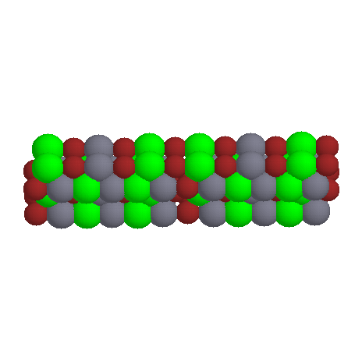
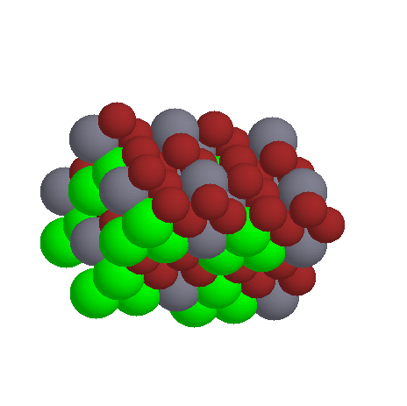
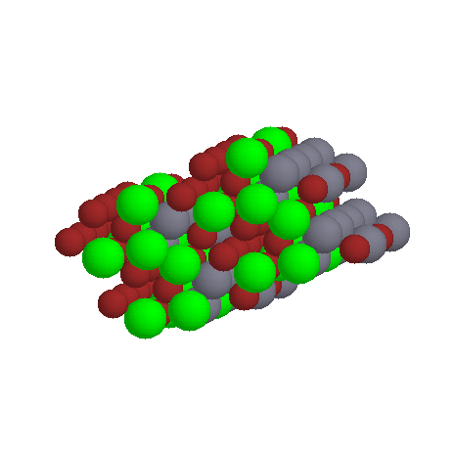
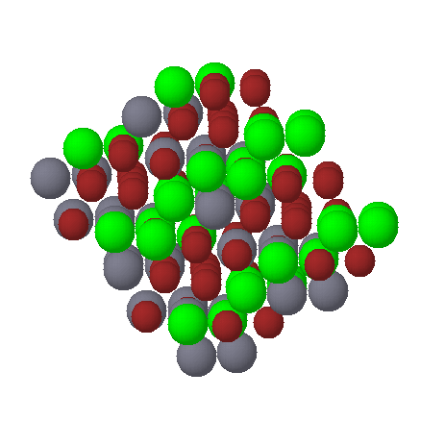
Multicomponent SQS Generation
SQS: Periodic structures of a given size that best
approximate a random solid solution.
(Zunger, Wei, Ferreira, Bernard (1990))
fcc SQS-12 ABC
fcc SQS-16 ABC₂
hcp SQS-16 ABC₂
bcc SQS-16 ABC₂
(2x2x2 supercells shown)

Slide 31
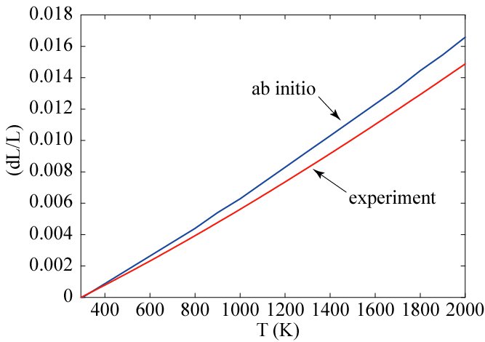
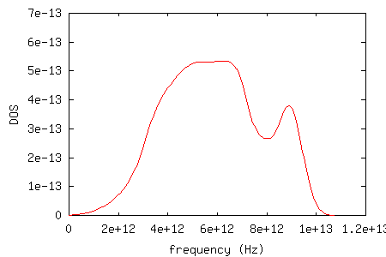
Automated lattice dynamics calculations
crystal structure
force constant range
Phonon DOS
Free energy, entropy
Thermal expansion
Input:
Output:
Automatic determination of
  supercell size
  minimum number of perturbations
  (symmetry)
Implements quasi-harmonic approximation
Features:
Examples:
Thermal expansion of Nb
Phonon DOS of disordered Ti₃Al (SQS-16)
Notes:
Experiment: Thermophysical Properties of Matter, Volume 12, Thermal expansion: metallic elements and alloys , TPRC Data Series, Edited by Y.S. Touloukian, (IFI/Plenum, New York, 1970–1979).
Ab initio: calculated within the GGA approximation using VASP. Lattice dynamics using the quasiharmonic approximation including up to 2nd nearest neighbor force constants using fitfc code from ATAT. Full phonon DOS were calculated at 0% 1% and 2% strain.
NOTE: GGA overestimates the equilibrium lattice parameter by about 0.5%. This cause slight softening and hence an verestimate of thermal expansion.

Slide 32
Conclusion
Essential tools for ab initio alloy thermodynamics:
  The cluster expansion (configurational entropy)
  Transferable length-dependent force constants
  (vibrational entropy)
Automated tools are essential
Thermodynamic properties can now be calculated with a precision comparable to calorimetric measurements
Future directions:
  Automated Monte Carlo code for general multicomponent systems.
ATAT homepage: http://cms.northwestern.edu/atat/

