Slide 1




Software tools for high-throughput CALPHAD from first-principles data
Axel van de Walle
Ruoshi Sun
Qijun Hong
Sara Kadkhodaei
Funding support:
DMR-1505657
N00014-16-1-3124
N00014-17-1-2202
Acknowledgements:
Thanks to Vidvuds Ozolins and Ursula Kattner for helpful comments.

Slide 2
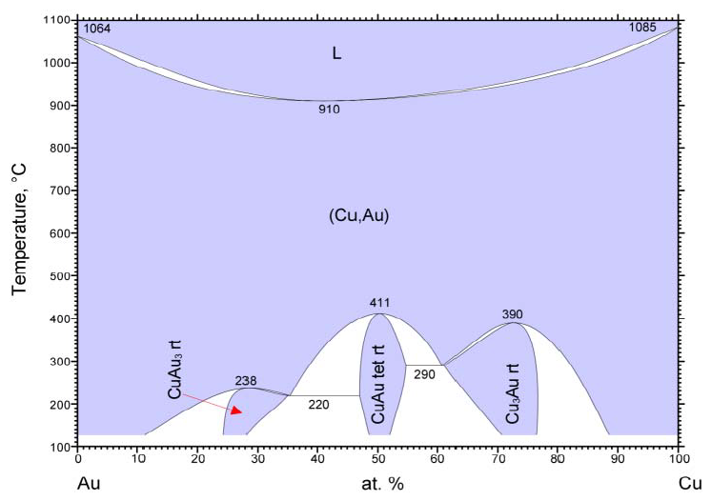
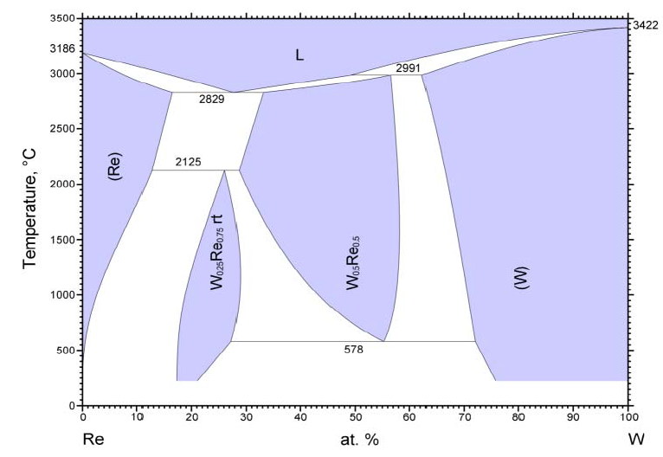
What does a typical phase diagram look like?
hcp
bcc
Cao et al. (2007)
σ
χ
Z.K. Liu
et al. (2000)
© ASM international
© ASM international
All phases are superstructures of a common lattice?
If you are lucky!
Complex mix of very different crystal structures:
More typical!

Slide 3
Spectrum of ab initio thermodynamics methods
Cluster expansion
with lattice dynamics
Cluster expansion
SQS + CALPHAD
Information or Accuracy
?
Dilute defect calculations
T = 0K Energies
Computational cost
Exploratory screening (high-throughput + solid solutions)
Starting point in CALPHAD modeling
Mid-range methods useful for:

Slide 4
SQS + CALPHAD Method
Experimental SGTE data
Free energy =
End member free energy
+ formation enthalpy: polynomial in composition
+ ideal solution formation entropy
+ short-range-order correction.
Special Quasirandom Structure
(SQS) formation energies.
Except for SRO correction, not a new method – Works by various research groups:
Zunger, Morgan, Liu, Arroyave, Asta, Wolverton, Sluiter, Crivello, Joubert,
among many others.
But we will “push it” further!

Slide 5
SQS + CALPHAD method
Well-known and apparently straightforward method, however:
Becomes less trivial when considering general multicomponent ordered phases with multiple sublattices. Why?
SQS generation is more difficult!
End members are not in SGTE database: Need to calculate formation free energies.
Have to properly handle the issue of mechanical stability!
Most phases (even bcc,fcc,hcp) become mechanically unstable in at least some composition range.
The end members reference energies are often mechanically unstable.

Slide 6
Software framework
Candidate lattices + composition
SGTE
Element
Database
SQS Database
“mcsqs” code
“.TDB” file
Pandat, ThermoCalc, OpenCalphad,…
Site Occupation
Enumeration
Interaction
Enumeration
Thermodynamic
Model
Cross-section re-assembly
Solution
Formation
Energy
“robustrelax” code
Statistical Fit
3D phase diagram
TST Tools
“sqs2tdb” code
Paraview, …
VASP

Slide 7
SQS for multi-component multi-sublattice systems
Need to generate SQSs that span the composition range of each sublattice with various levels (0,1,2,3,… ) of accuracy. Examples:
Rocksalt A_{1-x}B_{x}C_{1-y}D_{y}
bcc, fcc, hcp
AD
BD
0
A
0
2
1
2
0
2
4
4
4
2
2
2
4
y
1
4
3
4
1
1
1
3
2
4
4
4
2
2
4
4
2
0
2
1
2
0
0
2
1
2
0
AC
BC
B
C
x

Slide 8
Reference free energies
Intermetallic phase
Free energy
Composition
Typically: Compute vibrational free energy contributions for end members only.

Slide 9
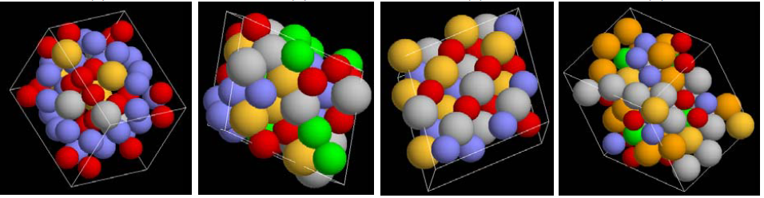
SQS Database
Examples
Current list
χ phase with sublattice disorder
5-component fcc solid solution,
Rocksalt structure with disorder on both sublattices
σ phase with disorder on all 3 of its sublattices.
fcc | A1 |  | Cuprite | C3
bcc | A2 |  | Rutile | C4
hcp | A3 |  | MgCu₂ | C15
β-Sn | A5 |  | ω | C32
χ | A12 |  | Heusler | D0₂₂
Cr₃Si | A15 |  | Fe₃Al | D0₃
Rocksalt | B1 |  | σ | D8_{b}
CsCl | B2 |  | Perovskite | E21
Zincblende | B3 |  | AuCu | L1₀
CuPt | B22 |  | γ | L1₂
Zintl | B32 |  | Heusler | L2₁
Fluorite | C1 |  | Zirconia (tet.)
Pyrite | C2 |  | …
Each entry represent 5 to 10 SQS!
(still growing…)

Slide 10
Liquid and gas phases?
Can use SGTE data for end members.
We add ab initio liquid solution formation enthalpy from a short MD run above highest melting point of end members.
This is needed to avoid systematic bias in solid-liquid free energy differences.
Inaccurate is liquid short-range orders…
For a better method, see Q.-J. Hong and A. van de Walle. “Solid-liquid coexistence in small systems: A statistical method to calculate melting temperatures.” J. Chem. Phys., 139:094114, 2013.
Gas phase: Use experimental or ideal gas.

Slide 11
Mechanically unstable phases: Why bother?
If one only looks at stable regions and relies on extrapolation:
The extrapolated free energies may accidentally lie below the free energy of stable phases
Extrapolation from different directions in composition space may disagree.
To keep the spirit of the CALPHAD method.
Extremely useful in the context of cluster expansions as well.

Slide 12
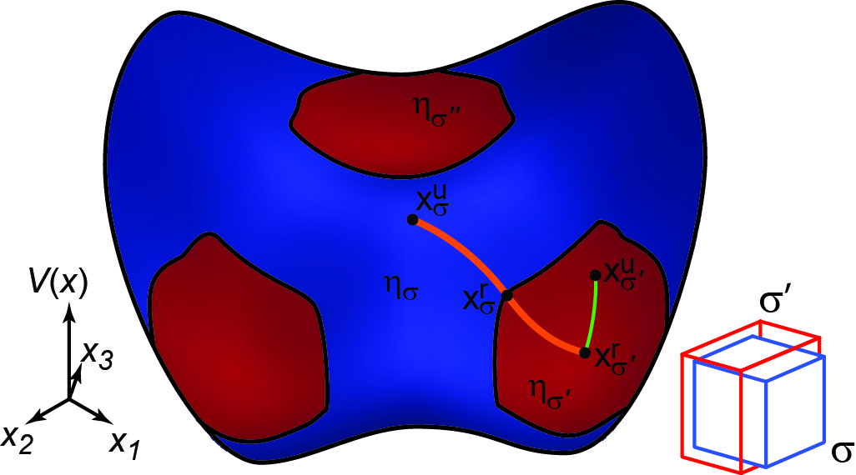
Handling mechanical instabilities: Curvature-based partitioning of phase space
Example of W
(bcc)
(fcc)
Positive-definite Hessian
Hessian with at least one negative eigenvalue
van de Walle, Hong, Kadkhodaei and Sun., “The free energy of mechanically unstable phases.”, Nature Commun., 6:7559, 2015.
Notes:
Basic idea: think of the an alloy’s energy surface: potential energy as a function of atomic position and cell parameters (what I call the vector x in this picture). In a mechanically stable region, where that surface has a positive curvature (in red), everybody agrees on what to do: you start at some “unrelaxed” structure x^u and you fully relax to find the nearest local minimum x^r. Then you can use a standard harmonic model to represent the free energy associate with that red “pocket” of stability.
When you have a mechanically unstable region (with at least one negative curvature), it is then natural to assign the complement of those stable red regions to the mechanically unstable phase in blue. If you then follow the same logic, starting from an unrelaxed structure x^u, you would want to find the minimum x^r in the blue region. Due to the instability, the minimum is always at the boundary. At the boundary, by definition, the minimum curvature is exactly zero [because it’s the transition between positive and negative curvature]. So the minimum, constrained to the blue region, is at an inflection point.

Slide 13
Advantages of this definition
Consistent with the usual notion of a stable basin.
Can use a simple harmonic expansion about a point at the boundary (x_{σ}^{r}).
By definition, only a finite number of modes are unstable at that point and a finite number of modes has a negligible contribution to the free energy.
Points inside η_{σ} do not have this property: they are associated with an infinite number of unstable modes.
The inflection point is a natural extension of a local minimum: “inflection-detection” method.
Phonon dispersion curve
at boundary of η_{σ}
Phonon dispersion curve
inside η_{σ}
ν
ν
k
k
Notes:
This definition of the energy of a mechanically unstable phase is completely consistent

Slide 14
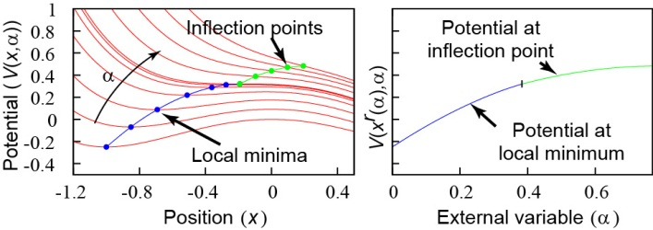
Onset of mechanical instability
The inflection point is a natural extension of a local minimum.
dV/dx
Why? When a local minimum disappears, it does so by joining an inflection point (and a local maximum):
x
Changes in potential V as a function of
position x and
some external variable α = composition, T, P, …

Slide 15
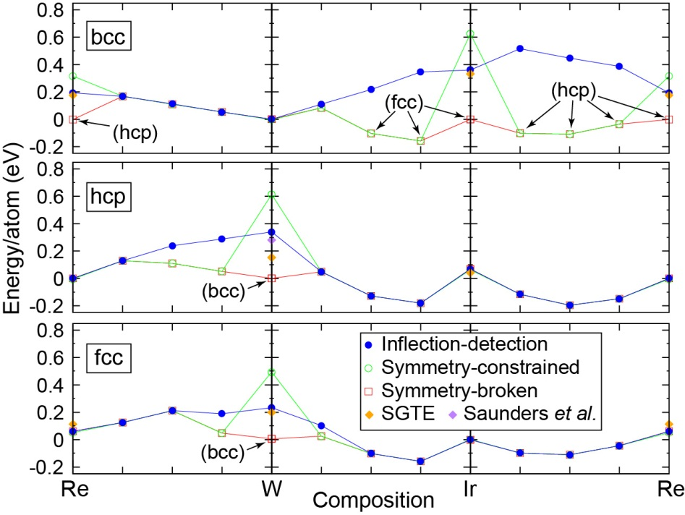
Extrapolation behavior and compatibility with SGTE data

Slide 16
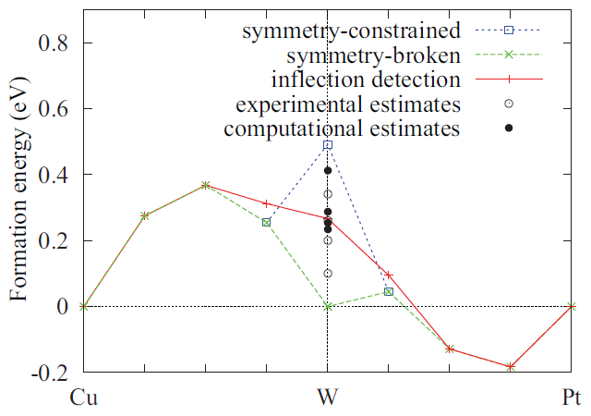
Extrapolation: A closer look

Slide 17
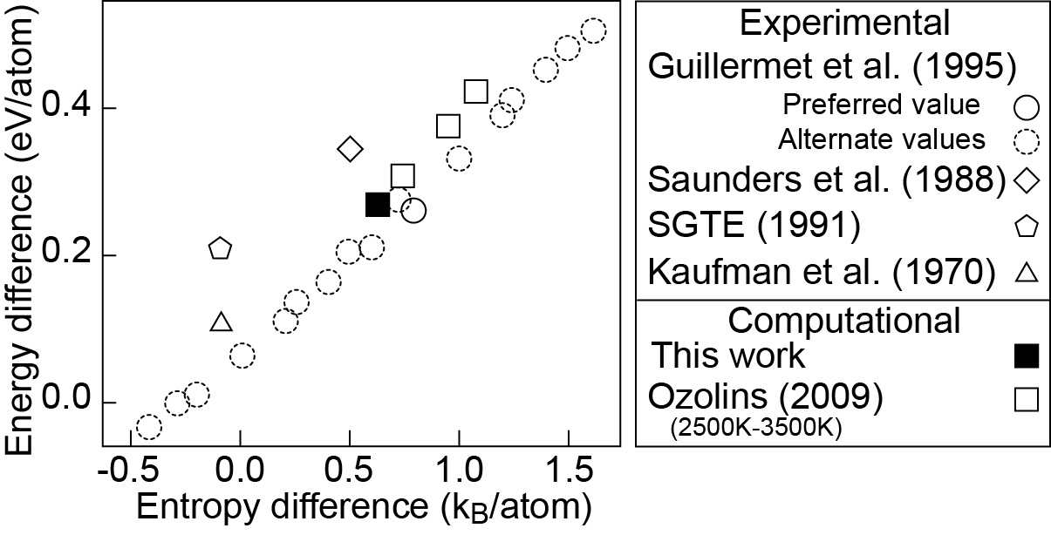
The case of fcc W - bcc W
(Adapted from Ozolins (2009))

Slide 18
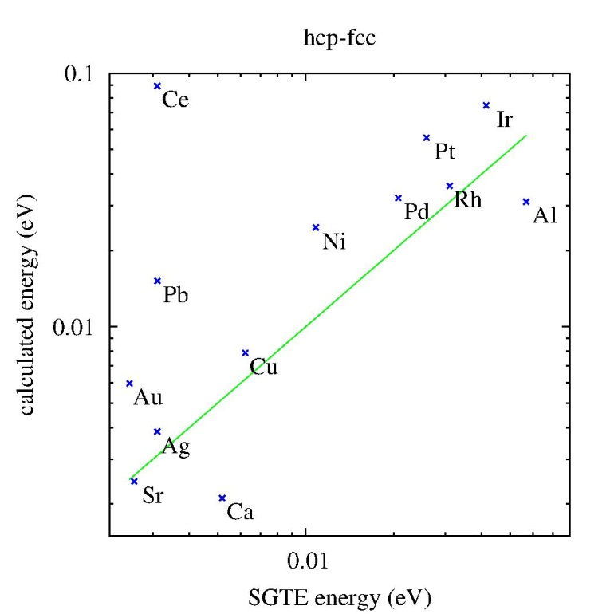
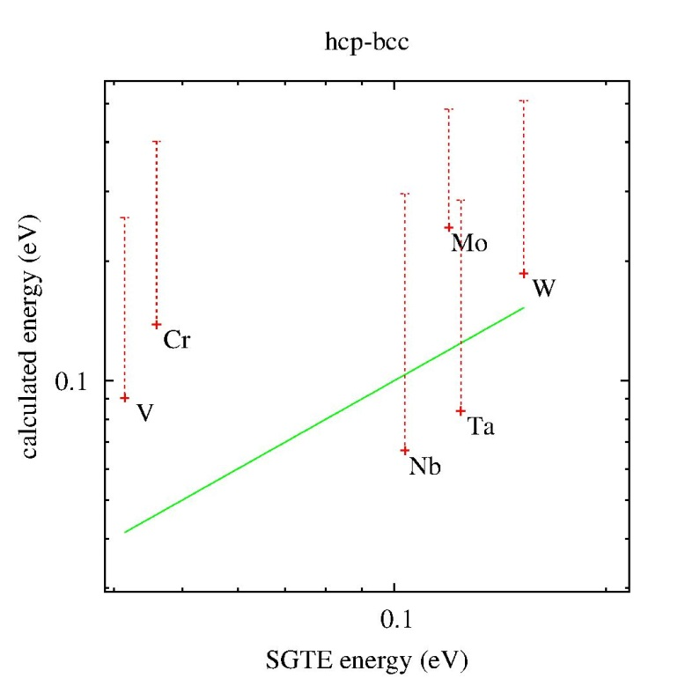
Compatibility with SGTE
* : fully relaxed
+ : inflection-detection
− : symmetry-constrained

Slide 19
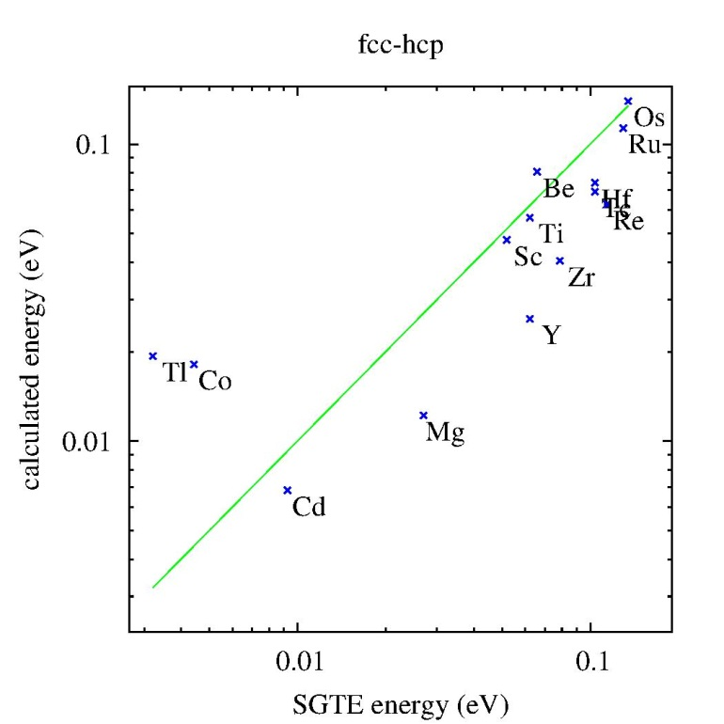
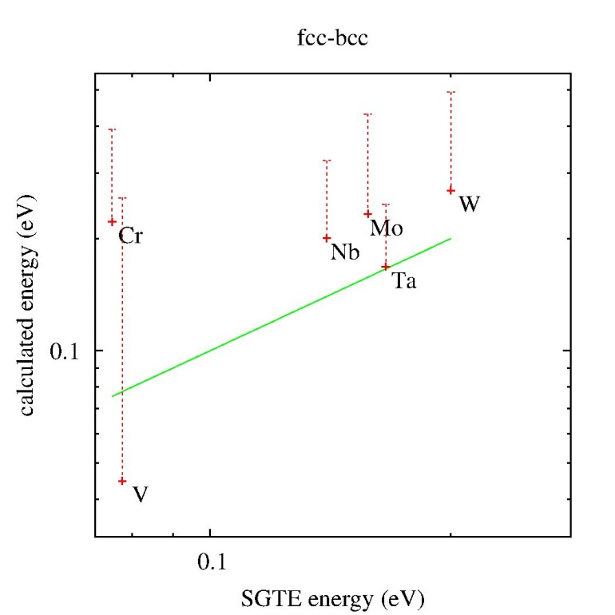
Compatibility with SGTE
* : fully relaxed
+ : inflection-detection
− : symmetry-constrained

Slide 20
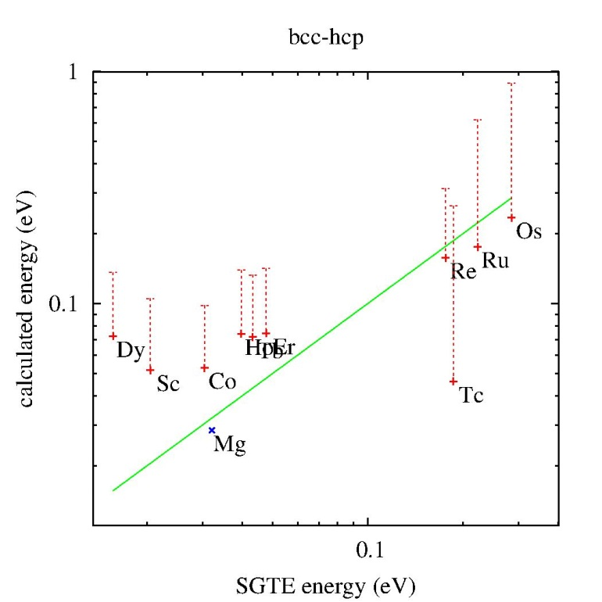
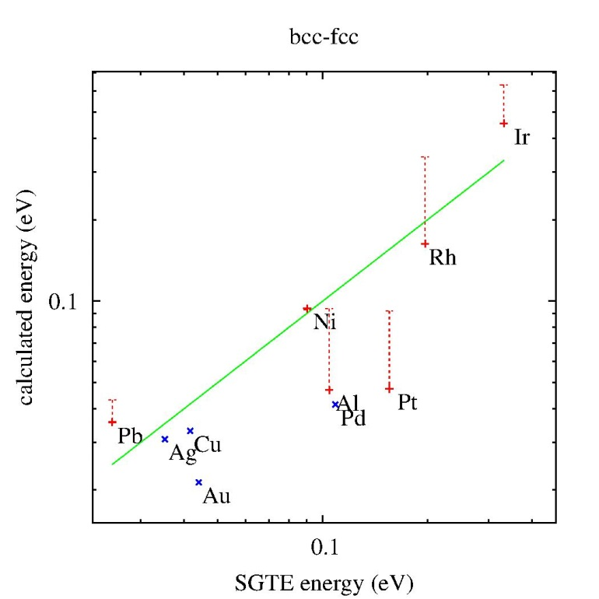
Compatibility with SGTE
* : fully relaxed
+ : inflection-detection
− : symmetry-constrained

Slide 21
How to find the minimum energy in mechanically unstable region of phase space?
Look for boundary solution:
Minimum energy subject to zero minimum curvature.
Equivalent formulation:
Minimize energy,
moving perpendicularly to gradient of min curvature.
Can be implemented via a dimer-like method, see:
van de Walle, Kadkhodaei Sun & Hong, “Epicycle method for elasticity limit calculations”, Phys. Rev. B 95 144113 (2017).

Slide 22
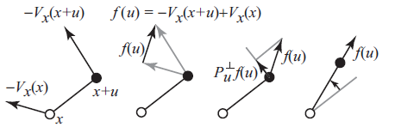
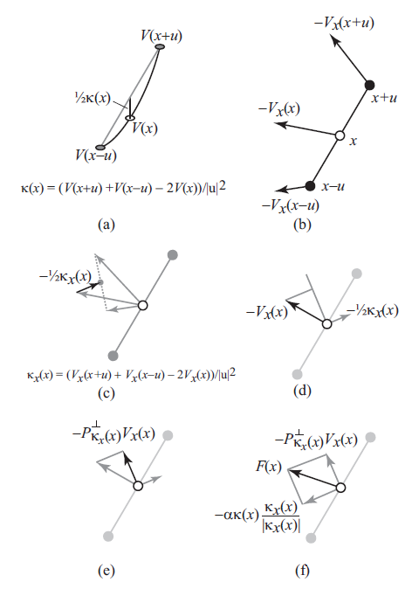
How to find minimum x_{σ}^{r} in region η_{σ}?
Minimum curvature
determination:
Ionic positions
optimization:

Slide 23
General solution to mechanical instabilities?
Covers phases that are mechanically unstable and truly unstable “in the real world”.
It is a formal definition (well-defined free energies) based on logical considerations but it is still a choice.
Nice extrapolation behavior.
It happens to agree well with historically accepted values.
Not aimed, on its own, at handling mechanically unstable phonon modes that are dynamically stabilized by anharmonicity.
Sampling of many configurations still needed.
See Kadkhodaei, Hong & van de Walle, “Free energy calculation of mechanically unstable but dynamically stabilized bcc titanium”, Phys. Rev. B 95, 064101 (2017) for a solution.

Slide 24
Short-range order effects…
Short-range order is (usually) a smaller contributions to free energy differences than differences in coordination number.
Equilibria between two different crystal structures usually involves phases that are far from ordering transition on their respective sublattices.
Free energy
Common tangent masks short-range ordered regions.
Composition

Slide 25
Short-range order correction
Starting point: Cluster Variation Method (CVM) within the pair approximation.
Truncated expansion: Polynomial in composition
Temperature-dependence: Solve CVM equations exactly for middle composition, scale solution to match first-order behavior at all compositions.
Why use such a simple scheme?
Comes “for free” (no additional ab initio calc needed)
We use it mostly in the near-random solution limit, so the expansion is accurate
Fits well within the “TDB” file format.

Slide 26
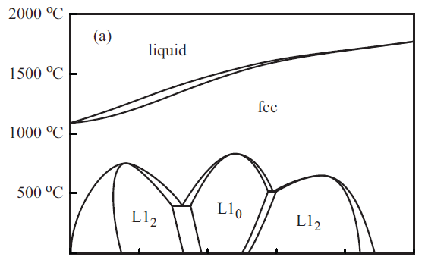
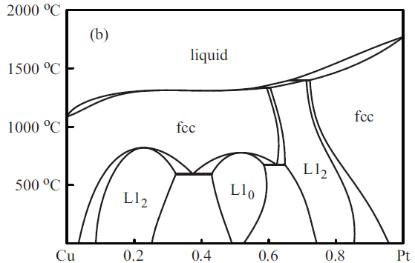
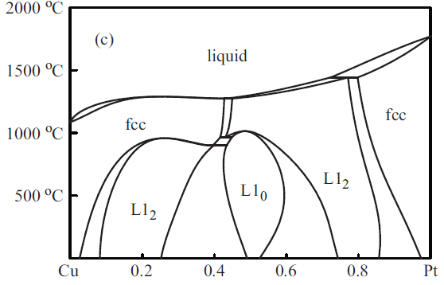
How well does this SRO model work?
Experiment (Fact Sage/SGnoble)
Calculations:
With SRO correction
Without SRO correction

Slide 27
Some examples…

Slide 28
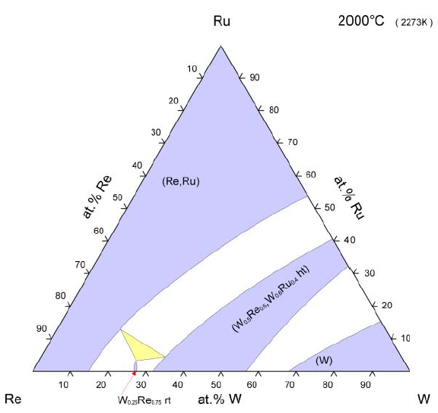
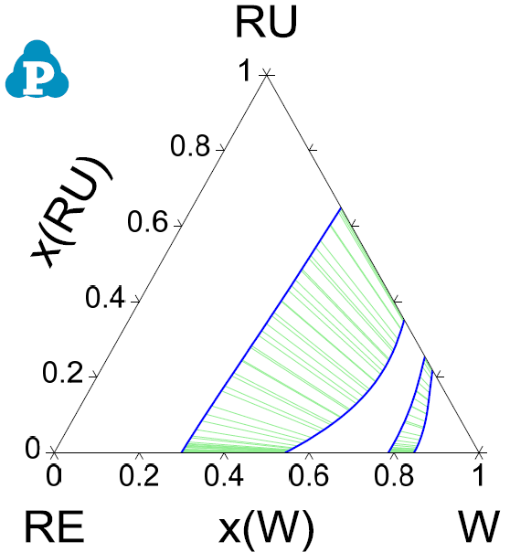
Re-Ru-W
hcp
hcp
σ
bcc
σ
χ
bcc
© ASM international
E.M Savitskii (1975)
This work.

Slide 29
Ir-Re-W: Binaries subsystems Full ternary system

Slide 30
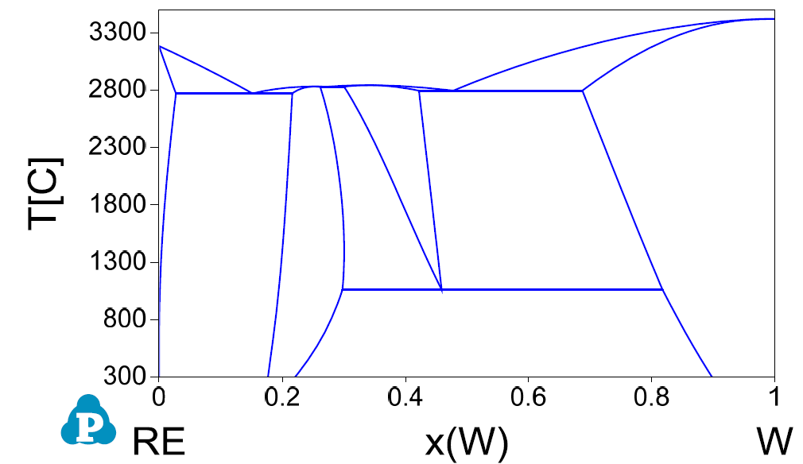
Binary subsystems: Re-W
L
L
hcp
hcp
σ
σ
bcc
bcc
χ
χ
© ASM international
Z.K. Liu et al. (2000)
This work.

Slide 31
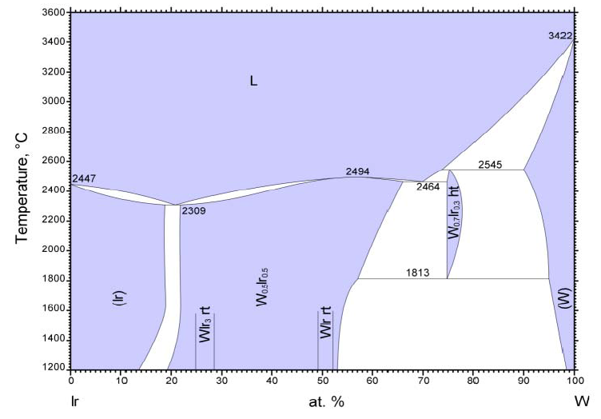
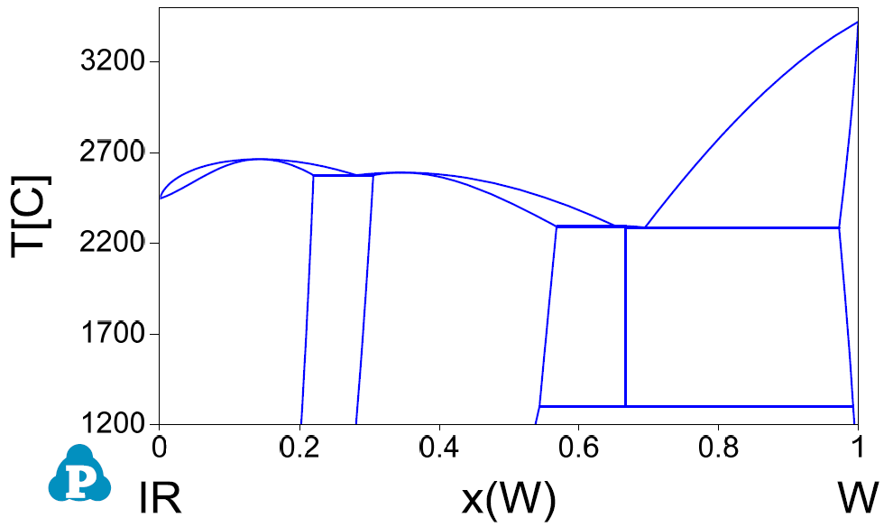
Binary subsytems: Ir-W
L
L
bcc
bcc
σ
fcc
fcc
hcp
hcp
σ
© ASM international
H. Okamoto et al. (1990)
This work.

Slide 32
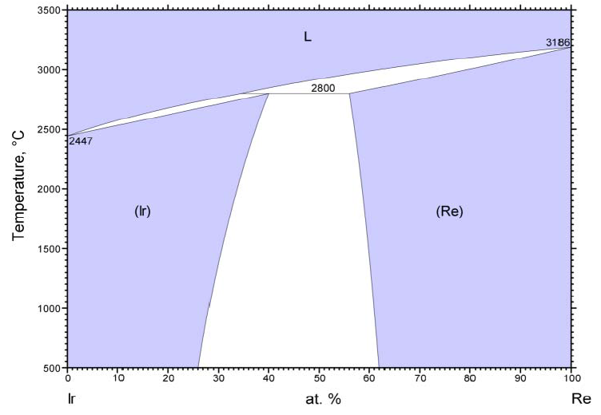
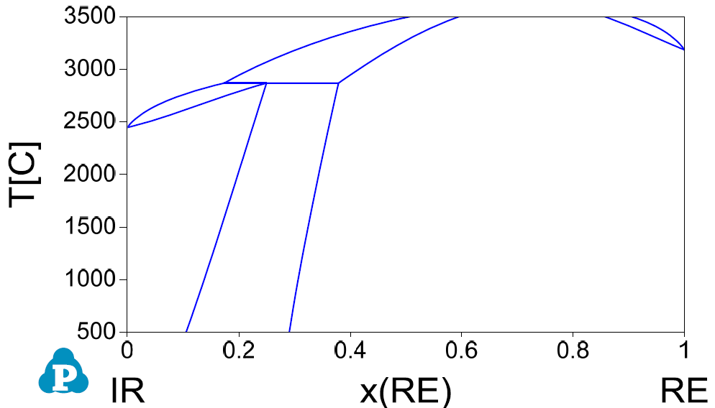
Binary subsytems: Ir-Re
L
L
fcc
hcp
hcp
fcc
© ASM international
H. Okamoto et al. (1990)
This work.

Slide 33
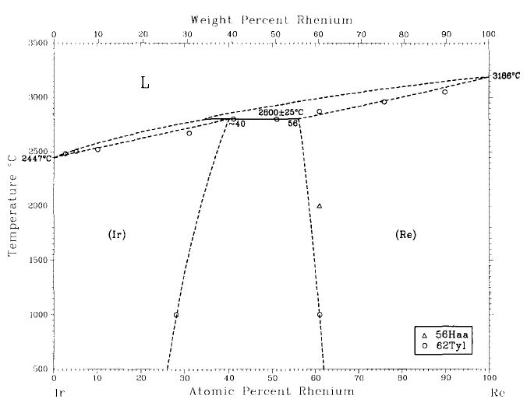
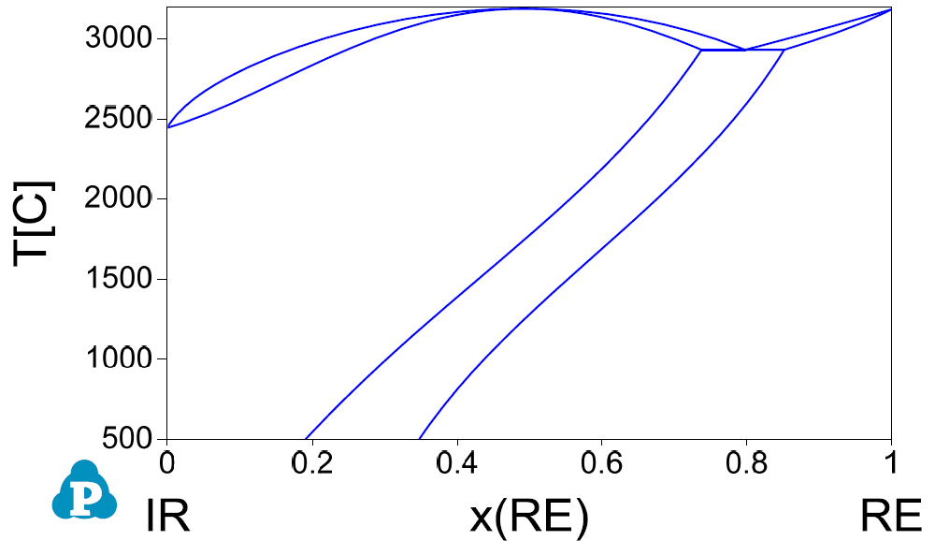
Ir-Re (continued) with vibrational formation free energy
L
L
fcc
hcp
fcc
hcp
H. Okamoto et al. (1990)
This work.

Slide 34
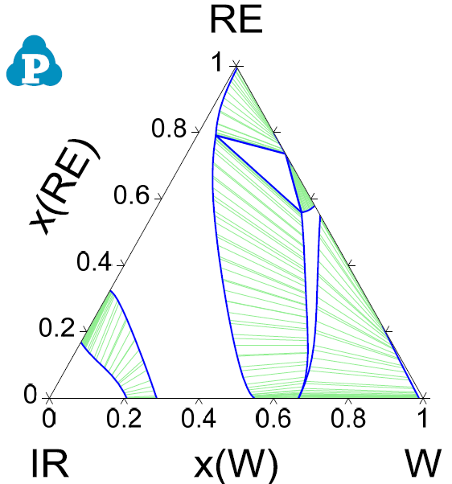
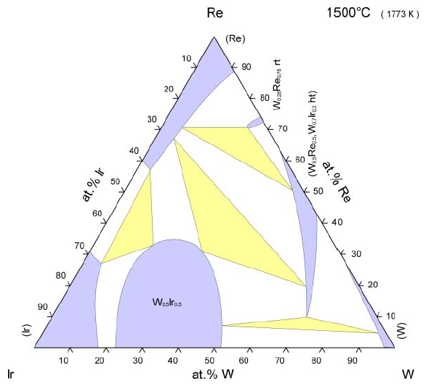
Isothermal section: Ir-Re-W
hcp
χ
χ
σ
σ
hcp
hcp
fcc
fcc
bcc
© ASM international
bcc
E.M Savitskii (1975)
This work.

Slide 35
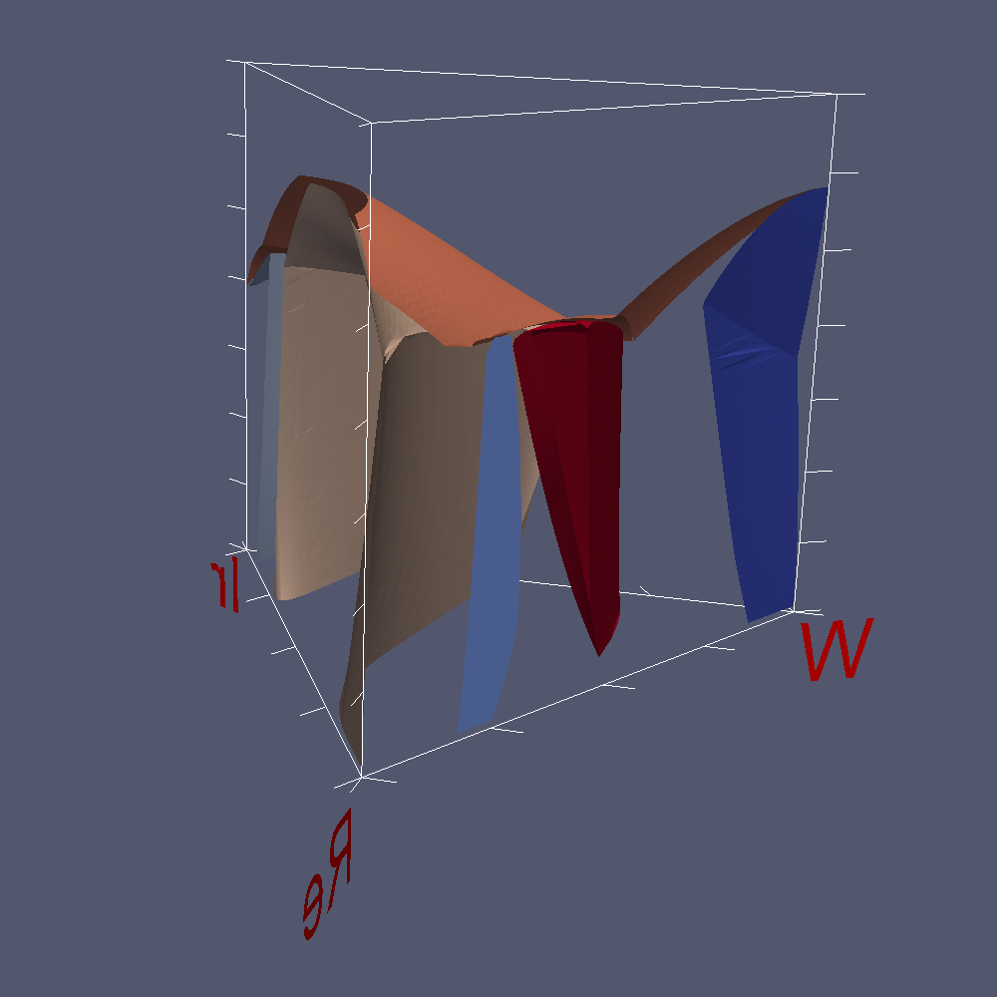
The Ir-Re-W phase diagram

Slide 36
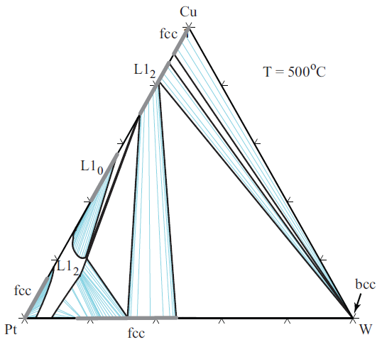
Cu-Pt-W

Slide 37
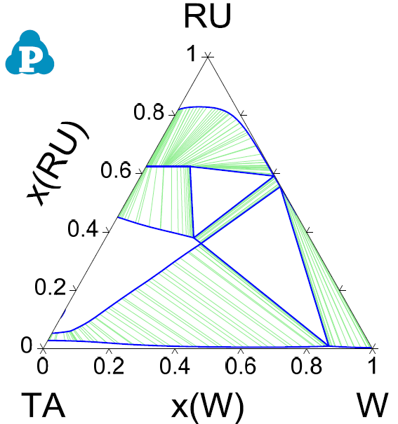
Ru-Ta-W
T = 2000ºC
hcp
Ga₃Pt₅
B2
bcc

Slide 38

Conclusion
We have presented
A simple method with surprisingly good predictive power.
A novel, theoretically justified and convenient definition of the free energy of mechanically unstable phases.
New software tools (included in ATAT) that allow you to take advantage of the above.
See the new ATAT forum: http://alum.mit.edu/www/avdw/forum/
>600 users, hundreds of posts…

