Slide 1

ATAT - A software toolkit for modeling coupled configurational and vibrational disorder in alloy systems
Axel van de Walle
Materials Science and Engineering Department
This work was supported by:
NSF under program DMR-0080766 and DMR-0076097.
DOE under contract no. DE-F502-96ER 45571.
AFOSR-MEANS under grant no. F49620-01-1-0529

Slide 2
A matter of time...
Time needed to complete a given first-principles calculation
Human
Time
Computer
1980
2005
The procedure needs to be automated

Slide 3
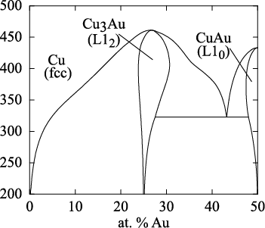

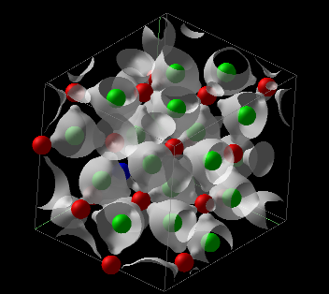
First-principles Thermodynamic Calculations
Thermodynamic data
Large number of atoms
Many configurations
Lattice model &
Monte Carlo Simulations
Configurational disorder
Lattice vibrations
Electronic excitations
Small number of atoms
Few configurations
Quantum Mechanical Calculations
http://cms.northwestern.edu/atat

Slide 4
First-principles Thermodynamic Calculations
Thermodynamic data
Lattice model &
Monte Carlo Simulations
Configurational disorder
Lattice vibrations
Electronic excitations
Quantum Mechanical Calculations
http://cms.northwestern.edu/atat

Slide 5
Thermodynamic data
Lattice model &
Monte Carlo Simulations
Configurational disorder
Configurational disorder
Lattice vibrations
Electronic excitations
Quantum Mechanical Calculations

Slide 6


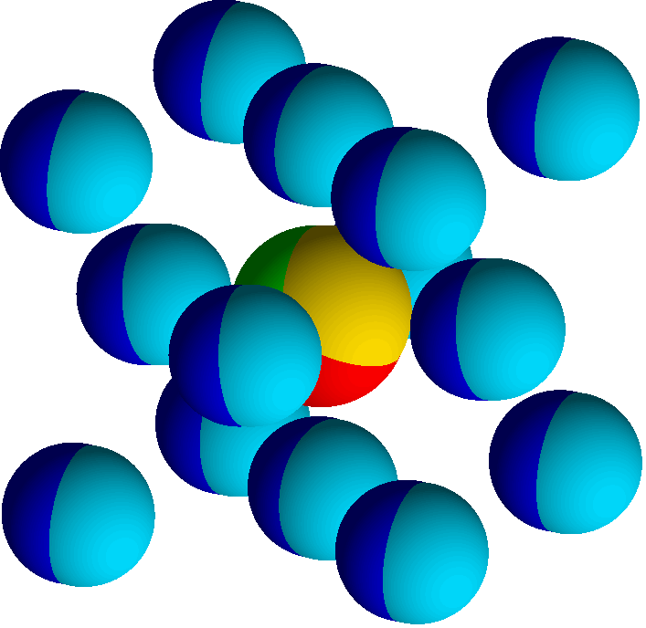



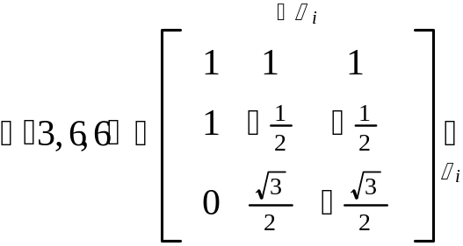
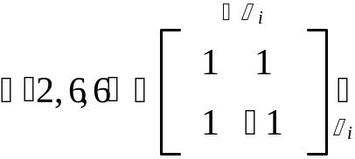
Coupled Sublattices
Multicomponent Cluster Expansion
Same basic form:
# components
Occupation variables:
“Decorated” clusters:
1
1
“Not in cluster”
1
2
Example: binary fcc sublattice with
ternary octahedral sites sublattice
Sanchez, Ducastelle and Gratias (1984)
Tepesch, Garbulski and Ceder (1995)

Slide 7
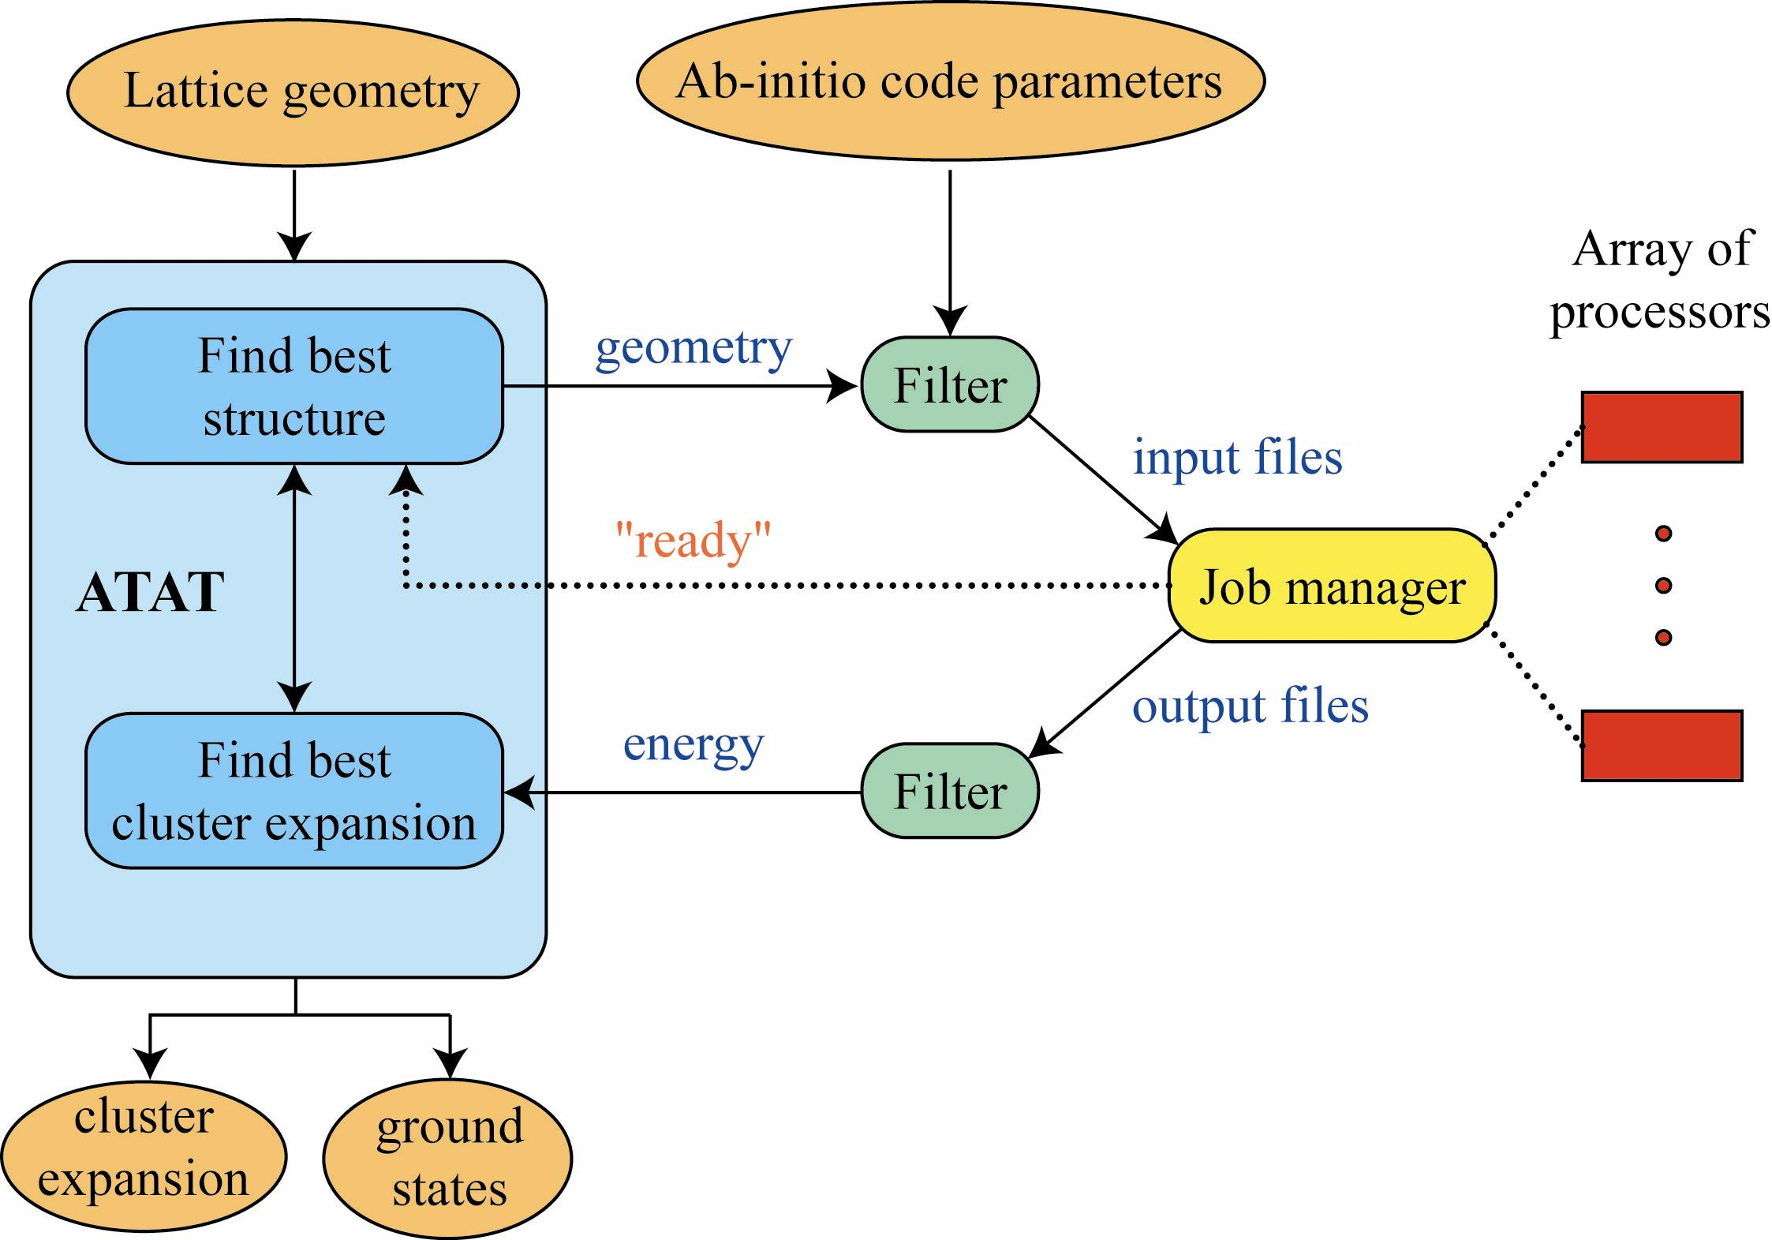
Automated Cluster Expansion Construction

Slide 8
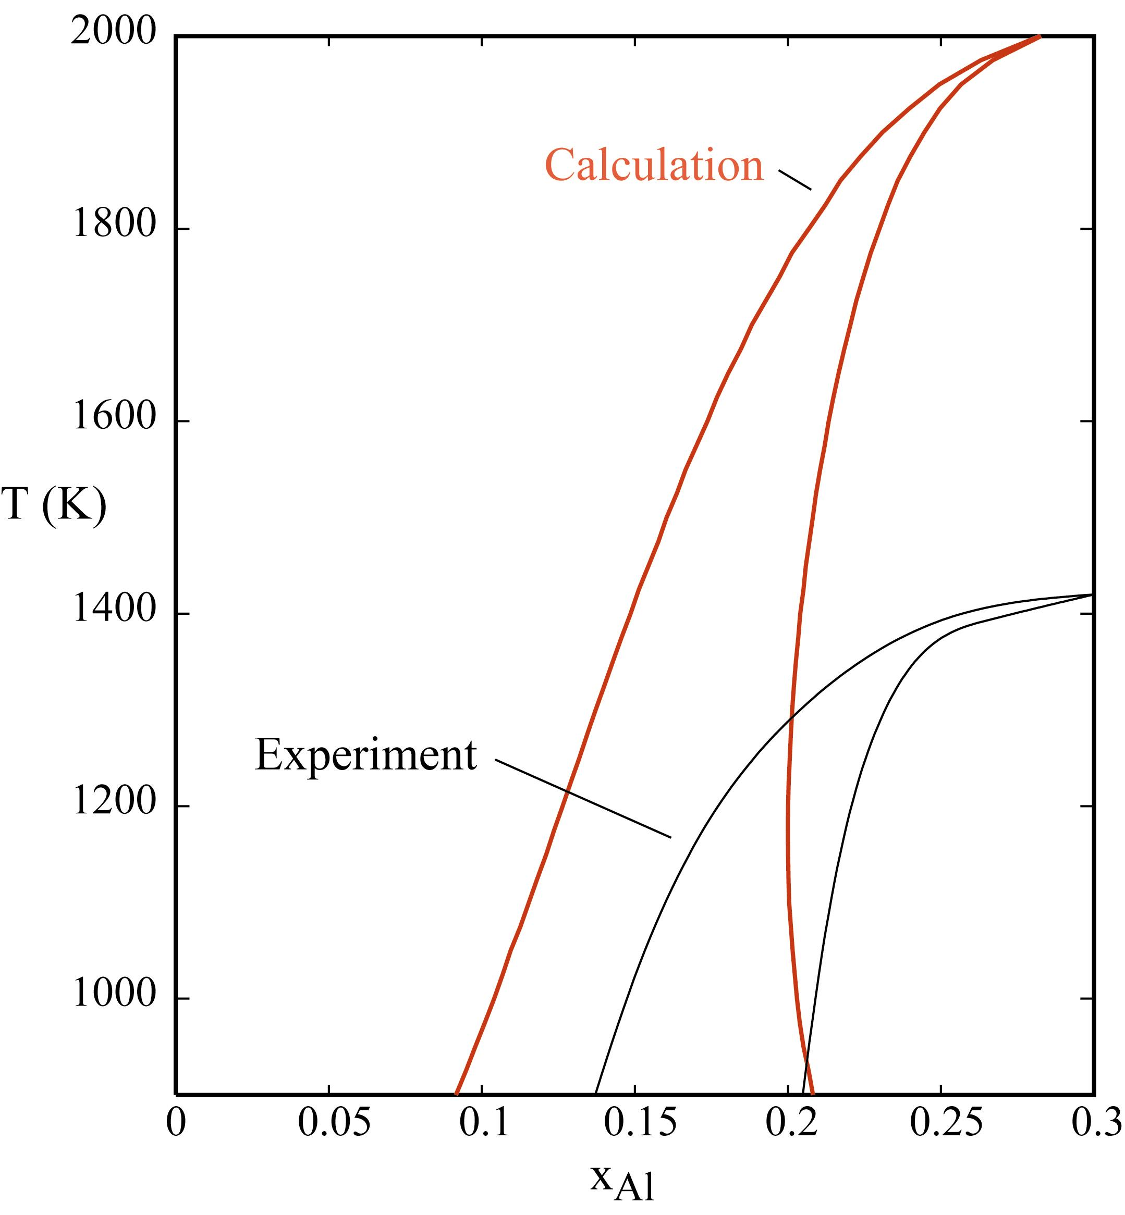
Temperature scale problem
Likely source of the discrepancy:
Vibrational entropy.
hcp Ti
Fultz, Nagel, Antony, et al. (1993-1999)
Ceder, Garbulsky, van de Walle (1994-2002)
de Fontaine, Althoff, Morgan (1997-2000)
Zunger, Ozolins, Wolverton (1998-2001)
DO₁₉
Ti₃Al
Van de Walle, Asta and Ceder (2002),
Murray (1987) (exp.)
Many other examples…

Slide 9
Thermodynamic data
Lattice model &
Monte Carlo Simulations
Lattice vibrations
Configurational disorder
Lattice vibrations
Electronic excitations
Quantum Mechanical Calculations

Slide 10
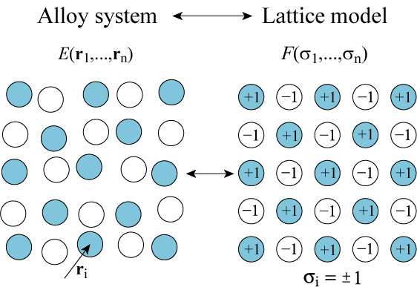

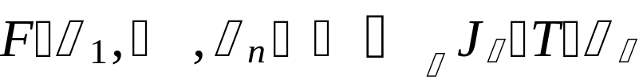
The Cluster Expansion Formalism with Coarse-Graining

Slide 11
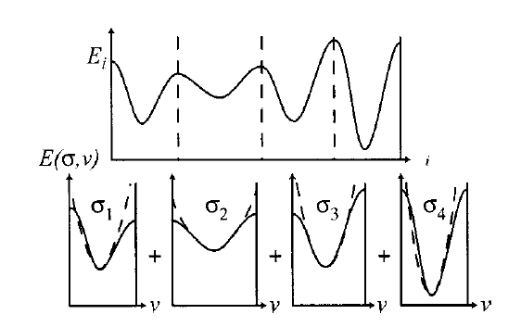
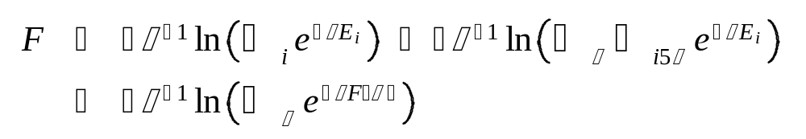


Coarse-Graining of the Free Energy
Graphically:
Formally: (Ceder (1993), Garbulski and Ceder (1994-1996))
where

Slide 12


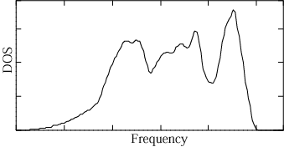
First-principles lattice dynamics
First-principles data
Computationally
intensive!
Must be done for
many configurations!
Least-squares fit to
Spring model
Phonon density of states
Thermodynamic
Properties
Direct force constant method
(Wei and Chou (1992), Garbuski and Ceder (1994),
among many others)

Slide 13
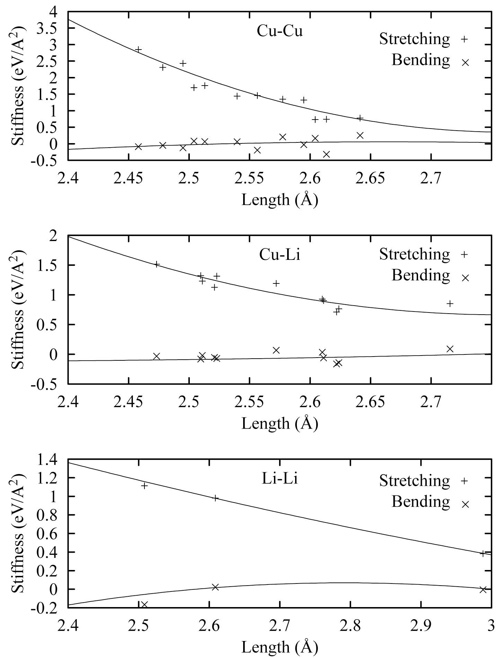
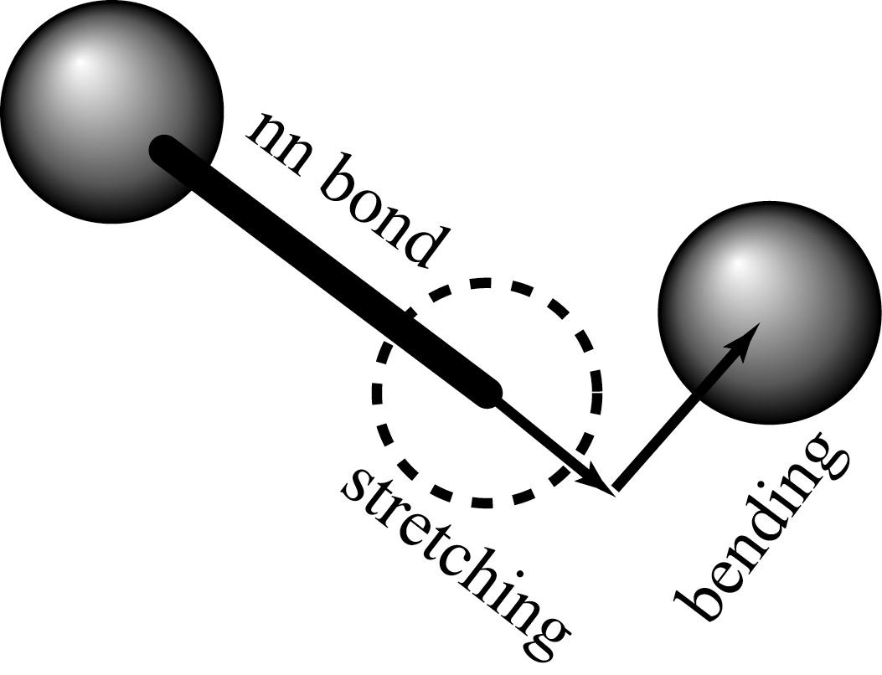
Transferable Force Constants
Chemical bond type and
bond length:
Good predictor
of nearest-neighbor force constants
(stretching and bending terms)
Relationship holds across different structures on the same lattice (here fcc is shown).
van de Walle and Ceder (2000,2002)

Slide 14
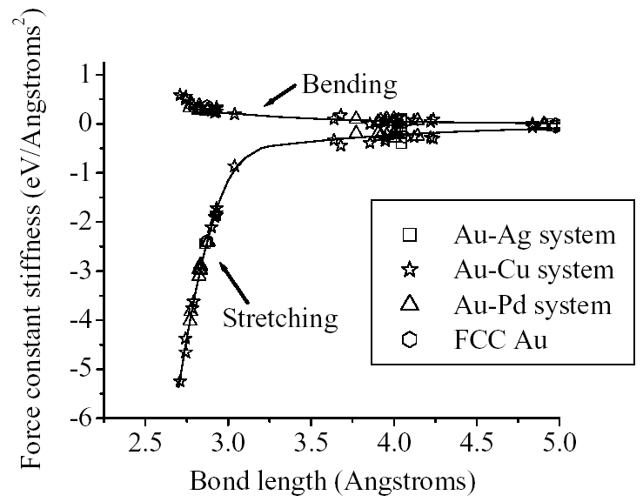
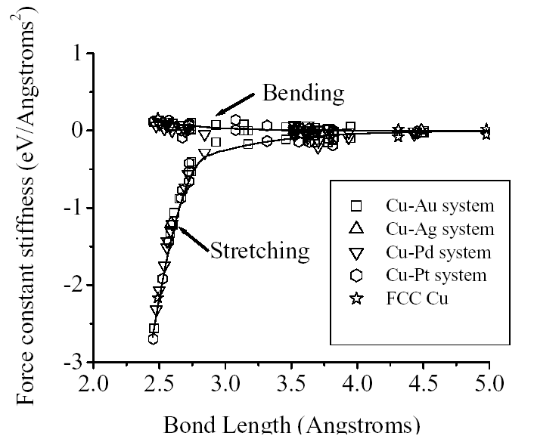
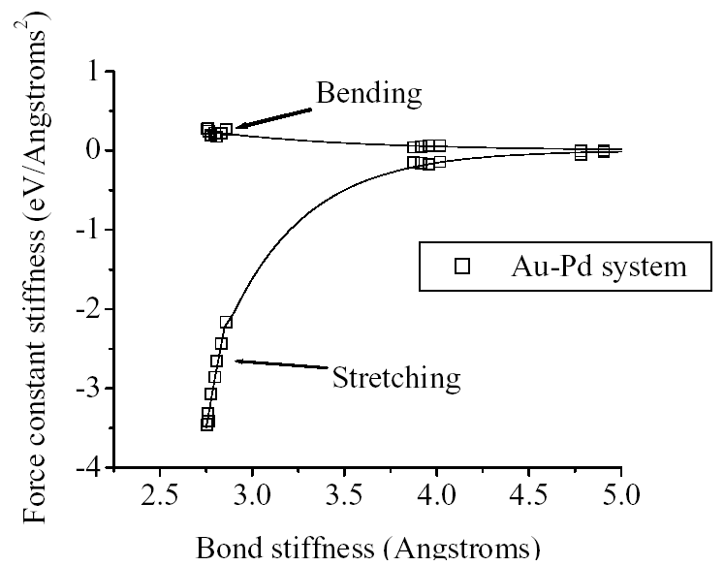
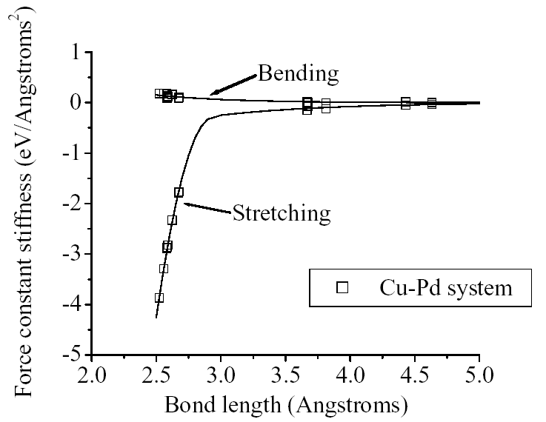
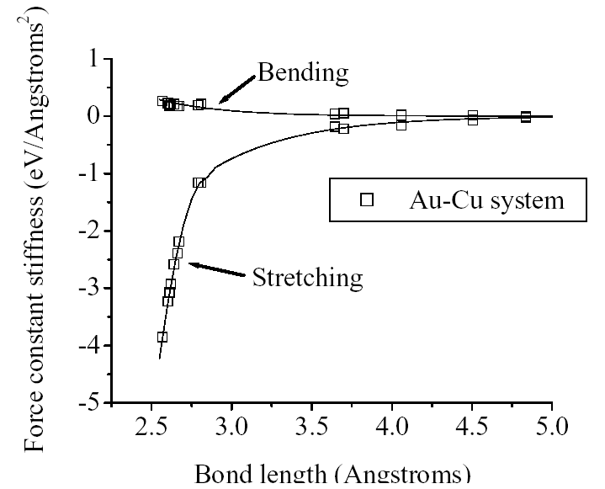
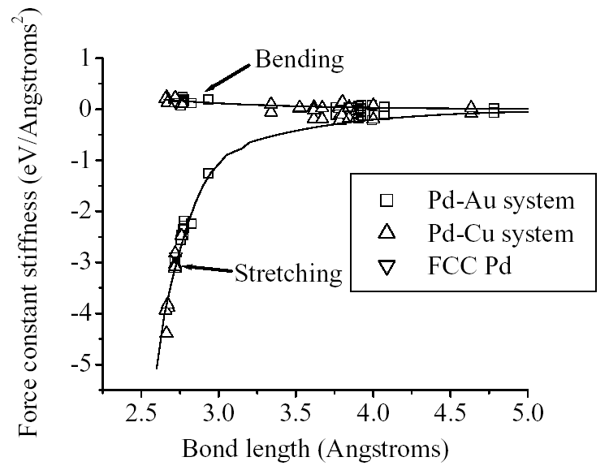
Further tests...
Wu, Ceder, van de Walle (2002)
Au-Au bonds
Cu-Cu bonds
Au-Pd bonds
Pd-Pd bonds
Cu-Pd bonds
Au-Cu bonds
Accuracy ~ 0.03 k_{B}

Slide 15
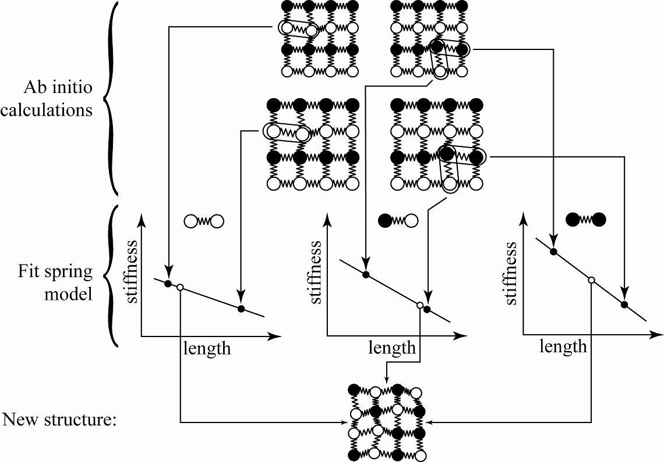
Length-Dependent Transferable
Force Constants (LDTFC)
van de Walle and Ceder (2000,2002)

Slide 16
Quasi-harmonic model
F(T,V) = E(V) + F_{H}(T,V)
Energy of a relaxed motionless lattice
with externally imposed volume V
Vibrational free energy of a harmonic solid
at temp. T with externally imposed volume V
Thermal expansion:
V*(T) = arg min_{V} F(T,V)
“True” free energy:
F(T) = F(T,V*(T))
Ideal for use with length-dependent transferable force constants

Slide 17
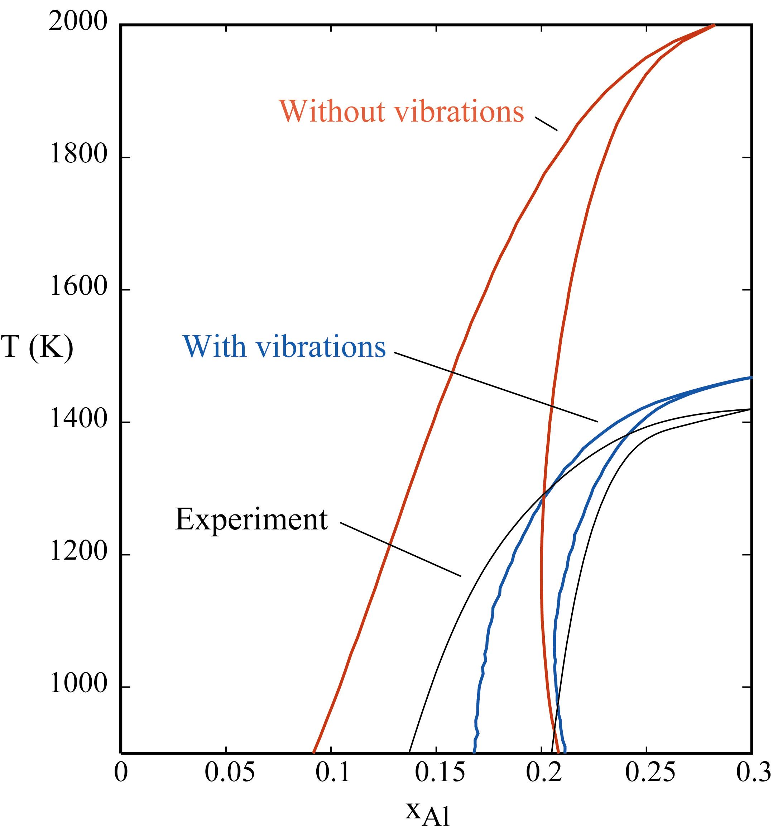
Calculated Ti-Al Phase Diagram
Assessed Phase Diagram:
I. Ohnuma et al., Acta Mater. 48, 3113 (2000)
1st-Principles Calculations:
van de Walle and Asta

Slide 18
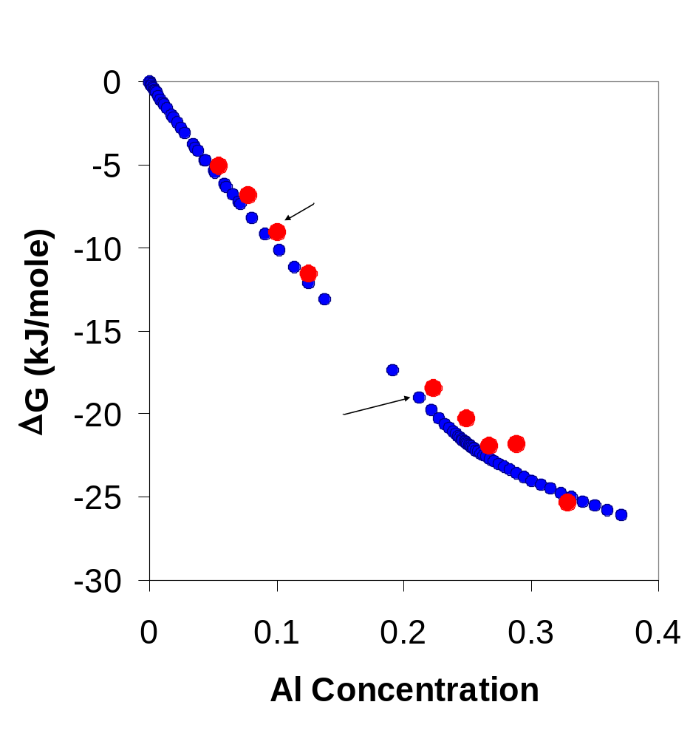
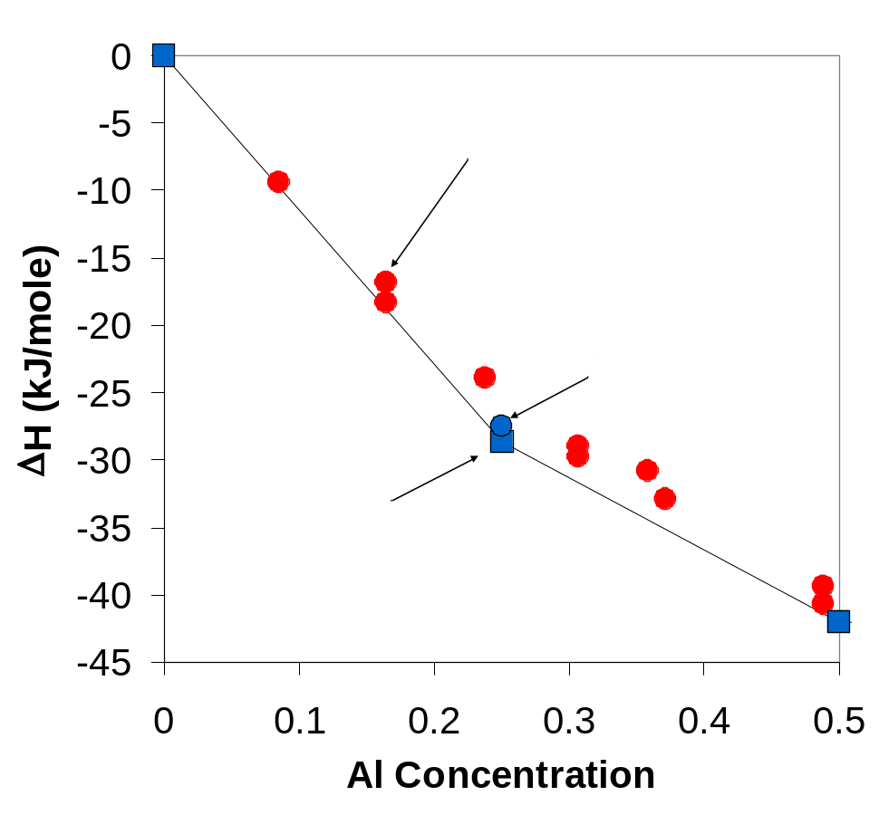
Ti-Al Thermodynamic Properties
1st-Principles Calculations vs. Measurements
Heats of Formation
Gibbs Free Energies (T=960 K)

Slide 19
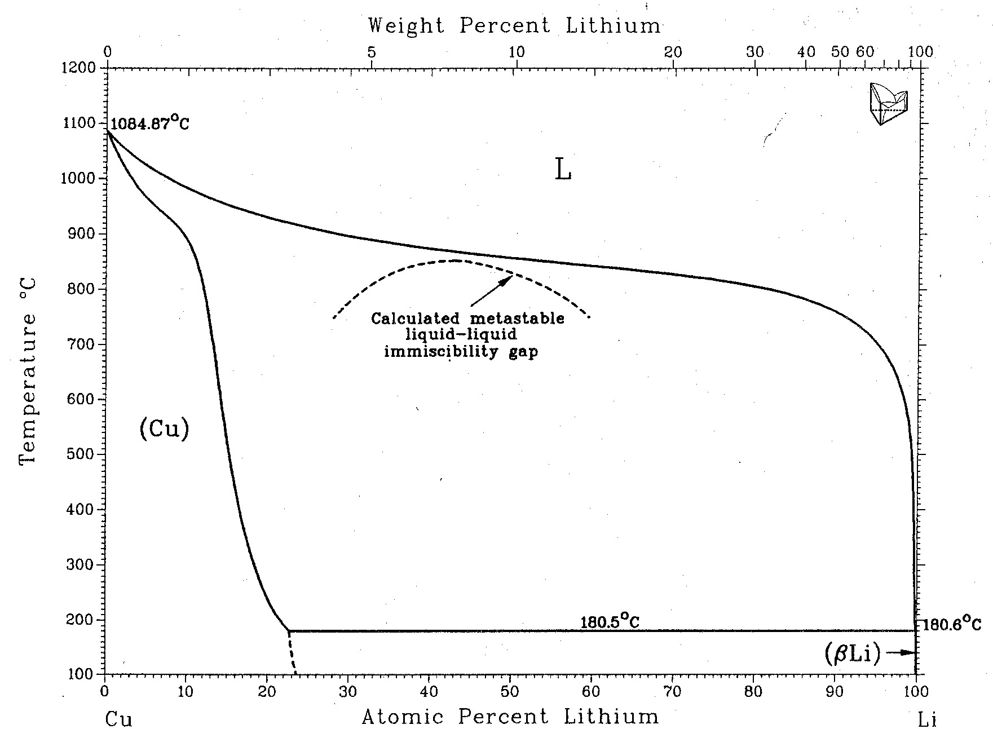
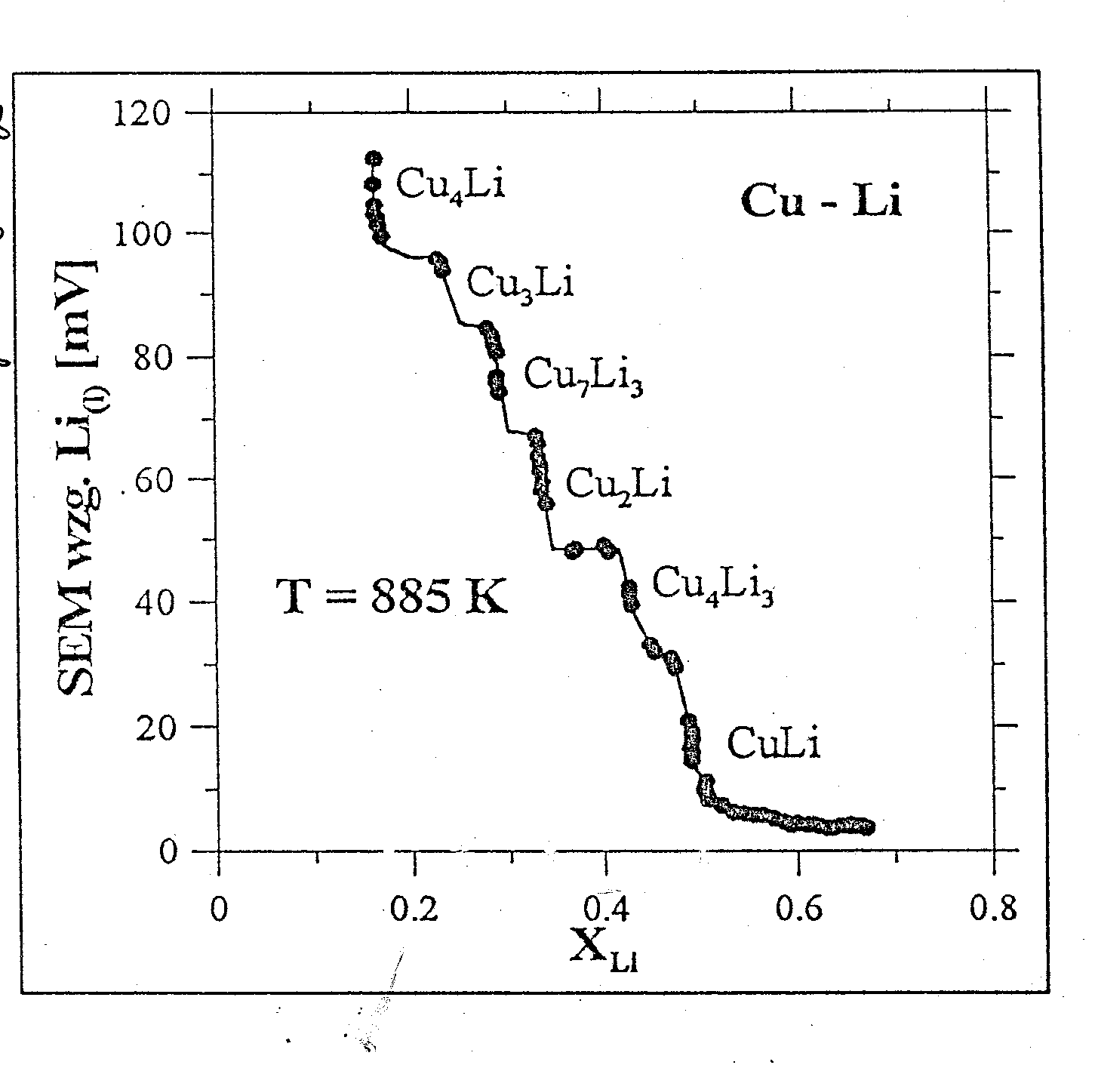
Ordering in the Cu-Li system?
Widely used assessments
do not include ordered phases
(Pelton (1986), Saunders (1998)).
Evidence from EMF measurements
Ordered Cu₄Li phase also suggested by
Borgsttedt & Gumiński (1996),
Krauss, Mendelson, Gruen, et al. (1986),
Old & Trawena (1981).

Slide 20
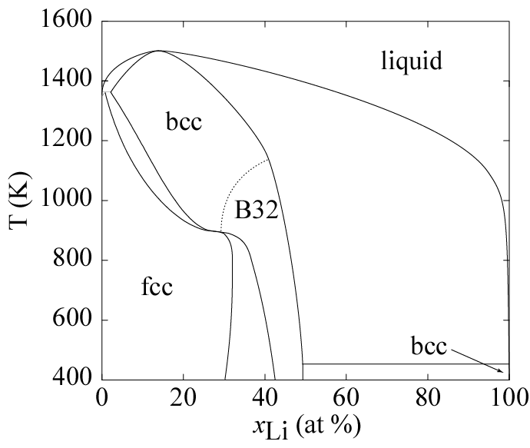
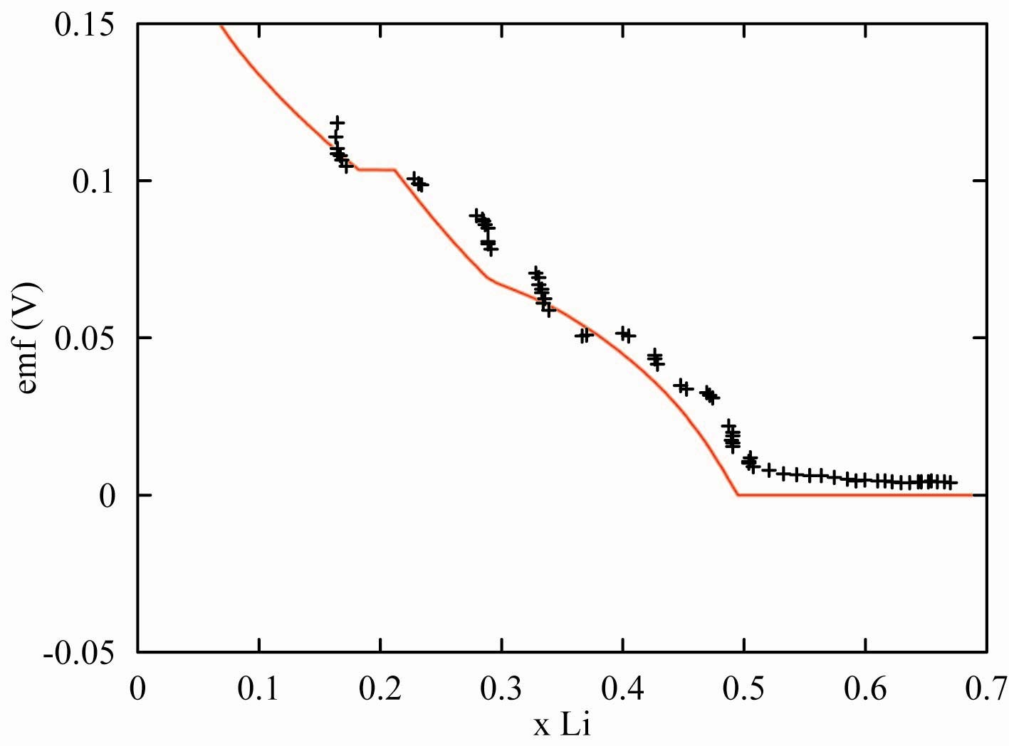
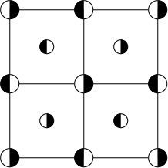
Calculated Thermodynamic data for Cu-Li system
Phase diagram
Electromotive Force (EMF)
1st order transition
fcc
bcc
B32
2nd order transition
T_{simulation} = 950 K
T_{measurement} = 885 K
2 adjustable parameters:
T_{simulation} + chemical potential of Li (liq)

Slide 21
Thermodynamic data
Lattice model &
Monte Carlo Simulations
Electronic excitations
Configurational disorder
Lattice vibrations
Electronic excitations
Quantum Mechanical Calculations

Slide 22



Electronic Excitations
Finite-temperature DFT
T-independent DOS and charge density
Advantage: Get F_{elec} “for free”
Electronic DOS
8
7
6
Fermi-Dirac Distribution
5
Density of States
4
3
2
Electronic Free energy
1
0
-4
-2
0
Energy (eV)
Cluster expansion:

Slide 23
Using ATAT
Overview of the input/output files
Syntax of the files
Sample output

Slide 24
File structure
Files:
ABlat
0
str.out
energy str_relax.out
fvib
lat.in
vasp.wrap
5
str.out
energy str_relax.out
fvib
eci.out
clusters.out
gs.out
maps.log
0.2_0_0
str.out
force.out
0.2_0_1
str.out
force.out
Perturbations
strnames.in
0.2_0.5_0
str.out
force.out
slsprings.out
0.2_0.5_1
str.out
force.out
Trange.in
. . .
fvib.eci
teci.out
Commands:
maps -d
fitsvsl -f
run ab initio code
foreachfile str.out svsl -d
fitsvsl -d
clusterexpand fvib
run ab initio code
mkteci fvib.eci

Slide 25
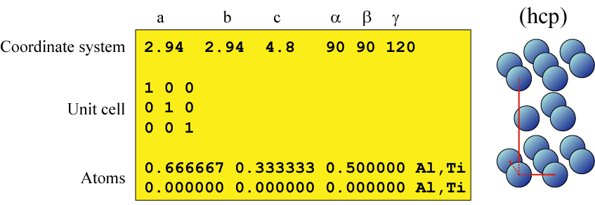
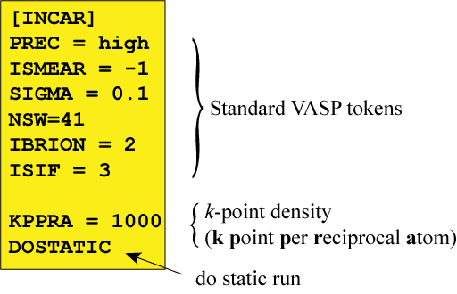
Example of input files
Simple lattice input file
Simple ab initio code input file

Slide 26
Clusters and ECI files
clusters.out
eci.out
fvib.eci
teci.out
1
0.000000
0
2
0.000000
1
1.000000 1.000000 1.000000
6
2.939999
2
0.666667 0.333333 0.500000
1.000000 0.000000 1.000000
6
2.940004
2
0.666667 0.333333 0.500000
-0.333333 -0.666667 0.500000
etc.
2000 21
0.312346
-0.351077
0.0473349
0.0411423
...
0.308527
-0.350903
0.0472538
0.0410874
...
T_{max}
# division
0.229683
-0.350275
0.047938
0.041720
etc.
0.0826
-0.0008
-0.0006
-0.0005
...
0.0793
-0.0008
-0.0006
-0.0006
...
T=0K
multiplicity
diameter
# of points
sites
(using coordinate
system in lat.in)
T=100K
etc.

Slide 27
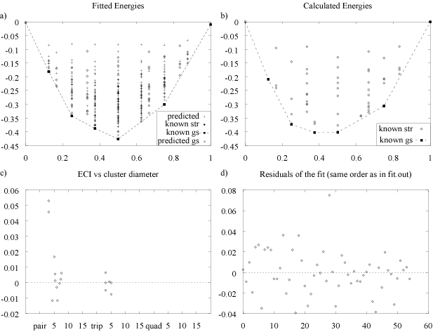
maps graphical output

Slide 28
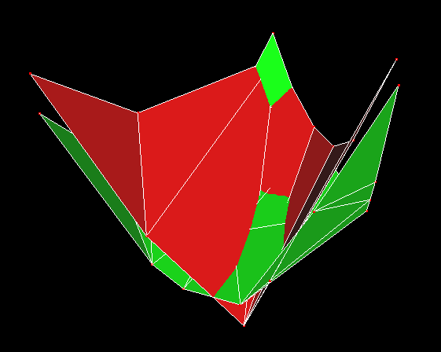
Search for new compounds in the Al-Mo-Ni system
Mo (bcc)
Ni (fcc)
Al (fcc)
E
Mo
Ni
Ni₃Al (L1₂)
NiAl (B2)
Al
plotted with MEDIT, INRIA-Rocquencourt.

Slide 29
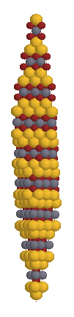
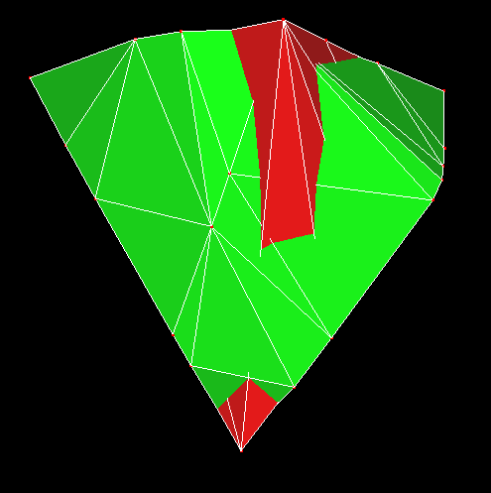
Predicted Compound
Ni
Al
(fcc)
(bcc)
AlMo₂Ni₂
Mo
plotted with MEDIT, INRIA-Rocquencourt.

Slide 30
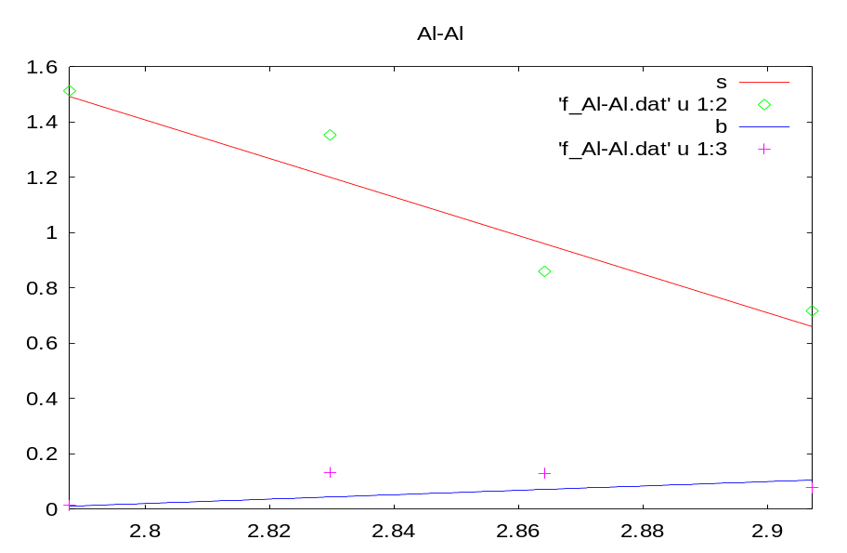
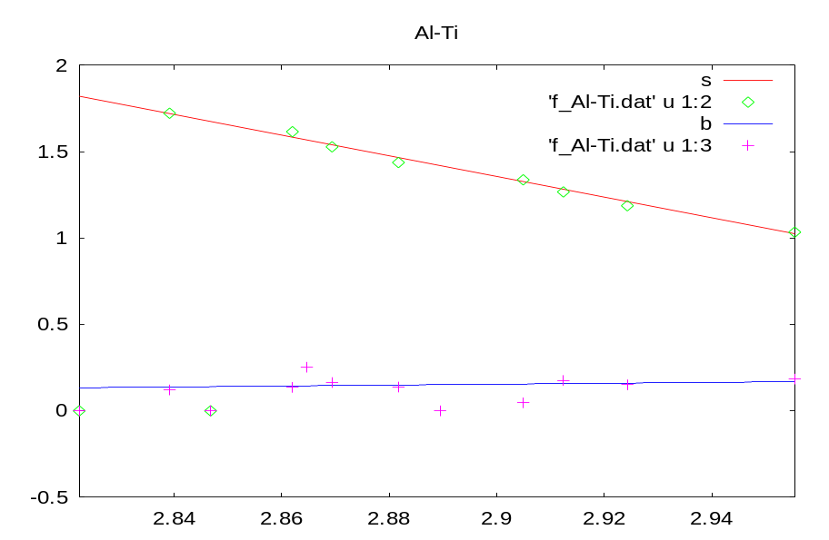
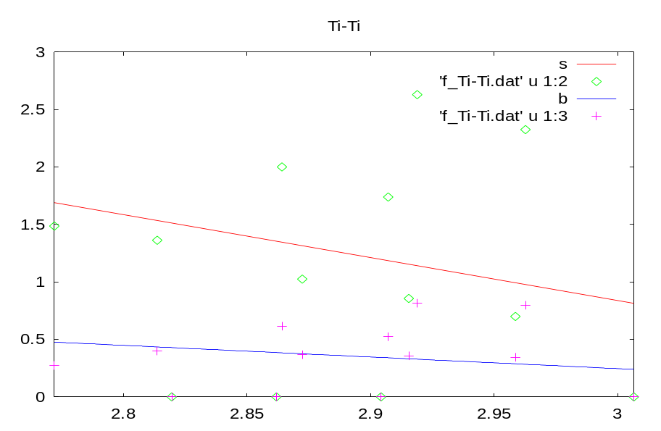
fitsvsl graphical output
Force constant (eV/Å²)
length (Å)
length (Å)
Force constant (eV/Å²)
length (Å)

Slide 31
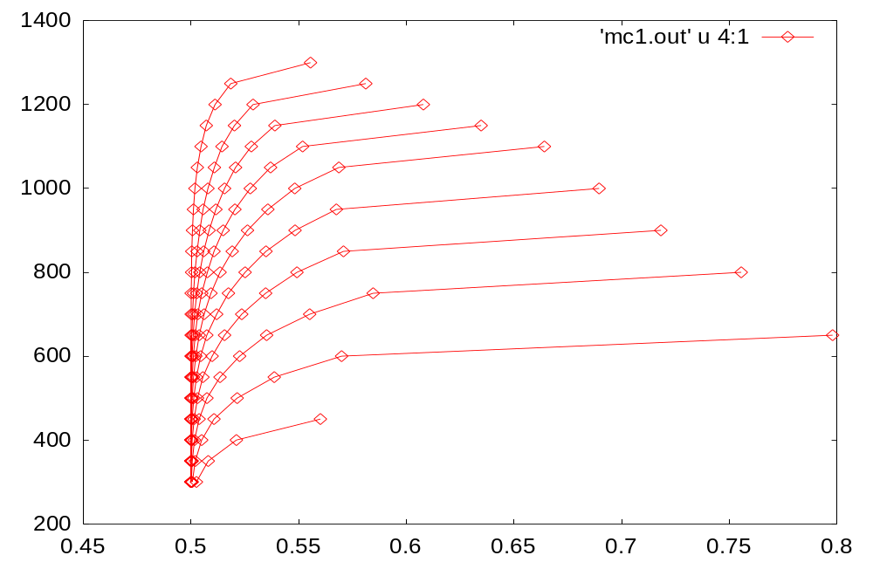
emc2 graphical output
Other outputs:
1) T: Temperature
2) mu: chemical potential
3) E-mu*x: Average energy
4) x: Average Concentration
5) phi: grand canonical potential
6) E2: heat capacity
7) x2: susceptibility
8) E_lte-mu*x_lte: from LTE
9) x_lte
10) phi_lte
11) E_mf-mu*x_mf: from MF
12) x_mf
13) phi_mf
14) E_hte-mu*x_hte: from HTE
15) x_hte
16) phi_hte
17) lro: Long Range Order parameter
18-) corr: correlations
T
x

Slide 32
Miscellanea (I)
  maps : Cluster expansion builder
  mmaps : Multicomponent version of maps
  emc2 : General purpose Monte Carlo code
  phb : Phase-transition-tracing Monte Carlo code
  checkrelax : Excessive relaxation detector
  corrdump : Cluster generator/correlation calculator
  clusterexpand : Manual cluster expansion generator
  genstr : Super structure generator
  gensqs : Special Quasirandom Structure generator
  pdef : Point defect supercells generator
  csfit : Constituent strain calculator
  cellcvrt : General crystal structure file format conversion utility
  lsfit : Least-squares fitting code
  fitfc : Phonon calculation with direct force method
  fitsvsl : Length-Dependent Transferable Force Constants generator
  svsl : Phonon calculations using LDTFC
  felec : Electronic free energy calculator
ATAT
Utilites

Slide 33
Miscellanea (II)
  runstruct_vasp : Interface with vasp
  runstruct_abinit : Interface with abinit
  runstruct_pwscf : Interface with pwscf
  runstruct_gulp : Interface with gulp
  pollmach : A job dispatcher for computer clusters
  foreachfile : A “loop over directories” utility
  str2xyz : File conversion utility for viewing with rasmol
  makelat : Database of crystal structures
  getvalue, (just)after, (just)before, (just)between sspp : Text extractors
  memc2 : Multicomponent version of emc2 (in development)
ab initio
empirical potential
ATAT
Utilites
Run command without any argument to get usage help
Use –h option to get detailed help
http://cms.northwestern.edu/atat/manual/manual.html
Getting Help

Slide 34
References
  A. van de Walle and G. Ceder. The effect of lattice vibrations on substitutional alloy thermodynamics. Rev. Mod. Phys., 74:11, 2002.
    A. van de Walle, M. Asta, and G. Ceder. The alloy theoretic automated toolkit: A user guide. CALPHAD Journal, 26:539, 2002.
    A. van de Walle and G. Ceder. Automating first-principles phase diagram calculations. Journal of Phase Equilibria, 23:348, 2002.
      A. van de Walle and M. Asta. Self-driven lattice-model monte carlo simulations of alloy thermodynamic properties and phase diagrams. Modelling Simul. Mater. Sci. Eng., 10:521, 2002.
    Web site: http://cms.northwestern.edu/atat
    This afternoon’s tutorial: http://cms.northwestern.edu/atat/tutorial

