Slide 1
Solder station
Axel Vanherle.

Slide 2
What am I going to talk about?
• Introduction
• Materials and methods
• Results
• Discussion
Notes:
INTRODUCTION
What did I make and how?
MAT AND MET
What software, why I selected those components and five steps I needed to take to complete it
RESULTS
Talk about the final products
DUSCUSSION
Reflect on the final product

Slide 3
Introduction
• What did I make?
• How did I do that?
Notes:
Solder station
Suggestion by mr hilven
Adjustable heat output
4 digit display to montitor that
Made using shematics from elektor
Customized to fit MY needs

Slide 4
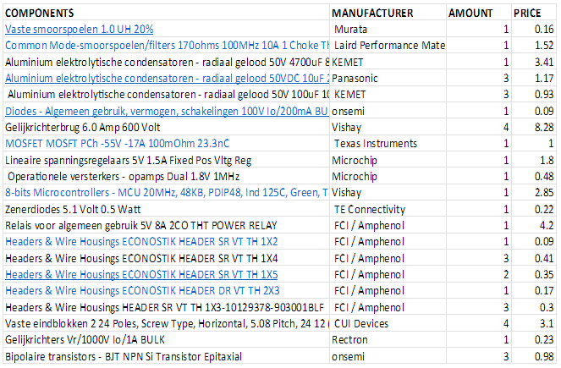
Materials and methods
• What software?
• Why these components?
• What five steps did i have to do?
Notes:
SOFTWARE
Altium designer schematic and pcb design
Autodesk fusion 360 for the case design which wil be 3d printed
Hardware is ordered from mouser mostly, but small orders conrad and RME
THE LIST
IT shows who makes them
Amount orderen
And price in euro.
They were chosen on 4 criteria
.Do they work in the design? Are they available? Is it a sensible price? And whether the footprint is easily available.
5 steps to complete the project
Component selection
Done on those 4 criteria
Finding matching footprints
Mainly mouser but sometimes third party websites.
footrpints were imported using a tool ecad to workable files
Schematic design
Schematics from mouser, modified with cutom pinheaders
PCB
relies heavily on schematics being correct
used autoroute
Case
Dimesions were know I could begin with the case design. Made thet specifaclly for my needs.

Slide 5
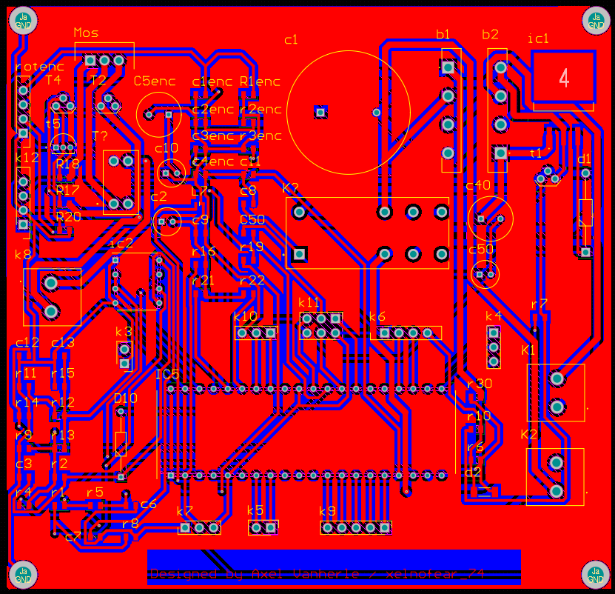
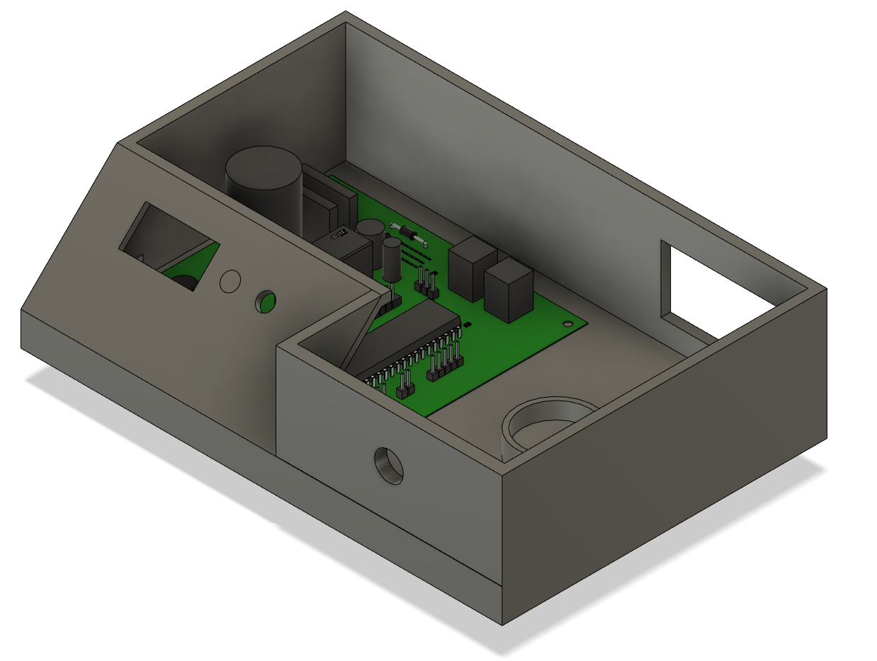
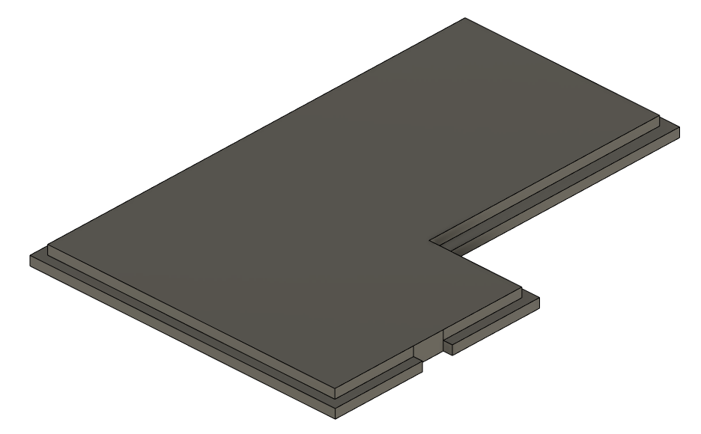
Results
Notes:
PCB
Was made with easy of use in mind
footprints are on sendible locations
easily measurable
All connectord are near the sides
easier when solderin
CASE
This part was based on my preferrance and use case
designed with height and material in mind
flat as possible without using unneserasy materuals
Due to my design choice with the dispkay and rot encoder I had complete freedom
display sits at a 45 degree angle for easily vuiewing angles
lid has a simply design that relies on pressure with a small cutout so I can remove it

Slide 6
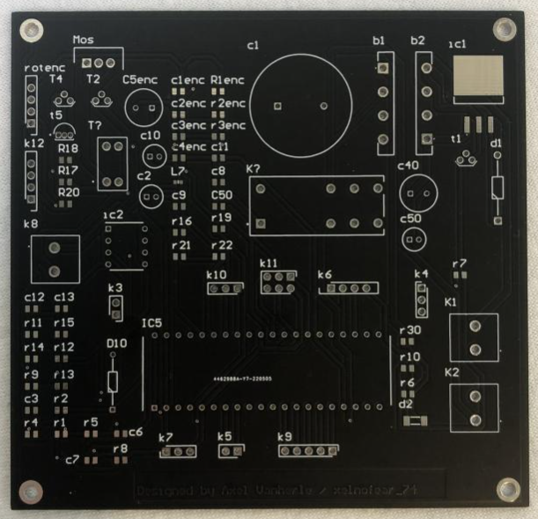
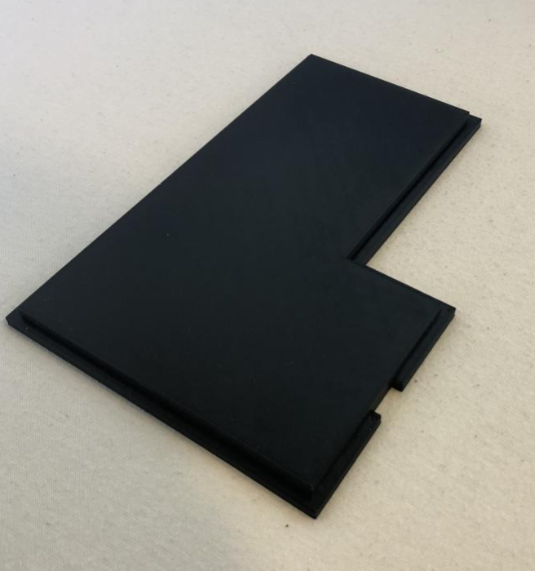
Discussion
Notes:
Several issues
Selectinfint components
oos or not available
Footprints not always available
Footprints don’t always match so finding how to connect them
Atmega chip not connected to ground
No issues with the pcb design phase , autoroute with custom rules was a great help
Ordering with the group went fine
Delivery fdate on eceything is fine
For the case design the doftware easy easy
Fitment issues on the case though
I would not do anything different. Its was a great learning curve.

Slide 7

Any questions?

