Slide 1

VisioniZZer
visualise your dreams ...
presented by :
N.Parashuram
Suman Narayan. B

Slide 2

Contents
Background of Development
Features of Visionizzer
Applications developed using Visionizzer
Demonstration

Slide 3

Development History ...
GUI procedures are redundant
Character Interfaces give Speed
System Programming easy with ‘C’
No Visual IDE for Character interfaces

Slide 4

Our Application
provides ...
Graphics designer
A visual editor
Program generator
Mouse support

Slide 5

Applications created with
VisioniZZer
Port Tester
ViewPointer
Tic-Tac-Toe

Slide 6
Port Tester
developed using VisioniZZer
for testing Parallel Ports

Slide 7
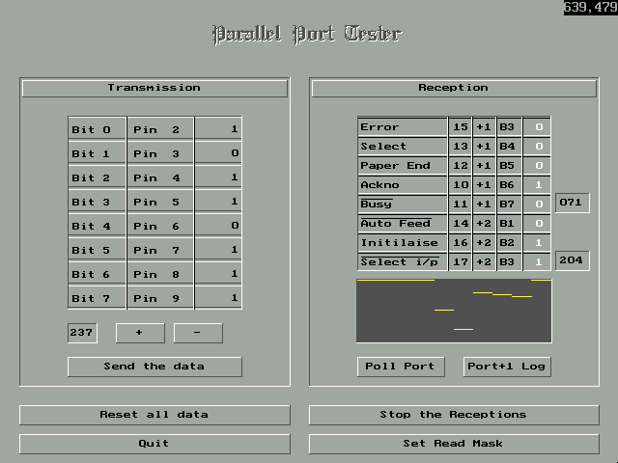

Slide 8
ViewPointer
product of VisioniZZer
creating exotic mouse cursors
for DOS

Slide 9
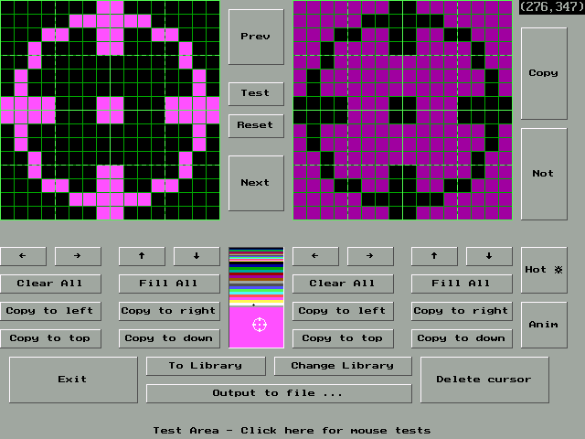

Slide 10
Tic-Tac-Toe
developed using VisioniZZer
the game - for the INVINCIBLE

Slide 11
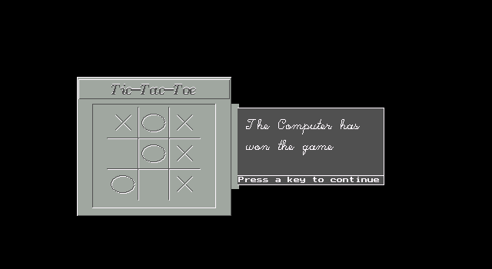

Slide 12
So we proceed to the
Demonstration .....

