Slide 1
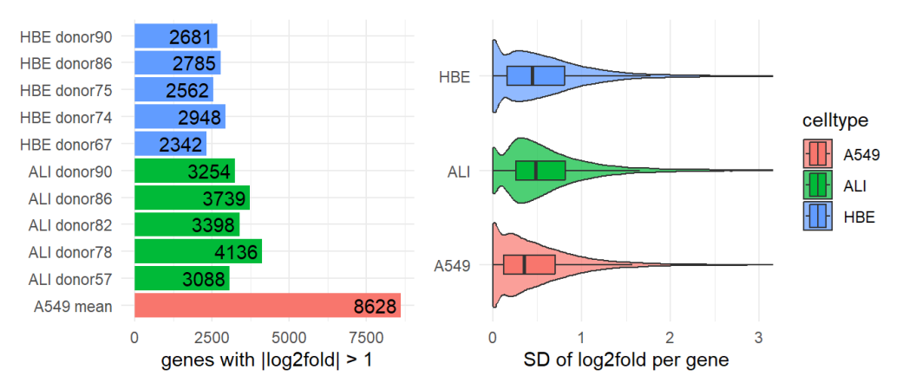
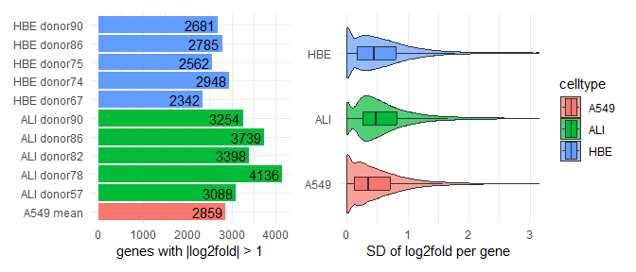
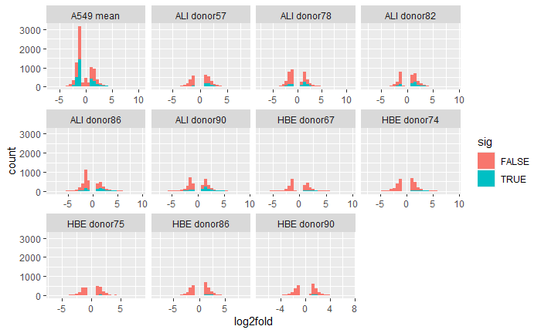
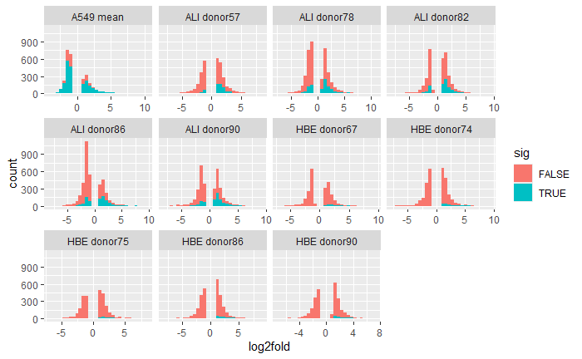


Pre-fix:
if gene x in any A549 rep meets the threshold, call the gene as regulated
Discrepancy: 8628 A549 genes vs ~2500 on Venn
Post-fix:
if the mean log2fold of gene x in A549 meets the threshold, only then do we call the gene as regulated
Discrepancy fixed
Inflated counts
sig = is FDR <-= 0.05?

