Slide 1








SQL PROJECT ON
PIZZA SALES
@axhhad-khan

Slide 2
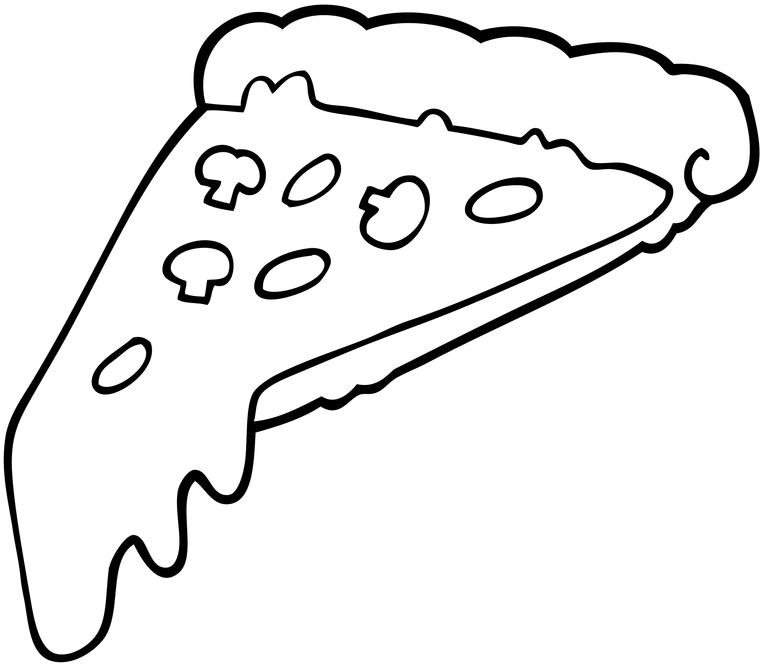
Hello!
My name is Ashhad Khan. I’ve created this project on SQL(Structured Query Language). In this progect I’ve utilized SQL queries to solve questions that were related to pizza sales database.

Slide 3


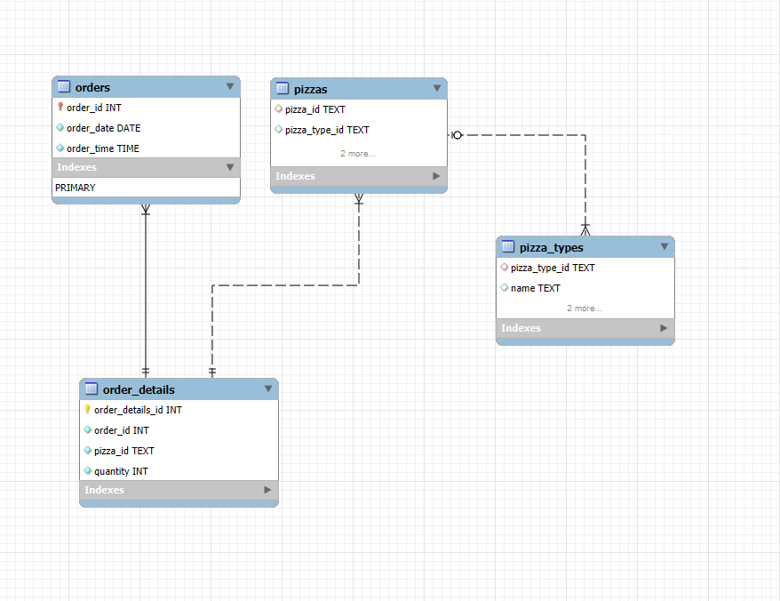
EER Diagram
of Database

Slide 4


Retrieve the total number
of orders placed.
QUERY:
OUTPUT:

Slide 5
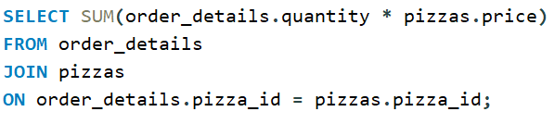

2. Calculate the total revenue generated from pizza sales.
QUERY:
OUTPUT:

Slide 6
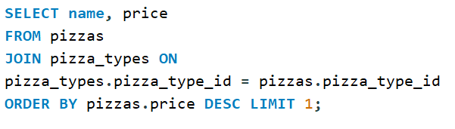

3.Identify the highest-priced pizza.
QUERY:
OUTPUT:

Slide 7
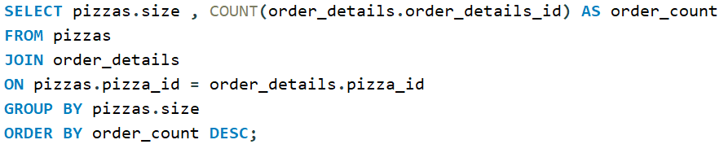
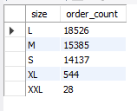
4.Identify the most common pizza
size ordered.
QUERY:
OUTPUT:

Slide 8
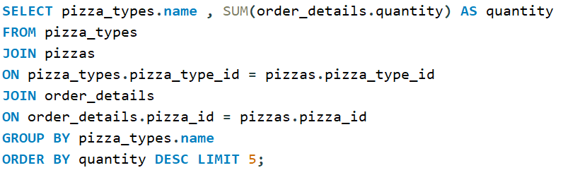
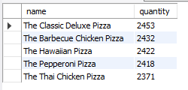
5. List the top 5 most ordered pizza types along with their quantities.
QUERY:
OUTPUT:

Slide 9
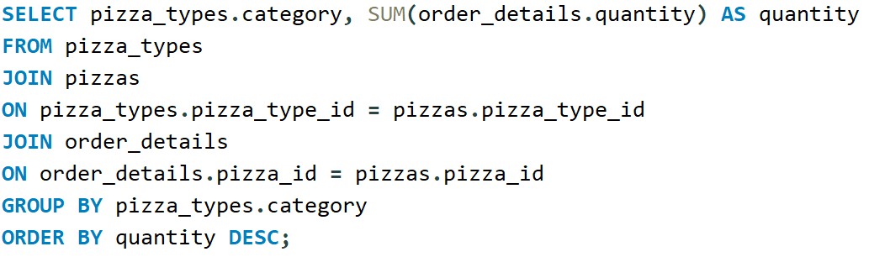

6. Join the necessary tables to find the total quantity of each pizza category ordered.
QUERY:
OUTPUT:

Slide 10
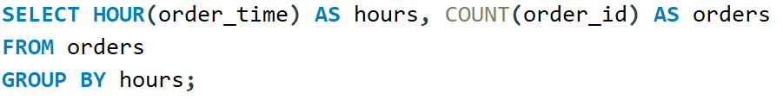
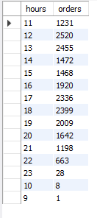
7. Determine the distribution of orders by hour of the day.
QUERY:
OUTPUT:

Slide 11
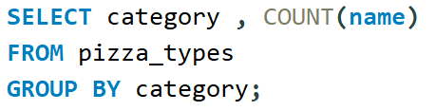
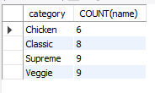
8. Join relevant tables to Find the category-wise distribution of pizzas.
QUERY:
OUTPUT:

Slide 12
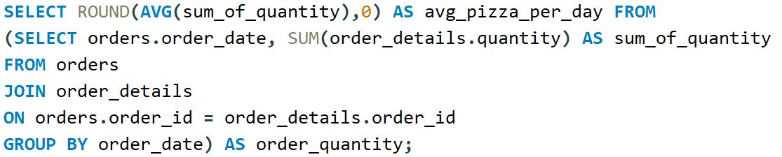

9. Group the orders by date and calculate the average number of pizzas ordered per day.
QUERY:
OUTPUT:

Slide 13
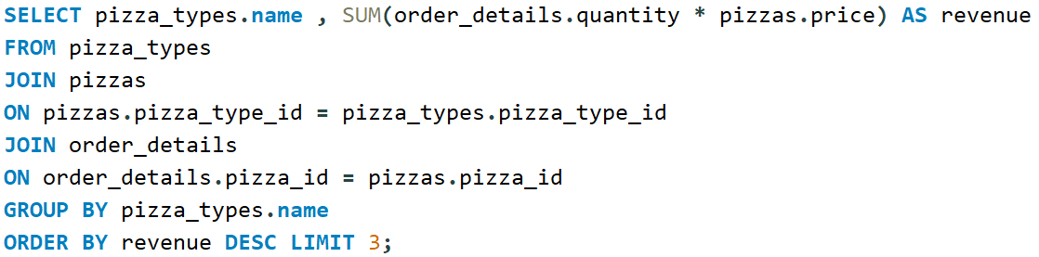

10. Determine the top 3 most ordered pizza types based on revenue.
QUERY:
OUTPUT:

Slide 14
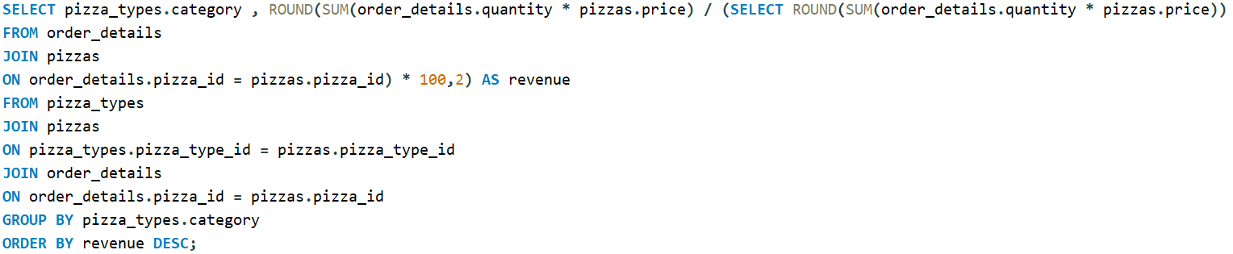
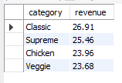
11. Calculate the percentage contribution of each pizza type to total revenue.
QUERY:
OUTPUT:

Slide 15
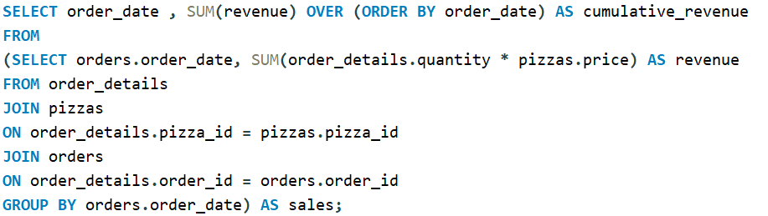
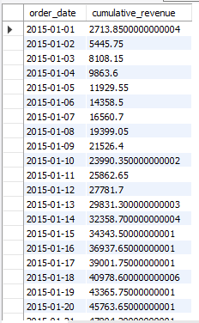
12. Analyze the cumulative revenue generated over time.
QUERY:
OUTPUT:

Slide 16
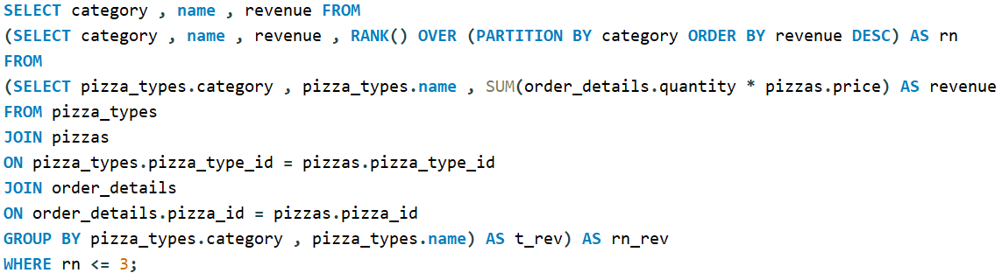
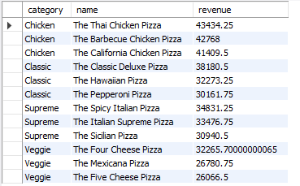
13. Determine the top 3 most ordered pizza types based on revenue for each pizza category.
QUERY:
OUTPUT:

Slide 17

Call us:
Phone Number:
+92 325 3923343
Github:
@axhhad-khan
Project Link:
Pizza-Sales-SQL-project

Slide 18
THANK
YOU
@axhhad-khan

