Slide 1








SQL PROJECT ON
PIZZA SALES
@axhhad-khan

Slide 2
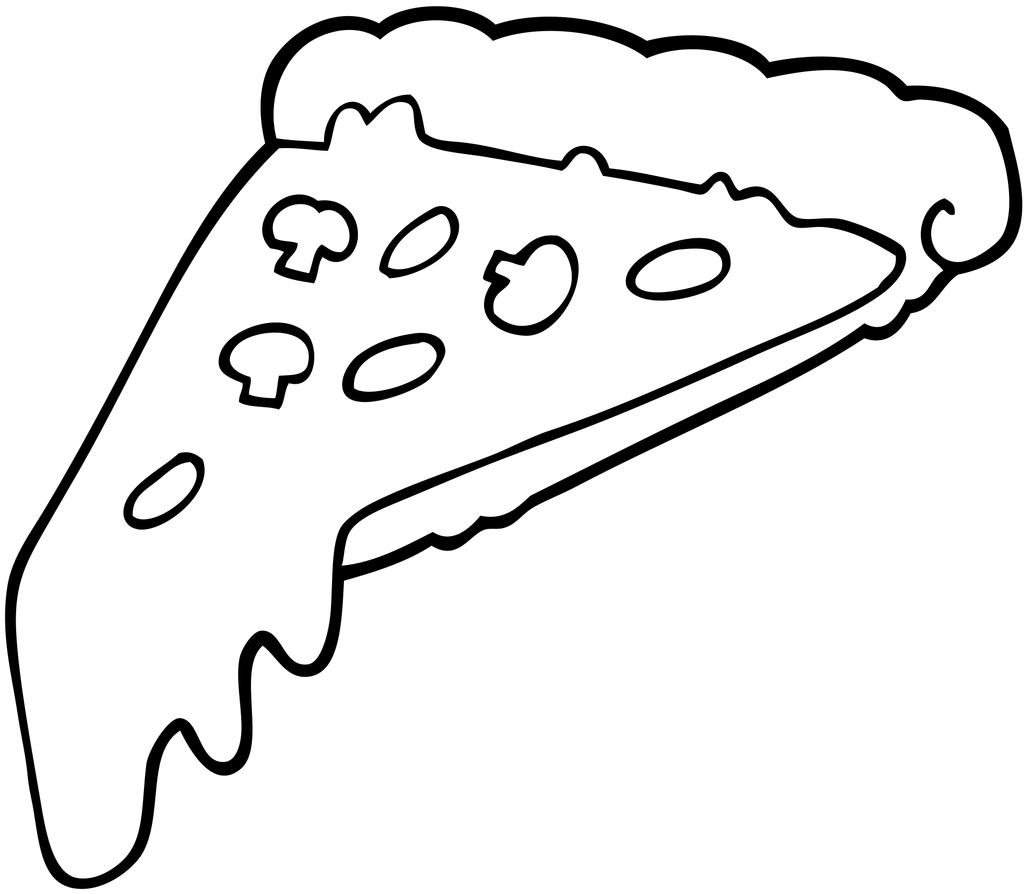
Hello!
My name is Ashhad Khan. I’ve created this project on SQL(Structured Query Language). In this progect I’ve utilized SQL queries to solve questions that were related to pizza sales database.

Slide 3


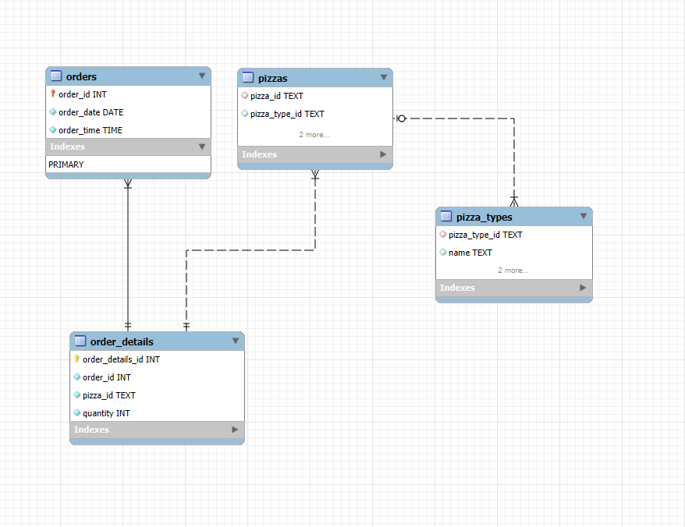
EER Diagram
of Database

Slide 4


Retrieve the total number
of orders placed.
QUERY:
OUTPUT:

Slide 5
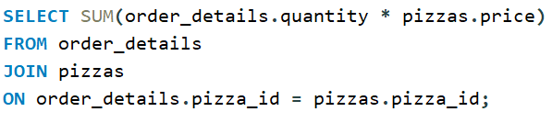

2. Calculate the total revenue generated from pizza sales.
QUERY:
OUTPUT:

Slide 6
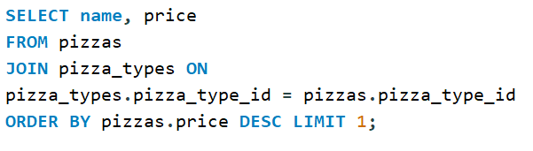

3.Identify the highest-priced pizza.
QUERY:
OUTPUT:

Slide 7
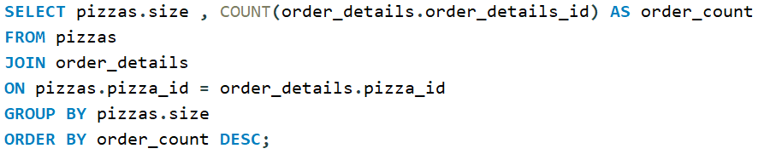
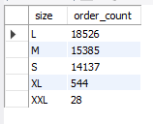
4.Identify the most common pizza
size ordered.
QUERY:
OUTPUT:

Slide 8
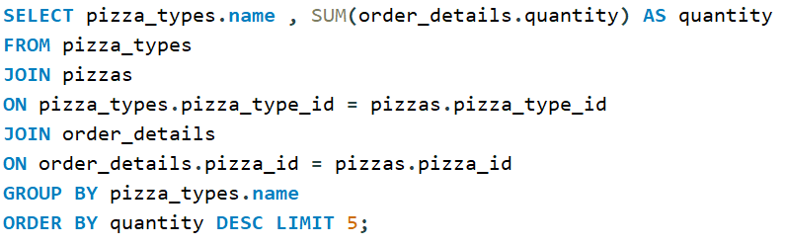
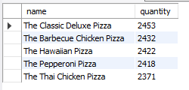
5. List the top 5 most ordered pizza types along with their quantities.
QUERY:
OUTPUT:

