Slide 1
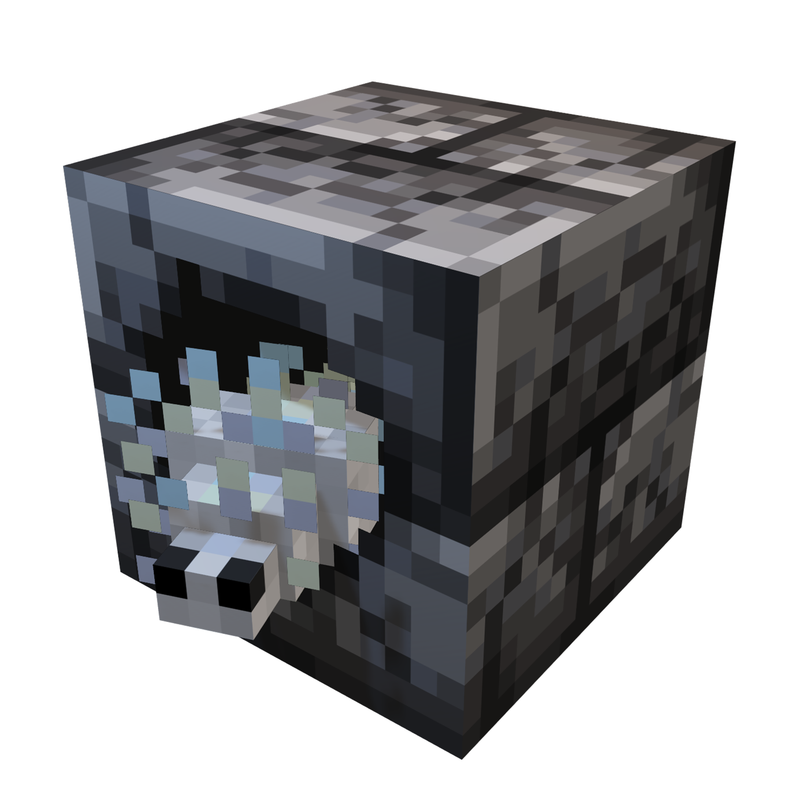
DEEPSLATE
DUNGEONS

