Slide 1
Pitch presentations

Slide 2
What’s a pitch presentation?
A pitch presentation is a brief presentation used to provide your audience with a quick overview of your business plan.

Slide 3
preparing the slides
While pitch presentations are short they have cover a lot of information.
Preparation is key for success.
Use one slide per idea!

Slide 4

introduction
Who are you?
Why are you here?

Slide 5

the team
Who are the people behind your idea?
What are their roles?

Slide 6
the problem
What is the need you are going to solve?
Is it really a problem?

Slide 7

the solution
How are you going to solve the problem?

Slide 8

advantages
Why is your solution the best one?
What does differentiate you from the other solutions?

Slide 9

market
You have to know, or at least predict, your target.

Slide 10

Competition
Are there other solutions for your problem?
Why are they worse than yours?

Slide 11

business model
How are you going to win money?
When are you going to get revenues?
How is your business organised?

Slide 12

investing
How much money do you need?
What are you going to use that money for?

Slide 13

contact
Always do a slide for your social networks / emails.
Explain how you use them.

Slide 14

preparing the presentation
Preparing your slides isn’t all, you also have to prepare the speech itself!

Slide 15

prepare your first impression
The first 2-3 min are the most important ones.

Slide 16
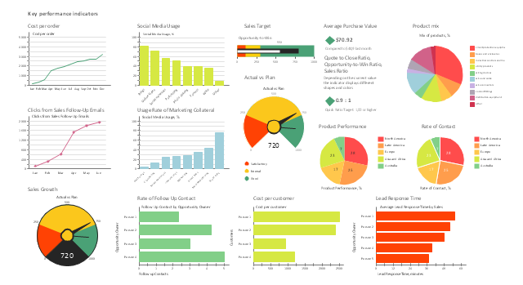
know your metrics
Remember relevant metrics and figures.

Slide 17
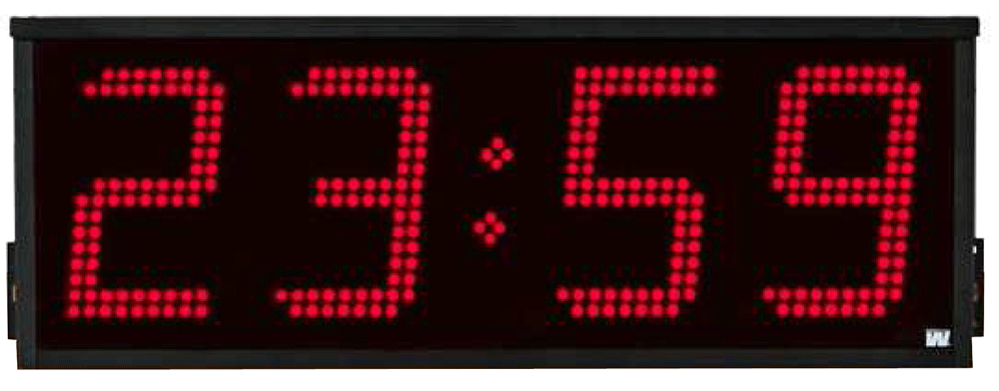
manage your time
Always keep track of the clock.
Calculate at the beginning how much time you can spend per slide.

Slide 18

we are not trying to, we will
Saying “We believe” “We are trying” makes you look insecure.

Slide 19

be visual
Use graphics and photografies.
Use big letters.

Slide 20

jokes
Be careful, if a joke fails you will give a really bad impression.

Slide 21

look at your audience
Don’t read your slides or notes.

Slide 22

be ready for questions
Try to anticipate the questions you might get.

Slide 23

know your space
Try to know where you will do your presentation.
Identify key places.

Slide 24

practice
Do your presentation to someone else before the real presentation.

Slide 25
questions

