Slide 1

Hands-on: Typhoid Simulation
Krishna Banik Pushpita
Assistant Applied Mathematician
Child Health Research Foundation
23rd September 2023

Slide 2
Table of contents
Normal Distribution
Beta Distribution
Binomial Distribution
Confidence Intervals
Poisson Distribution
Simulation

Slide 3
Normal Distribution

Slide 4
Normal Distribution
Normal distribution, also known as the Gaussian distribution, is a probability distribution that is symmetric about the mean, showing that data near the mean are more frequent in occurrence than data far from the mean.

Slide 5
Characteristics of Normal Distribution
It is symmetric, unimodal (i.e. one mode), and asymptotic.
The values of mean, median, and mode are all equal.
A normal distribution is quite symmetrical about its center. That means the left side of the center of the peak is a mirror image of the right side. There is also only one peak (i.e., one mode) in a normal distribution.

Slide 6
Usefulness of Normal Distribution
A normal distribution is significant in statistics and is often used in the natural sciences and social arts to describe real-valued random variables whose distributions are unknown.

Slide 7


Time to play with codes

Slide 8


Slide 9
Binomial Distribution

Slide 10
Binomial Distribution
The binomial distribution is the discrete probability distribution that gives only two possible results in an experiment, either success or failure.

Slide 11

Properties of Binomial Distribution
There are two possible outcomes: true or false, success or failure, yes or no.

Slide 12
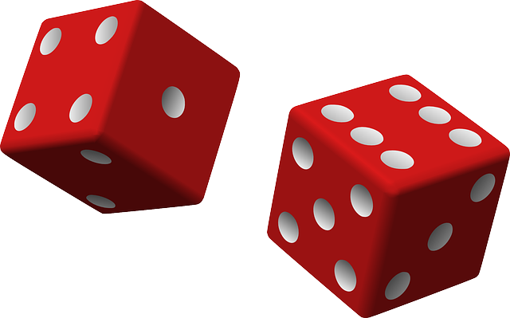
Properties of Binomial Distribution
There is ‘n’ number of independent trials or a fixed number of n times repeated trials.

Slide 13
Properties of Binomial Distribution
The probability of success or failure remains the same for each trial.
Only the number of success is calculated out of n independent trials.
Every trial is an independent trial, which means the outcome of one trial does not affect the outcome of another trial.

Slide 14
Time to play with codes

Slide 15
Poisson Distribution

Slide 16

Poisson Distribution
Binomial
Poisson distribution is a limiting process of the binomial distribution.
Poisson

Slide 17
Poisson Distribution
A Poisson distribution measures how many times an event is likely to occur within “x” period of time. In other words, we can define it as the probability distribution that results from the Poisson experiment. A Poisson experiment is a statistical experiment that classifies the experiment into two categories, such as success or failure.

Slide 18
Properties of Poisson Distribution
In order for the Poisson distribution to be accurate, all events are independent of each other, and events cannot occur simultaneously.
The mean and the variance will be equal to one another.
The rate of events through time is constant

Slide 19
Time to play with codes

Slide 20

What’s next?
What if we know the probability but want to know the uncertainty???

Slide 21
Beta Distribution

Slide 22
Beta Distribution
The Beta distribution is considered as a continuous probability distribution defined by two positive parameters. It is a type of probability distribution which is used to represent the outcomes or random behavior of proportions or percentage.

Slide 23

Beta Distribution
The most common use of this distribution is to model the uncertainty about the probability of success of a random experiment.
All my uncertainities
Beta Distribution

Slide 24
Beta Distribution Notation
It is defined on the interval [0,1] denoted by α and β, usually. α and β are two positive parameters that appear as exponents of the random variable and is intended to control the shape of the distribution. Its notation is Beta(α,β), where α and β are the real numbers, and the values are more than zero.

Slide 25
Beta Distribution Applications
Bayesian hypothesis testing
The rule of succession
Task duration modelling
Project planning control systems like CPM and PERT.

Slide 26
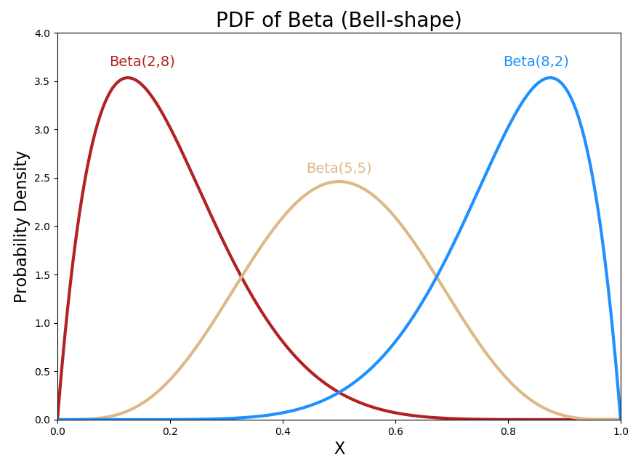
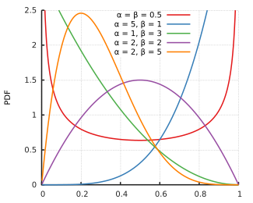
Graph of Beta Distribution

Slide 27
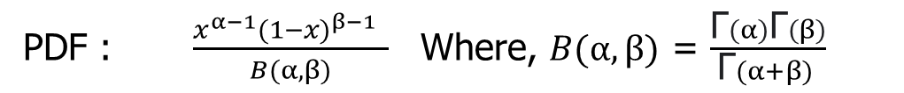
Formula of Beta Distribution
PDF : $\frac{x^{α−1}{(1−x)}^{β−1} }{B(α, β)}$Where, $B(α, β)$ = $\frac{\text{Γ}(α)\text{Γ}(β)}{\text{Γ}(α+β) }$

Slide 28


Beta Distribution
Mean, $µ= \frac{α}{α+β}$
Varience, ${\text{σ}}^{2}$ = $\frac{αβ}{ {\left(α+β\right)}^{2}(α+β+1)}$

Slide 29


Beta Distribution
$$α=\left(\frac{1−µ}{{\text{σ}}^{2}}− \frac{1}{µ}\right)µ^{2}$$
$$β= α (\frac{1}{µ}−1)$$

Slide 30
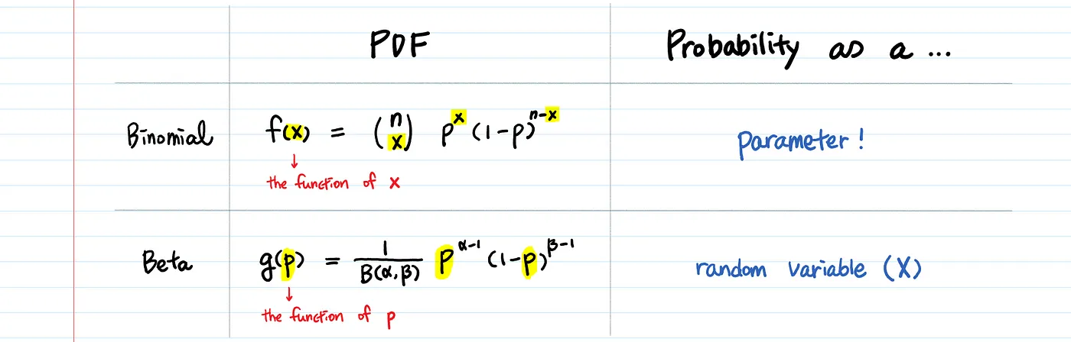

Slide 31
Time to play with codes

Slide 32
Confidence Intervals

Slide 33

Confidence Intervals
Confidence Intervals are estimates that are calculated from sample data to determine ranges likely to contain the population parameter(mean, standard deviation) of interest.

Slide 34
Understanding with an example

