Slide 1
Genomic Analysis of Salmonella Typhi
Group-3
Saika Farook
Fabiha Saiyara
Krishna Banik Pushpita
Sudipta Deb Nath

Slide 2
Learning Outcomes
Course name: Bacterial genomic and Antimicrobial resistance
- To learn assembling and annotating bacterial genome
- To identify Antimicrobial Resistance (AMR) genes and plasmids
- To identify SNPs
- To determine MLST
- To construct phylogenetic tree

Slide 3
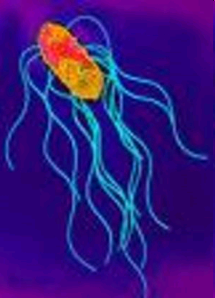
Salmonella enterica serovar Typhi
Gram negative bacilli
Transmitted through faeco-oral route
Causes typhoid fever
Around 17M/annum people are infected by this pathogen (according to WHO)

Slide 4
Methodology
Raw data of eight isolates
Quality check with FastQC
Trimming of adapter sequences with FastP
Genomes assembly with Unicycler
Automated annotation with PROKKA

Slide 5
Methodology
Process | Tools used
Detection of AMR genes, point mutations | ResFinder
Plasmid detection | PlasmidFinder/ Pathogenwatch (for MAC users)
MLST | MLST
Construction of phylogenetic tree | Snippy/snippy multi/RAxML/iTOL

Slide 6
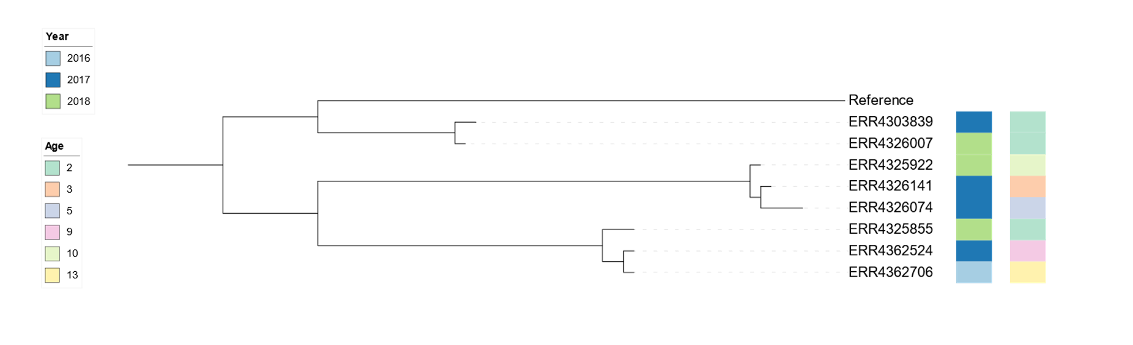
Results

Slide 7
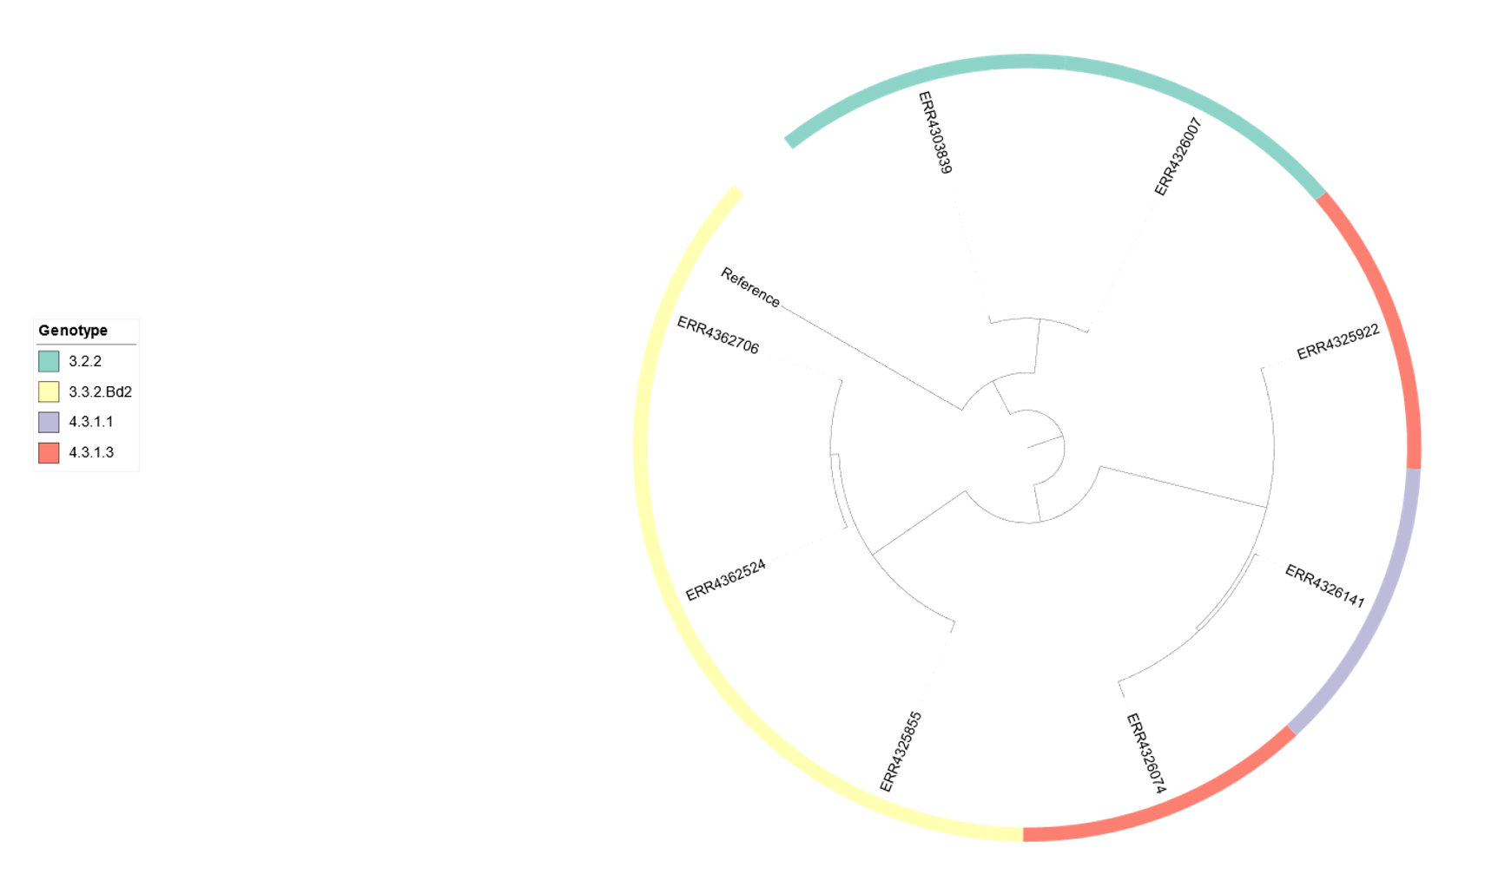
Results

Slide 8
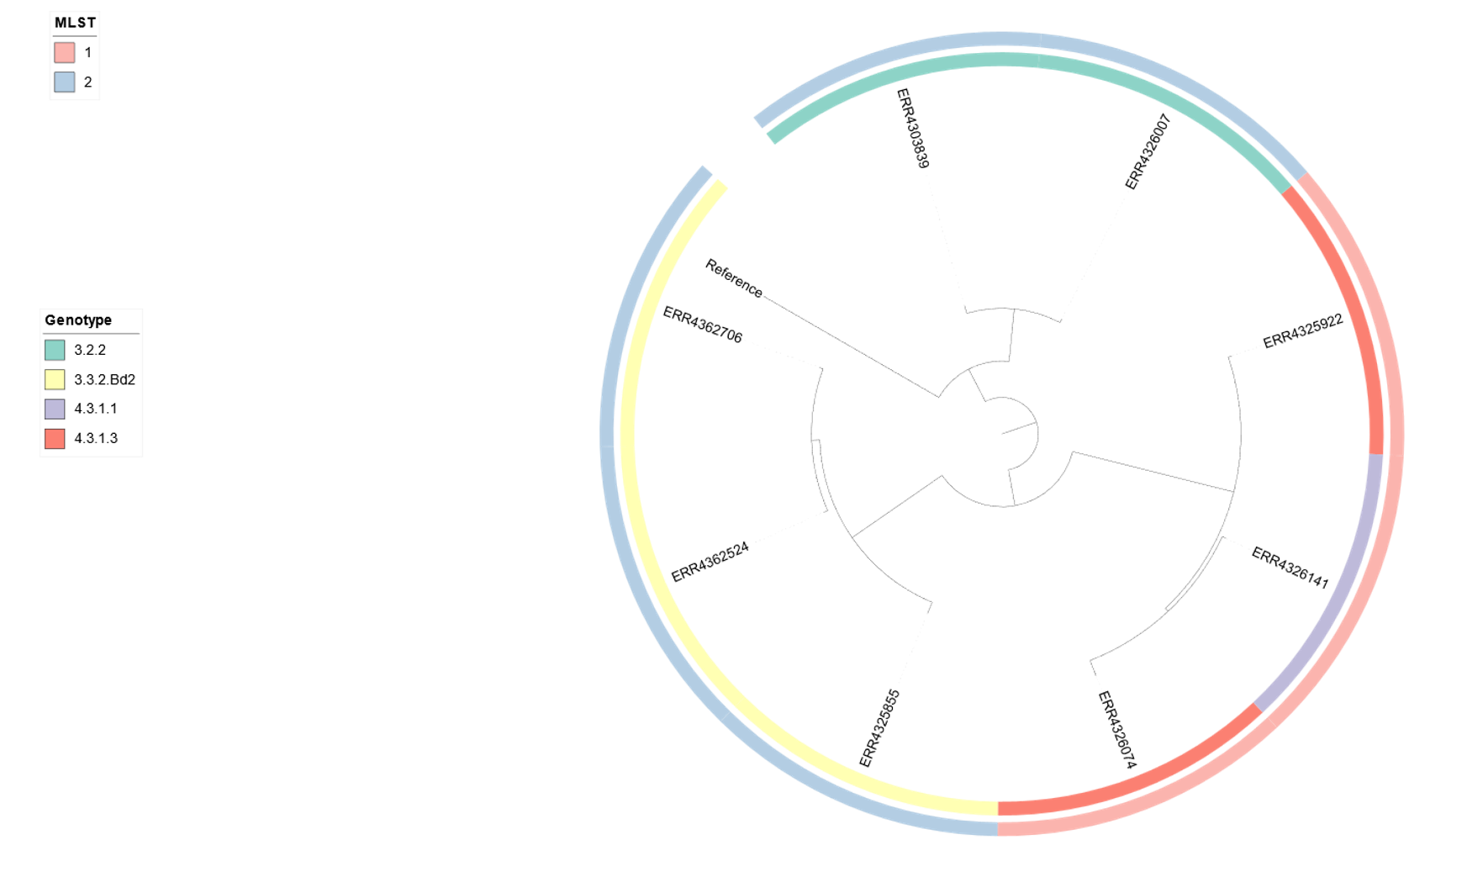
Results

Slide 9
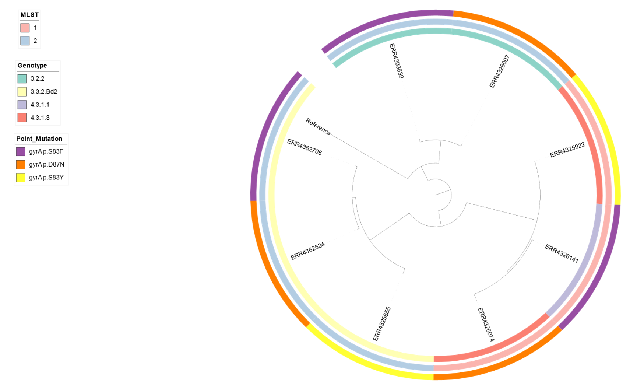
Results

Slide 10
Results
Name of Gene | Point Mutation | Amino Acid Change
gyrA p S83F | TCC >> TTC | Serine > Phenylamine
gyrB D87N | GAC >> AAC | D-serine > Asparagine
gyrA p S83Y | TCC >> TAC | Serine > Tyrosine

Slide 11
Results
Strain ID | Genotype (AMR genes) | Resistant Antibiotics
ERR4303839 | aac(6')-Iaa | Ciprofloxacin
ERR4326141 | aac(6')-Iaa, blaTEM-1B, qnrS1, sul2, tet(A) | Ampicillin, Sulfonamides, Ciprofloxacin
ERR4326007 | aac(6')-Iaa | Ciprofloxacin
ERR4362524 | aac(6')-Iaa | Ciprofloxacin
ERR4325855 | aac(6')-Iaa | Ciprofloxacin
ERR4325922 | aac(6')-Iaa, aph (3’’)-Ib, blaTEM-1B, catA1, sul1, sul2, tet(B), dfrA7 | Amikacin, Streptomycin, Amoxicillin, Chloramphenicol, Sulphamethoxazole, Doxycycline, Trimethoprim
ERR4326074 | aac(6')-Iaa, blaTEM-1B, qnrS1, sul2, tet(A) | Ampicillin, Sulfonamides, Ciprofloxacin
ERR4362706 | aac(6')-Iaa | Ciprofloxacin

Slide 12
Thank You!!!!

