Slide 1
Real V. Fake Face Detection
Anas Puthawala, Jayaram Chandar

Slide 2

Info slide

Slide 3
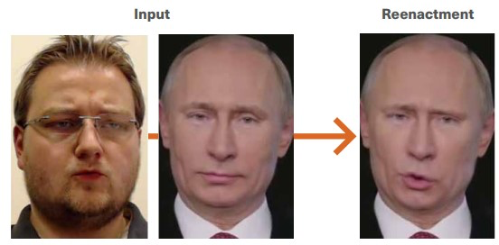
Problem Statement & Background
Deepfakes on the rise, with the number of them doubling every 6 months ^{[1]}
Dangerous, big threat to safety and reliability especially when dealing with political circumstances
Beyond deepfakes, there exists other types of AI that aim to bypass / cheat facial recognition softwares by creating fake faces that look very similar to real faces that the facial recognition was trained on
The problem is such that there is an inadequate amount of technology that can counter the explosive spread of deepfakes, and fake facial curations
Deepfakes are developed using GAN’s
Fig. 1 - Illustration of deepfakes

Slide 4
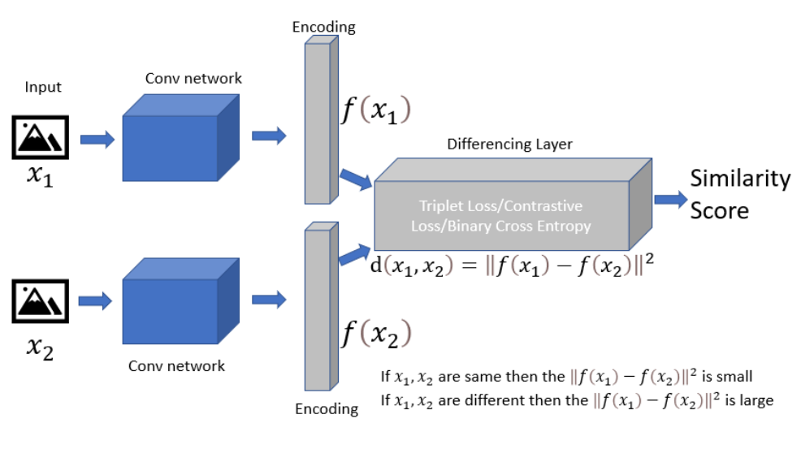
Proposed Solution
Distill the problem down to detecting whether images of faces are real or fake
At the heart of the problems we’ve mentioned in the previous section lies the fact that it’s mostly faces that are generated
If we can have a system that is able to recognize faces in a streaming video and save those faces, then we can apply our proposed system
This will be a binary classification task, where our input data will be a bunch of images that are real and those that are fake and generated by AI
Siamese networks are widely used in similarity detection problems such as signature verification so our proposed system consists of applying siamese networks to this problem
Fig. 2 - Siamese Network general architecture

Slide 5
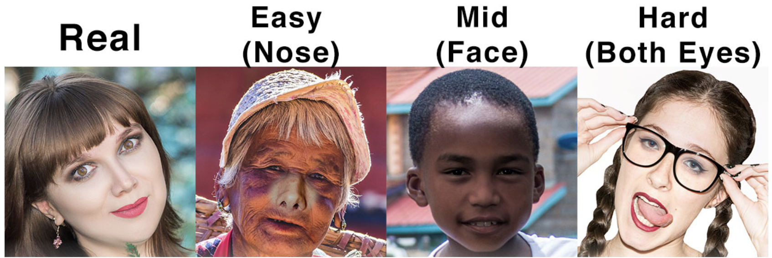
Implementation Details | Data Description
Data was obtained through Kaggle’s Real and Fake Face data & challenge as uploaded by CIPLAB @ Yonsei University ^{[2]}
960 color images of fake faces each of size 600x600 and 1081 color images of real faces of size 600x600
Consisting of varying levels of difficulty in terms of classification of real v. fake faces:
Fig. 3 - Data Description
Data was shuffled to ensure our model randomly is exposed to all levels of difficulty when learning to classify fake faces

Slide 6
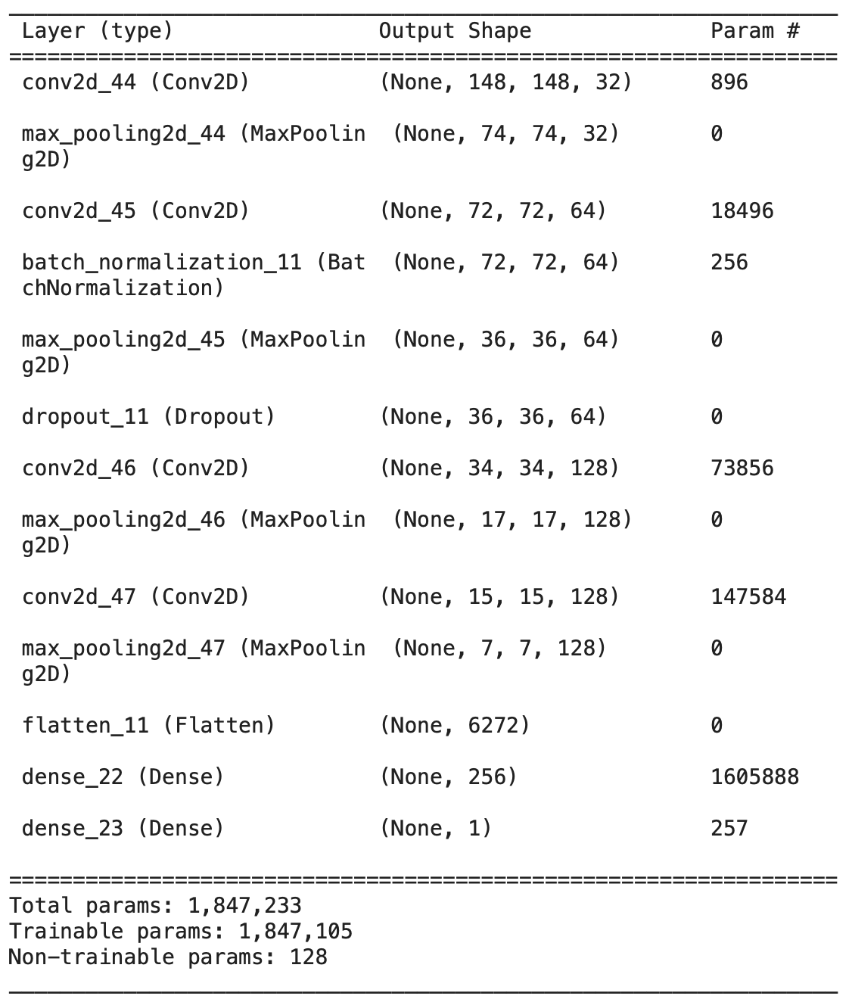
Implementation Details | Network Details - CNN
In order to ensure validity of our results, we implemented a Naive CNN architecture and trained it to perform the binary classification task of separating Real V. Fake faces
Note: Random classifier should have on average 50% accuracy for this task
The model consisted of the classic conv-net based architecture (convolution layers, followed by pooling, etc)
No pre-trained conv-base was used
Fig. 4 - Naive CNN

Slide 7
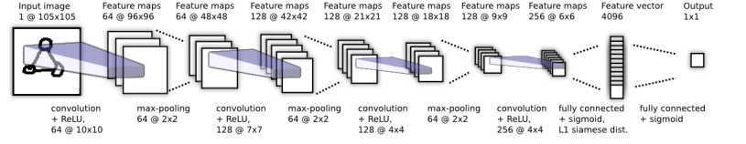
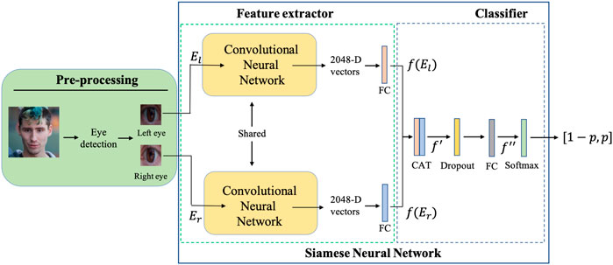
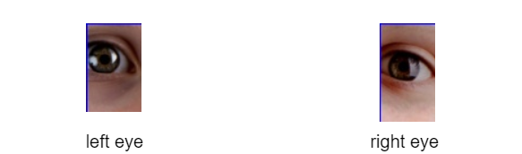
Implementation Details | Network Details - Siamese Net
Fig. 5 - Conv model
Fig. 6 - Siamese Model

Slide 8
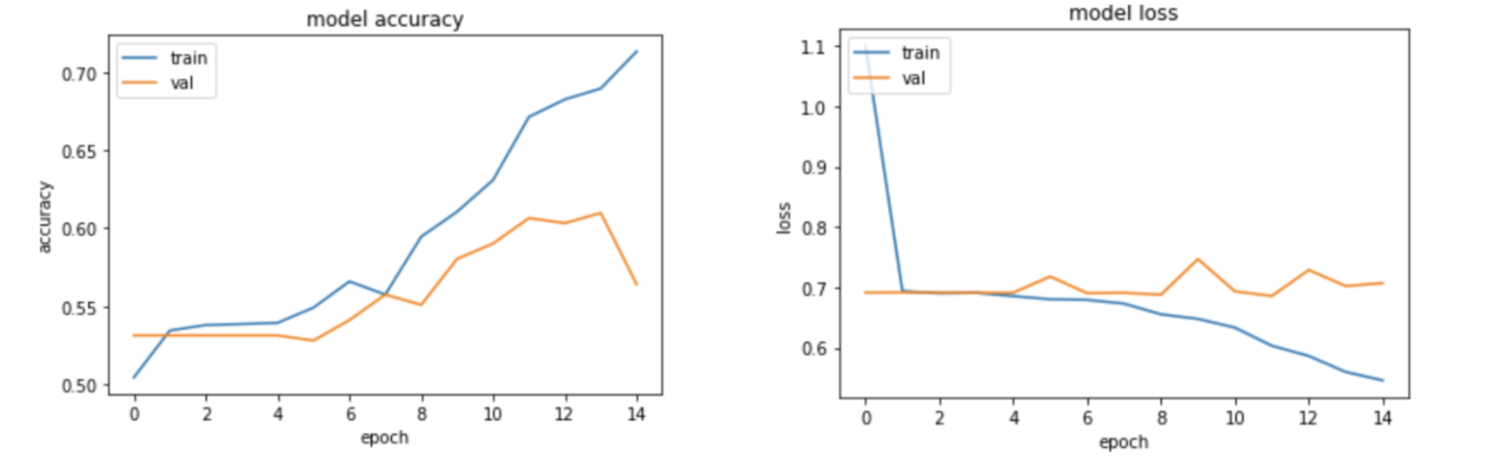
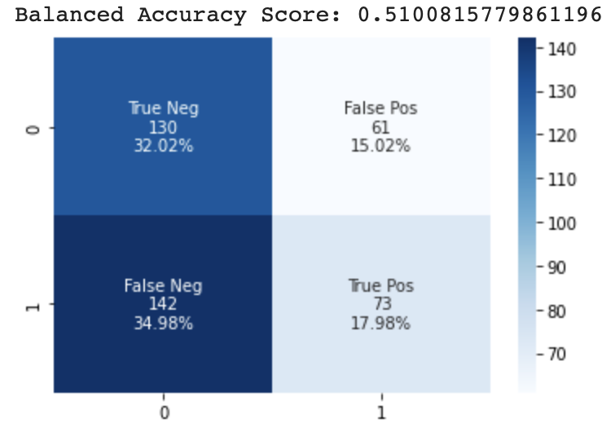
Results & Discussion | Naive CNN
Fig. 7 - Naive CNN model performance
Model begins to overfit after around 9 - 10 epochs
After combining the training data and validation data, tuning hyperparameters (LR, batch size, epochs) and re-training we obtain the results displayed in Fig. X (make sure you change fig. name)
Slightly better than random classifier (model acc. was .55), predicts a lot more negatives
The model, a majority of the time (~67% of the time), is predicting 0s – i.e. that the faces are fake
After running k-fold cross validation, we received a mean balanced accuracy of .542 and a mean k-fold loss of .689 (note that there were outliers).
Fig. 8 - Naive CNN model performance

Slide 9
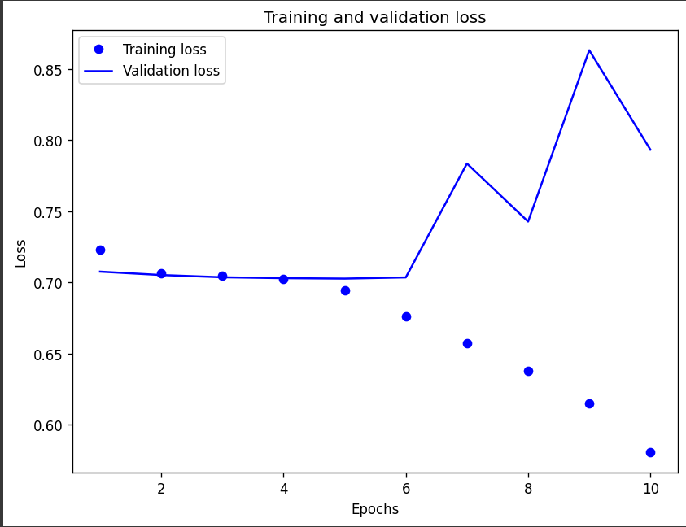
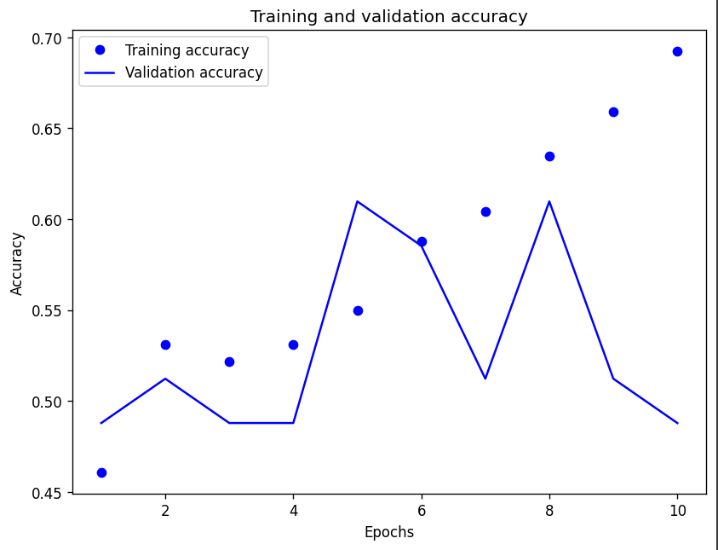
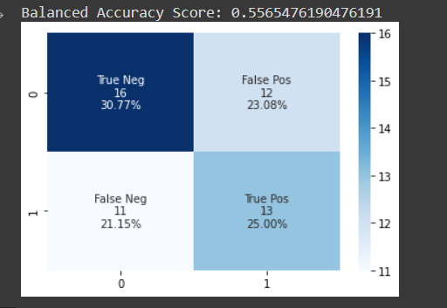
Results & Discussion | Siamese Network
Fig. 9 - Siamese + CNN hybrid results
It was always slightly better than the CNN in repeated testing
Data size should be taken into consideration, however
Test set and balanced accuracy stayed at about 55% in all rounds of testing

Slide 10
Conclusion & Future Directions
Side note: We also took 100 hard & medium images from the test set and tried to classify if they were fake or real and it was difficult to surpass ~60% accuracy
Model performance improved (slightly & variably) after using siamese neural network for the task
Future directions could be exploring various types of contrastive loss functions, and aiming to figure out a methodology to be able to detect faces in real time video streaming and then applying the siamese network to classify whether the face is fake or real
Could be useful to use a pre-trained model for this task
Adding the nose and other facial features as part of the feature vector
Data augmentation, different distance function for encoding distance, one-shot learner, more fake data generation with GAN’s

Slide 11
References
[1] Zurich.com. [Online]. Available: https://www.zurich.com/en/media/magazine/2022/three-reasons-to-take-note-of-the-sinister-rise-of-deepfakes. [Accessed: 12-Nov-2022].
[2] “Report: Number of deepfakes double every six months | cybernews.” [Online]. Available: https://cybernews.com/privacy/report-number-of-expert-crafted-video-deepfakes-double-every-six-months/. [Accessed: 12-Nov-2022].
[3] C. I. P. L. A. B. @ Y. University, “Real and fake face detection,” Kaggle, 14-Jan-2019. [Online]. Available: https://www.kaggle.com/datasets/ciplab/real-and-fake-face-detection. [Accessed: 12-Nov-2022].
[4] J. Wang , B. Tondi, and M. Barni, “An eyes-based Siamese neural network for the detection of gan-generated face images,” Frontiers, 01-Jan-1AD. [Online]. Available: https://www.frontiersin.org/articles/10.3389/frsip.2022.918725/full. [Accessed: 15-Nov-2022].
[5] “Siamese neural networks for one-shot image recognition.” [Online]. Available: https://www.cs.cmu.edu/~rsalakhu/papers/oneshot1.pdf. [Accessed: 16-Nov-2022].
[6] Davisking, “Dlib-models/shape_predictor_5_face_landmarks.dat.bz2 at master · Davisking/dlib-models,” GitHub. [Online]. Available: https://github.com/davisking/dlib-models/blob/master/shape_predictor_5_face_landmarks.dat.bz2. [Accessed: 16-Nov-2022].

