Slide 1
Clustering documents and visualization of Embedding Vector Space
Presented By:
Aditya Shidhaye (1566213)
Pradeep Patwa (1564727)
Adithya Ramesh (1567434)
Examined by:
Prof. Dr. Damir Dobric
Prof. Dr. Andreas Pech

Slide 2
Content
Introduction
Problem Statement
Methodology
Implementation
Results
Conclusion

Slide 3

Introduction
Document clustering is an essential technique for organizing large volumes of textual data.
Traditional clustering (TF-IDF, BoW) approaches often struggle with capturing semantic meaning.
This project leverages OpenAI’s text embeddings for efficient and meaningful document grouping.

Slide 4
Problem Statement
Large datasets contain unstructured textual data that is difficult to categorize manually.
Keyword-based approaches fail to capture semantic relationships between documents.
The goal is to create an AI-powered clustering model that groups similar documents efficiently.

Slide 5
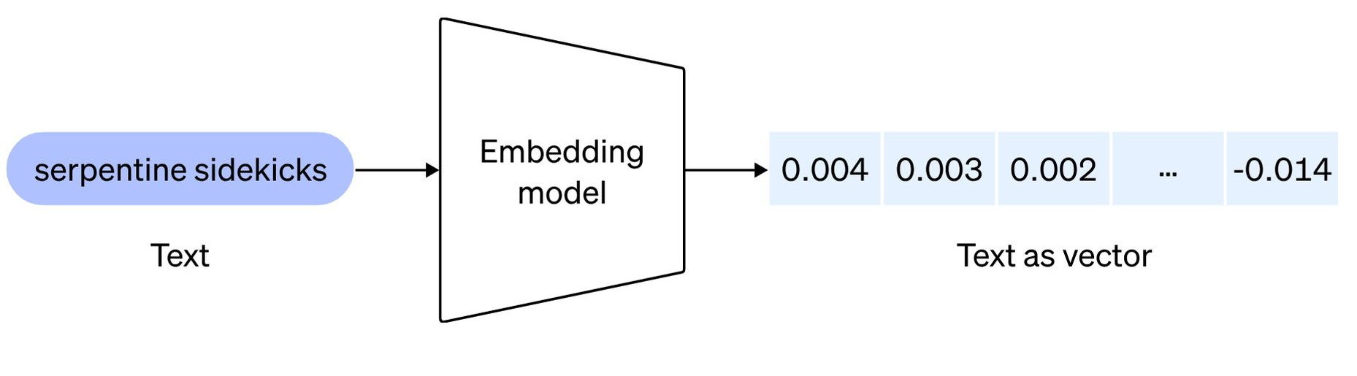
Methodology
Text Embedding Process
OpenAI’s text-embedding-3-large
Captures semantic relationships between words and phrases.
Eg. Apple(fruit)/Apple(company), not feeling good / sick
Allows for more accurate clustering compared to traditional term frequency methods.

Slide 6
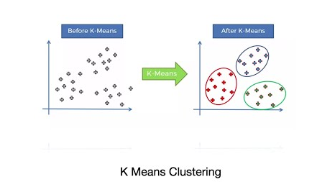
Clustering Algorithm
K-Means Clustering: An unsupervised learning algorithm that partitions data into K clusters.
Objective: Minimize intra-cluster distance and maximize inter-cluster separation.
The embeddings are clustered based on their numerical similarities.

Slide 7
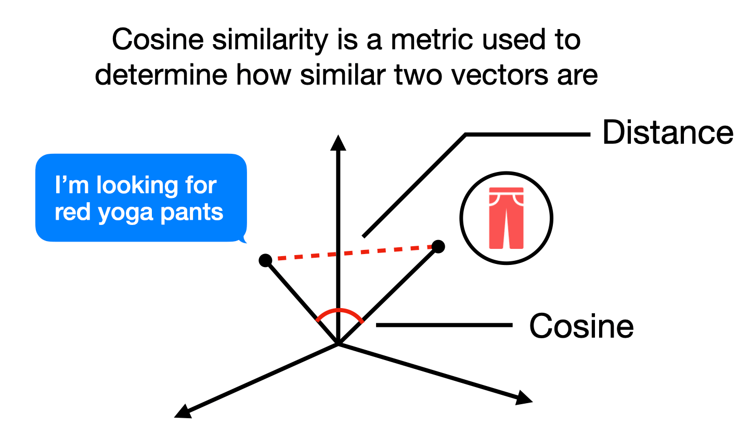
measure simililarity within the same cluster.
Intra-cluster similarity: Higher similarity within a cluster indicates well-defined groups. Similarity = 0.95 → "Artificial Intelligence" and "Machine Learning" (very related)
Inter-cluster similarity: Lower similarity between different clusters ensures better separation. Similarity = 0.10 → "Artificial Intelligence" and "Cooking Recipes" (almost unrelated)
Cosine Similarity Analysis
Closer angle = more similar | Wider angle = less similar

Slide 8
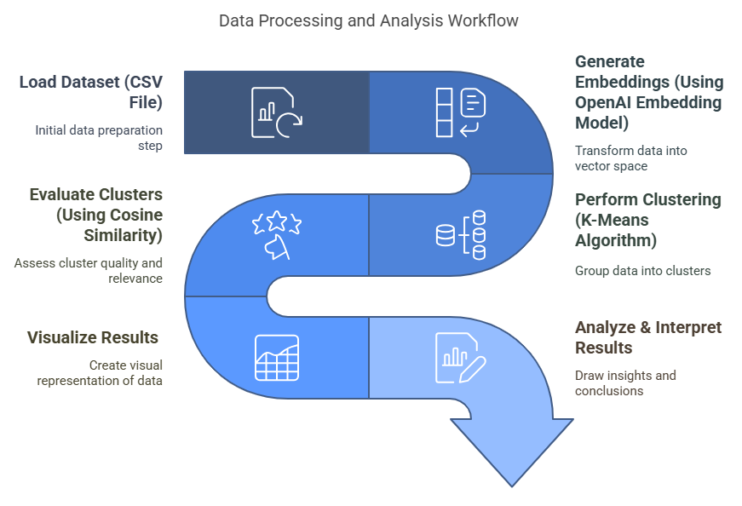
Implementation

Slide 9
Results
Clusters were successfully formed based on the semantic meaning of documents.
Cosine similarity confirmed well-defined groups with minimal overlap.
Visualization showed clear separation between clusters.
Challenges: Optimal selection of K-value and processing time for large datasets.

Slide 10
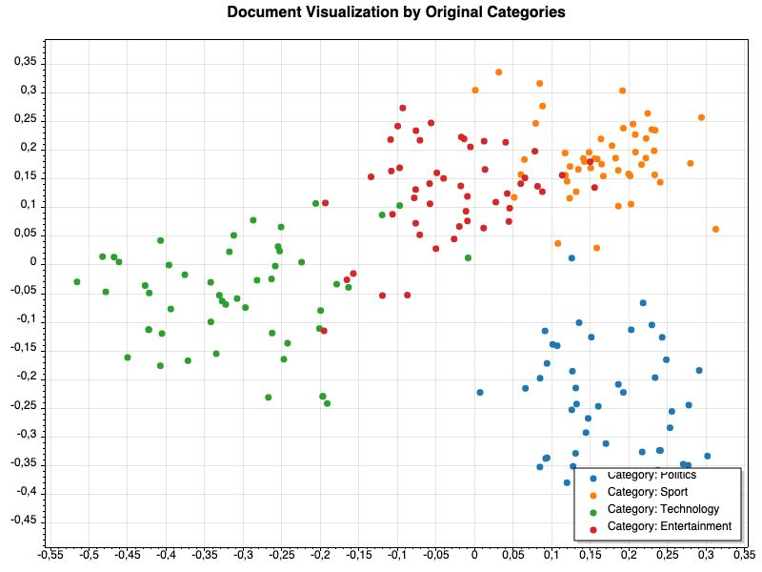
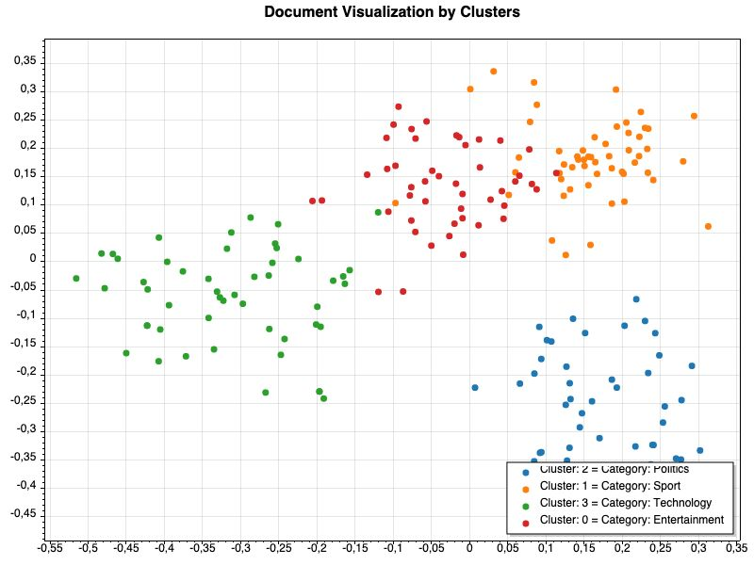

Outputs
K - means
algorithm

Slide 11
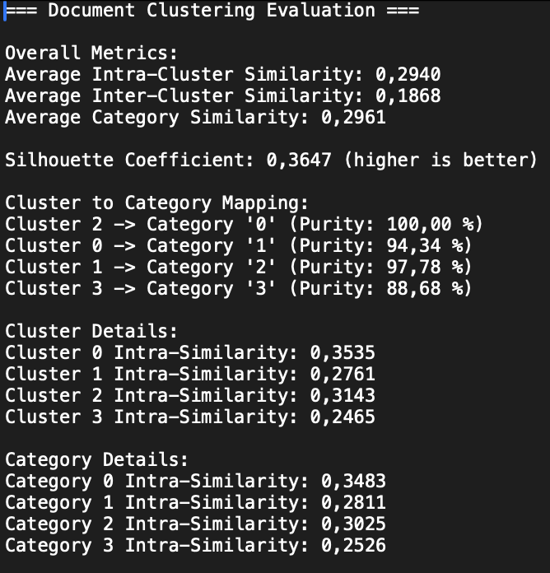
Cosine Similarity values

Slide 12
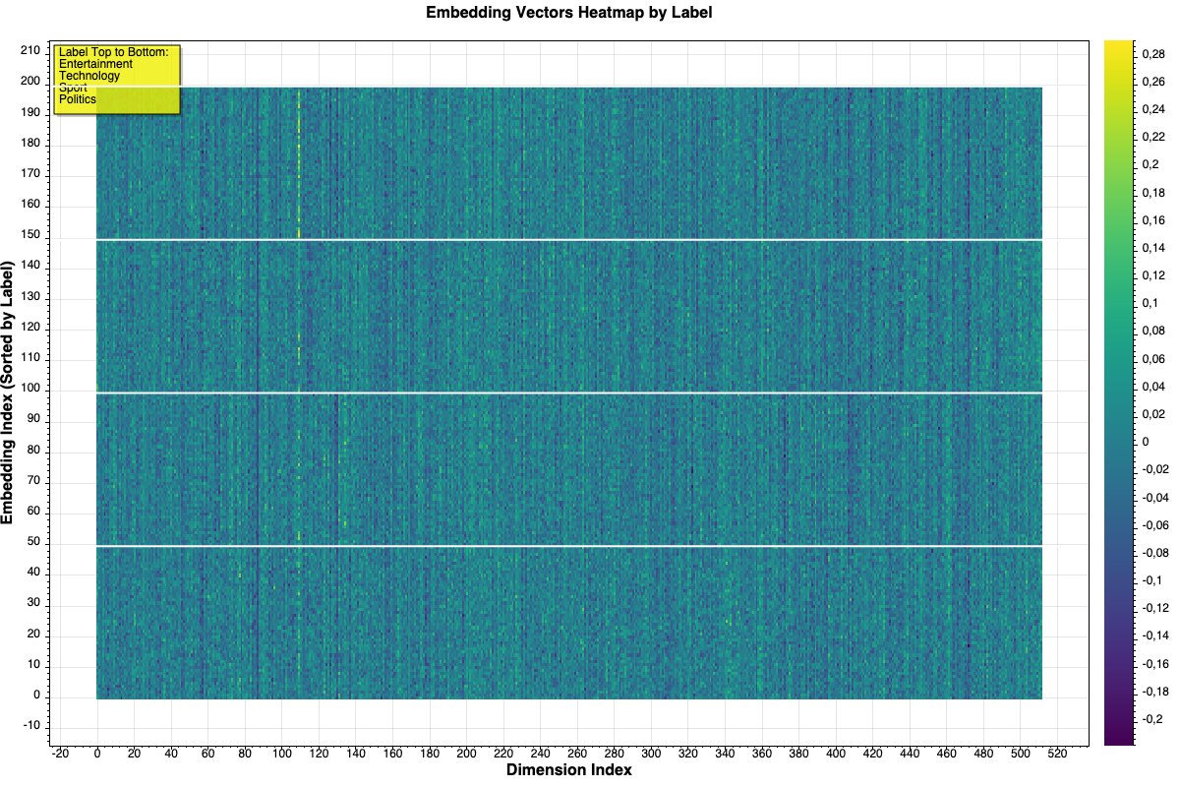
Heatmap representation of the embeddings based on the category they belong.

Slide 13
Conclusion
AI-driven document clustering provides a more efficient and scalable approach.
OpenAI embeddings enhance clustering accuracy by capturing semantic meaning.
Future improvements can lead to even more refined document classification models.
Trade-off between accuracy and efficiency

Slide 14
Thank you !

