Slide 2
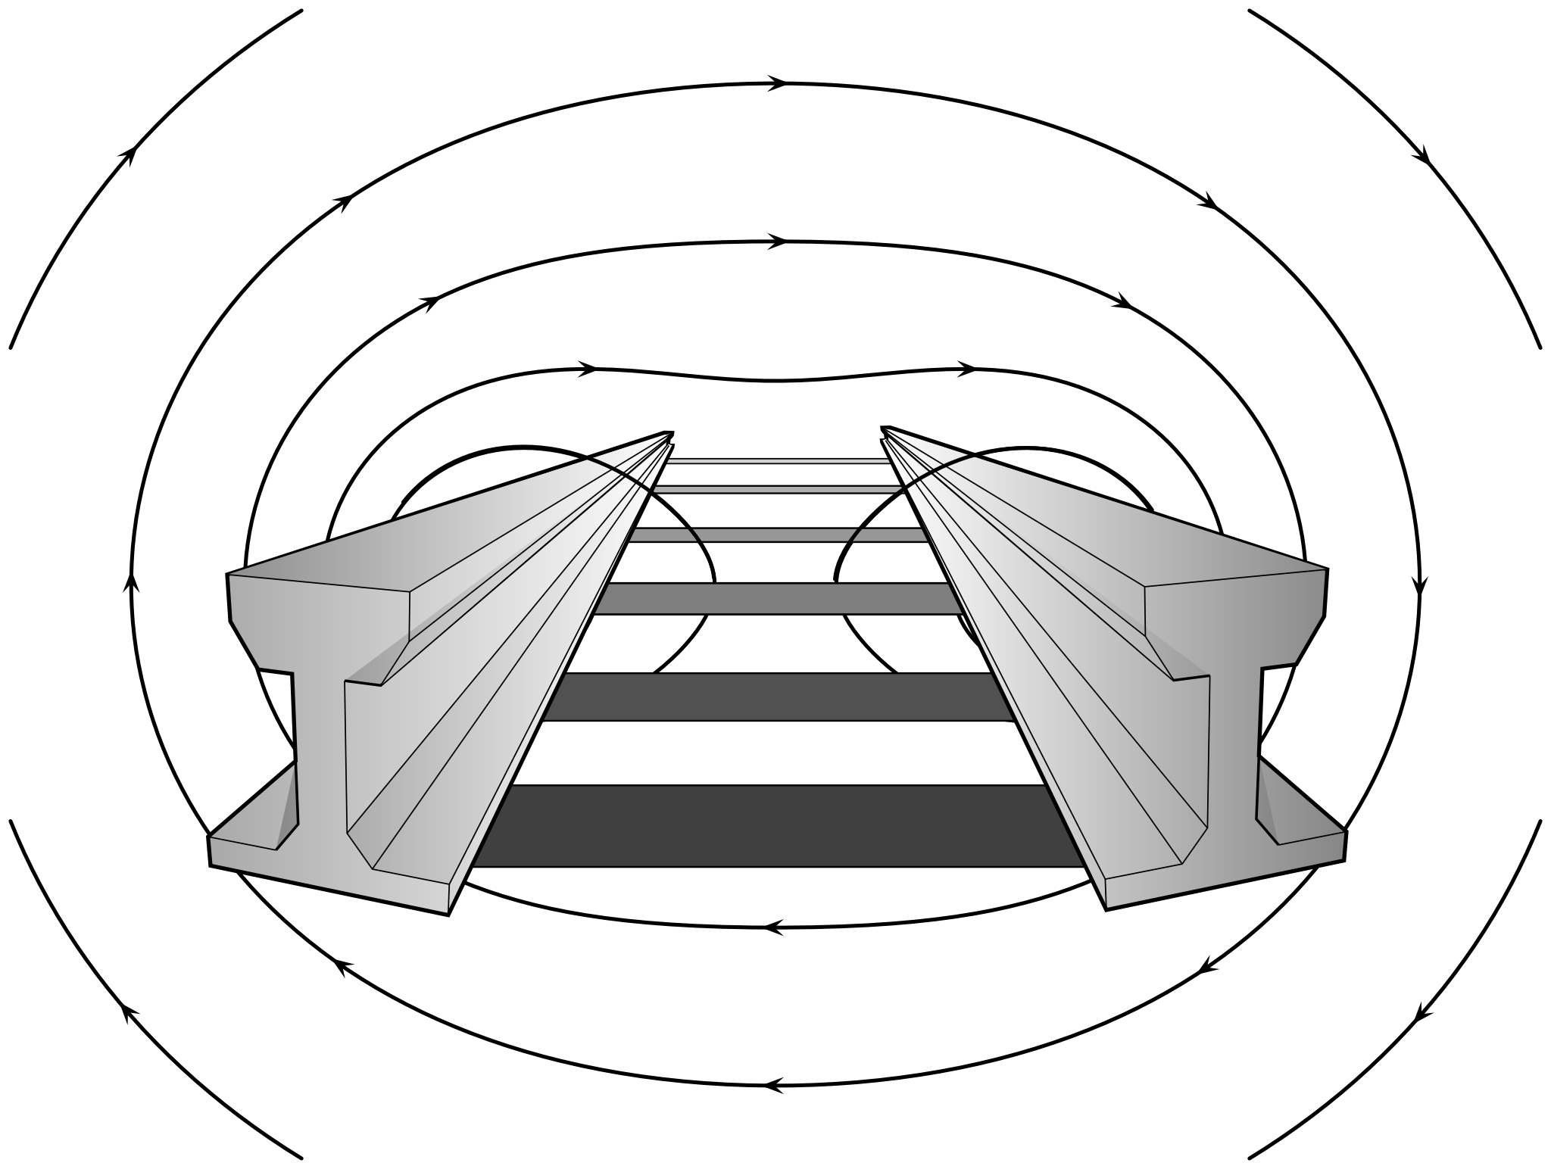

Electromagnetic Field 2016
Riddles on Rails
Dan Hagon
@axiomsofchoice

Slide 3
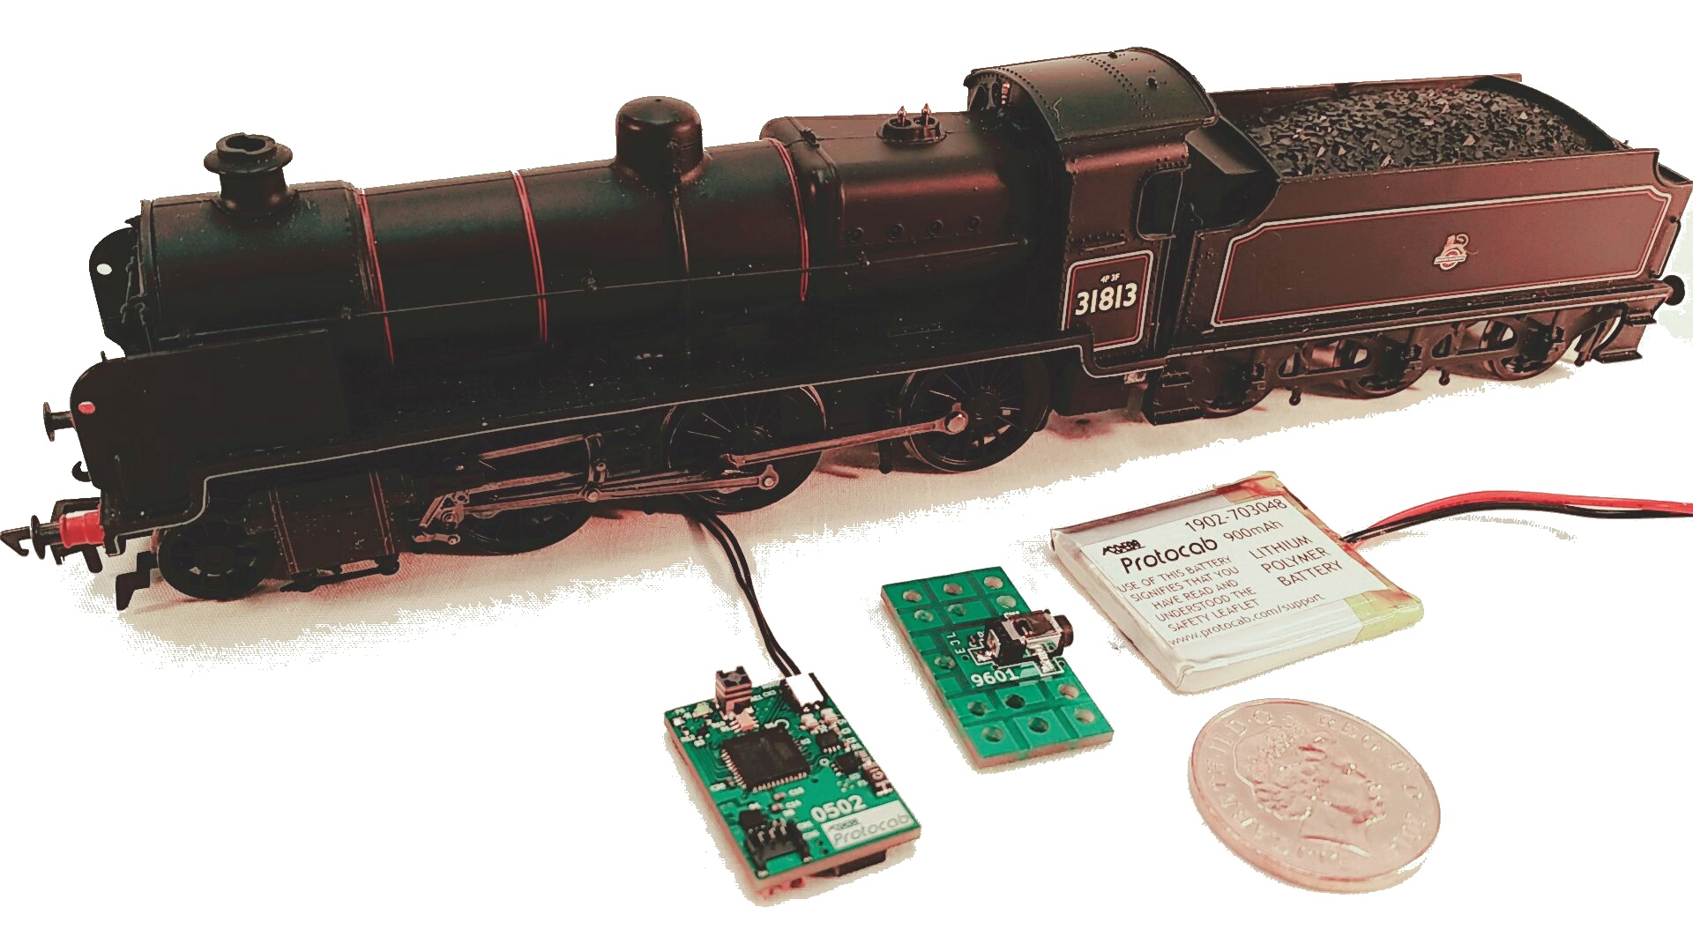

Slide 4
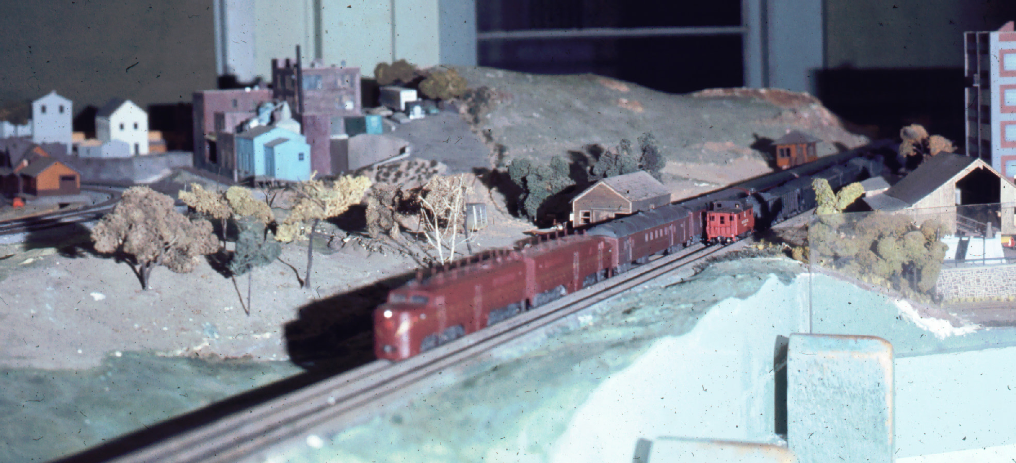
Tech Model Railroad Club (MIT)
“Hackers: Heroes of the Computer Revolution” by Steven Levy.
https://backchannel.com/the-tech-model-railroad-club-3b06a3163563

Slide 5
Semaphores

Slide 6
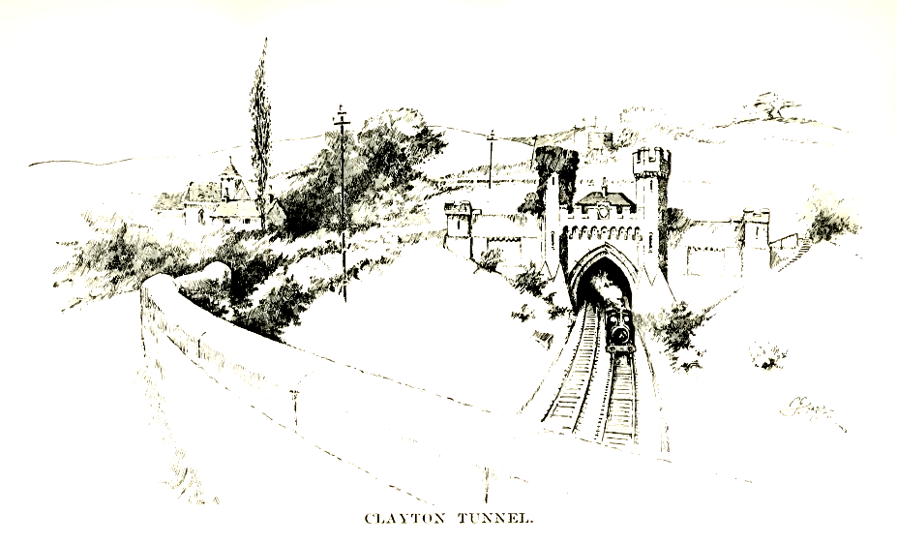
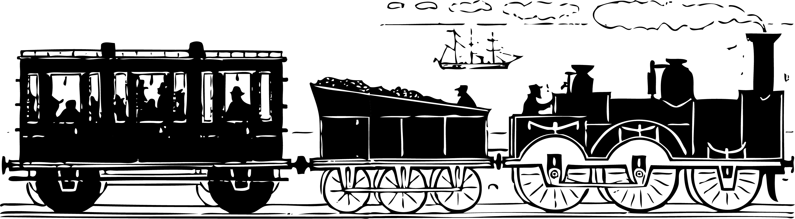
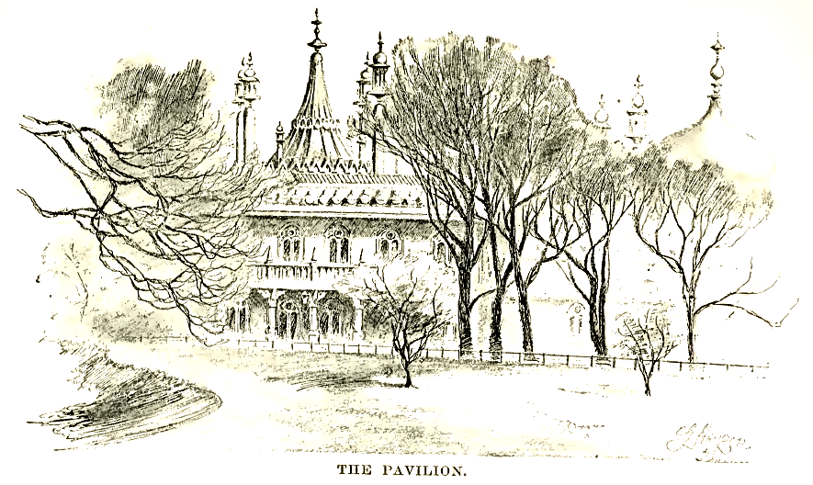
The Clayton Tunnel Accident (1861)
BRIGHTON
08.28
08.31
08.35
5 MILES
CLAYTON TUNNEL
Time intervals used to prevent train collisions on departure from Brighton station.

Slide 7

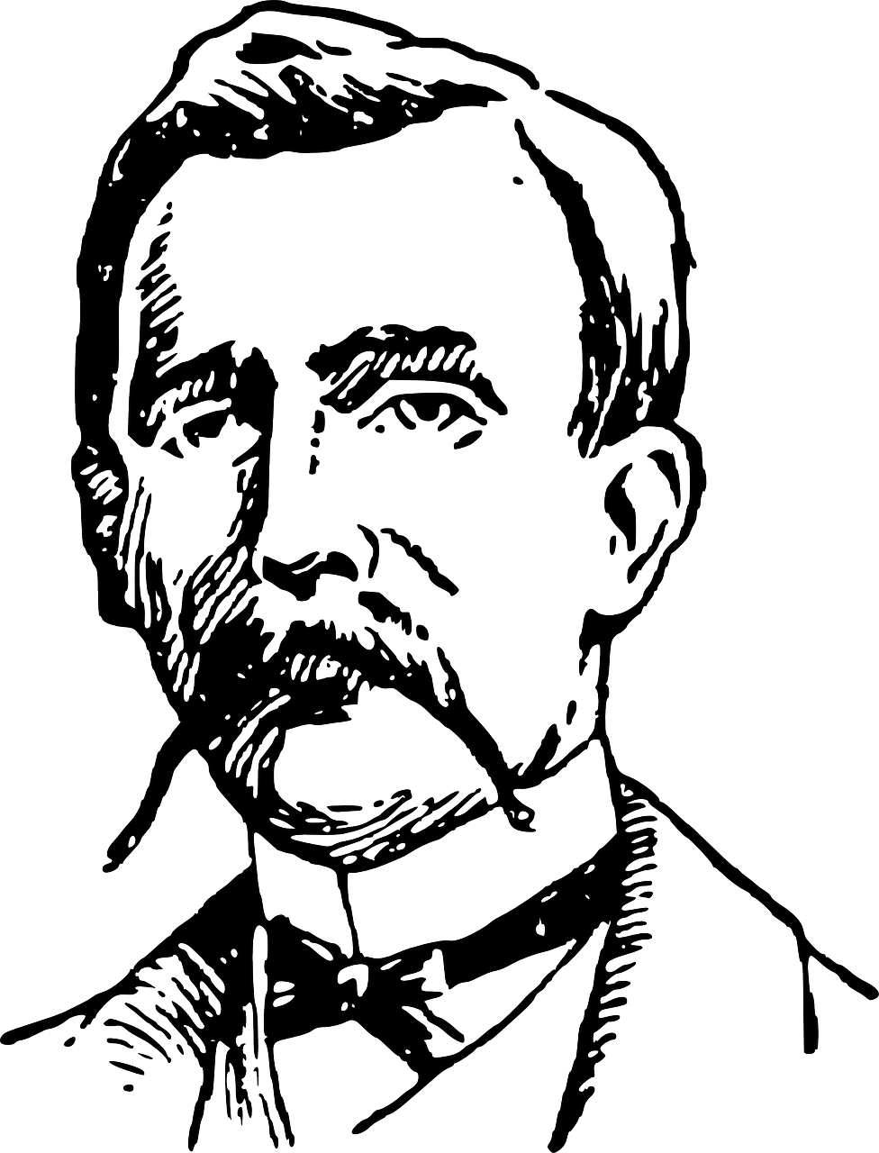
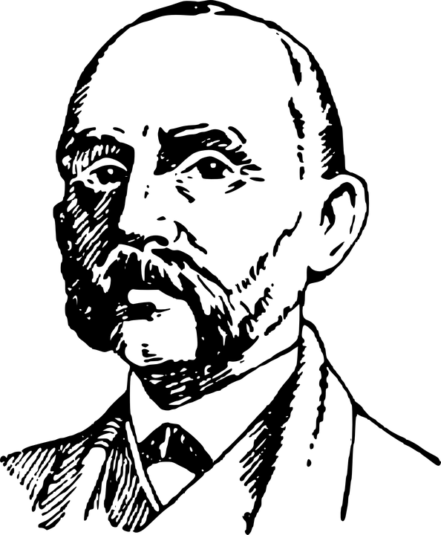
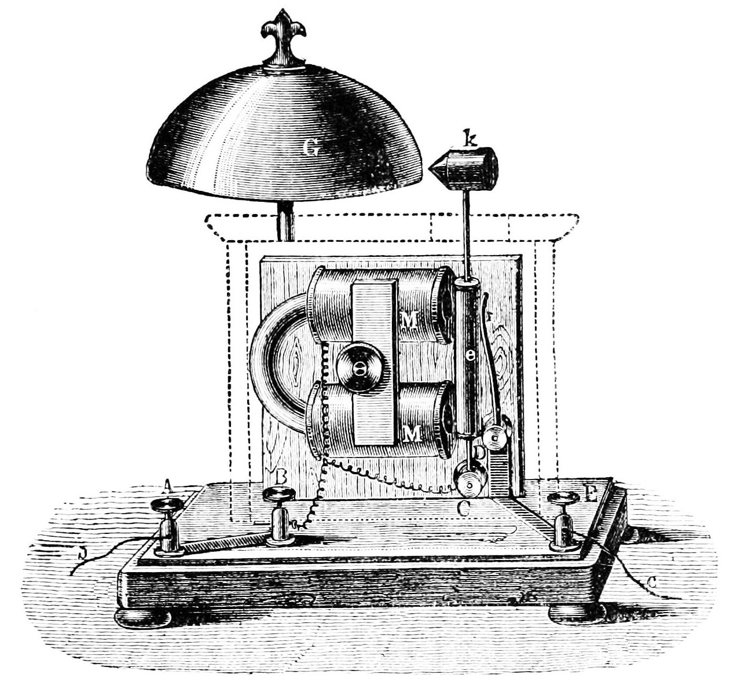
The Clayton Tunnel Accident (1861)
“Train in tunnel!”
“Is tunnel clear?”
“Tunnel clear”
http://www.railwaysarchive.co.uk/

Slide 8
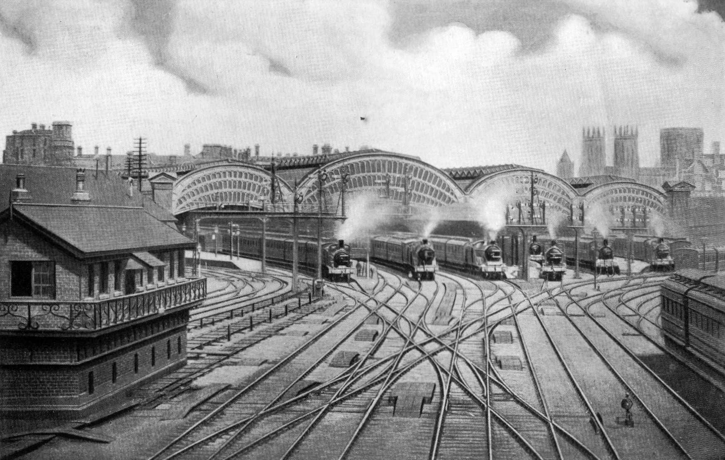
The signaller can see all the trains and therefore can control them to prevent an accident...

Slide 9
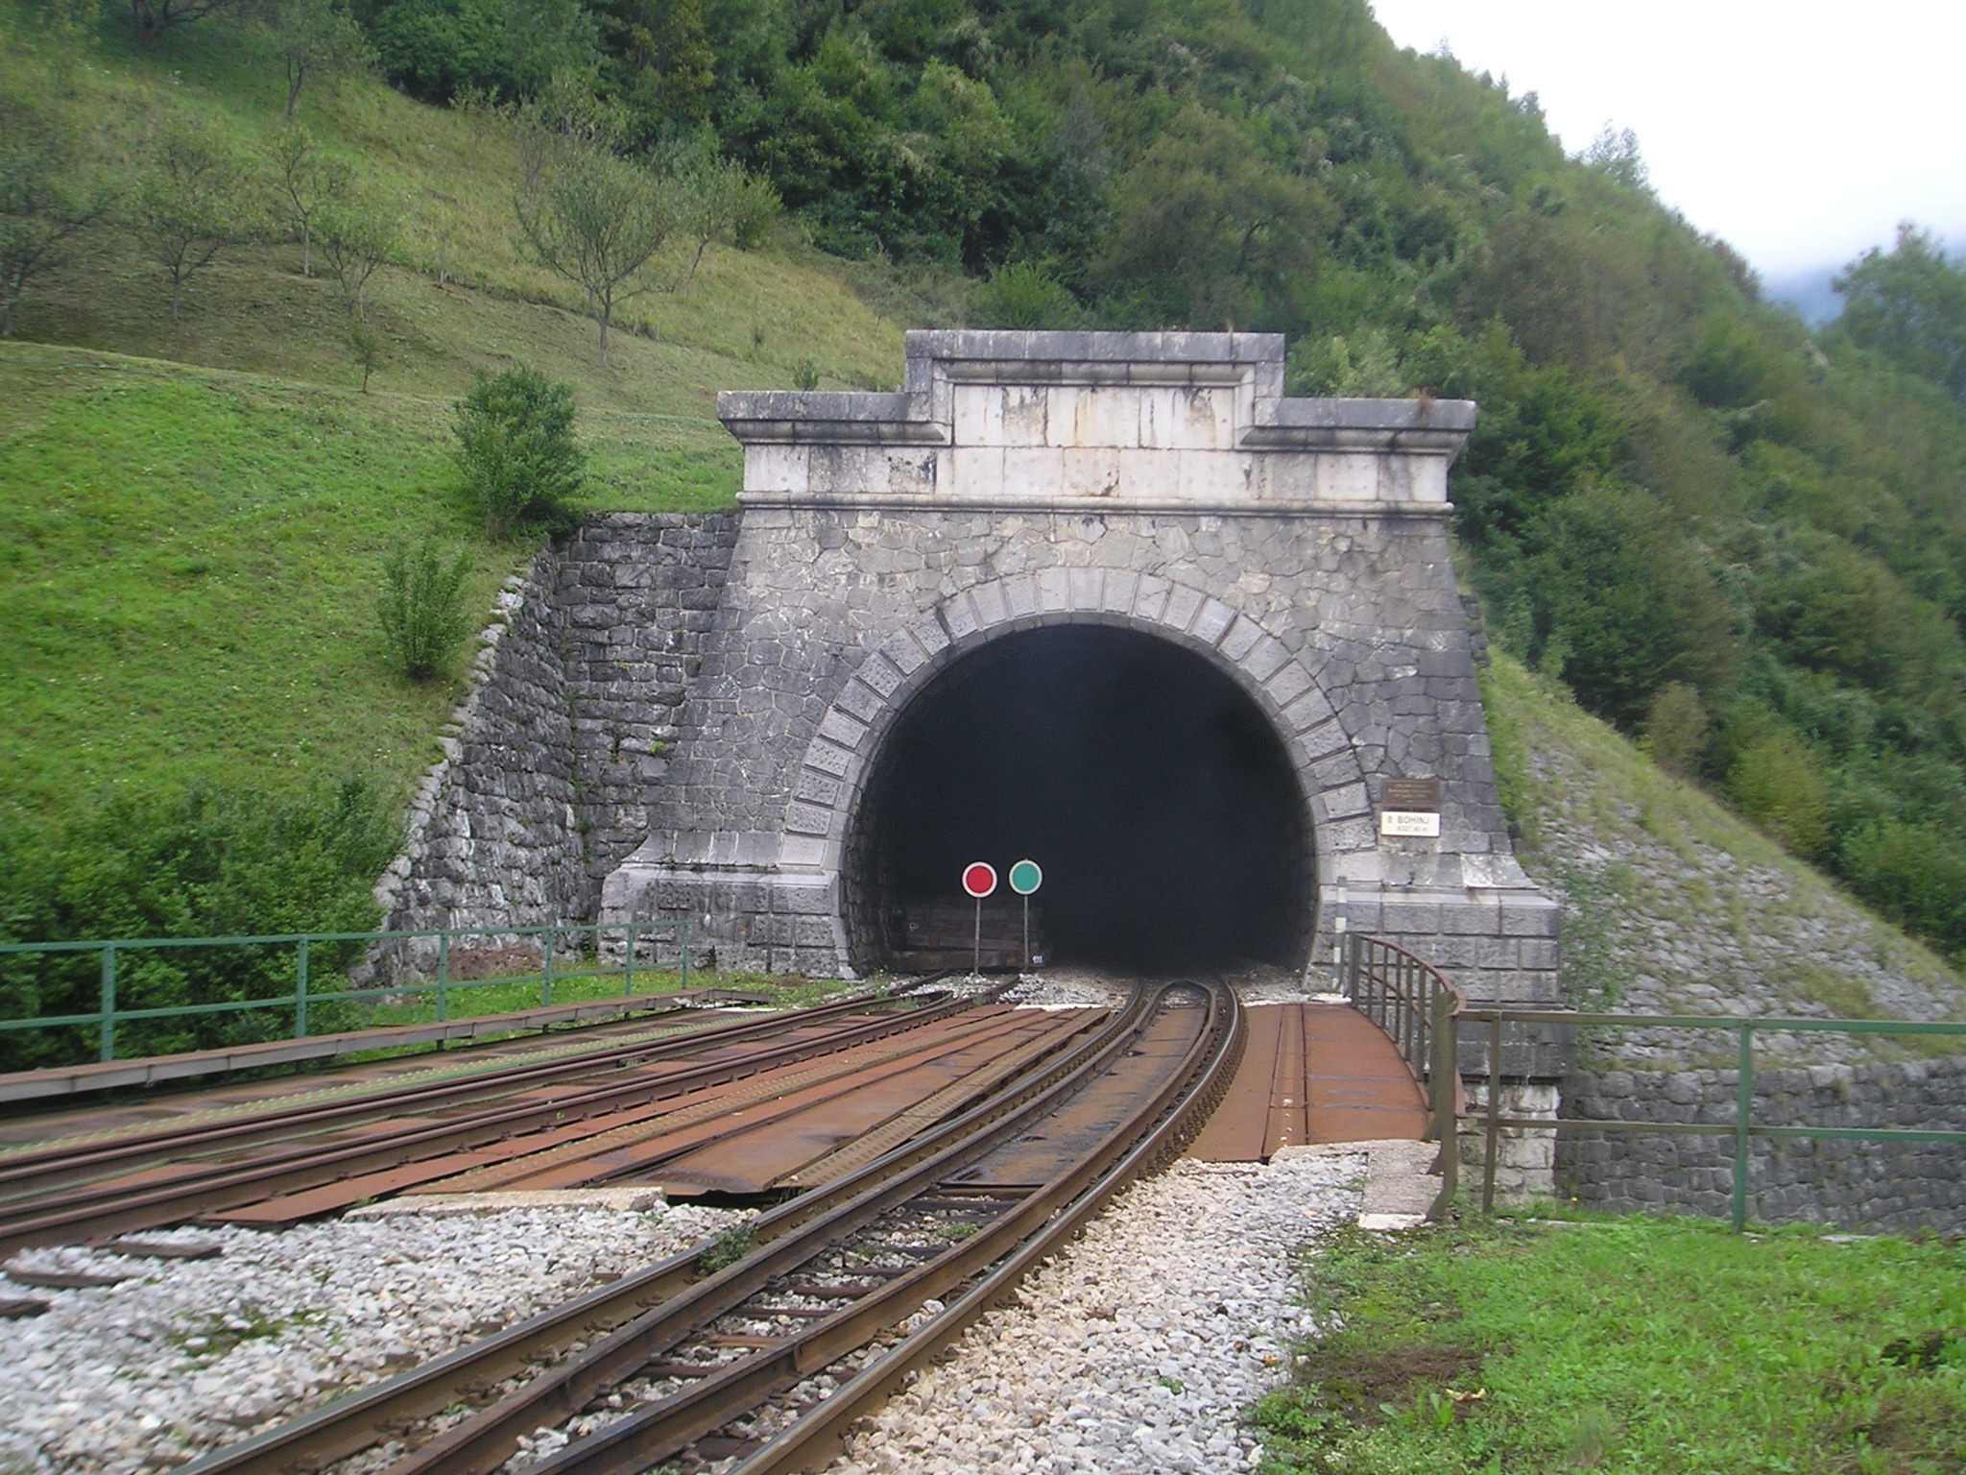
The problem arises when the signaller cannot see all the trains...
This tunnel in Slovenia is 6.3km long!

Slide 10
STATION A
STATION B
“The Block Section”
Direction of travel
- only ONE train
at any time
in the block section

Slide 11
STATION A
STATION B
Direction of travel
STATION B controls the line between A and B
STATION A ask STATION B for permission

Slide 12
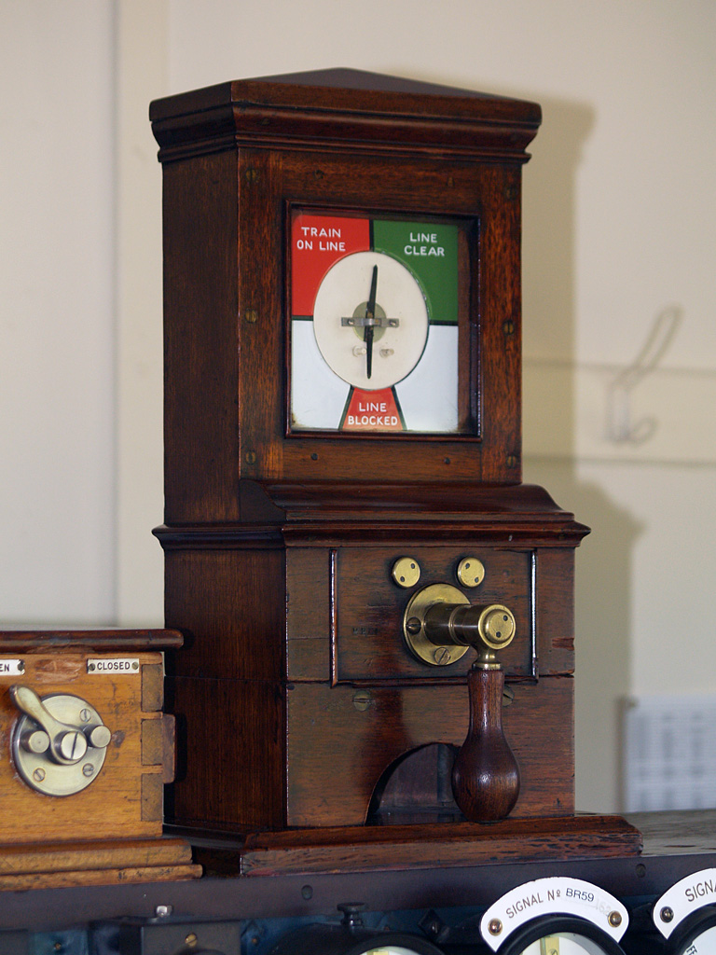

Slide 13
STATION A
STATION B
Direction of travel
“STARTER”
“HOME”

Slide 14
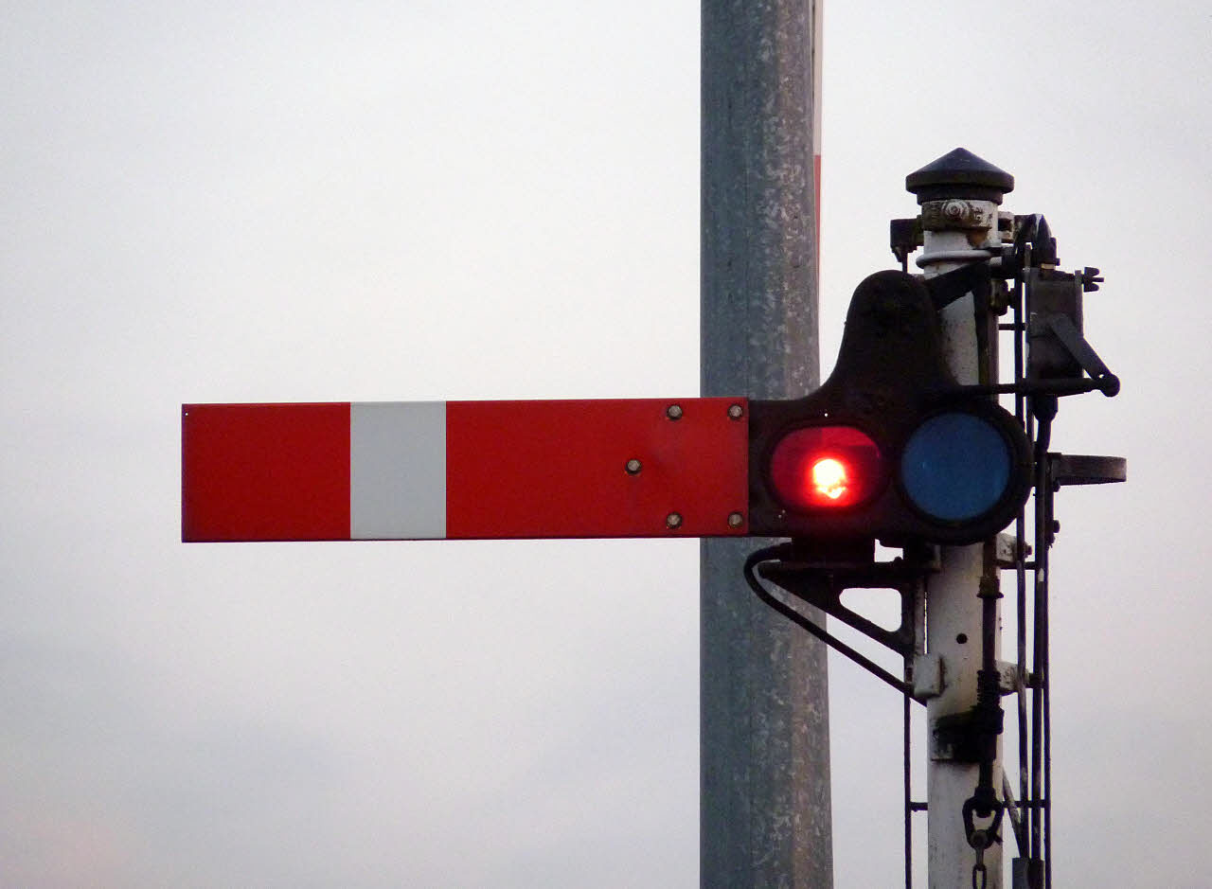
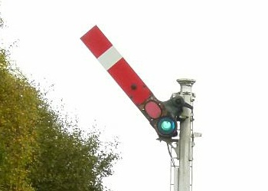
Semaphore Aspects
STOP
PROCEED

Slide 15
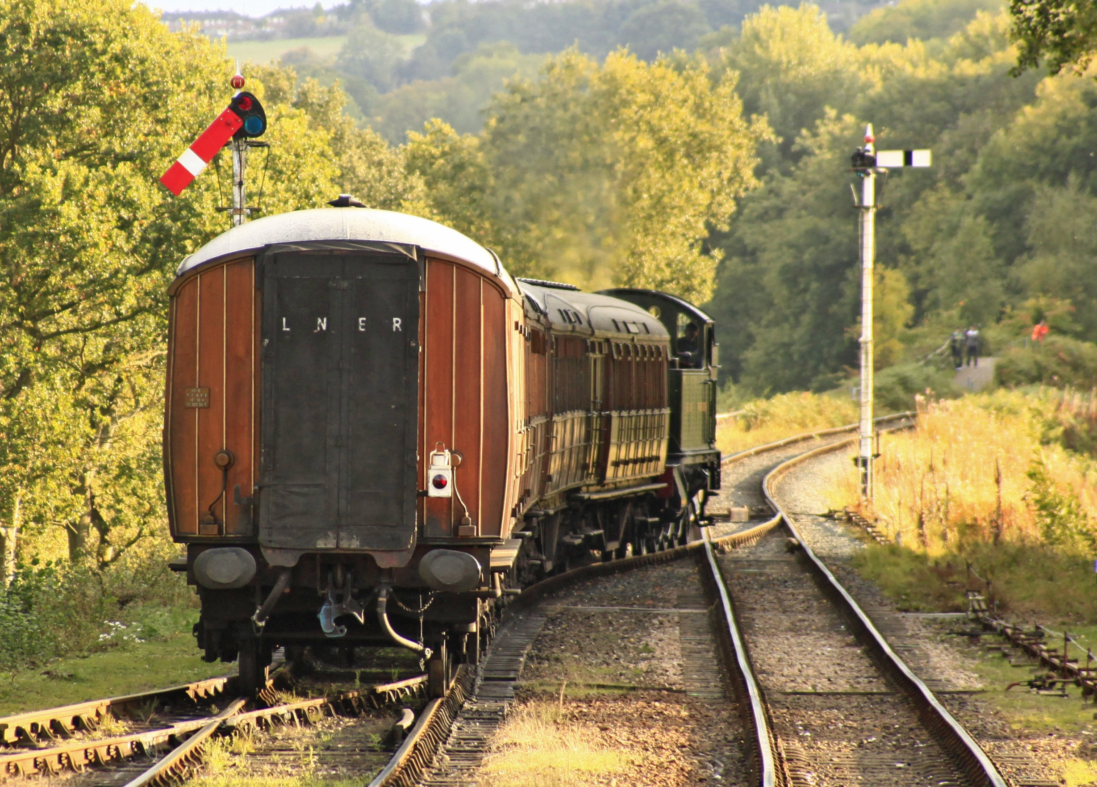
Clearing the section

Slide 16
Semaphores for Mutual Exclusion
Process A
while true:
  wait()
  critical-section
  signal()
  non-critical code
Process B
while true:
  wait()
  critical-section
  signal()
  non-critical code
“About the sequentiality of process descriptions” (EWD35)

Slide 17
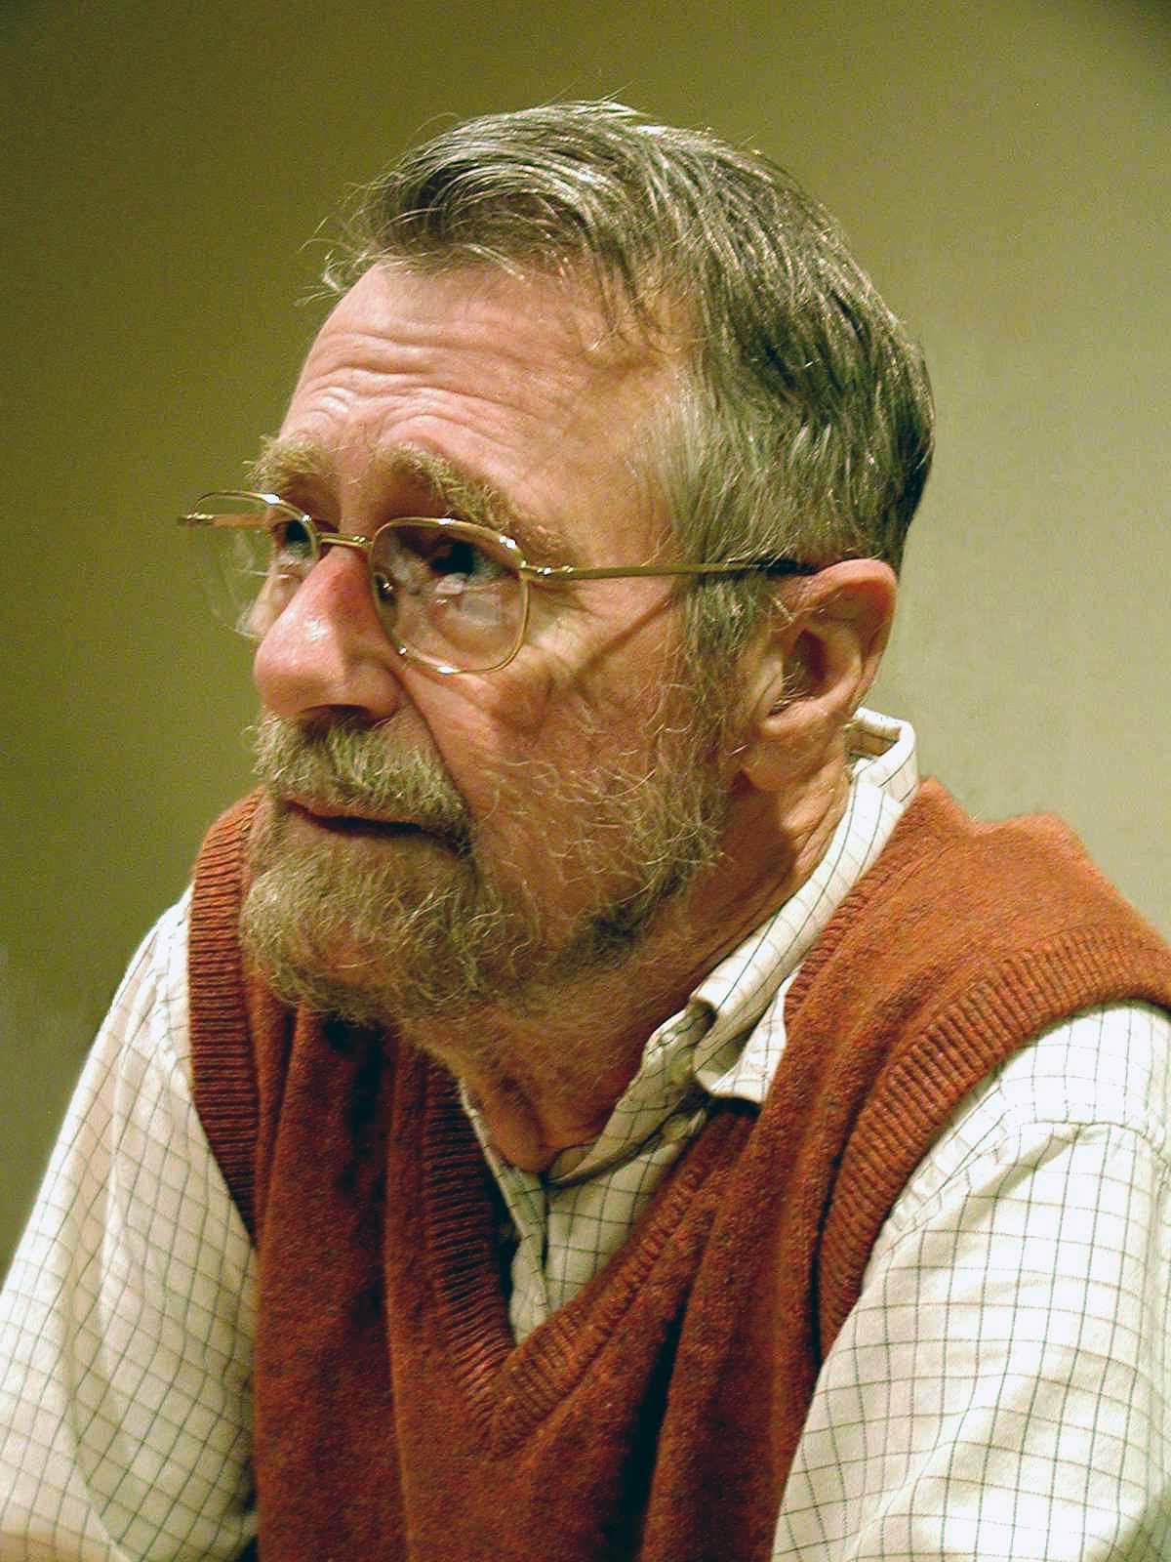
Dijkstra's Semaphores
A semaphore is just an integer, with atomic operations:
  SIGNAL
    Increment the semaphore and wake another process if the value is less than zero.
  WAIT
    Wait until semaphore is zero and then decrement it.

Slide 18
The Trolley Problem

Slide 19
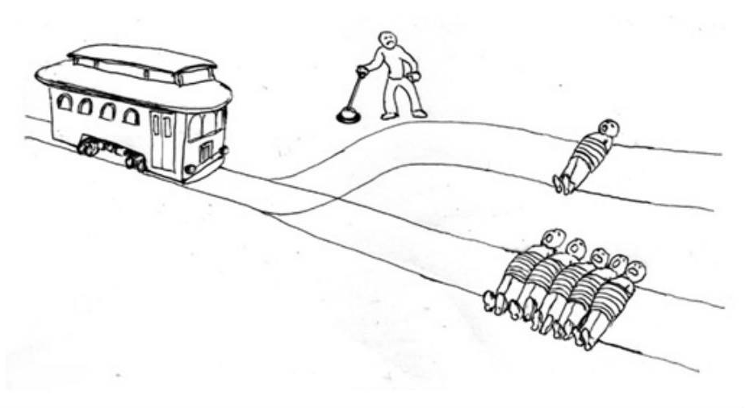
The Trolley Problem
https://www.facebook.com/TrolleyProblemMemes/

Slide 20
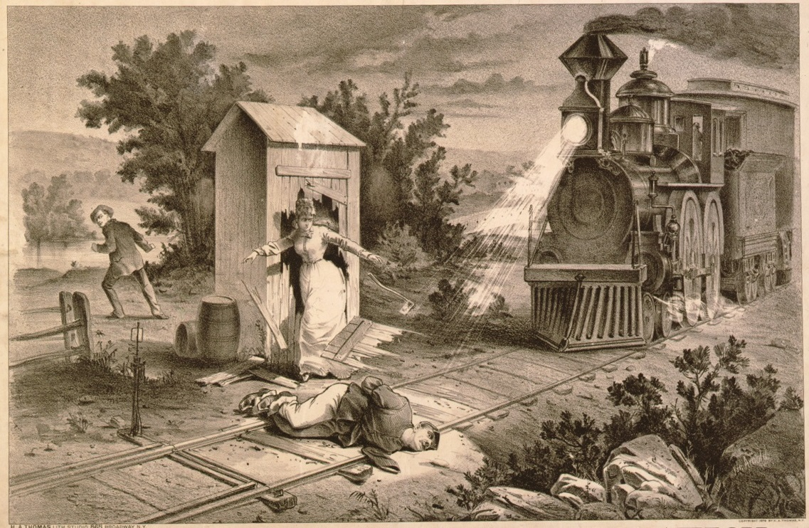
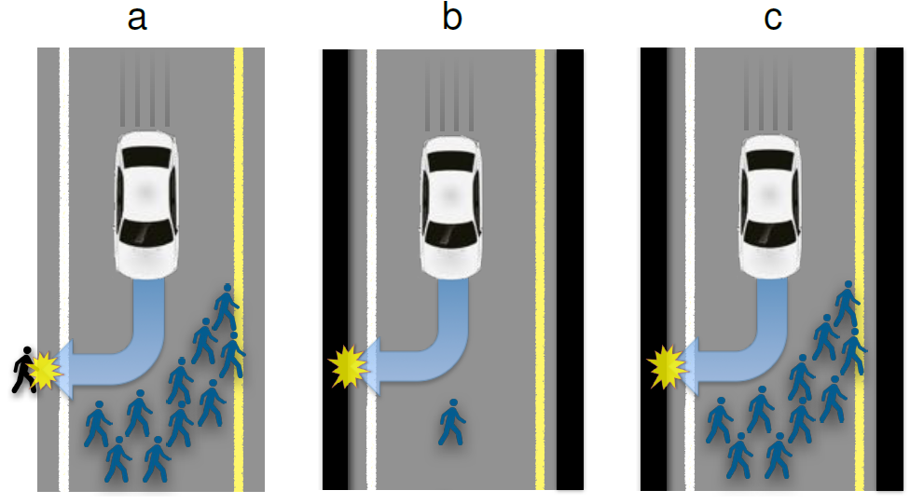
What is The Trolley Problem?
“Under the Gaslight” by Augustin Daly was an early example of person tied to track trope.
Thought experiment in ethics and morality originally by Phillippa Foot (1967).
Several subtle variations have been proposed to tease out the issues involved.

Slide 21
Time

Slide 22
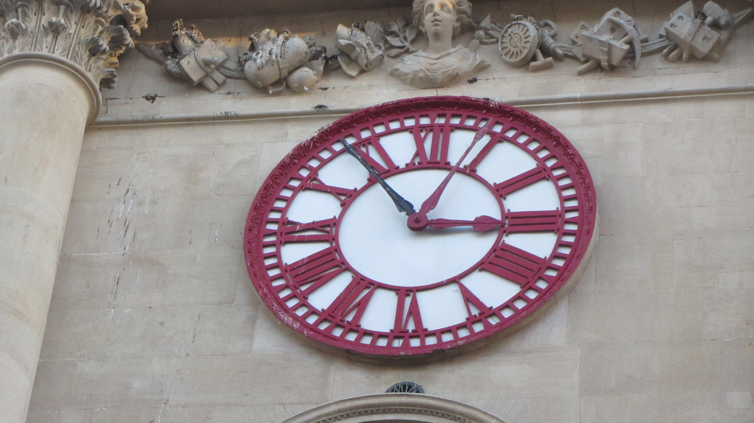
Time Before Railways
Travellers adjusted their clocks to either run too fast or too slow in order to keep pace.
Trains ran to a timetable.
  Passengers did would miss their trains.
  Some types of accidents needed to be avoided.

Slide 23
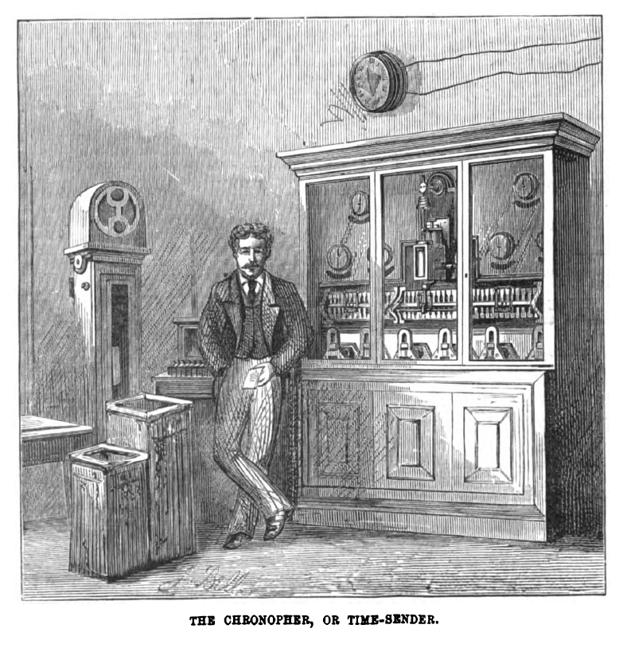
The Chronopher
The Electric Telegraph Company (ETC) was established in 1846 and built its network alongside the railway lines as it could also be used to transmit signalling information between signal boxes.
As a result it became known as "Railway Time".

Slide 24
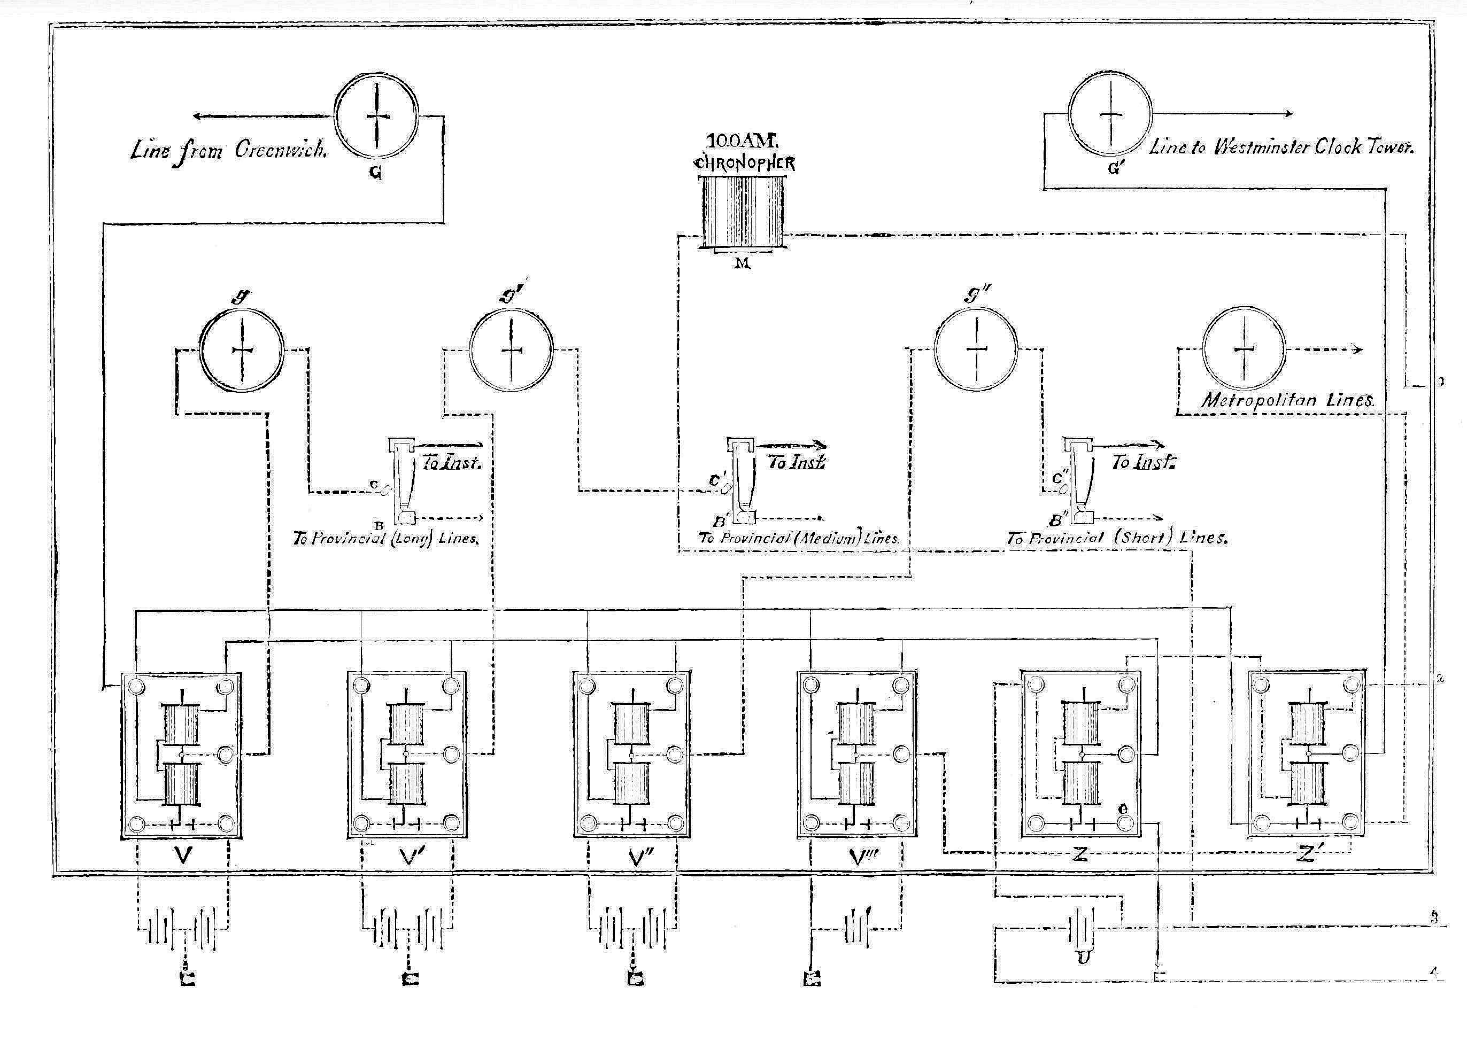
"Beside this general automatic distribution of the time-signal, a considerable distribution of the 10 A.M. signal goes on by hand. At that instant the chronopher makes a sound which an operator sits ready to catch by ear.”

Slide 25
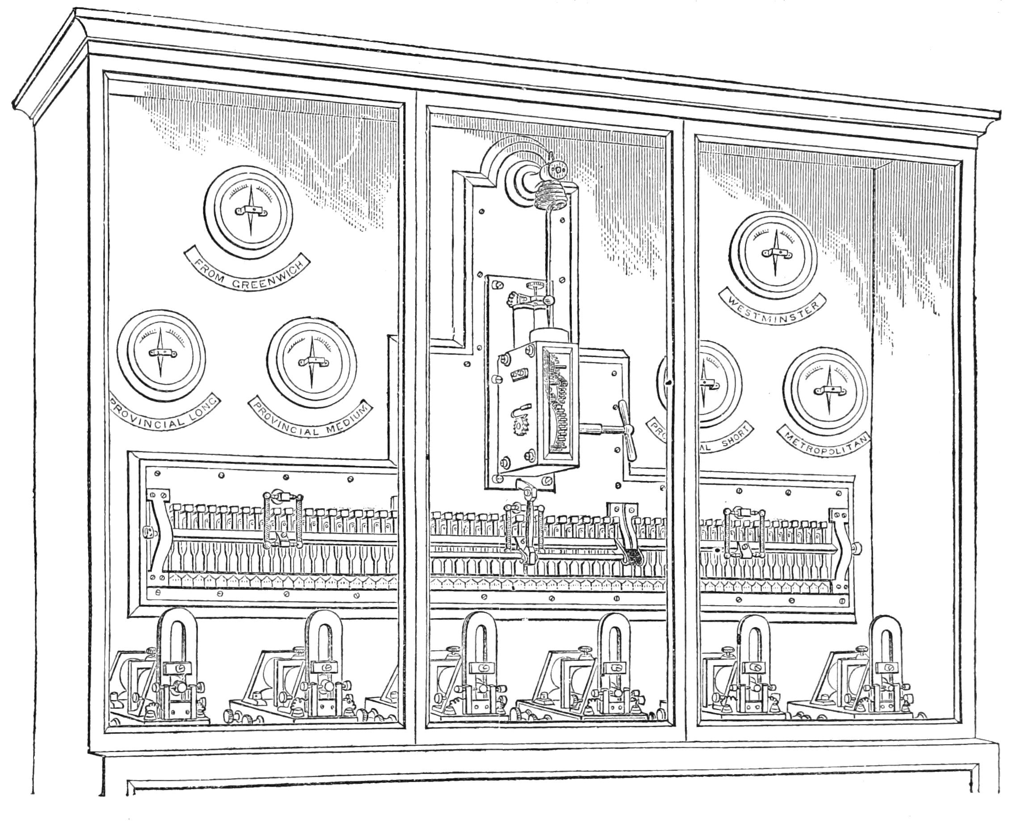
“Upon hearing it he immediately dispatches a signal by ordinary telegraphic instrument, and this signal is received at six hundred or more places, which again serve as distributing points for more distant places. These are usually railway or post offices in towns not supplied by the chronopher, which by virtue of authority become the regulators of the surrounding district."

Slide 26
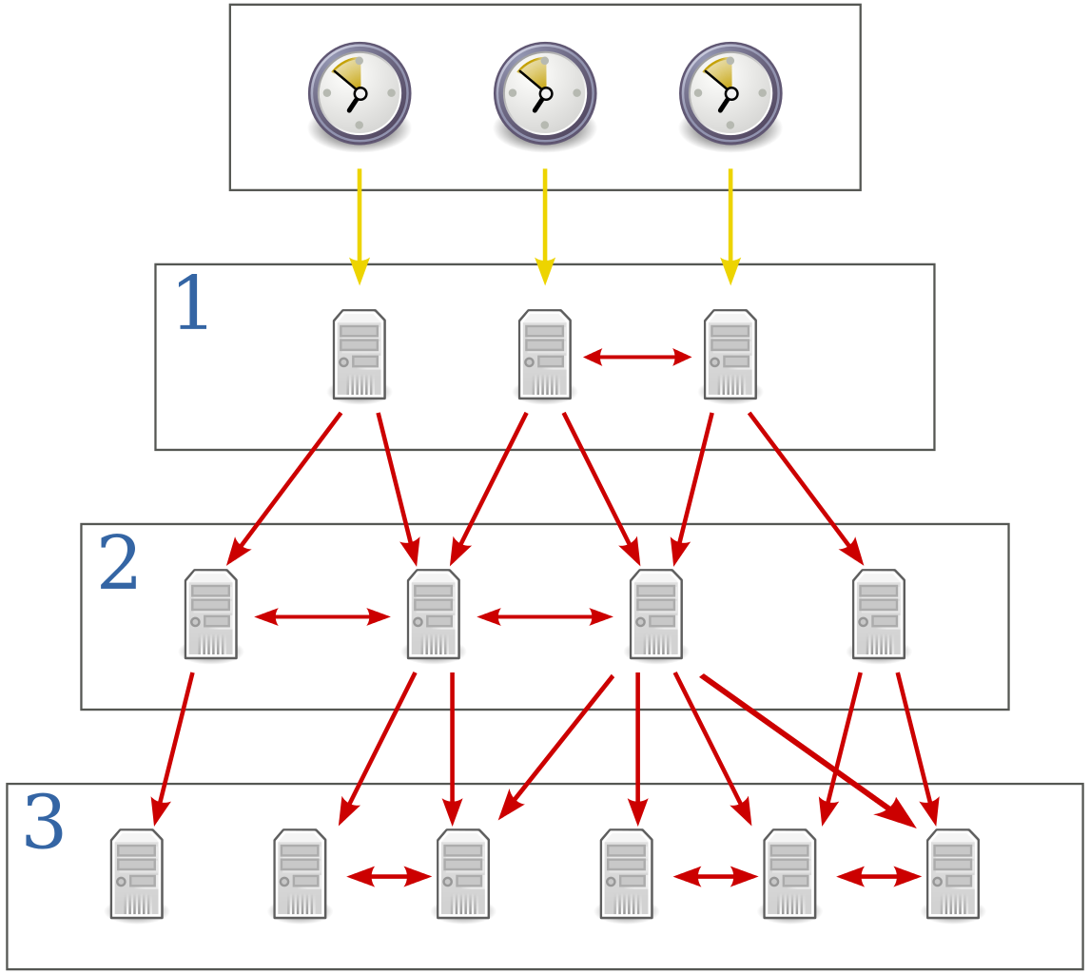
Network Time Protocol (NTP)
139.143.5.30
(ntp1.npl.co.uk)
139.143.5.31
(ntp2.npl.co.uk)
78.158.87.11
(ntp1.emf.camp)
78.158.87.12
(ntp2.emf.camp)

Slide 27
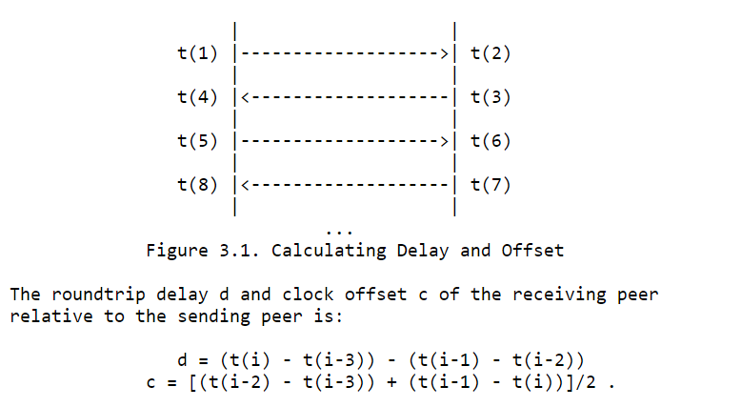
RFC 1059
Consensus between clocks is achieved by combining their time server responses using a variation on Marzullo's Algorithm known as the Intersection Algorithm.

Slide 28
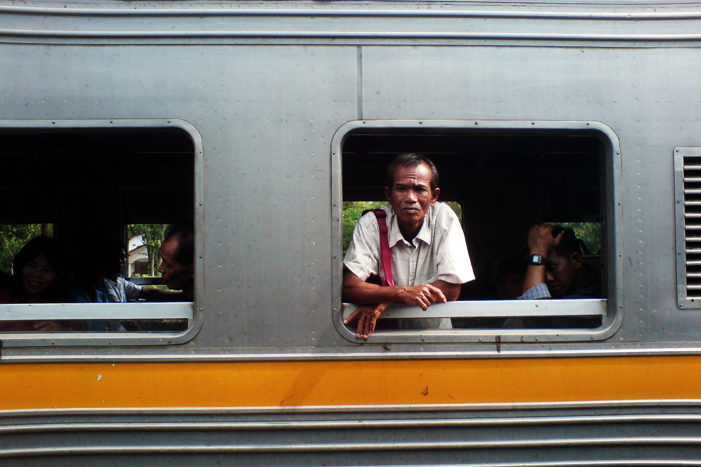
Einstein's Thought Experiments with Trains
Einstein, 1920 "Relativity: The Special & The General Theory"
“I stand at the window of a railway carriage which is travelling uniformly, and drop a stone on the embankment, without throwing it.”
”I now ask: Do the "positions" traversed by the stone lie "in reality" on a straight line or on a parabola?"

Slide 29
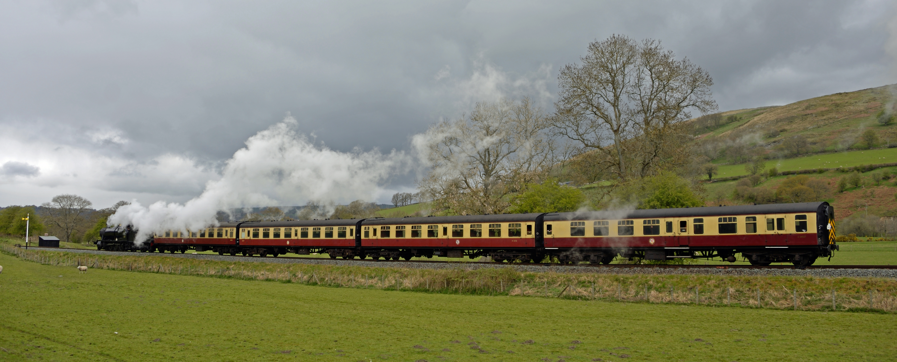
The Principle of Relativity
Physical laws are the same for all frames of reference.
→ Speed of Light is the same in all reference frames.

Slide 30
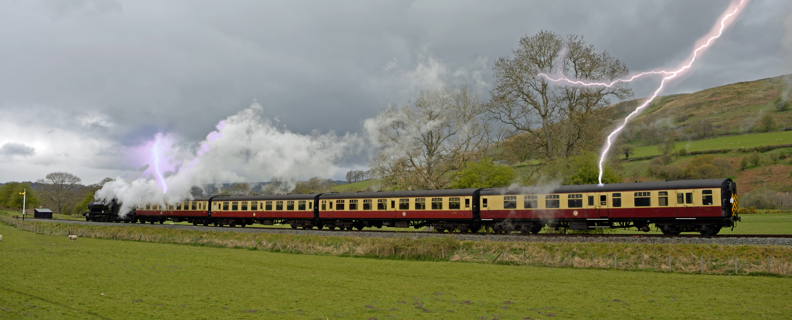
Simultaneity
"Lightning has struck the rails on our railway embankment at two places A and B far distant from each other.”
"Are two events (e.g. the two strokes of lightning A and B) which are simultaneous with reference to the railway embankment also simultaneous relative to the train?"

Slide 31
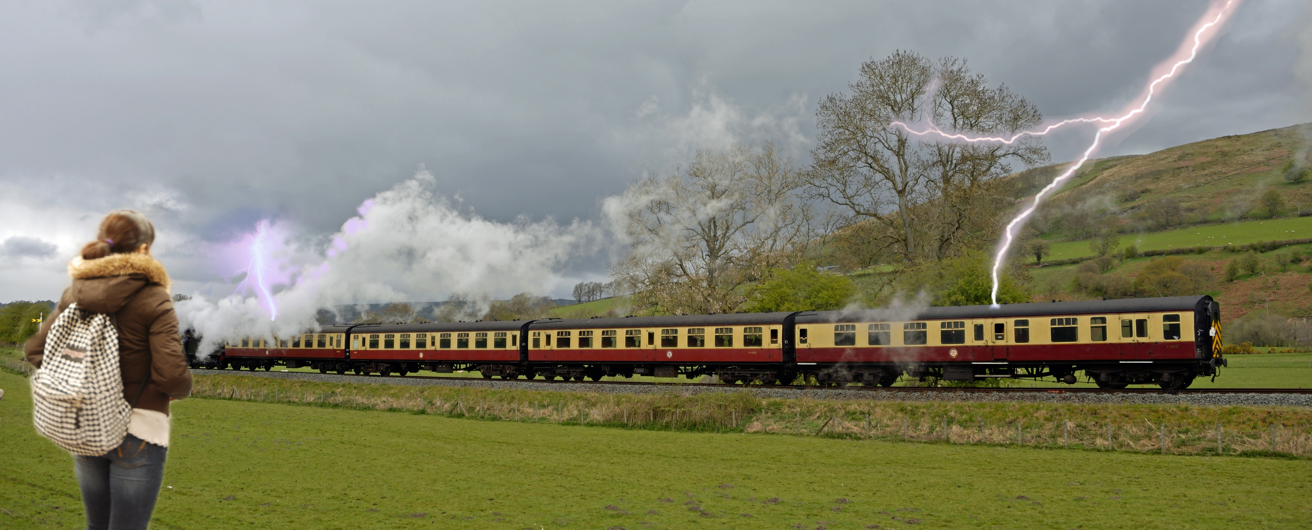

Measuring Simultaneous Events
"By measuring along the rails, the connecting line AB should be measured up and an observer placed at the mid-point M of the distance AB"
"If the observer perceives the two flashes of the lightning at the same time, then they are simultaneous."

Slide 32
Relativity of Simultaneity
"Let M' be the mid-point of the distance A->B on the travelling train."
"Now in reality (considered with reference to the railway embankment) [the person at M'] is hastening towards the beam of light coming from B, whilst he is riding on ahead of the beam of light coming from A. Hence the observer will see the beam of light emitted from B earlier than he will see that emitted from A."
"Every reference-body (co-ordinate system) has its own particular time; unless we are told the reference-body to which the statement refers, there is no meaning in a statement of the time of an event."

Slide 33
Effects on Distributed Systems
GPS needs to correct for General Relativity.
Network latency.
  Line speed.
  Queuing in buffers.
  Varies between routes.
Remote machines may spoof timestamps to gain advantage:
  e.g. “timestamp fraud” in high frequency trading.

Slide 34
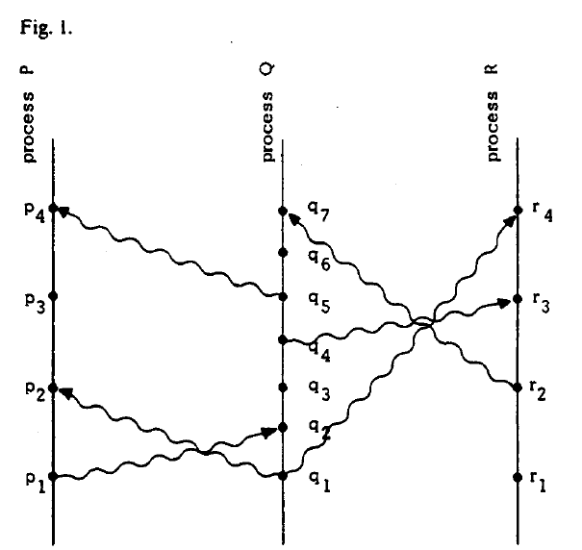
Lamport Timestamps:
Space-time diagrams
TIME
"Time, Clocks, and the Ordering of Events in a Distributed System" (1978) Leslie Lamport.

Slide 35
Shunting Yards

Slide 36
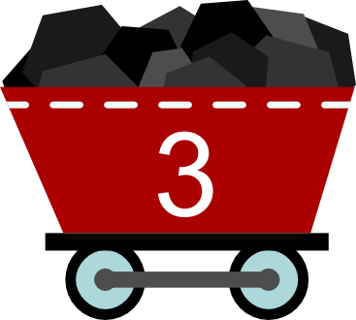
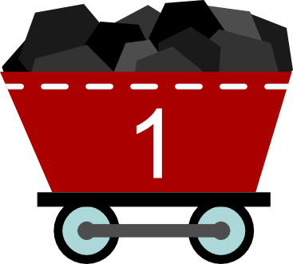
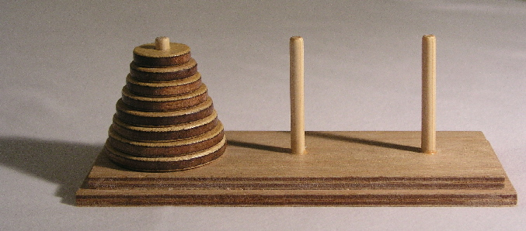
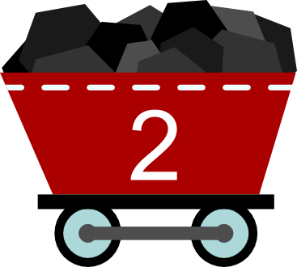
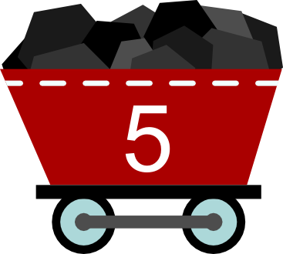
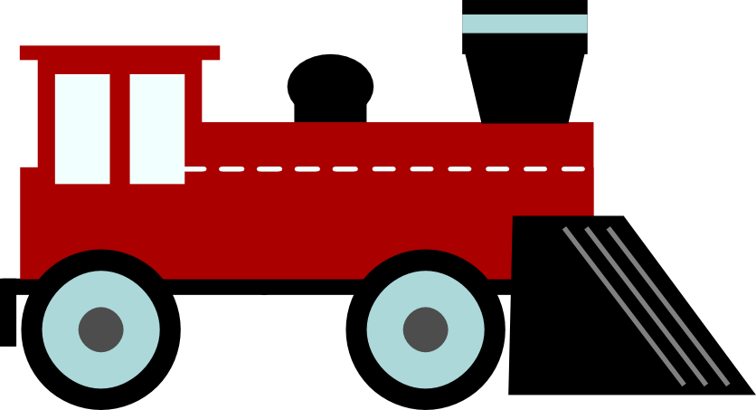
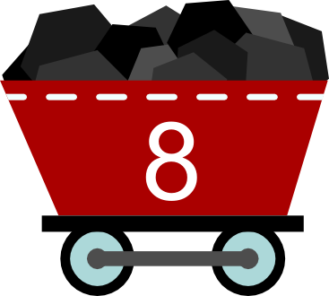
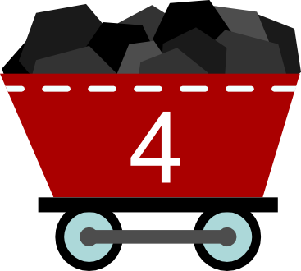


Shunting Yard Puzzles
Inglenook Sidings by Alan Wright
Consist a train using wagons 1-5 in that order.

Slide 37
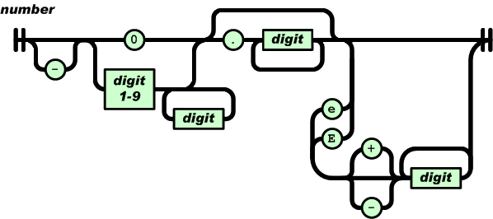
Railroad Diagrams for Grammars
Examples:
-0.25
9.24e-3
JSON.org

Slide 38
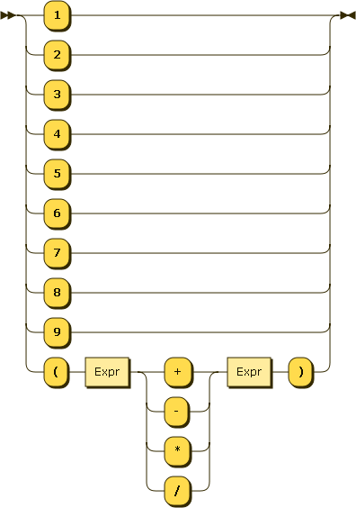
Grammar of Arithmetic Expressions

Slide 39
Reverse Polish Notation
"((1 - 2) + (3 * 4)) / 5)"
1 2 – 3 4 * + 5 /
1
2
-
-1
3
4
*
12
+
11
5
/
2
1
-1
3
-1
11
-1

Slide 40
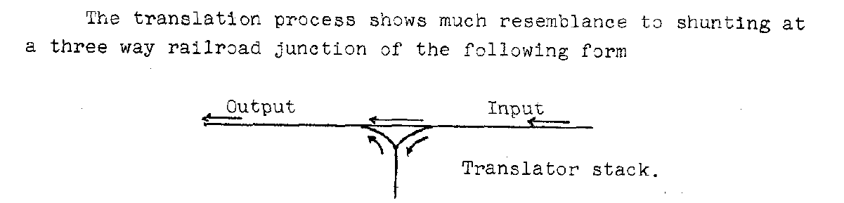
Shunting Yards for Parsing
1
-
2
X
3
+
4
http://www.cs.utexas.edu/~EWD/MCReps/MR35.PDF

Slide 41
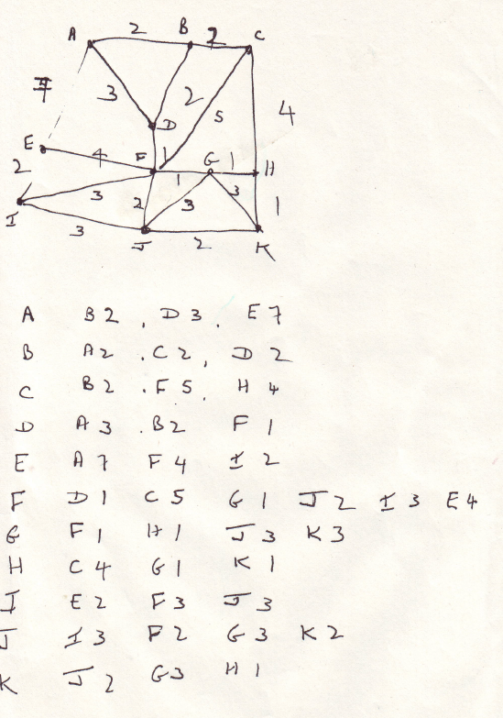
Dijkstra's Algorithm
LEO I (Lyons Electronic Office I); 1955.
Calculate distances between stations within the BR network; used for freight tariffs.
Independently invented Dijkstra's shortest path algorithm.
They had 5,500 stations but the machine only had 2k of RAM, including for program.
Found choke points in the map and computed distances within sub-graphs.
“LEO and the BR Job” by Tim Greening-Jackson: http://www.larlou.org/index.php/8-computer-history/3-big-data-in-the-era-of-punched-cards
"The Great Railway Caper" by John Graham-Cumming, Strata 2012 http://blog.jgc.org/2012/10/the-great-railway-caper-big-data-in-1955.html
"A note on two problems in connexion with graphs" (1959; EWD841)

Slide 42
Bonus Track

Slide 43
Jastrow's Illusion

Slide 44
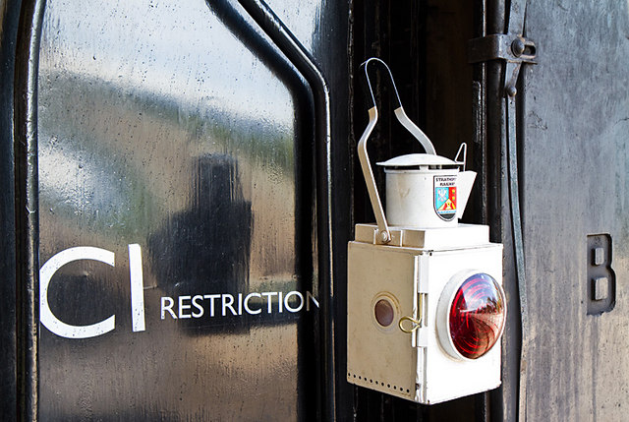
The End
Thank you!

Slide 45
Acknowledgements
By Geek3 (CC-BY-SA-3.0) https://commons.wikimedia.org/wiki/File:VFPt_wires_parallel_in.svg By Averater (CC-BY-SA-3.0) https://commons.wikimedia.org/wiki/File:Rail2_perspective.svg By “Bengt 1955” (CC BY-NC 2.0): https://www.flickr.com/photos/bengtm/480962046 “The Brighton Road” by Charles G. Harper https://archive.org/details/brightonroadclas00harp “19th century train” by johnny_automatic https://openclipart.org/detail/5408/19th-century-train https://pixabay.com/en/man-mustache-fashion-gentleman-148343/ https://pixabay.com/en/man-mustache-fashion-gentleman-148342/ Man with flag: https://openclipart.org/detail/213858/man-with-flag Anon (Public Domain) https://commons.wikimedia.org/wiki/File:PSM_V18_D069_Alarm_bell_mechanism.jpg F.S. Hartnell (unknown, circa 1910 - 1916) All About Railways https://commons.wikimedia.org/wiki/File:York_station_approaches_(All_About_Railways,_Hartnell).jpg By David Ingham (CC-BY-SA-2.0) https://commons.wikimedia.org/wiki/File:Block_instrument.jpg By Ajznponar (CC-BY-SA-3.0) https://commons.wikimedia.org/wiki/File:Podbrdo-southern_entrance_of_the_Bohinj_railway_tunnel.jpg By Alan Murray-Rust (CC-BY-SA-2.0) http://www.geograph.org.uk/photo/4257528 By Alan Murray-Rust (CC-BY-SA-2.0) http://www.geograph.org.uk/photo/4718718 By 70023venus2009 (CC-BY-ND-2.0): https://www.flickr.com/photos/70023venus2009/6182134468/ By Hamilton Richards https://en.wikipedia.org/wiki/File:EdsgerDijkstra.jpg "Under the Gaslight" from Library of Congress: https://www.loc.gov/item/2014636015/ Autonomous vehicle: https://arxiv.org/abs/1510.03346 By Stephen Colebourne (CC-BY-2.0): https://www.flickr.com/photos/jodastephen/11025659585/ “The Illustrated London News” https://archive.org/details/TheIllustratedLondonNews65 (Public Domain) https://commons.wikimedia.org/wiki/File:PSM_V22_D345_The_chronopher_schematic.jpg (Public Domain) https://commons.wikimedia.org/wiki/File:PSM_V22_D343_Perspective_of_the_chronopher.jpg From “The Popular Science Monthly” https://archive.org/stream/popularsciencemo22newy#page/328/mode/2up By Benjamin D. Esham (Public Domain) https://en.wikipedia.org/wiki/File:Network_Time_Protocol_servers_and_clients.svg Track Gaze by Steve Calcott (CC-BY-NC-2.0) https://www.flickr.com/photos/stevec77/5005083281/ By Andrew (CC-BY-2.0) https://www.flickr.com/photos/arg_flickr/17333171291/ By Nathan Vaughn (CC-BY-2.0) https://www.flickr.com/photos/46799485@N00/5802508421/ By See1,Do1,Tech1 (CC-BY-2.0)https://www.flickr.com/photos/mpaulmd/14391745411/ By Tripp CC-BY-2.0 https://www.flickr.com/photos/trippchicago/3292918869/ By joaolima https://openclipart.org/detail/204661/alarm-clock ByEvanherk (CC-BY-SA-3.0)https://en.wikipedia.org/wiki/File:Tower_of_Hanoi.jpeg By pl402 (Public Domain) https://openclipart.org/detail/184808/vaga%C2%B3n-de-carbon-coal-wagon By pl402 (Public Domain) https://openclipart.org/detail/184810/locomotora-locomotive By Martin Addison (CC-BY-SA-2.0) http://www.geograph.org.uk/photo/2414143

