Slide 1




CIT 596 MODULE 6.5
Breadth-First Search
Sampath Kannan

Slide 2



BREADTH-FIRST SEARCH
Imagine that a large sound is made at the starting vertex.
In what order would the sound wave reach the other vertices?
Intuitively, this is order in which breadth-first search visits vertices.
Algorithmically, BREADTH-FIRST-SEARCH(v) puts all neighbors of v in a queue
It processes vertices in queue order.
So neighbors of $v$ will be visited before neighbors of neighbors of $v$.

Slide 3

BREADTH-FIRST SEARCH
d
e
Vertices will be unseen, visited, or finished
Key idea: If $v$ is visited before $u$, $v$ will be finished before $u$. Use a queue to accomplish this.
Visited = inserted into the queue
Finished = all unseen neighbors added to the queue
Figure: snapshot of BFS started on vertex c
Unseen = green
Visited = white
Finished = purple
b
a
c
f
g
h

Slide 4
EXAMPLE
d
e
// all vertices start unseen
BREADTH-FIRST-SEARCH(G, s):
initialize an empty queue Q
mark s visited
enqueue(Q, s)
while Q is not empty
x <- dequeue(Q)
for each unseen neighbor y of x
mark y visited
enqueue(Q, y)
mark x finished
b
a
c
f
g
h

Slide 5

PROPERTIES OF BFS
Level 0
c
Level 1
f
b
a
Level 2
g
h
d
e
If $u$ is enqueued while exploring $v$ then $level\left(u\right)=level\left(v\right)+1$.
All non-tree edges are between vertices whose levels differ by at most 1.
Vertices in a level are explored consecutively.
Vertices are explored in order of levels.

Slide 6

MORE PROPERTIES OF BFS
d
e
$level(u)$ is the distance from $c$ (the starting vertex) to $u$.
Distance = number of edges in shortest path from $c$ to $u$.
Key application of BFS: shortest paths from source vertex
b
a
c
f
g
h

Slide 7

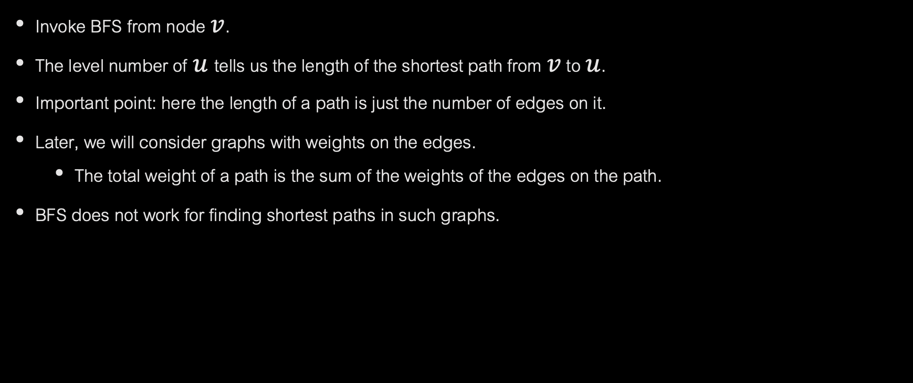
SHORTEST PATHS FROM NODE $v$
Invoke BFS from node $v$.
The level number of $u$tells us the length of the shortest path from $v$ to $u$.
Important point: here the length of a path is just the number of edges on it.
Later, we will consider graphs with weights on the edges.
The total weight of a path is the sum of the weights of the edges on the path.
BFS does not work for finding shortest paths in such graphs.

