Slide 1
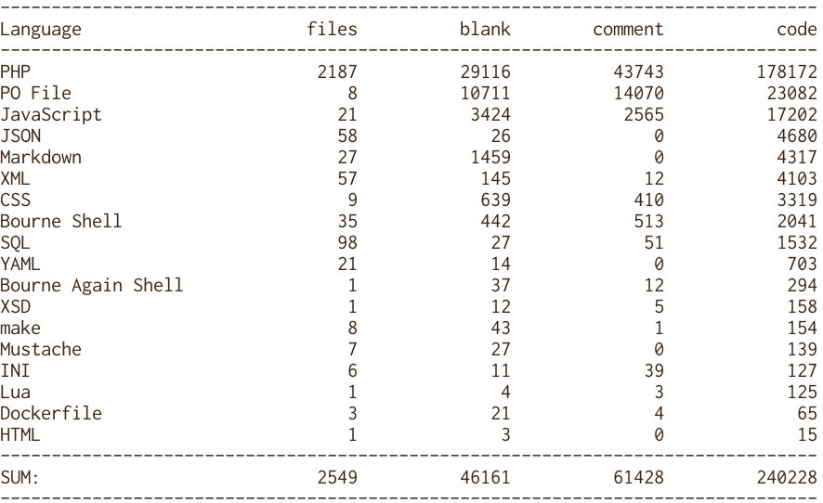
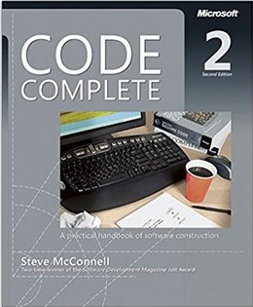
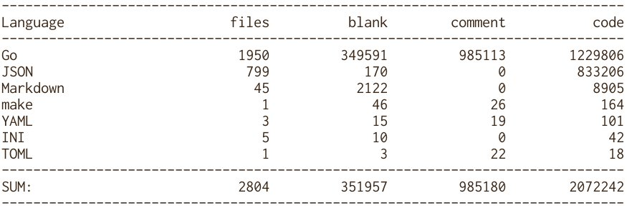
9 x
97 x

Slide 2
Backend development Go
Techniques and concepts
By
Gregory Vincic

Slide 3
Content
History
Language concepts
Tools – the go family
Explore packages
Testing
Lunch break
Workshop - structure and modules
Blog design
AWS Lambdas

Slide 4
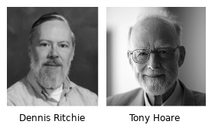
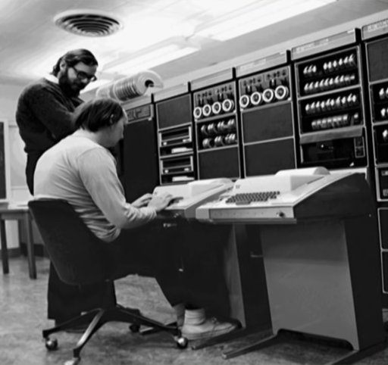
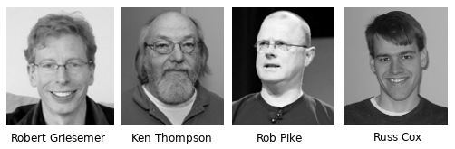
History
Notes:
Alan Touring 1912-1954, first computer 1945
Dennis Ritchie, 1941-2011, C-unix
Tony Hoare, 1934- Communicating sequential processes
Ken Thompson, 1943- unix
Rob Pike, 1956- Plan9, UTF-8
Robert Griesemer
Russ Cox

Slide 5
Language concepts
Slices
Maps
Structs and methods
Embedding
Interfaces
Go routines and channels

Slide 6
Tools – the go family
go
  get github.com/YOU/blog
  build
gofmt
golang.org/x/tools/cmd/goimports
golang.org/x/tools/cmd/godoc

Slide 7
Explore packages
strings, bytes, sort, os, flag, sync, io, io/util, html/template
net/http
  download
  server
encoding/json
  memstore, testing

Slide 8
Testing
Unit tests, -short
Examples
Benchmarks
Grouping, integration
httptest
  Server
  Recorder

Slide 9
Lunch break

Slide 10
Workshop – structure and modules
go mod init
go.mod
  go mod tidy
directory structure
  cmd
  internal
  vendor
  idea of dependency order
Notes:
Create a repository

Slide 11
blog - design
Domain layer in root
  Author can write an Article to a Page
  In memory storage, slice or map
REST
  gorilla/mux for routing
  /articles endpoint
  json for input and output
  html/template for user interface

Slide 12
AWS Lambdas
https://godoc.org/github.com/aws/aws-lambda-go/lambda#Start
https://godoc.org/github.com/aws/aws-lambda-go/events#APIGatewayProxyRequest
Using adapters
  Easy to test
  Use one binary for multiple lambdas
  Only used with APIGatewayProxyRequest

