Slide 1
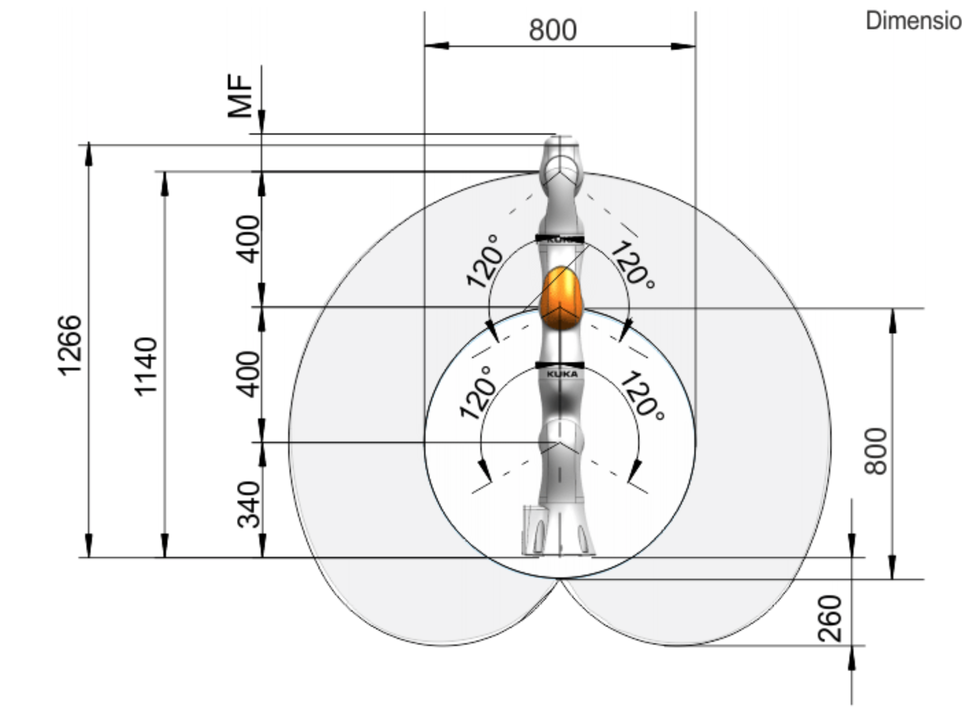
workspace center
leap motion clearance
virtual leap motion

Slide 2
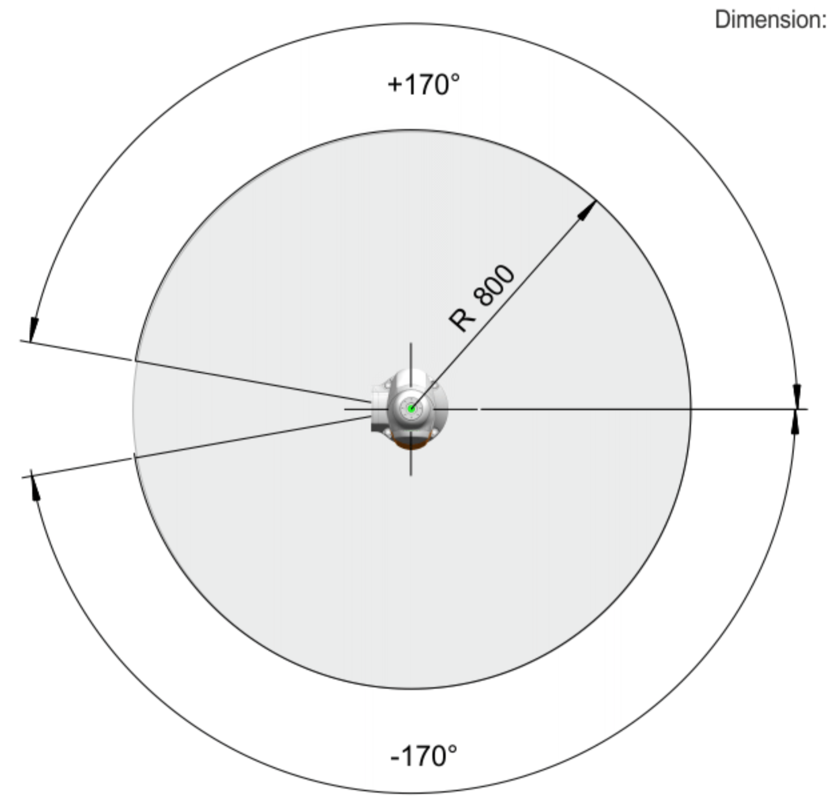
virtual leap motion
opening angle
workspace centerline

Slide 3
center of sphere
inner sphere radius
outer sphere radius
z upper limit
z lower limit

Slide 4
opening angle
center line

Slide 5
upper z limit
J2
lower z limit
outer sphere limit
inner sphere limit
base

Slide 6
ɣ
β
⍺

Slide 7





$$\overset{⃑}{v_{i}}$$
$$\overset{⃑}{p_{c}}$$
𝛿
$$\overset{⃑}{v_{t}}$$
ɣ
$$\overset{⃑}{v_{m}}$$
β
⍺
$$\overset{⃑}{v_{p}}$$

Slide 8
Y
X
Z

Slide 10
simplification plane
simplification plane
J4
J4
J5
J5
J3
J3
J6
J6
J7
J2
J2
J7
G
G
J1, B
J1, B
center line
center line

Slide 11
simplification plane
J4
J5
J3
J6
J2
J7
G
J1, B
center line

Slide 12
fixed hand
known
known
virtual leap motion
center line
base
unknown

Slide 13
adjusted hand
measured hand
unknown
fixed hand
known
known
virtual leap motion

Slide 14
adjusted hand
tool
virtual leap motion
base

Slide 15
{H}
{T}
{L}
{B}

