Slide 1
Image Album Project
Ante Hakstok
Marko Pancirov
Antonio Labriola
Ane Hakstok

Slide 2
Image I/O
Handles pictures, albums and JSON I/O
Album class
It has Album class which aggregates Pictures.
It can add tags, remove and get tags to itself.
It can add parent albums and remove child albums.
Album can add, get and remove Picture objects.

Slide 3
JSON I/O
JSONReader and JSONWriter manage reading and writing to json file which holds data about images.
Picture class represents a picture. Each picture has its tag list and those tags can be added or removed. Also each picture has a list of all parent albums.
The picture has its name, id and file path.

Slide 4
AlterCommands – Command Pattern
AlterCommand interface is a layout for the editing commands. Each command class implements this interface, so it has to implement execute and undo methods. This is command pattern.
The commands and corresponding classes are: Crop, Flip, Mirror, Resize, Rotate and Search.
Command: AlterCommand
Concrete Command: Resize
Client/Invoker: ResizeAction
Receiver: Picture

Slide 5
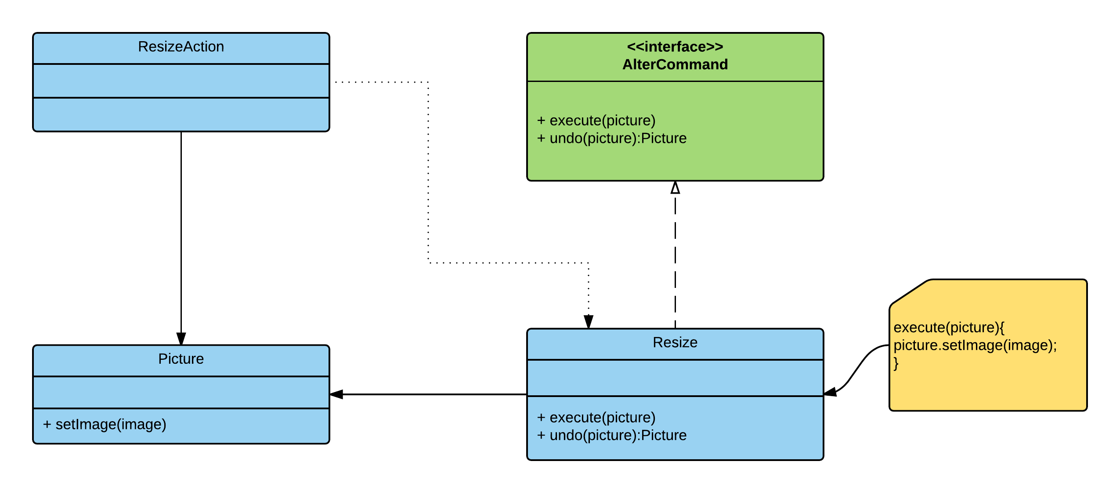
AlterCommands – Command Pattern

Slide 6
UndoRedo
BasicUndoRedoStack has a undo and redo stacks which store the commands which represent the changes made to the picture.
It has undoPicture and redoPicture methods.

Slide 7
GUI
The main class is GUI which holds and manages all the components of the graphical user interface.
It stores the picture which is currently being edited, so it retains a reference of the Picture class.
For each element on the GUI there is a class that is a Listener which performs the corresponding action when the user clicks that element.
For example the class CropAction retains a reference to the GUI and instantiates the Crop class and calls its execute method on the picture that is currently being edited which is stored in the GUI class.
Then it notifies the Observers to let them know that a change happened and it adds the crop to the undo/redo stack.

Slide 8
GUI – Observer Pattern
In this case the Picture is Observable and the GUI is the Observer
GUI needs to update the screen when a change happens to a picture. For example when the Crop command makes changes to the picture it uses the Picture’s setImage() method which notifies the observers – in our case the GUI class
We are using standard java Observable class and Observer interface
Concrete subject: Picture
Concrete observer: GUI

Slide 9
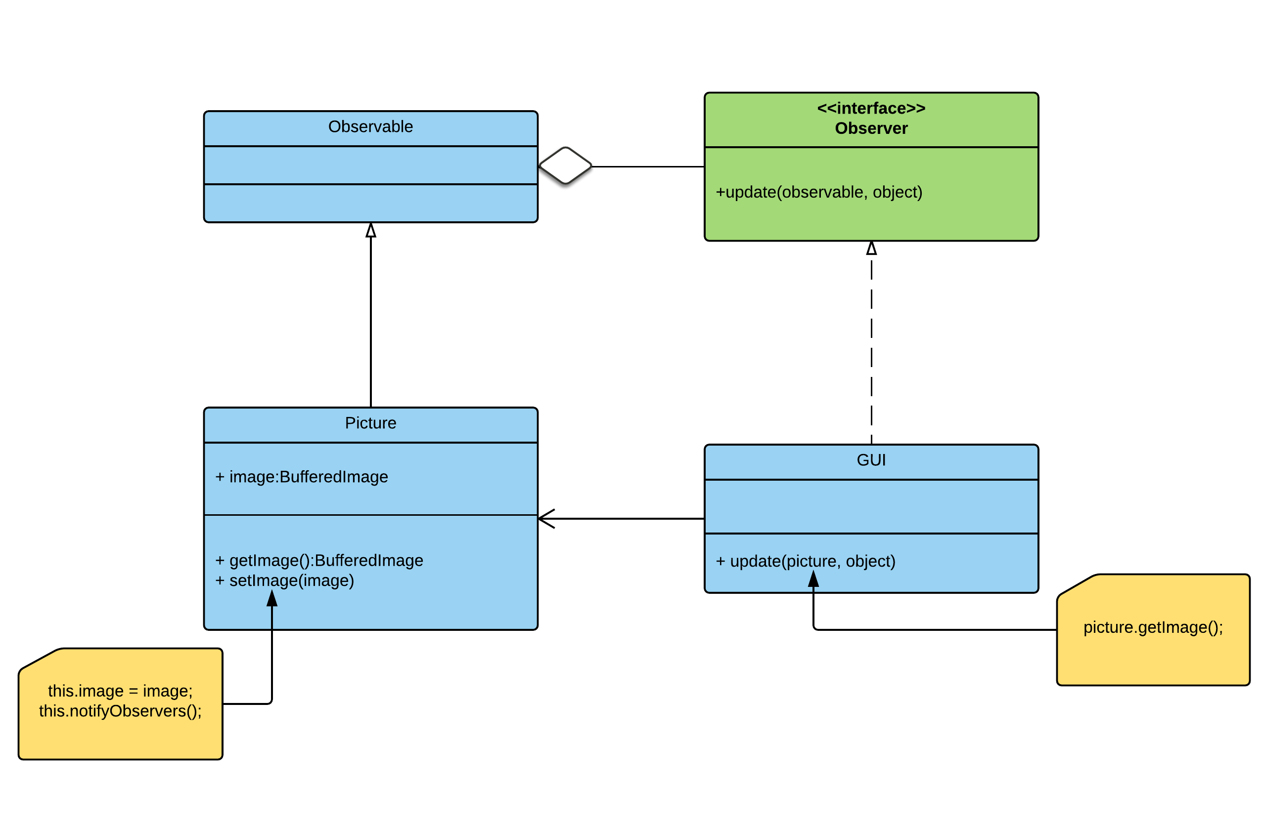
GUI – Observer Pattern

Slide 10
Controller
Contains the main method which sets up everything and starts the application. It instantiates the master album and the GUI.

