Slide 1
Bike Finder
Jeff Eben, Tristan Maidment, Aditya malik

Slide 2
Application Purpose
The purpose is to organize bikes, whose details are contained on websites sprawled across the internet, and store their details in one central database
Currently it is hard to find consistent information on bikes in one centralized location, such as manufacturer, prices, parts, year, etc.

Slide 3
Application Features

Slide 4
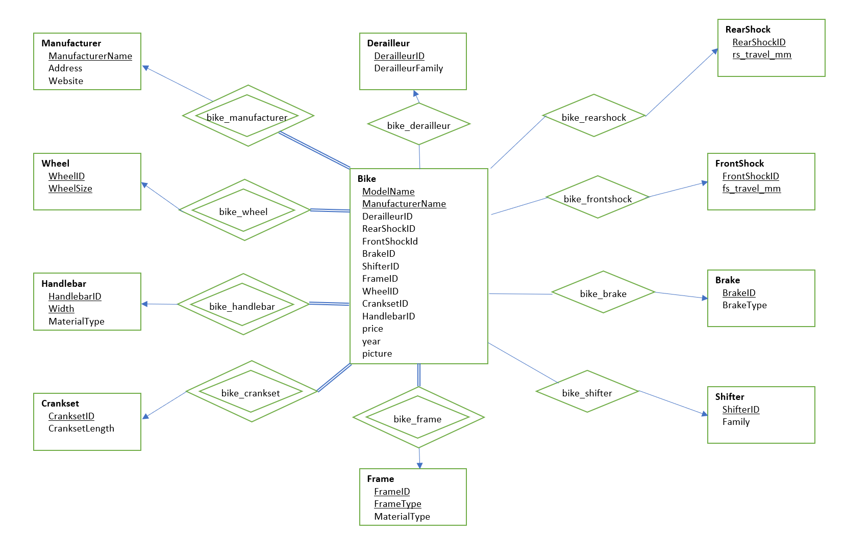
Database Design E-R Diagram

Slide 5
Application UI Screenshots

