Slide 1
Inpainting with homogeneous diffusion

Slide 2
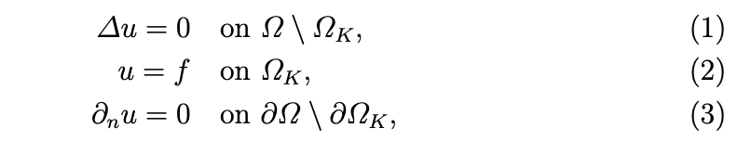

Inpainting with homogeneous diffusion
We borrow ideas from PDE-based inpainting methods
Homogeneous diffusion reconstruction method -- also known as Laplace interpolation.
The aim is to reconstruct the image such that
is satisfied on the missing data points. Here represents the known data points in the field. If there are unknown points or pixels on the boundary, we enforce normal boundary conditions.
In all the experiments shown in this presentation, we assume there are no unknown points on the boundary.

Slide 3
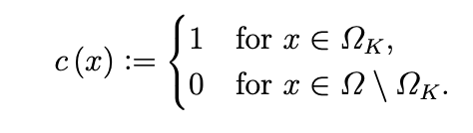
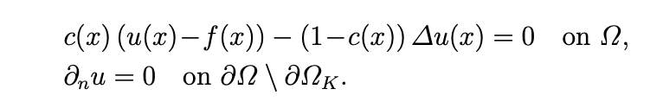

Inpainting with homogeneous diffusion
For convenience we will we introduce a new function c which states whether a point is known or not
Then we can rewrite the PDE as
And we get the following linear system after we discretize using central finite differences:

Slide 4
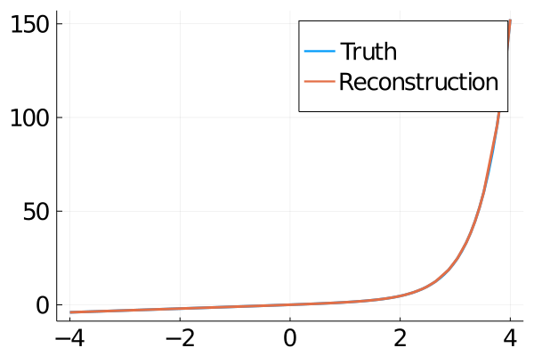
1D Example
Consider the function:
We verify the norm((Au)[ReconstructedPoints]) ~ 10^{-13}

Slide 5
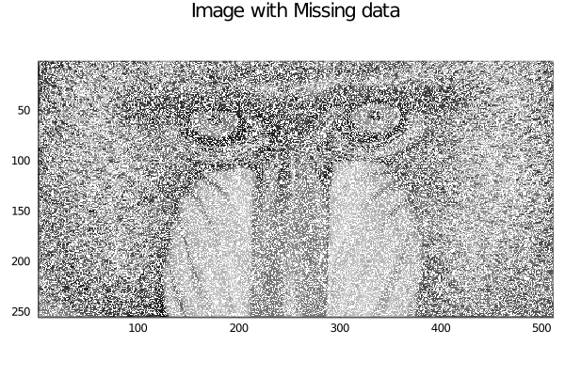
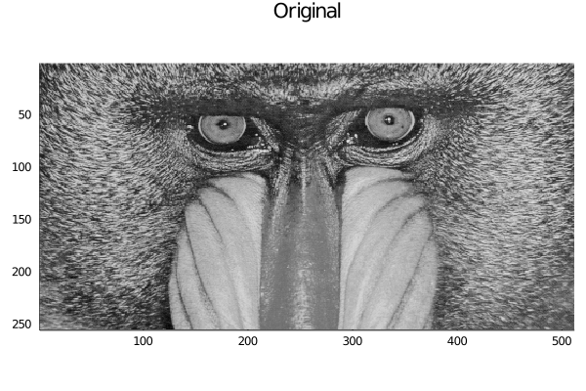
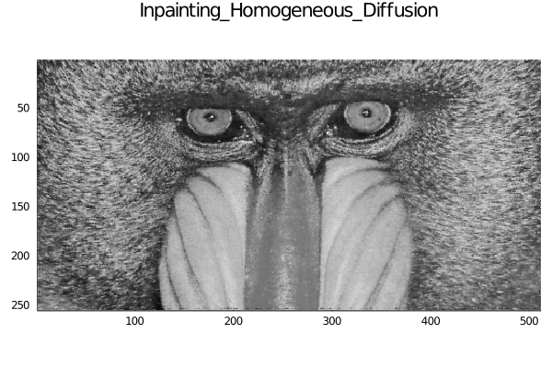
Mandrill Example
max((A_new*u)[discard]) ~ 1E-16

Slide 6
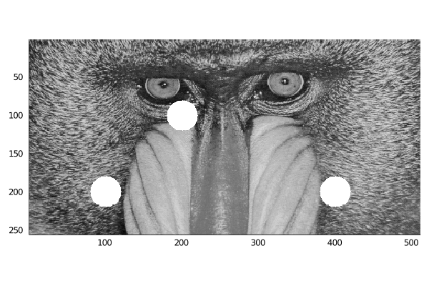
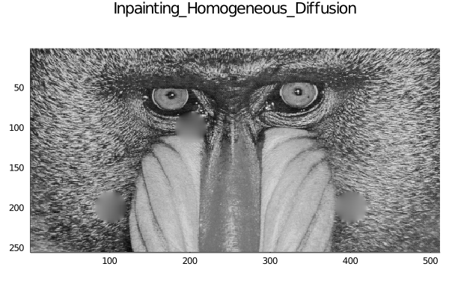
Mandrill with holes

Slide 7
Mandrill with Local Interpolation holes
Instead of solving the big linear system, we can solve 3 smaller systems

Slide 8

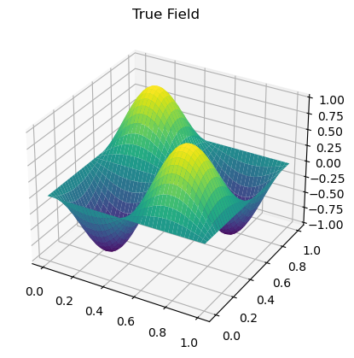
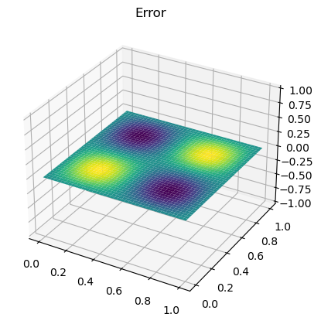
3D Example
We now solve a simple Poisson equation in 3D to ensure we have the right matrix that corresponds to 7-point stencil.
We solve with Dirichlet boundary conditions. We use the method of manufactured solution with

Slide 9
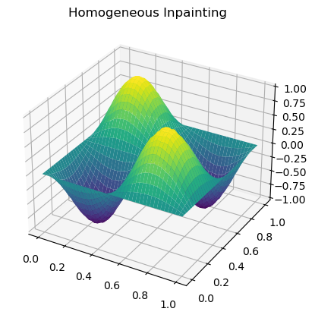
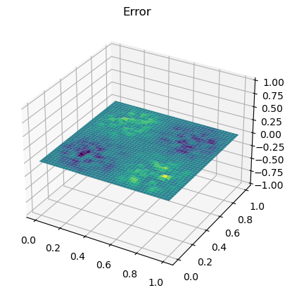
3D Reconstruction
We remove about 50% of the points and reconstruct the field

Slide 10
Next Steps
Get the inpainting approach to work for the Bob Ross video
Look at possible algorithms to solve this system:
Other Inpainting techniques?

