Slide 1
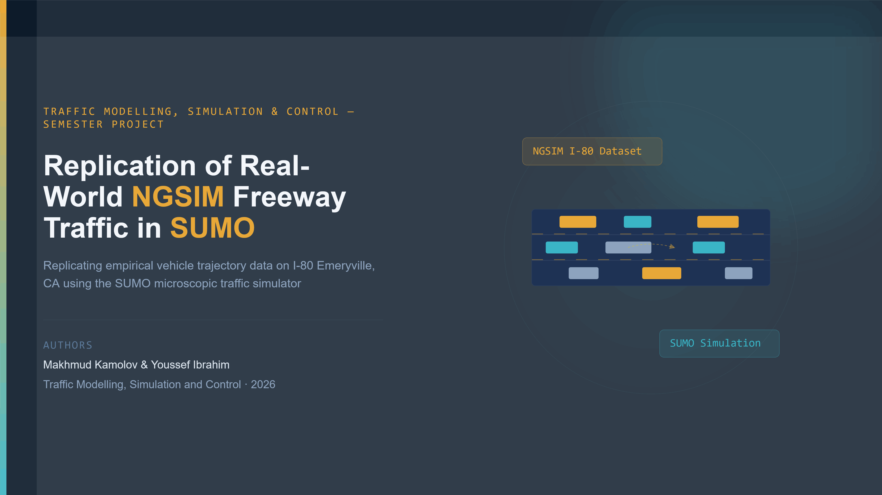
Notes:
Welcome everyone. Today we will be presenting our semester project for the Traffic Modelling, Simulation and Control course. Our project is titled 'Replication of Real-World NGSIM Freeway Traffic Data in SUMO Simulation'. My name is Youssef Ibrahim, and together with other project group member Makhmud Kamolov, we set out to take real measured vehicle trajectories from a California freeway and replay them faithfully inside a microscopic traffic simulator.

Slide 2
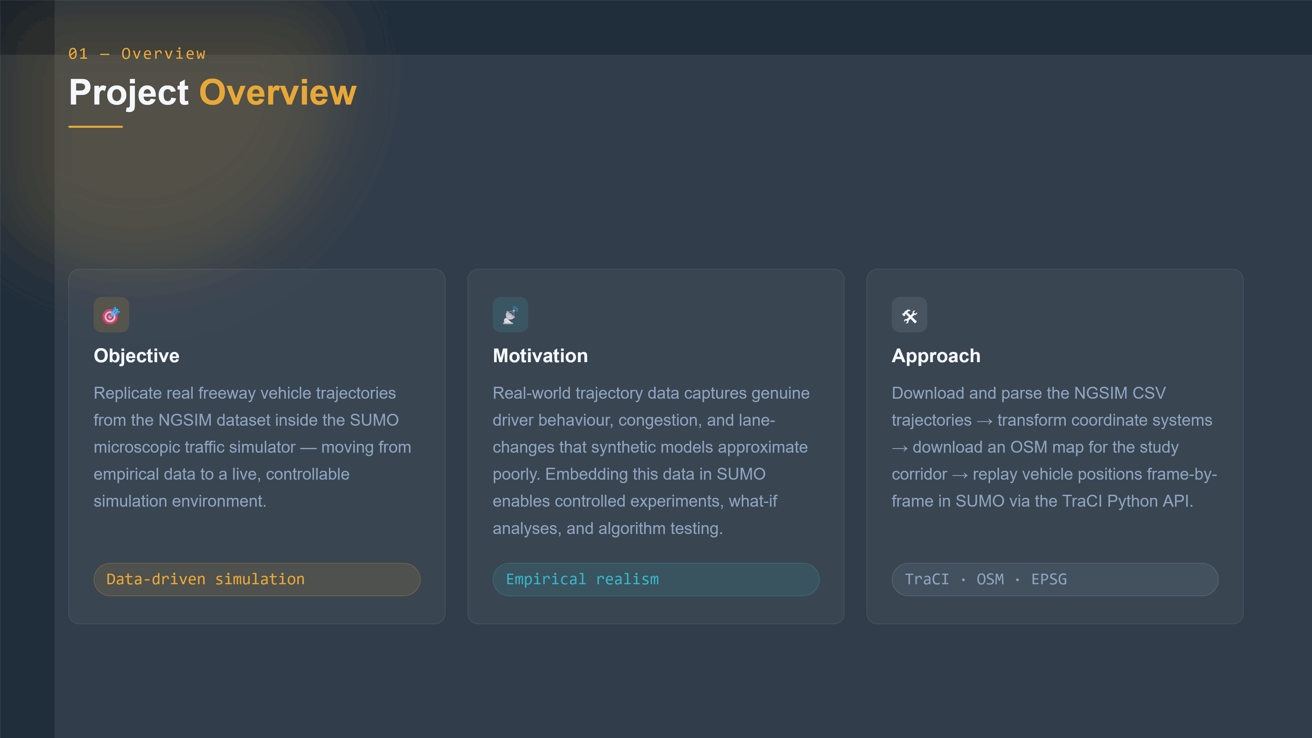
Notes:
So what is the project actually about? Our objective was to take empirical vehicle trajectory data from the NGSIM dataset — recorded on Interstate 80 in Emeryville, California — and replicate those real movements inside the SUMO traffic simulator. Why does this matter? Because real-world data captures genuine driver behaviour: lane changes, congestion, following distances, that synthetic traffic models can only approximate. By embedding this data in SUMO, researchers can run controlled experiments, test traffic control algorithms, and perform what-if analyses on a realistic baseline. Our approach involved four main steps: loading and processing the trajectory CSV files, transforming coordinate systems, downloading an OpenStreetMap road network for the study corridor, and then replaying vehicle positions frame by frame using the TraCI Python API.

Slide 3
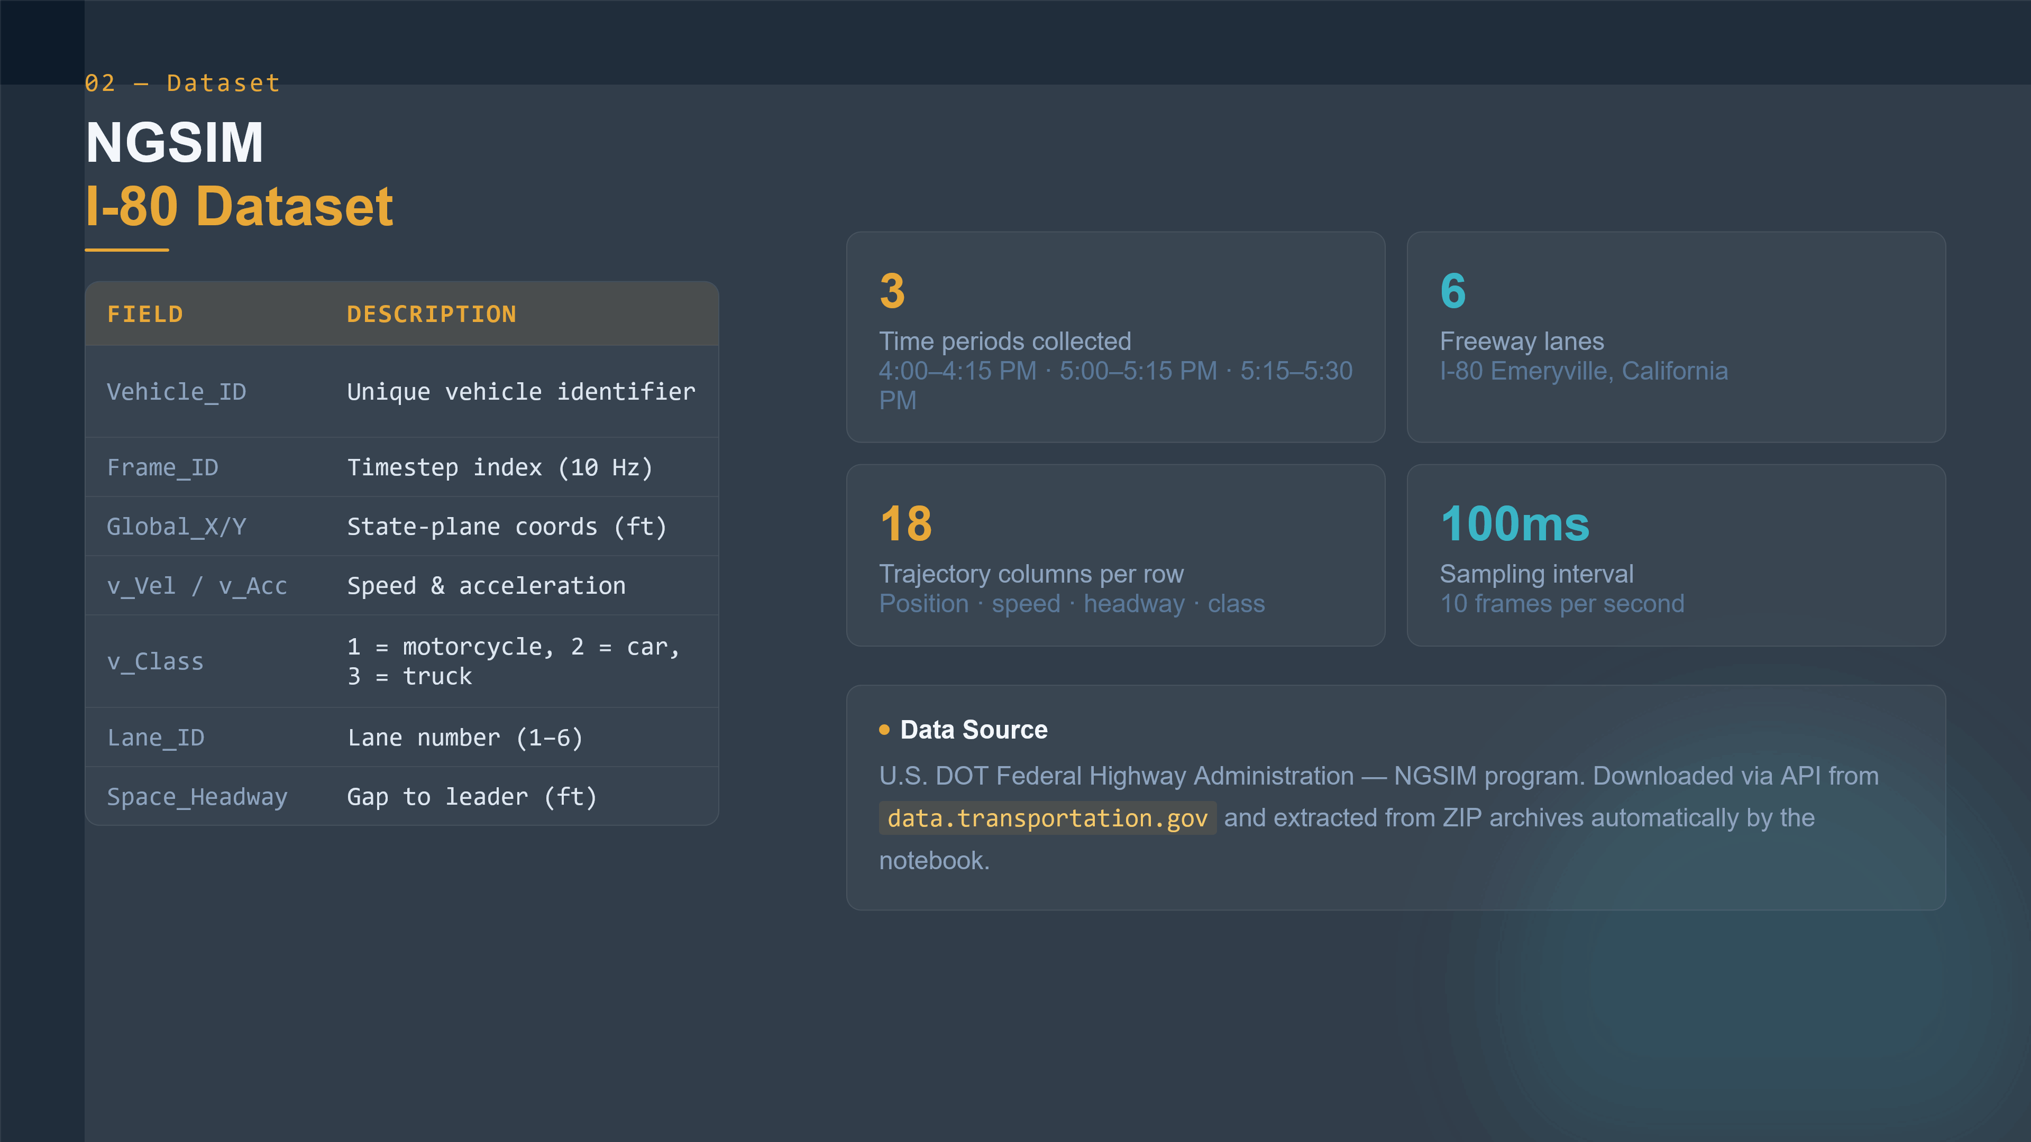
Notes:
The data we used comes from the NGSIM program — the Next Generation Simulation initiative of the U.S. Federal Highway Administration. Specifically, we used the I-80 Emeryville dataset, which was recorded during peak evening hours: four to four-fifteen PM, five to five-fifteen PM, and five-fifteen to five-thirty PM. The dataset contains 18 columns per row, including vehicle ID, frame ID, global coordinates, vehicle dimensions, speed, acceleration, lane ID, and headway measurements. Data was sampled at 100 milliseconds — ten frames per second — giving us very high temporal resolution. We downloaded the full dataset programmatically via the data.transportation.gov API and extracted it automatically in the notebook.

Slide 4
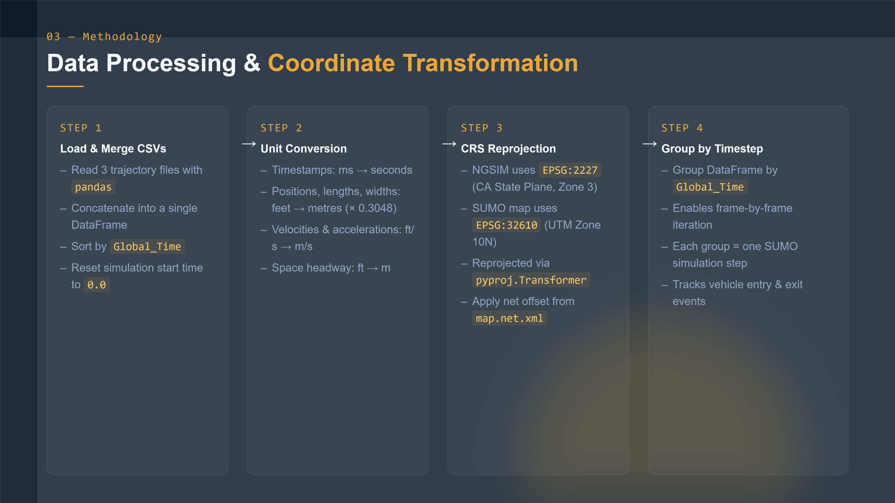
Notes:
Before we could use the data in SUMO, we had to do significant preprocessing. First, we loaded and merged the three CSV files into a single pandas DataFrame, sorted by time, and reset the simulation clock to zero. Second, we converted all units from the imperial system used in NGSIM — feet, feet per second — to metric units used by SUMO. Third, and most critically, we reprojected the coordinates. NGSIM stores positions in EPSG 2227, the California State Plane coordinate system, while SUMO's network uses EPSG 32610, UTM Zone 10 North. We used the pyproj library to transform all vehicle positions, then applied the network offset values taken directly from the map dot net dot xml file. Finally, we grouped the entire DataFrame by timestep, so we could iterate through it one simulation frame at a time.

Slide 5
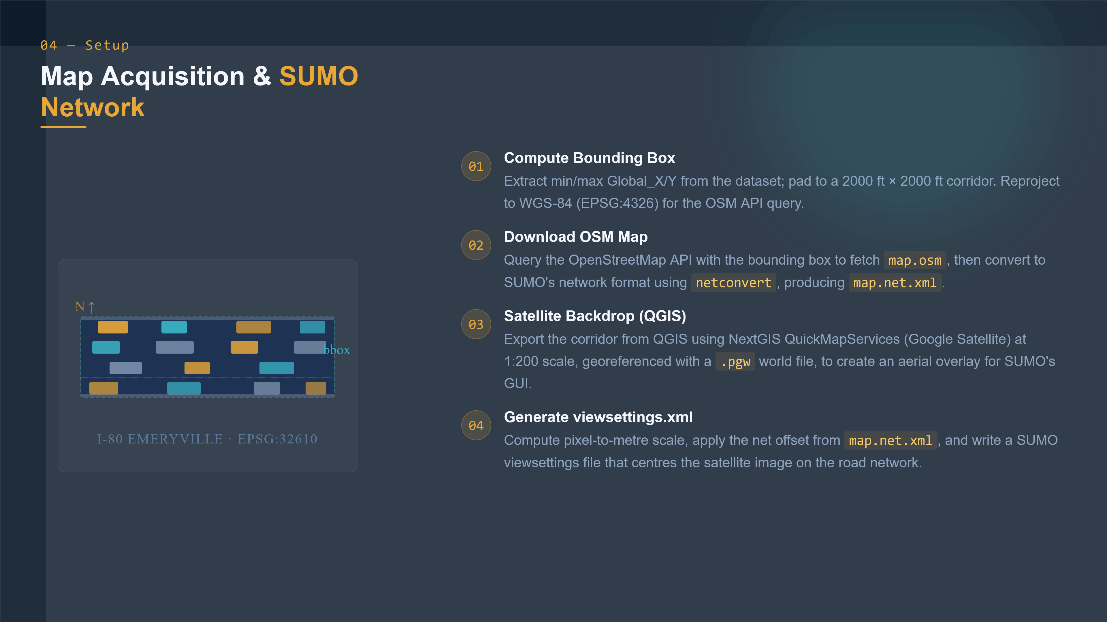
Notes:
To run the simulation, we needed a road network matching the real-world study area. We computed a bounding box from the vehicle trajectory extents, padded it to a two-thousand foot corridor, and reprojected the corners to WGS-84 latitude and longitude. We then queried the OpenStreetMap API to download the raw map file, and converted it to SUMO's network format using the netconvert tool. For visual realism, we also exported a satellite image of the corridor from QGIS using the NextGIS QuickMapServices plugin — Google Satellite layer — at one to two hundred scale, with a georeferenced world file. From the world file parameters and the network offset, we computed the exact pixel-to-metre mapping and generated a SUMO viewsettings dot xml file that overlays the satellite image on the road network.

Slide 6
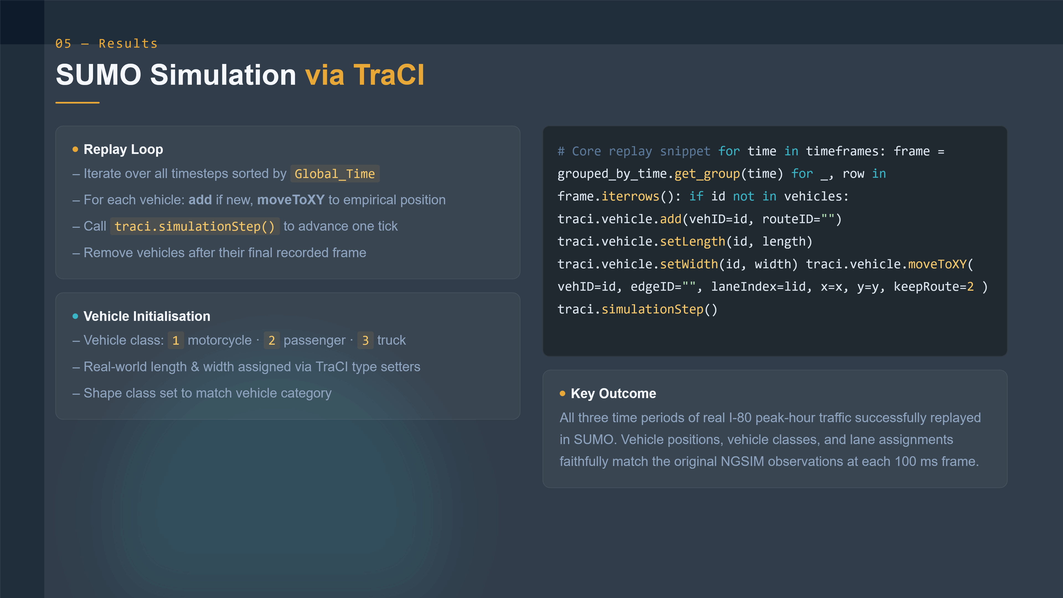
Notes:
The actual simulation runs through a Python script using TraCI — the Traffic Control Interface — which allows Python to communicate with a running SUMO process in real time. For each timestep, we iterate over all vehicles in that frame. If a vehicle has not been seen before, we add it to SUMO and assign its vehicle class, shape class, length and width from the NGSIM data. Then for every vehicle, we call moveToXY to teleport it to its empirical recorded position. Once all vehicles in the frame are updated, we call simulationStep to advance the clock. Vehicles are removed once they have completed their total recorded frames. The result is that all three peak-hour time periods of real I-80 traffic are successfully replayed in SUMO, with vehicle positions, classes, and lane assignments faithfully matching the original observations at every hundred-millisecond frame.

Slide 7
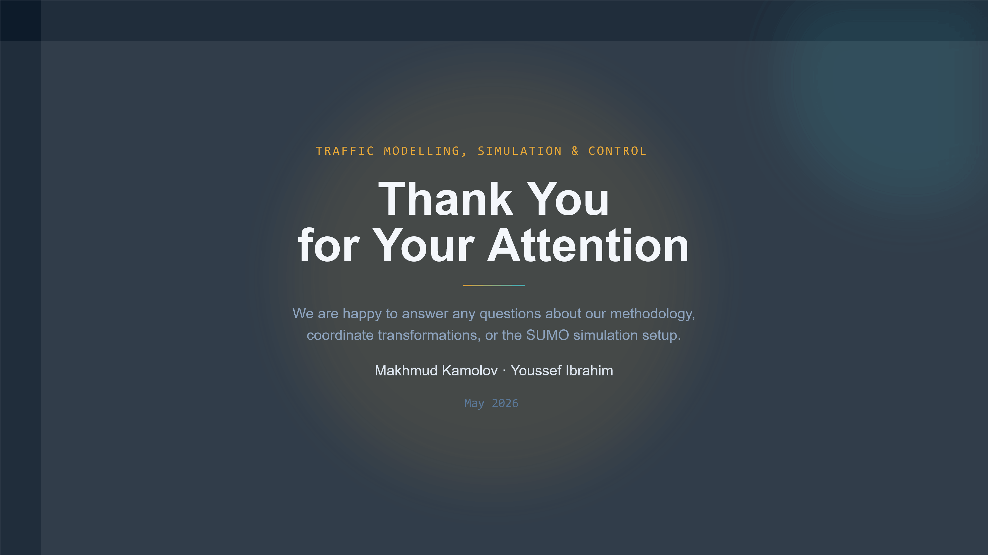
Notes:
Thank you very much for your attention. We are happy to answer any questions about our methodology — whether about the coordinate transformation pipeline, the TraCI replay loop, the QGIS satellite overlay, or anything else in the project. Thank you.

